Slide 1


8
Integration Techniques and Improper Integrals
P
Copyright © Cengage Learning. All rights reserved.

Slide 2

8.8
Improper Integrals
Copyright © Cengage Learning. All rights reserved.

Slide 3
Objectives
Evaluate an improper integral that has an infinite limit of integration.
Evaluate an improper integral that has an infinite discontinuity.

Slide 4
Improper Integrals with Infinite Limits of Integration

Slide 5
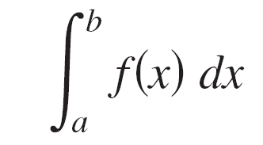
Improper Integrals with Infinite Limits of Integration
The definition of a definite integral
requires that the interval [a, b] be finite.
Furthermore, the Fundamental Theorem of Calculus requires that f be continuous on [a, b].
You will study a procedure for evaluating integrals that do not satisfy these requirements—usually because either one or both of the limits of integration are infinite or because f has a finite number of infinite discontinuities in the interval [a, b].

Slide 6
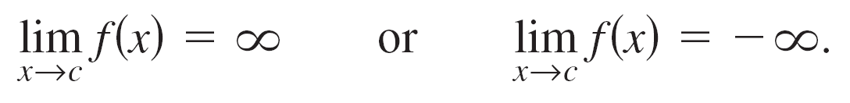

Improper Integrals with Infinite Limits of Integration
Integrals that possess either property are improper integrals.
Note that a function f is said to have an infinite discontinuity at c when, from the right or left,
To get an idea of how to evaluate an improper integral, consider the integral

Slide 7

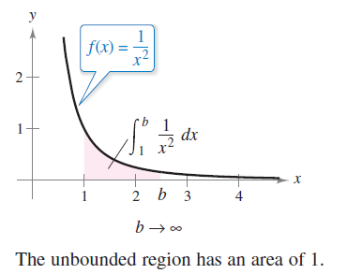
Improper Integrals with Infinite Limits of Integration
This integral can be interpreted as the area of the shaded region shown in Figure 8.20. Taking the limit as b → produces
This improper integral can be
interpreted as the area of the
unbounded region between
the graph of f (x) = 1/x² and
the x-axis (to the right of
x = 1.)
Figure 8.20

Slide 8
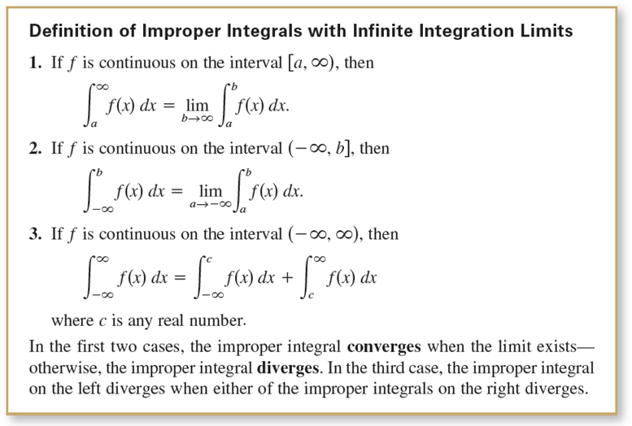
Improper Integrals with Infinite Limits of Integration

Slide 9

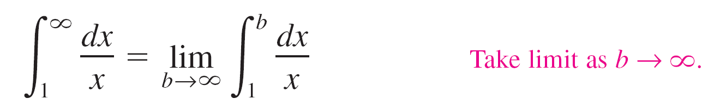
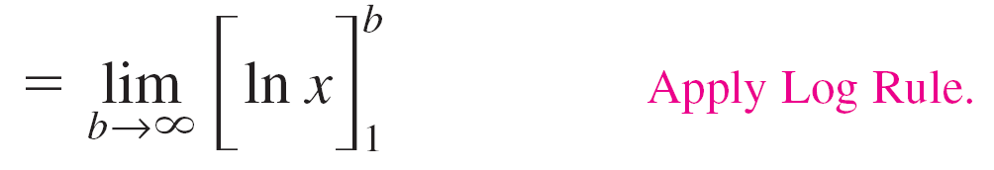
Example 1 – An Improper Integral That Diverges
Evaluate
Solution:

Slide 10
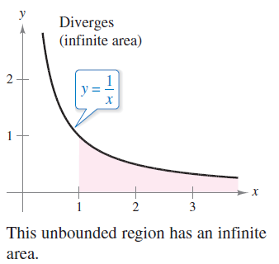
Example 1 – Solution
cont’d
The limit does not exist. So, you can conclude that the improper integral diverges. See Figure 8.21.
Figure 8.21

Slide 11
Improper Integrals with Infinite Discontinuities

Slide 12
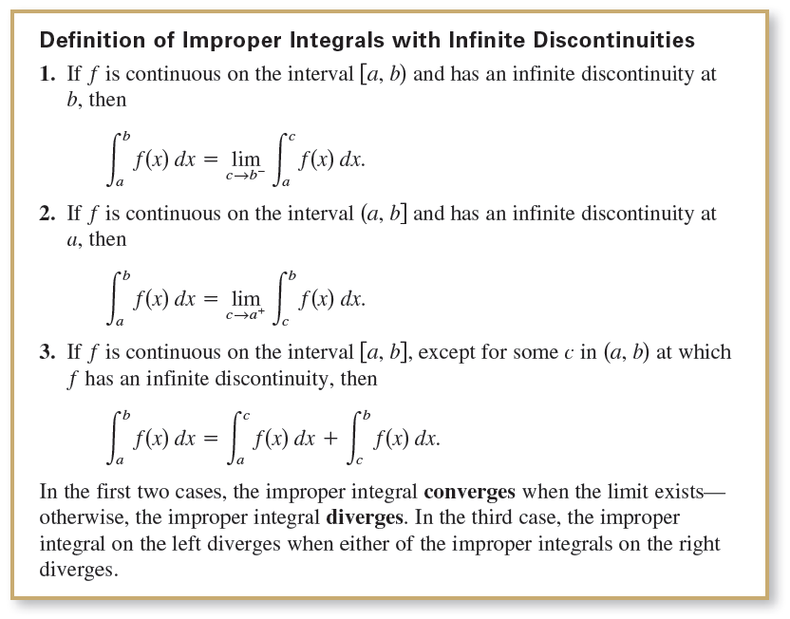
Improper Integrals with Infinite Discontinuities
The second basic type of improper integral is one that has an infinite discontinuity at or between the limits of integration.

Slide 13
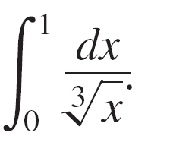
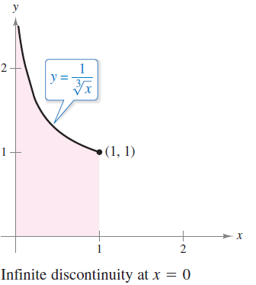
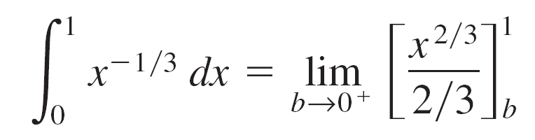
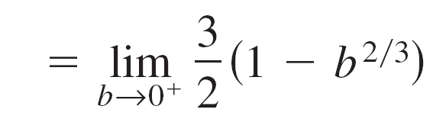
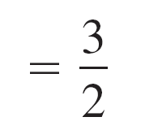
Example 6 – An Improper Integral with an Infinite Discontinuity
Evaluate
Solution:
The integrand has an infinite discontinuity
at x = 0, as shown in the figure at the right.
You can evaluate this integral as shown
below.

Slide 14
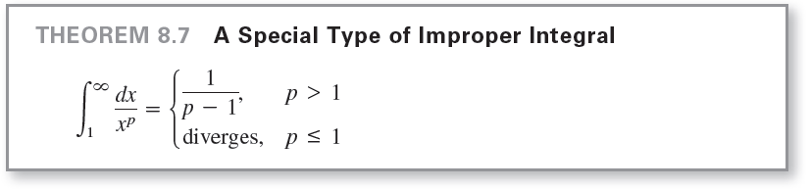
Improper Integrals with Infinite Discontinuities

Slide 15
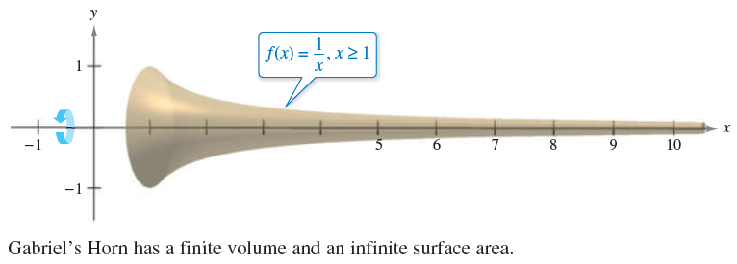
Example 11 – An Application Involving a Solid of Revolution
The solid formed by revolving (about the x-axis) the unbounded region lying between the graph of f(x) = 1/x and the x-axis (x ≥ 1) is called Gabriel’s Horn. (See Figure 8.29.) Show that this solid has a finite volume and an infinite surface area.
Figure 8.29

Slide 16

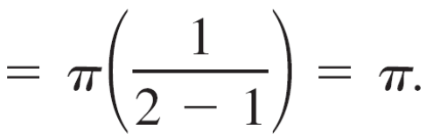
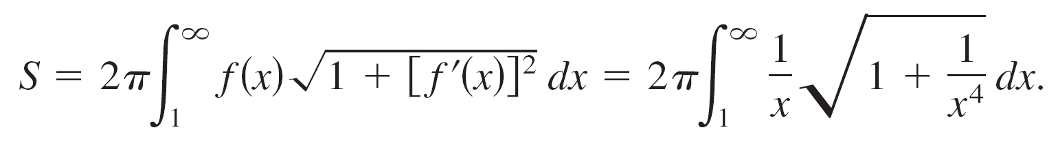
Example 11 – Solution
Using the disk method and Theorem 8.7, you can determine the volume to be
The surface area is given by

Slide 17
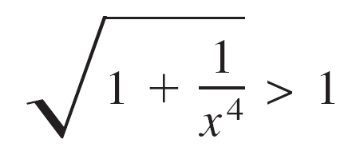

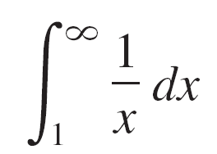
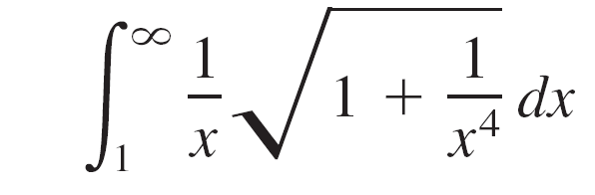
Example 11 – Solution
cont’d
Because
on the interval [1, ), and the improper integral
diverges, you can conclude that the improper integral
also diverges.
So, the surface area is infinite.

