Slide 1


9
P
Infinite Series
Copyright © Cengage Learning. All rights reserved.

Slide 2

9.2
Series and Convergence
Copyright © Cengage Learning. All rights reserved.

Slide 3
Objectives
Understand the definition of a convergent infinite series.
Use properties of infinite geometric series.
Use the nth-Term Test for Divergence of an infinite series.

Slide 4
Infinite Series

Slide 5


Infinite Series
One important application of infinite sequences is in representing “infinite summations.”
Informally, if {a_{n}} is an infinite sequence, then
is an infinite series (or simply a series).
The numbers a₁, a₂, a₃, and so on are the terms of the series. For some series it is convenient to begin the index at n = 0 (or some other integer). As a typesetting convention, it is common to represent an infinite series as

Slide 6
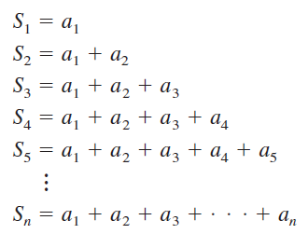
Infinite Series
In such cases, the starting value for the index must be taken from the context of the statement.
To find the sum of an infinite series, consider the following sequence of partial sums.
If this sequence of partial sums converges, then the series is said to converge and has the sum indicated in the next definition.

Slide 7
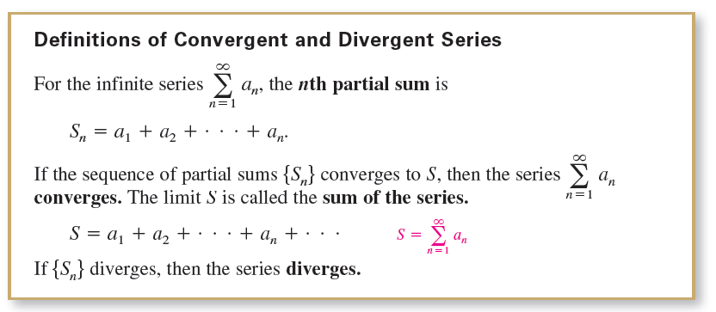
Infinite Series

Slide 8
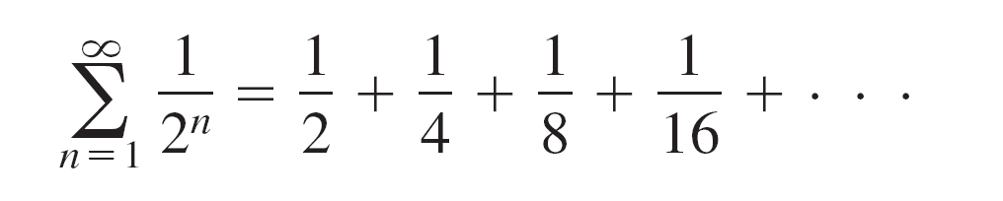

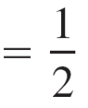

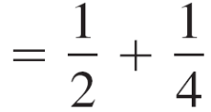
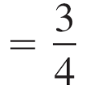

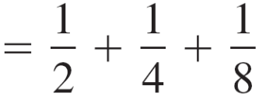
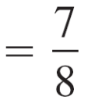


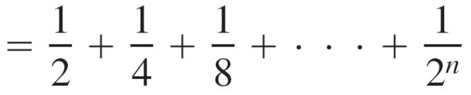
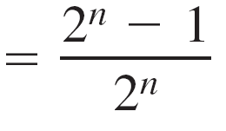
Example 1 – Convergent and Divergent Series
a. The series
has the following partial sums.

Slide 9
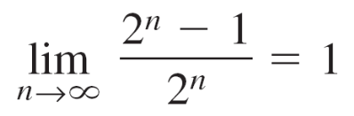
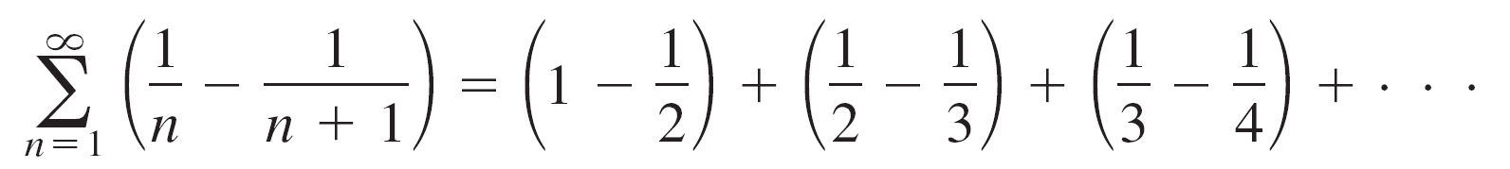
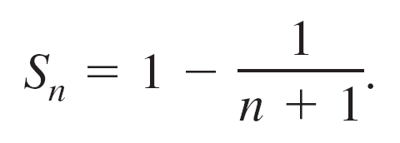
Example 1 – Convergent and Divergent Series
cont’d
Because
it follows that the series converges and its sum is 1.
b. The nth partial sum of the series
is
Because the limit of S_{n} is 1, the series converges and its
sum is 1.

Slide 10
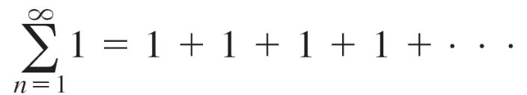
Example 1 – Convergent and Divergent Series
cont’d
c. The series
diverges because S_{n} = n and the sequence of partial
sums diverges.

Slide 11
Infinite Series
The series
is a telescoping series of the form
Note that b₂ is canceled by the second term, b₃ is canceled
by the third term, and so on.

Slide 12


Infinite Series
Because the nth partial sum of this series is
S_{n} = b₁ – b_{n + 1}
it follows that a telescoping series will converge if and only if b_{n} approaches a finite number as
Moreover, if the series converges, then its sum is

Slide 13
Geometric Series

Slide 14
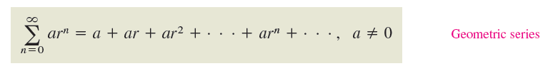
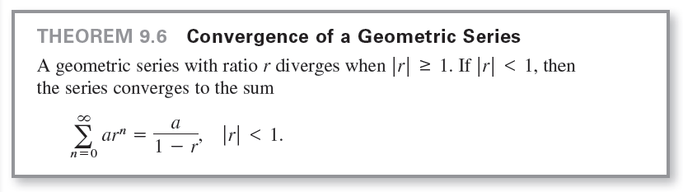
Geometric Series
The series is a geometric
series. In general, the series
is a geometric series with ratio r, r ≠ 0.

Slide 15
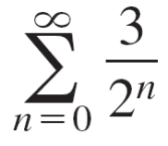
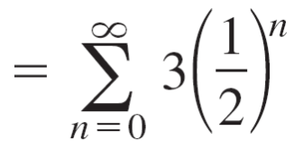
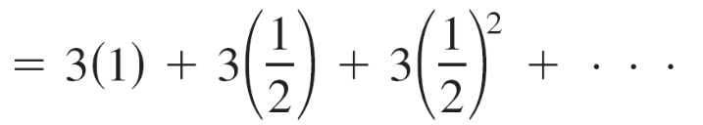
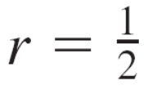
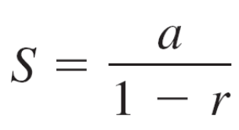
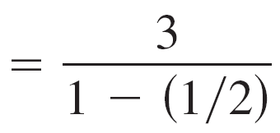
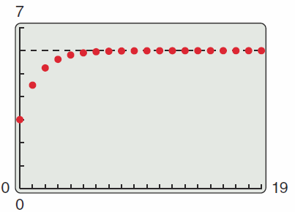
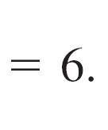

Example 3 – Convergent and Divergent Geometric Series
a. The geometric series
has a ratio of with a = 3.
Because |r | < 1, the series converges and its sum is
Figure 9.6

Slide 16
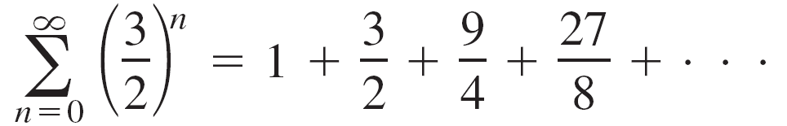
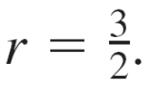
Example 3 – Convergent and Divergent Geometric Series
cont’d
b. The geometric series
has a ratio of
Because |r | ≥ 1, the series diverges.

Slide 17
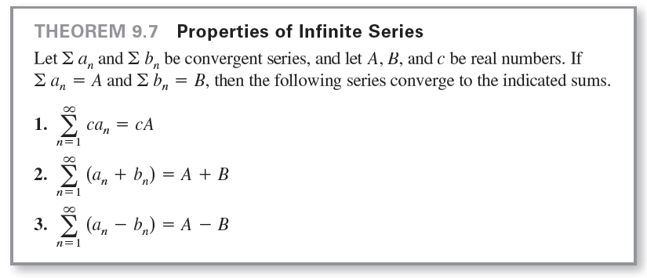
Geometric Series

Slide 18
nth-Term Test for Divergence

Slide 19
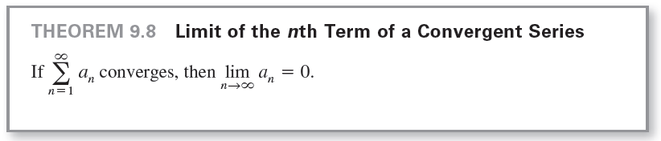
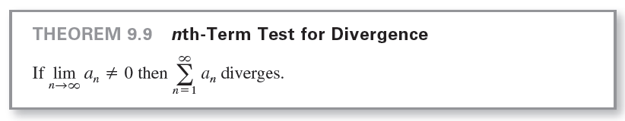
nth-Term Test for Divergence
The contrapositive of Theorem 9.8 provides a useful test for divergence. This nth-Term Test for Divergence states that if the limit of the nth term of a series does not converge to 0, then the series must diverge.

Slide 20
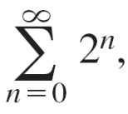
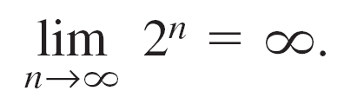
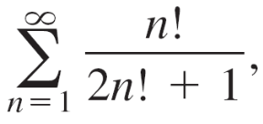
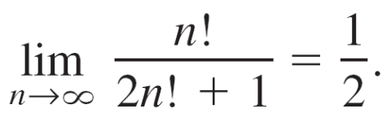
Example 5 – Using the nth-Term Test for Divergence
a. For the series you have
So, the limit of the nth term is not 0, and the series
diverges.
b. For the series you have
So, the limit of the nth term is not 0, and the series
diverges.

Slide 21
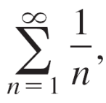
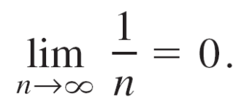
Example 5 – Using the nth-Term Test for Divergence
cont’d
c. For the series you have
Because the limit of the nth term is 0, the nth-Term Test for Divergence does not apply and you can draw no conclusions about convergence or divergence.

