Slide 1


9
P
Infinite Series
Copyright © Cengage Learning. All rights reserved.

Slide 2

The Integral Test and p-Series
9.3
Copyright © Cengage Learning. All rights reserved.

Slide 3
Objectives
Use the Integral Test to determine whether an infinite series converges or diverges.
Use properties of p-series and harmonic series.

Slide 4
The Integral Test

Slide 5
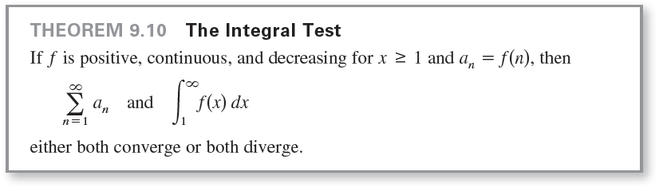
The Integral Test

Slide 6
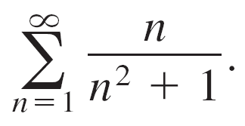


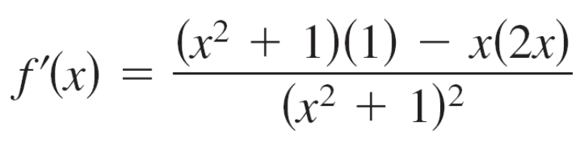
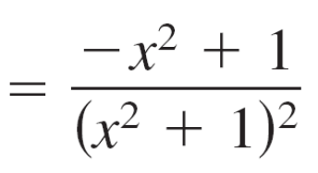
Example 1 – Using the Integral Test
Apply the Integral Test to the series
Solution:
The function is positive and continuous for
To determine whether f is decreasing, find the derivative.

Slide 7
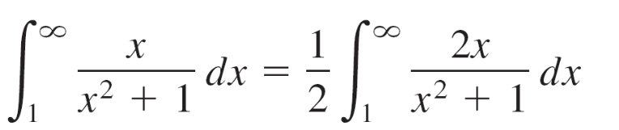
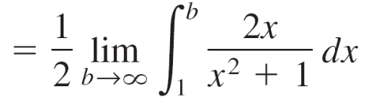
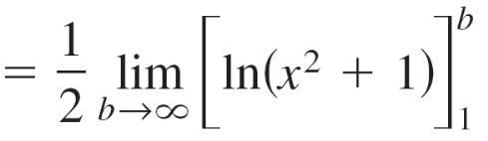
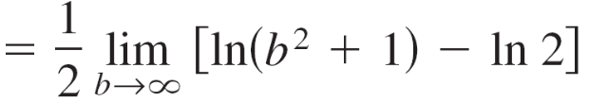

Example 1 – Solution
cont'd
So, f'(x) < 0 for x > 1 and it follows that f satisfies the conditions for the Integral Test.
You can integrate to obtain
So, the series diverges.

Slide 8
p-Series and Harmonic Series

Slide 9


p-Series and Harmonic Series
A second type of series has a simple arithmetic test for convergence or divergence. A series of the form
is a p-series, where p is a positive constant. For p = 1,
the series
is the harmonic series.

Slide 10

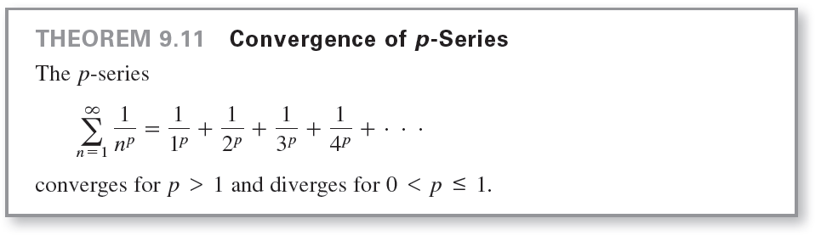
p-Series and Harmonic Series
A general harmonic series is of the form In music, strings of the same material, diameter, and tension, whose lengths form a harmonic series, produce harmonic tones.

Slide 11
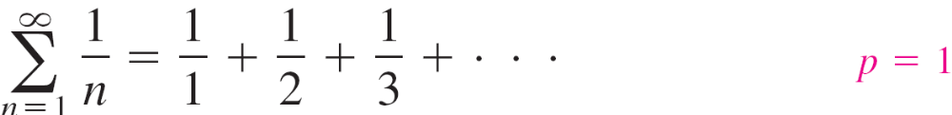
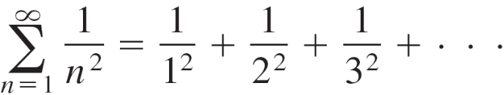

Example 3 – Convergent and Divergent p-Series
Discuss the convergence or divergence of (a) the harmonic
series and (b) the p-series with p = 2.
Solution:
a. From Theorem 9.11, it follows that the harmonic series
diverges.
b. From Theorem 9.11, it follows that the p-series
converges.

