Slide 1


9
P
Infinite Series
Copyright © Cengage Learning. All rights reserved.

Slide 2

9.4
Comparisons of Series
Copyright © Cengage Learning. All rights reserved.

Slide 3
Objectives
Use the Direct Comparison Test to determine whether a series converges or diverges.
Use the Limit Comparison Test to determine whether a series converges or diverges.

Slide 4
Direct Comparison Test

Slide 5
Direct Comparison Test
For the convergence tests developed so far, the terms of the series have to be fairly simple and the series must have special characteristics in order for the convergence tests to be applied.
A slight deviation from these special characteristics can make a test inapplicable.

Slide 6
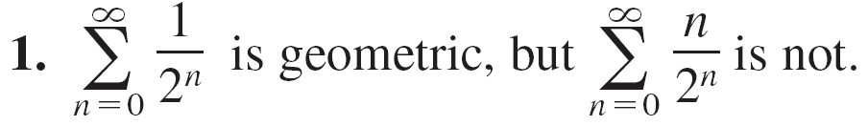
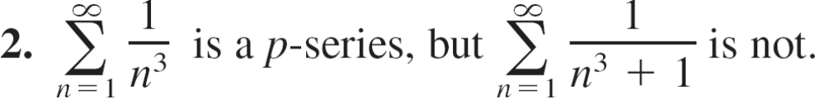
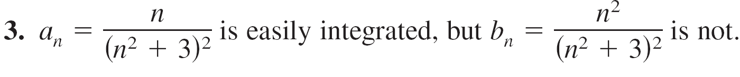
Direct Comparison Test
For example, in the pairs listed below, the second series cannot be tested by the same convergence test as the first series, even though it is similar to the first.

Slide 7
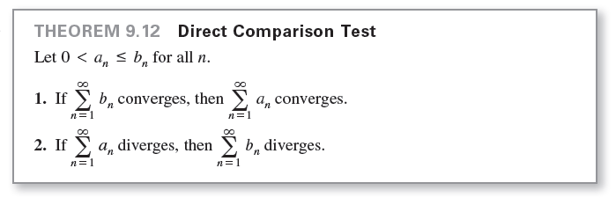
Direct Comparison Test

Slide 8
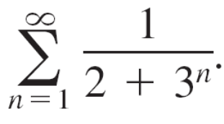
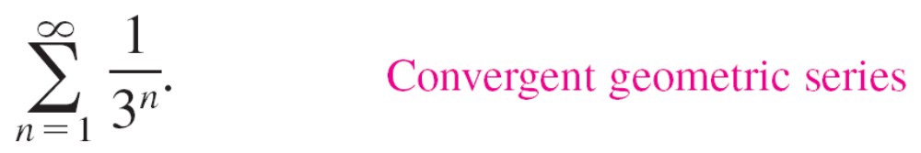
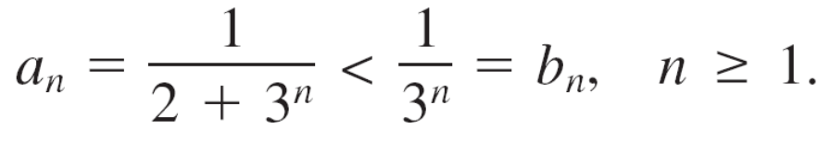
Example 1 – Using the Direct Comparison Test
Determine the convergence or divergence of
Solution:
This series resembles
Term-by-term comparison yields
So, by the Direct Comparison Test, the given series converges.

Slide 9


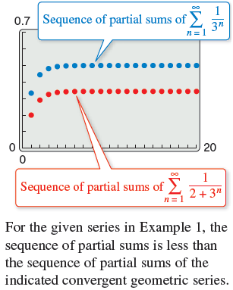
Example 1 – Solution
cont’d
This conclusion is supported by Figure 9.10, which shows that the sequence of partial sums of . is less than the sequence of partial sums of the convergent geometric series
Figure 9.10

Slide 10
Limit Comparison Test

Slide 11
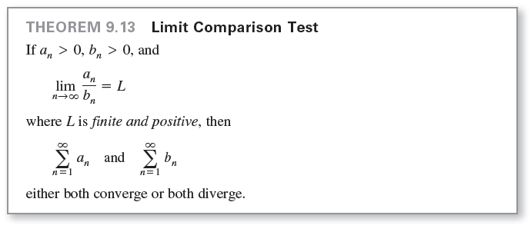
Limit Comparison Test
Sometimes a series closely resembles a p-series or a geometric series, yet you cannot establish the term-by-term comparison necessary to apply the Direct Comparison Test. Under these circumstances you may be able to apply a second comparison test, called the Limit Comparison Test.

Slide 12
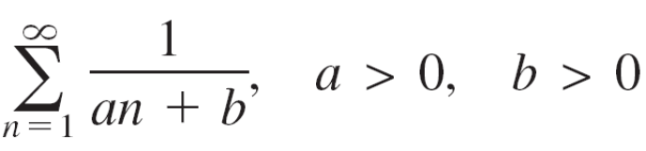
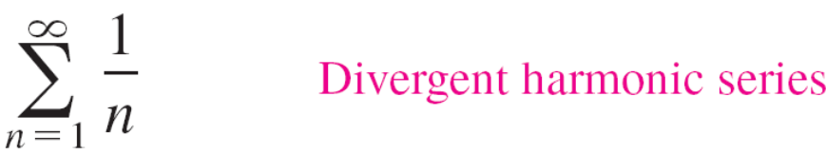
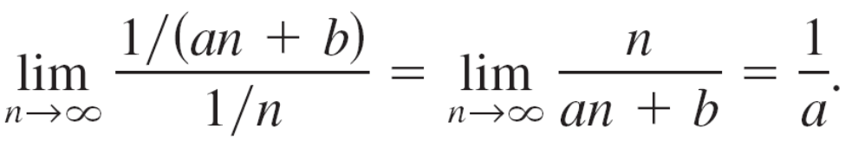
Example 3 – Using the Limit Comparison Test
Show that the general harmonic series below diverges.
Solution:
By comparison with
you have
Because this limit is greater than 0, you can conclude from the Limit Comparison Test that the given series diverges.

Slide 13
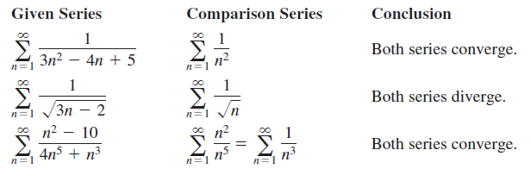
Limit Comparison Test
The Limit Comparison Test works well for comparing a “messy” algebraic series with a p-series. In choosing an appropriate p-series, you must choose one with an nth term of the same magnitude as the nth term of the given series.
In other words, when choosing a series for comparison, you can disregard all but the highest powers of n in both the numerator and the denominator.

