Slide 1


9
P
Infinite Series
Copyright © Cengage Learning. All rights reserved.

Slide 2

9.5
Alternating Series
Copyright © Cengage Learning. All rights reserved.

Slide 3
Objectives
Use the Alternating Series Test to determine whether an infinite series converges.
Use the Alternating Series Remainder to approximate the sum of an alternating series.
Classify a convergent series as absolutely or conditionally convergent.
Rearrange an infinite series to obtain a different sum.

Slide 4
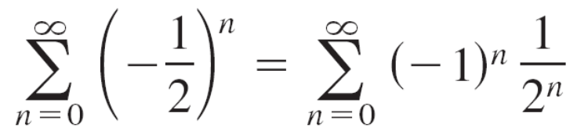
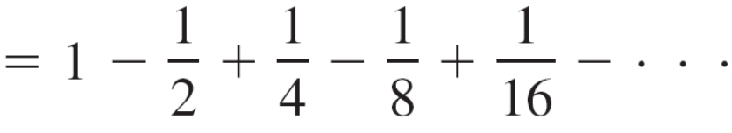
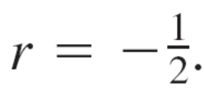
Alternating Series
The simplest series that contain both positive and negative terms is an alternating series, whose terms alternate in sign. For example, the geometric series
is an alternating geometric series with
Alternating series occur in two ways: either the odd terms are negative or the even terms are negative.

Slide 5
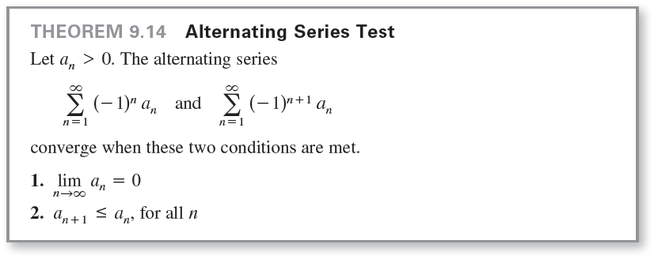
Alternating Series

Slide 6
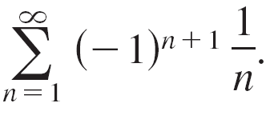
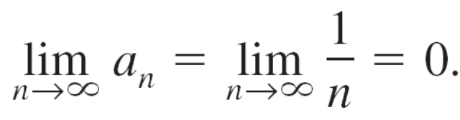
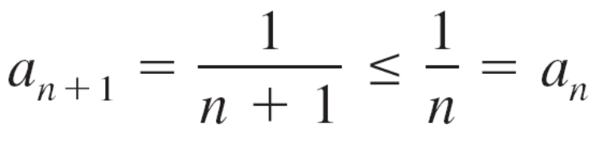
Example 1 – Using the Alternating Series Test
Determine the convergence or divergence of
Solution:
Note that
So, the first condition of Theorem 9.14 is satisfied.
Also note that the second condition of Theorem 9.14 is satisfied because
for all n.
So, applying the Alternating Series Test, you can conclude that the series converges.

Slide 7
Alternating Series Remainder

Slide 8


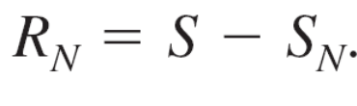
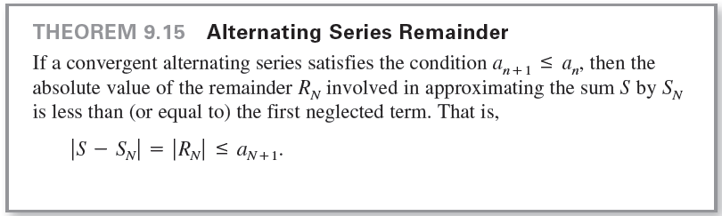
Alternating Series Remainder
For a convergent alternating series, the partial sum
can be a useful approximation for the sum S of the series. The error involved in using is the remainder

Slide 9
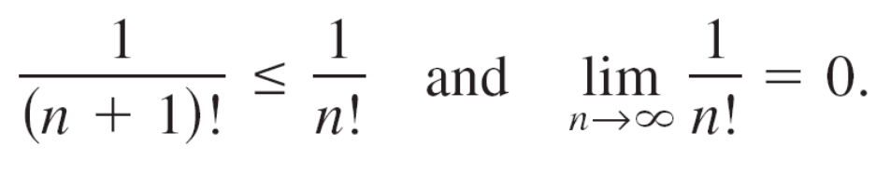
Example 4 – Approximating the Sum of an Alternating Series
Approximate the sum of the following series by its first six terms.
Solution:
The series converges by the Alternating Series Test because

Slide 10
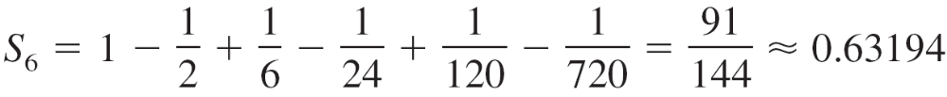
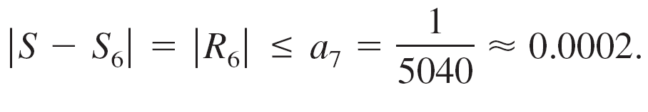
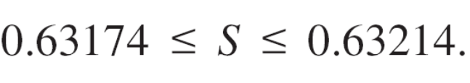
Example 4 – Solution
cont’d
The sum of the first six terms is
and, by the Alternating Series Remainder, you have
So, the sum S lies between
and you have

Slide 11
Absolute and Conditional Convergence

Slide 12
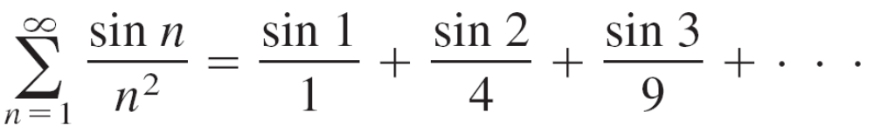
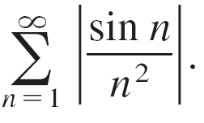
Absolute and Conditional Convergence
Occasionally, a series may have both positive and negative terms and not be an alternating series. For instance, the series
has both positive and negative terms, yet it is not an alternating series. One way to obtain some information about the convergence of this series is to investigate the convergence of the series

Slide 13
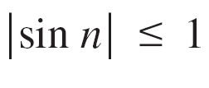
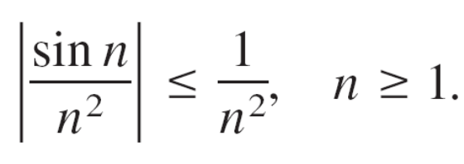
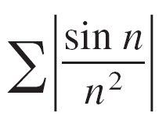
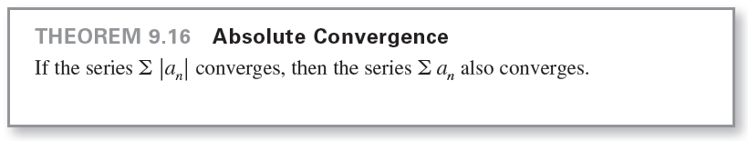
Absolute and Conditional Convergence
By direct comparison, you have for all n, so
Therefore, by the Direct Comparison Test, the series
converges. The next theorem tells you that the
original series also converges.

Slide 14
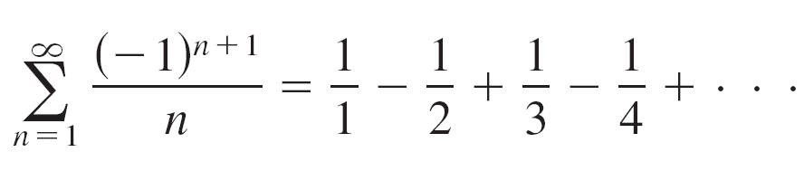
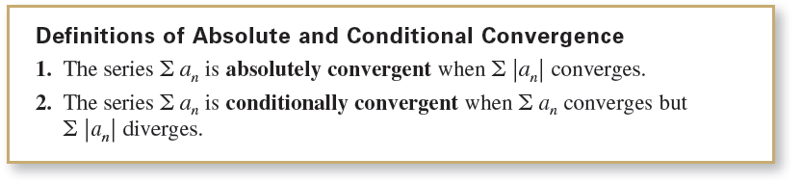
Absolute and Conditional Convergence
The converse of Theorem 9.16 is not true. For instance, the alternating harmonic series
converges by the Alternating Series Test. Yet the harmonic series diverges. This type of convergence is called conditional.

Slide 15
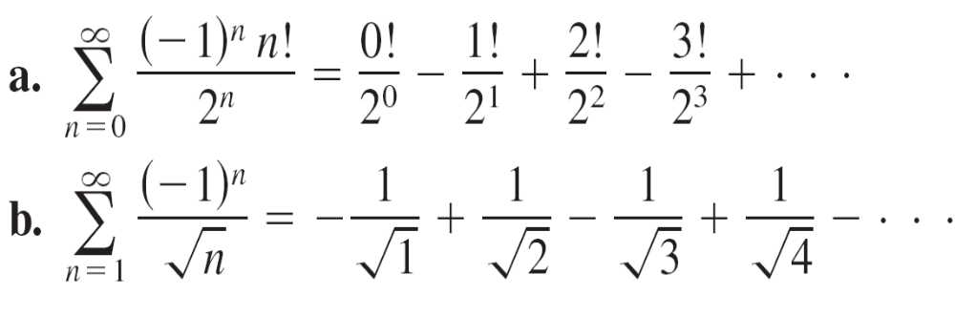
Example 6 – Absolute and Conditional Convergence
Determine whether each of the series is convergent or divergent. Classify any convergent series as absolutely or conditionally convergent.

Slide 16
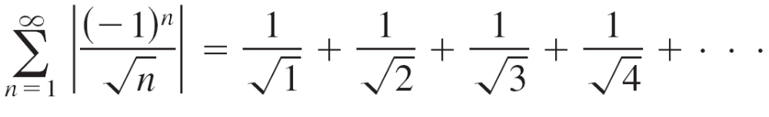
Example 6 – Solution
a. This is an alternating series, but the Alternating Series Test does not apply because the limit of the nth term is not zero. By the nth-Term Test for Divergence, however, you can conclude that this series diverges.
b. The given series can be shown to be convergent by the Alternating Series Test.
Moreover, because the p-series
diverges, the given series is conditionally convergent.

Slide 17
Rearrangement of Series

Slide 18
Rearrangement of Series
A finite sum such as 1 + 3 – 2 + 5 – 4 can be rearranged without changing the value of the sum. This is not necessarily true of an infinite series—it depends on whether the series is absolutely convergent or conditionally convergent.
1. If a series is absolutely convergent, then its terms can be
rearranged in any order without changing the sum of the
series.
2. If a series is conditionally convergent, then its terms can
be rearranged to give a different sum.

Slide 19
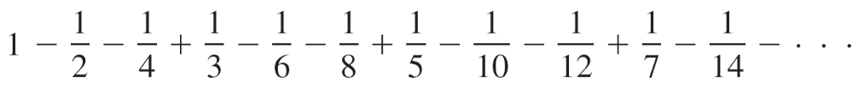
Example 8 – Rearrangement of a Series
The alternating harmonic series converges to ln 2. That is,
Rearrange the terms of the series to produce a different sum.
Solution:
Consider the following rearrangement.

Slide 20
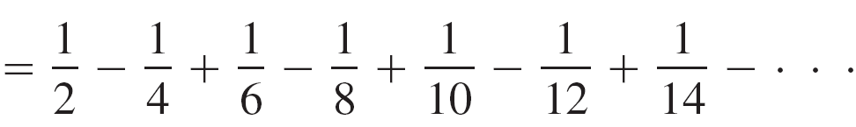
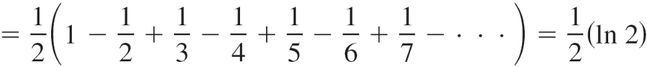

Example 8 – Solution
cont’d
By rearranging the terms, you obtain a sum that is half the original sum.

