Slide 1


9
P
Infinite Series
Copyright © Cengage Learning. All rights reserved.

Slide 2

9.6
The Ratio and Root Tests
Copyright © Cengage Learning. All rights reserved.

Slide 3
Objectives
Use the Ratio Test to determine whether a series converges or diverges.
Use the Root Test to determine whether a series converges or diverges.
Review the tests for convergence and divergence of an infinite series.

Slide 4
The Ratio Test

Slide 5
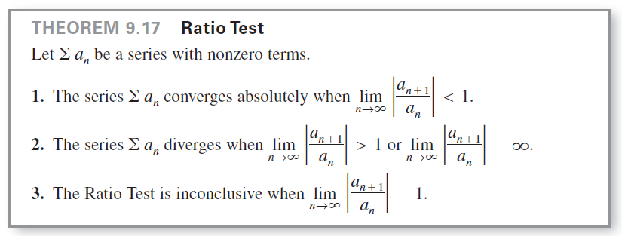
The Ratio Test
This section begins with a test for absolute convergence—the Ratio Test.

Slide 6
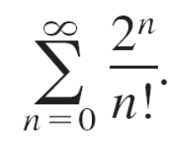
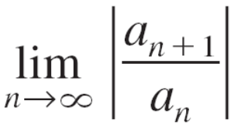
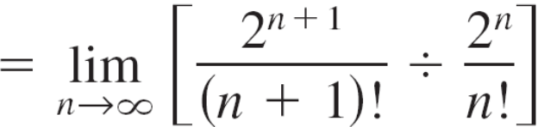
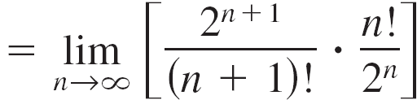
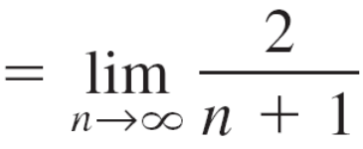

Example 1 – Using the Ratio Test
Determine the convergence or divergence of
Solution:
Because a_{n} = 2^{n}/n!, you can write the following.
This series converges because the limit of |a_{n + 1}/a_{n}| is less than 1.

Slide 7
The Root Test

Slide 8
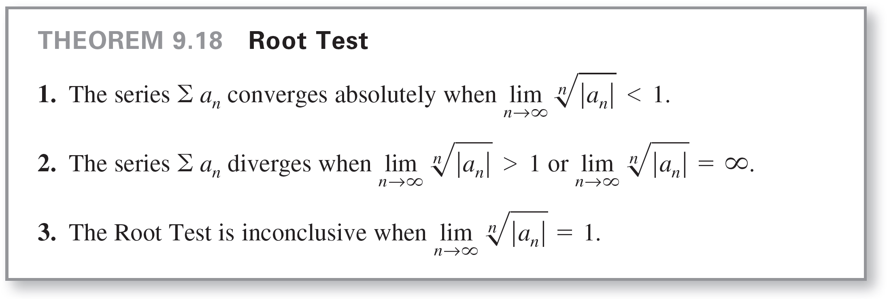
The Root Test
The next test for convergence of series works especially well for series involving nth powers.

Slide 9
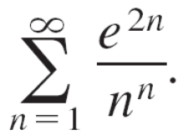
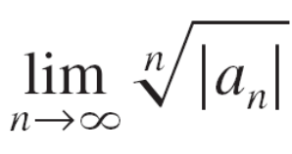
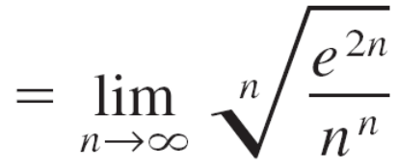
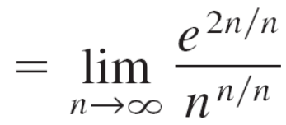
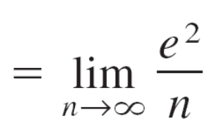

Example 4 – Using the Root Test
Determine the convergence or divergence of
Solution:
You can apply the Root Test as follows.
Because this limit is less than 1, you can conclude that the series converges absolutely (and therefore converges).

Slide 10
Strategies for Testing Series

Slide 11
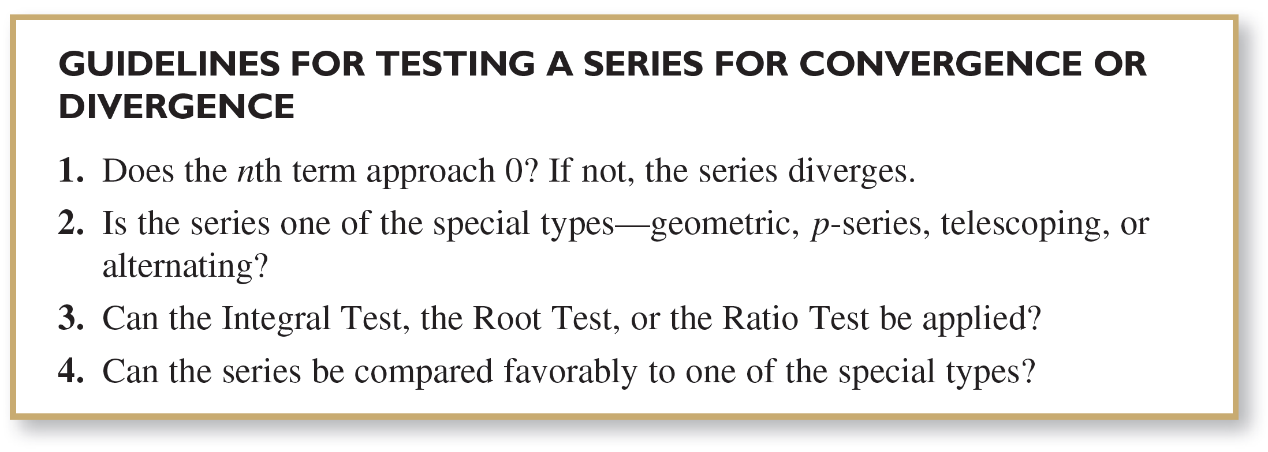
Strategies for Testing Series
You have studied various tests for determining the convergence or divergence of an infinite series. Below is a set of guidelines for choosing an appropriate test.

Slide 12
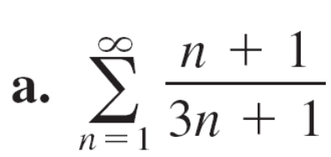
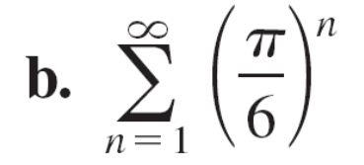
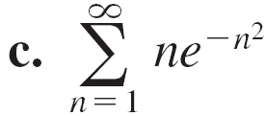
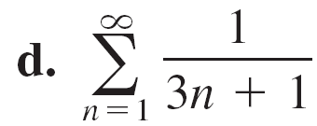
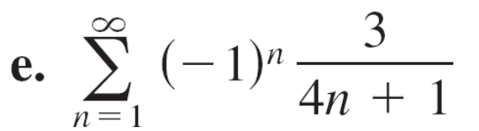
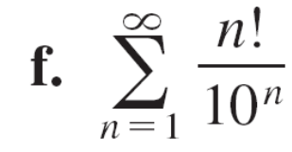
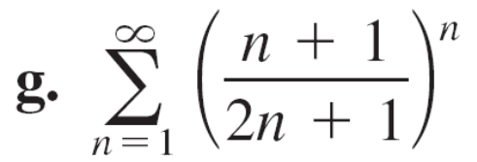
Example 5 – Applying the Strategies for Testing Series
Determine the convergence or divergence of each series.

Slide 13


Example 5 – Solution
a. For this series, the limit of the nth term is not . So, by the nth-Term Test, the series
diverges.
b. This series is geometric. Moreover, because the ratio of
the terms r = π/6 is less than 1 in absolute value, you
can conclude that the series converges.
c. Because the function is easily integrated, you
can use the Integral Test to conclude that the series
converges.
d. The nth term of this series can be compared to the nth term of the harmonic series. After using the Limit Comparison Test, you can conclude that the series diverges.

Slide 14

Example 5 – Solution
cont’d
e. This is an alternating series whose nth term approaches
0. Because you can use the Alternating
Series Test to conclude that the series converges.
f. The nth term of this series involves a factorial, which
indicates that the Ratio Test may work well. After
applying the Ratio Test, you can conclude that the
series diverges.
g. The nth term of this series involves a variable that is raised to the nth power, which indicates that the Root Test may work well. After applying the Root Test, you can conclude that the series converges.

Slide 15
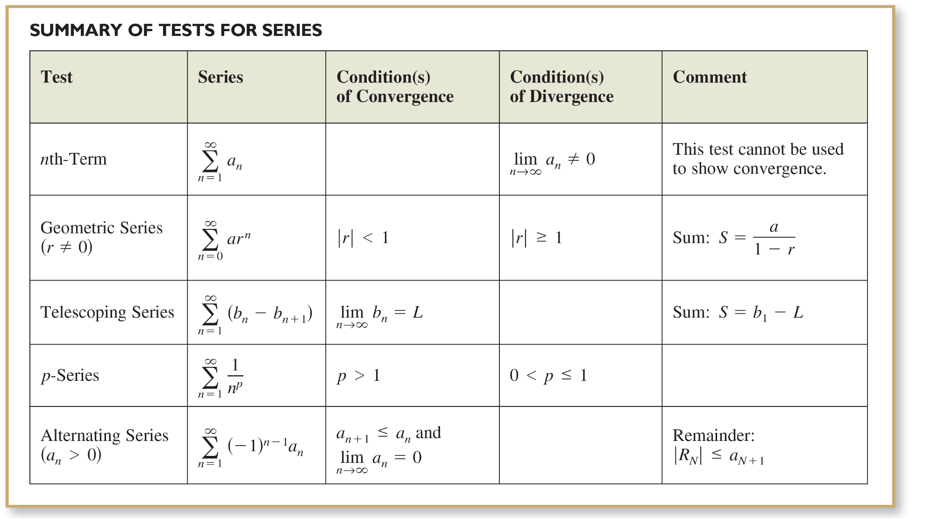
Strategies for Testing Series

Slide 16
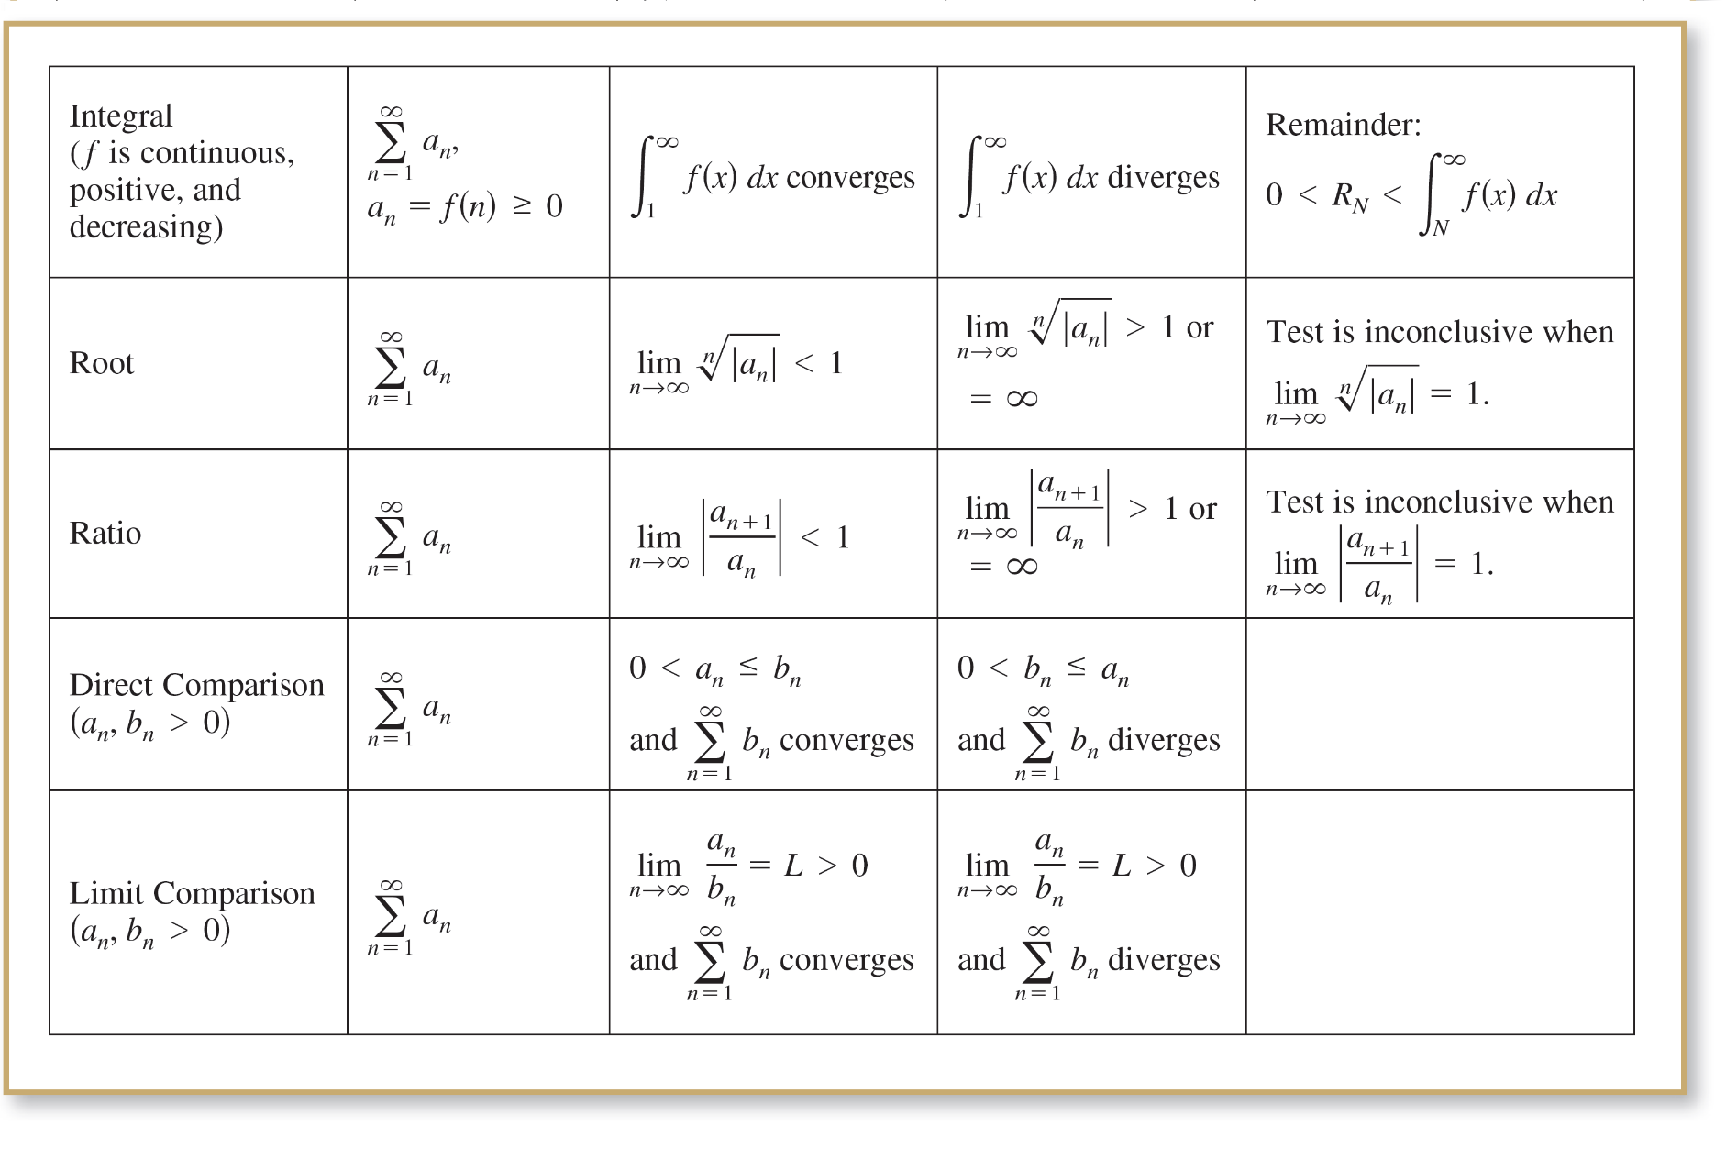
Strategies for Testing Series
cont’d

