Slide 1


9
P
Infinite Series
Copyright © Cengage Learning. All rights reserved.

Slide 2

9.8
Power Series
Copyright © Cengage Learning. All rights reserved.

Slide 3
Objectives
Understand the definition of a power series.
Find the radius and interval of convergence of a power series.
Determine the endpoint convergence of a power series.
Differentiate and integrate a power series.

Slide 4

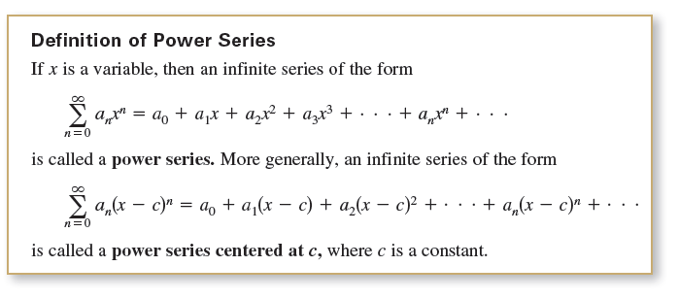
Power Series
An important function f(x) = e^{x}, can be represented exactly by an infinite series called a power series. For example, the power series representation for e^{x} is
For each real number x, it can be shown that the infinite series on the right converges to the number e^{x}.

Slide 5
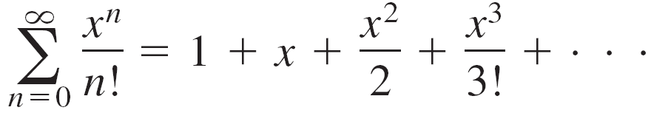
Example 1 – Power Series
The following power series is centered at 0.
The following power series is centered at –1.
The following power series is centered at 1.

Slide 6
Radius and Interval of Convergence

Slide 7

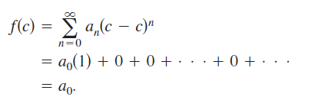
Radius and Interval of Convergence
A power series in x can be viewed as a function of x
where the domain of f is the set of all x for which the power series converges. Of course, every power series converges at its center c because

Slide 8
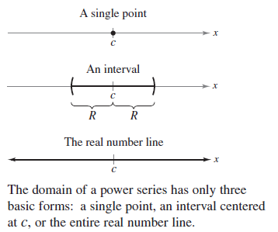
Radius and Interval of Convergence
So, c always lies in the domain of f. Theorem 9.20 (to follow) states that the domain of a power series can take three basic forms: a single point, an interval centered at c, or the entire real number line, as shown in Figure 9.18.
Figure 9.18

Slide 9
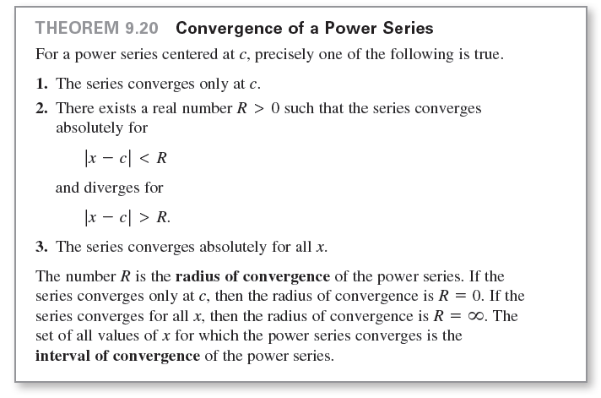
Radius and Interval of Convergence

Slide 10
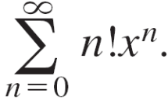
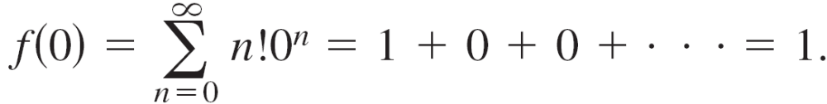

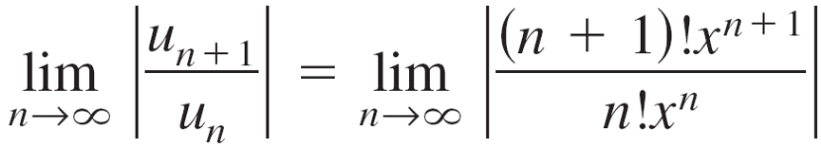
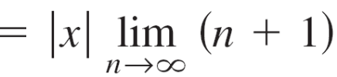

Example 2 – Finding the Radius of Convergence
Find the radius of convergence of
Solution:
For x = 0, you obtain
For any fixed value of x such that |x| > 0, let
Then

Slide 11
Example 2 – Solution
cont’d
Therefore, by the Ratio Test, the series diverges for |x| > 0 and converges only at its center, 0.
So, the radius of convergence is R = 0.

Slide 12
Endpoint Convergence

Slide 13
Endpoint Convergence
For a power series whose radius of convergence is a finite number R, Theorem 9.20 says nothing about the convergence at the endpoints of the interval of convergence.
Each endpoint must be tested separately for convergence or divergence.

Slide 14
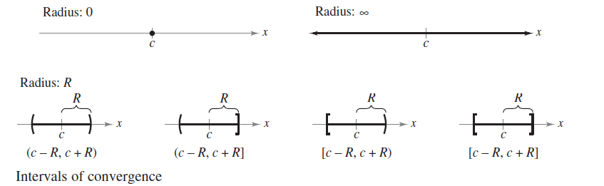
Endpoint Convergence
As a result, the interval of convergence of a power series can take any one of the six forms shown in Figure 9.19.
Figure 9.19

Slide 15
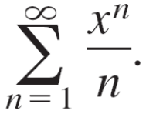
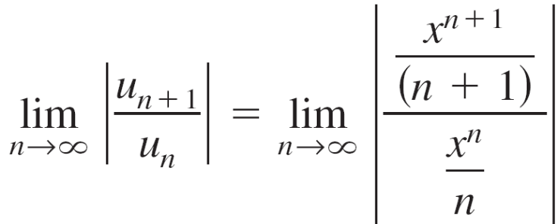
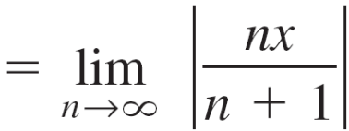

Example 5 – Finding the Interval of Convergence
Find the interval of convergence of
Solution:
Letting u_{n} = x^{n}/n produces

Slide 16
Example 5 – Solution
cont’d
So, by the Ratio Test, the radius of convergence is R = 1.
Moreover, because the series is centered at 0, it converges in the interval (–1, 1).
This interval, however, is not necessarily the interval of convergence.
To determine this, you must test for convergence at each endpoint.
When x = 1, you obtain the divergent harmonic series

Slide 17
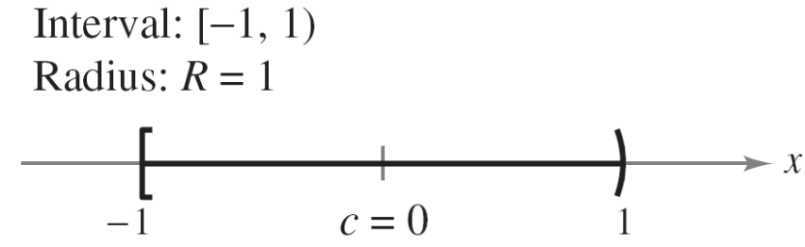
Example 5 – Solution
cont’d
When x = –1, you obtain the convergent alternating harmonic series
So, the interval of convergence for the series is [–1, 1), as shown in Figure 9.20.
Figure 9.20

Slide 18
Differentiation and Integration of Power Series

Slide 19
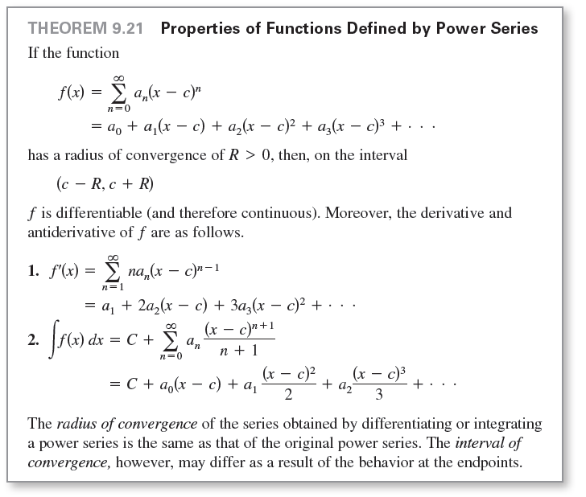
Differentiation and Integration of Power Series

Slide 20
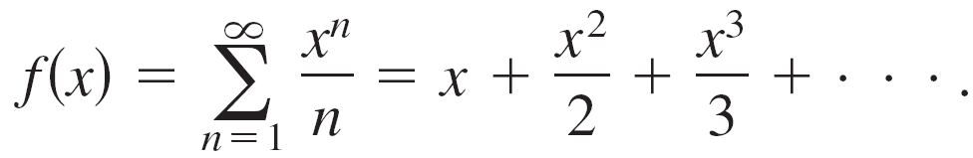
Example 8 – Intervals of Convergence for f(x), f'(x), and ∫f(x)dx
Consider the function
Find the interval of convergence for each of the following.
a. ∫f(x)dx
b. f(x)
c. f'(x)

Slide 21
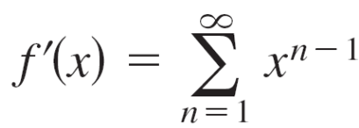
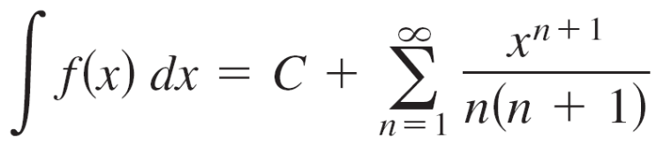
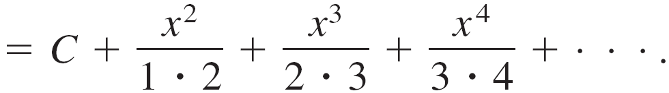
Example 8 – Solution
By Theorem 9.21, you have
and
By the Ratio Test, you can show that each series has a radius of convergence of R = 1.

Slide 22
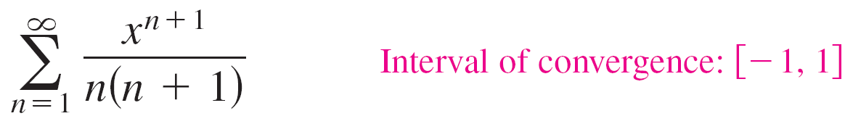
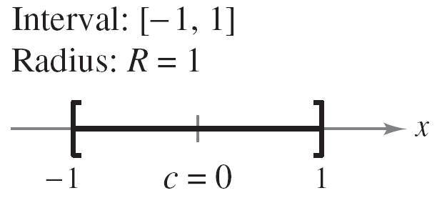
Example 8 – Solution
cont’d
Considering the interval (–1, 1), you have the following.
a. For ∫f(x)dx, the series
converges for x = ±1, and its interval of convergence is
[–1, 1].
See Figure 9.23(a).
Figure 9.23(a)

Slide 23
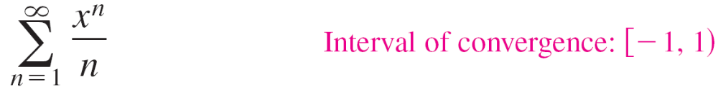
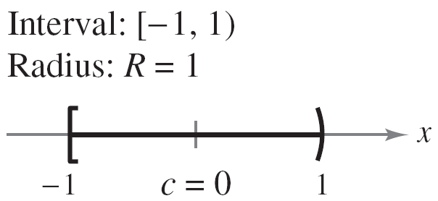
Example 8 – Solution
cont’d
b. For f(x), the series
converges for x = –1 and diverges for x = 1. So, its
interval of convergence is [–1, 1).
See Figure 9.23(b).
Figure 9.23(b)

Slide 24
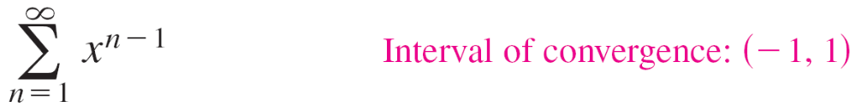
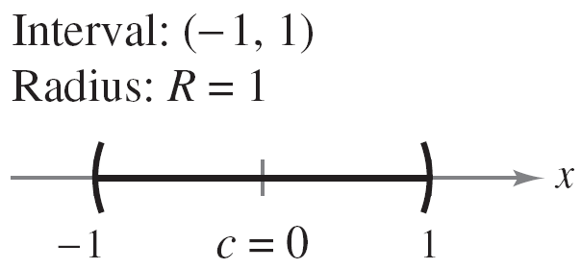
Example 8 – Solution
cont’d
c. For f'(x), the series
diverges for x = ±1, and its interval of convergence is
(–1, 1).
See Figure 9.23(c).
Figure 9.23(c)

