Slide 1

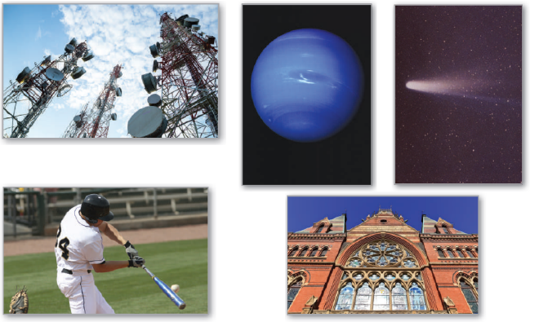
10
Conics, Parametric Equations, and Polar Coordinates
P
Copyright © Cengage Learning. All rights reserved.

Slide 2

10.1
Conics and Calculus
Copyright © Cengage Learning. All rights reserved.

Slide 3
Objectives
Understand the definition of a conic section.
Analyze and write equations of parabolas using properties of parabolas.
Analyze and write equations of ellipses using properties of ellipses.
Analyze and write equations of hyperbolas using properties of hyperbolas.

Slide 4
Conic Sections

Slide 5
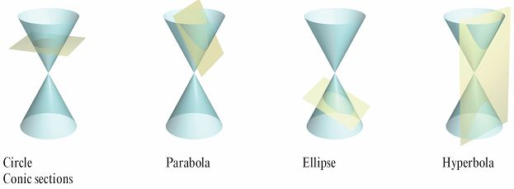
Conic Sections
Each conic section (or simply conic) can be described as the intersection of a plane and a double-napped cone. Notice in Figure 10.1 that for the four basic conics, the intersecting plane does not pass through the vertex of the cone.
Figure 10.1

Slide 6
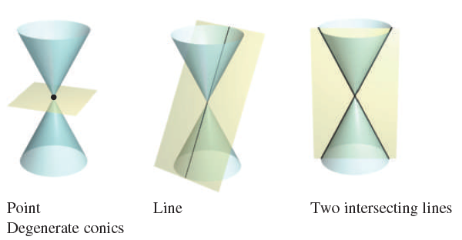
Conic Sections
When the plane passes through the vertex, the resulting figure is a degenerate conic, as shown in Figure 10.2.
Figure 10.2

Slide 7

Conic Sections
There are several ways to study conics. You could begin as the Greeks did, by defining the conics in terms of the intersections of planes and cones, or you could define them algebraically in terms of the general second-degree equation
However, a third approach, in which each of the conics is defined as a locus (collection) of points satisfying a certain geometric property, works best.

Slide 8

Conic Sections
For example, a circle can be defined as the collection of all points (x, y) that are equidistant from a fixed point (h, k). This locus definition easily produces the standard equation of a circle

Slide 9
Parabolas

Slide 10
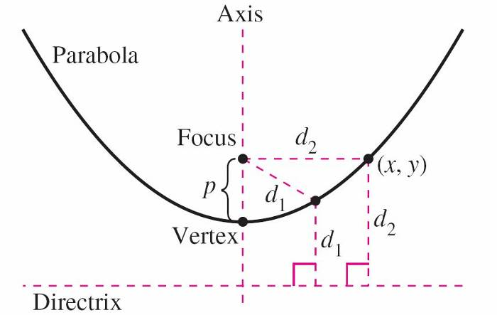
Parabolas
A parabola is the set of all points (x, y) that are equidistant from a fixed line, the directrix, and a fixed point, the focus, not on the line.
The midpoint between the focus
and the directrix is the vertex,
and the line passing through the
focus and the vertex is the axis
of the parabola.
Note in Figure 10.3 that a parabola is
symmetric with respect to its axis.
Figure 10.3

Slide 11
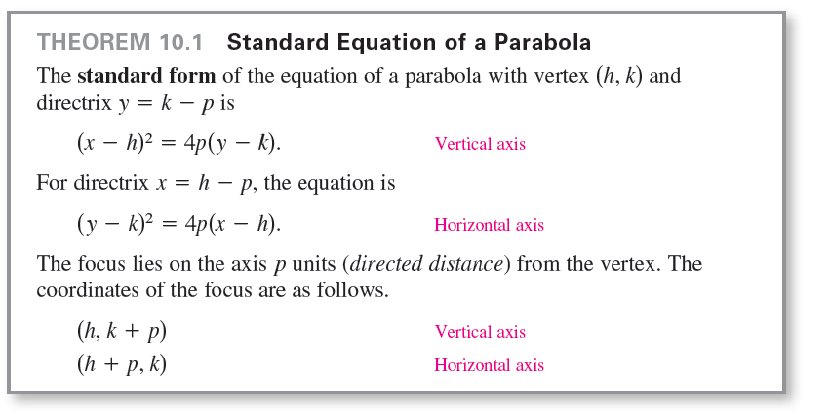
Parabolas

Slide 12


Example 1 – Finding the Focus of a Parabola
Find the focus of the parabola
Solution:
To find the focus, convert to standard form by completing the square.

Slide 13

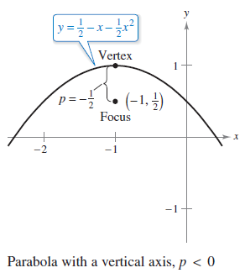


Example 1 – Solution
cont’d
Comparing this equation with you can conclude that
Because p is negative, the parabola
opens downward, as shown in
Figure 10.4.
So, the focus of the parabola is
p units from the vertex, or
Figure 10.4

Slide 14
Parabolas
A line segment that passes through the focus of a parabola and has endpoints on the parabola is called a focal chord. The specific focal chord perpendicular to the axis of the parabola is the latus rectum.
One widely used property of a parabola is its reflective property. In physics, a surface is called reflective when the tangent line at any point on the surface makes equal angles with an incoming ray and the resulting outgoing ray.
The angle corresponding to the incoming ray is the angle of incidence, and the angle corresponding to the outgoing ray is the angle of reflection.
One example of a reflective surface is a flat mirror.

Slide 15
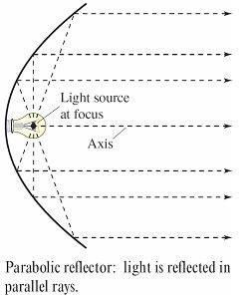
Parabolas
Another type of reflective surface is that formed by revolving a parabola about its axis.
The resulting surface has the property
that all incoming rays parallel to the
axis are directed through the focus
of the parabola. This is the principle
behind the design of the parabolic
mirrors used in reflecting telescopes.
Conversely, all light rays emanating
from the focus of a parabolic reflector
used in a flashlight are parallel, as
shown in Figure 10.6.
Figure 10.6

Slide 16
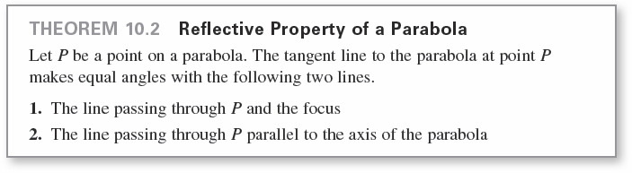
Parabolas

Slide 17
Ellipses

Slide 18
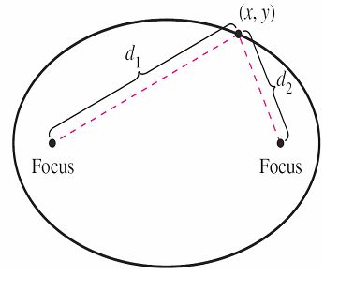
Ellipses
An ellipse is the set of all points (x, y) the sum of whose distances from two distinct fixed points called foci is constant. (See Figure 10.7.)
The line through the foci intersects the ellipse at two points, called the vertices.
Figure 10.7

Slide 19
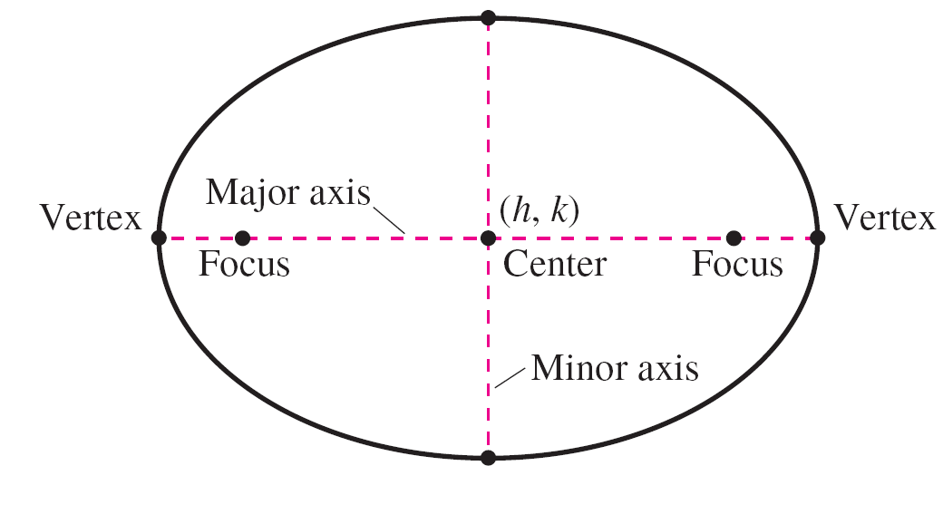
Ellipses
The chord joining the vertices is the major axis, and its midpoint is the center of the ellipse.
The chord perpendicular to the major axis at the center is the minor axis of the ellipse. (See Figure 10.8.)
Figure 10.8

Slide 20
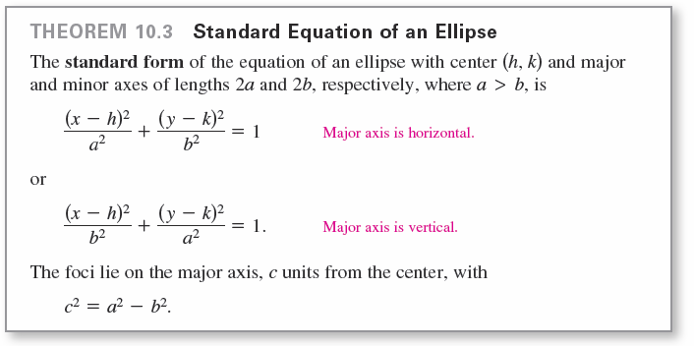
Ellipses

Slide 21
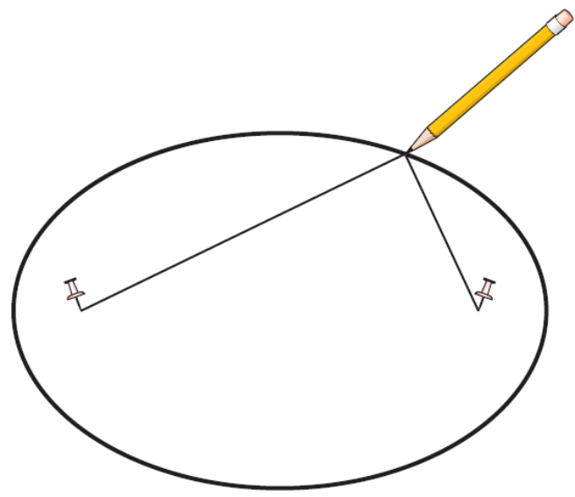
Ellipses
You can visualize the definition of an ellipse by imagining two thumbtacks placed at the foci, as shown in Figure 10.9.
If the ends of a fixed length of string are fastened to the thumbtacks and the string is drawn taut with a pencil, then the path traced by the pencil will be an ellipse.
Figure 10.9

Slide 22

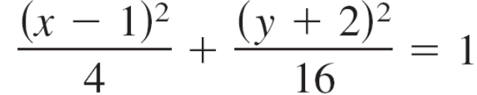

Example 3 – Analyzing an Ellipse
Find the center, vertices, and foci of the ellipse
Solution:
Complete the square to write the original equation in standard form.

Slide 23

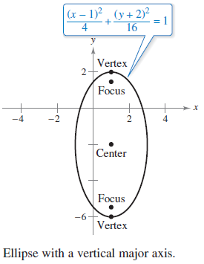



Example 3 – Solution
cont’d
So, the major axis is vertical, where h = 1, k = –2, a = 4,
b = 2, and
So, you obtain the following.
The graph of the ellipse is
shown in Figure 10.10.
Figure 10.10

Slide 24
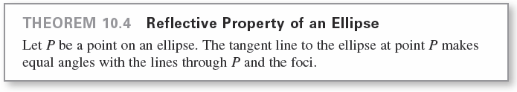
Ellipses
One of the reasons that astronomers had difficulty
detecting that the orbits of the planets are ellipses is that the foci of the planetary orbits are relatively close to the center of the sun, making the orbits nearly circular.

Slide 25
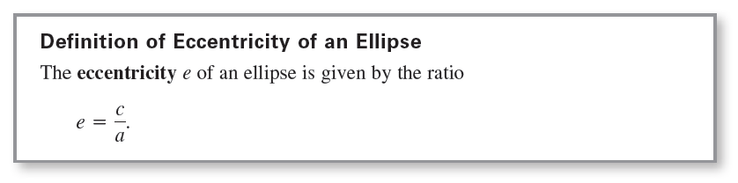
Ellipses
To measure the ovalness of an ellipse, you can use the concept of eccentricity.
To see how this ratio is used to describe the shape of an ellipse, note that because the foci of an ellipse are located along the major axis between the vertices and the center, it follows that
0 < c < a.

Slide 26
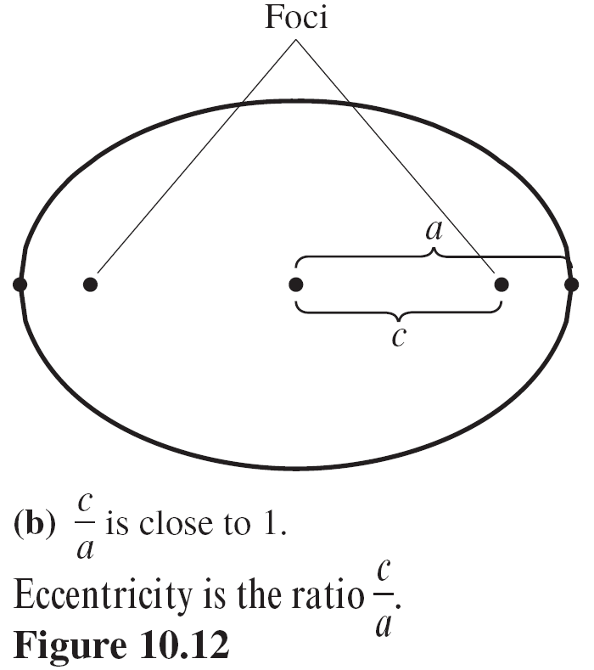
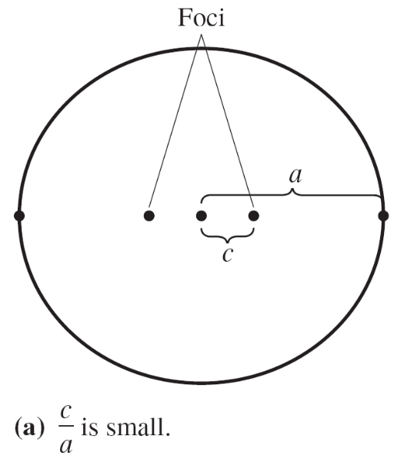
Ellipses
For an ellipse that is nearly circular, the foci are close to the center and the ratio c/a is close to 0, and for an elongated ellipse, the foci are close to the vertices and the ratio c/a is close to 1, as shown in Figure 10.12.
Figure 10.12

Slide 27
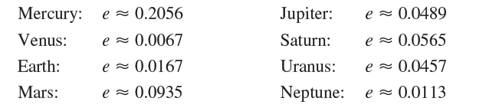

Ellipses
Note that 0 < e < 1 for every ellipse.
The orbit of the moon has an eccentricity of e ≈ 0.0549, and the eccentricities of the eight planetary orbits are listed below.
You can use integration to show that the area of an ellipse is

Slide 28
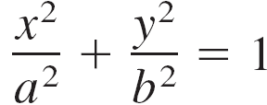
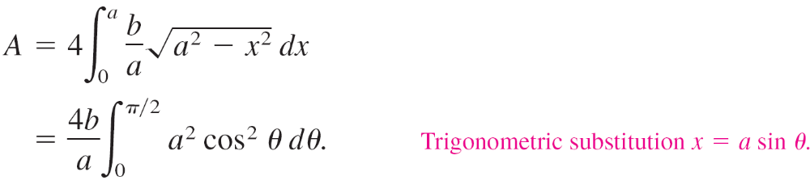
Ellipses
For instance, the area of the ellipse
is
However, it is not so simple to find the circumference of an ellipse.

Slide 29
Hyperbolas

Slide 30
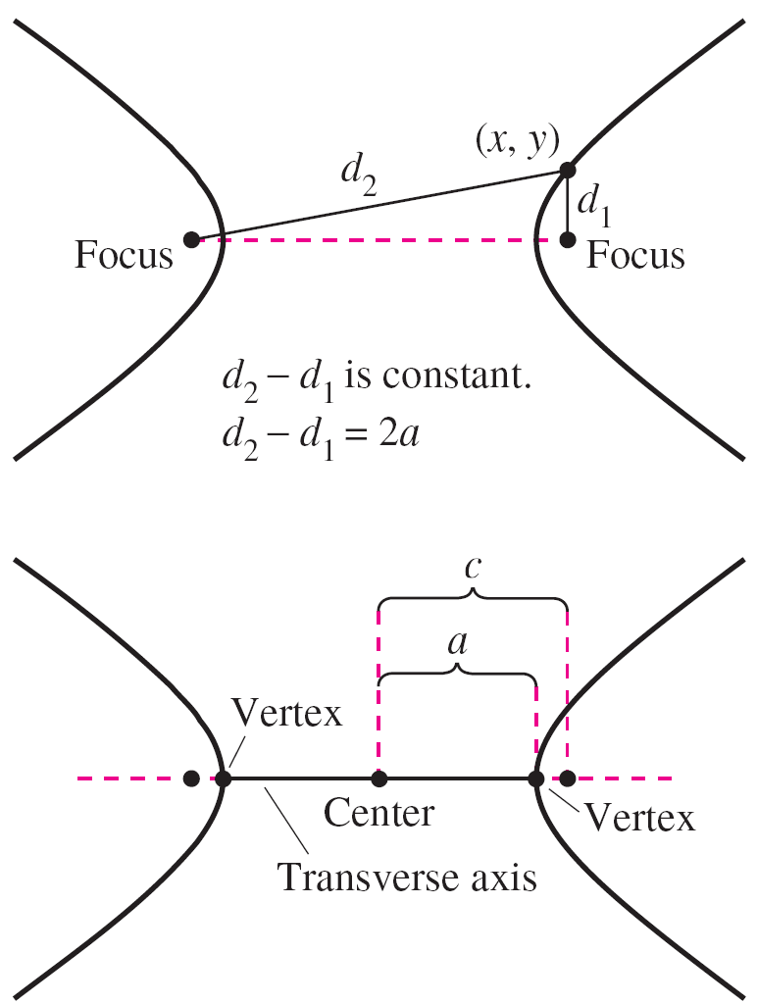
Hyperbolas
A hyperbola is the set of all points
(x, y) for which the absolute value
of the difference between the
distances from two distinct fixed
points called foci is constant.
(See Figure 10.14.)
The line through the two foci
intersects a hyperbola at two points
called the vertices.
Figure 10.14

Slide 31
Hyperbolas
The line segment connecting the vertices is the transverse axis, and the midpoint of the transverse axis is the center of the hyperbola.
One distinguishing feature of a hyperbola is that its graph has two separate branches.

Slide 32
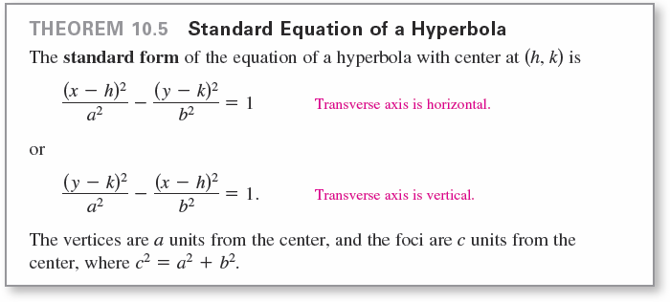
Hyperbolas

Slide 33
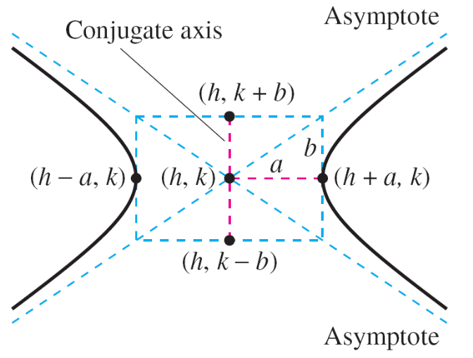
Hyperbolas
An important aid in sketching the graph of a hyperbola is the determination of its asymptotes, as shown in Figure 10.15. Each hyperbola has two asymptotes that intersect at the center of the hyperbola. The asymptotes pass through the vertices of a rectangle of dimensions 2a by 2b, with its center at (h, k).
The line segment of length 2b
joining (h, k + b) and (h, k – b)
is referred to as the
conjugate axis of the hyperbola.
Figure 10.15

Slide 34
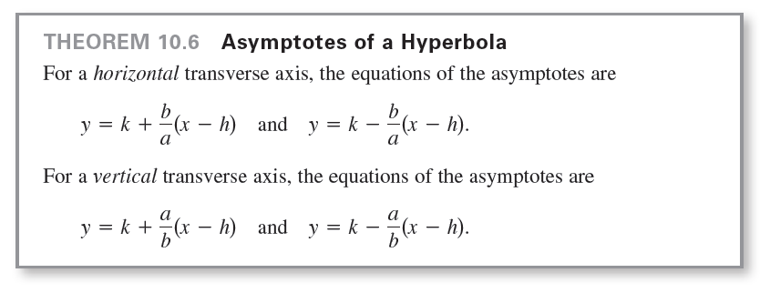
Hyperbolas

Slide 35
Hyperbolas
In Figure 10.15 you can see that the asymptotes coincide with the diagonals of the rectangle with dimensions
2a and 2b, centered at (h, k).
This provides you with a quick means of sketching the asymptotes, which in turn aids in sketching the hyperbola.
Figure 10.15

Slide 36
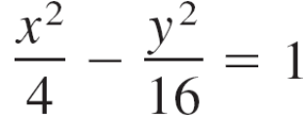
Example 7 – Using Asymptotes to Sketch a Hyperbola
Sketch the graph of the hyperbola
4x² – y² = 16.
Solution:
Begin by rewriting the equation in standard form.
The transverse axis is horizontal and the vertices occur at (–2, 0) and (2, 0).
The ends of the conjugate axis occur at (0, –4) and (0, 4).

Slide 37
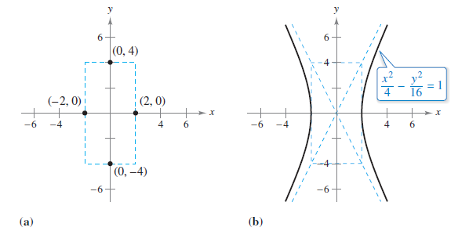
Example 7 – Solution
cont’d
Using these four points, you can sketch the rectangle shown in Figure 10.16(a).
By drawing the asymptotes through the corners of this rectangle, you can complete the sketch as shown in Figure 10.16(b).
Figure 10.16

Slide 38
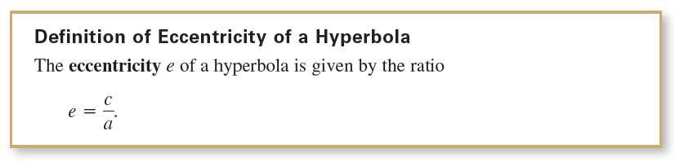
Hyperbolas

Slide 39
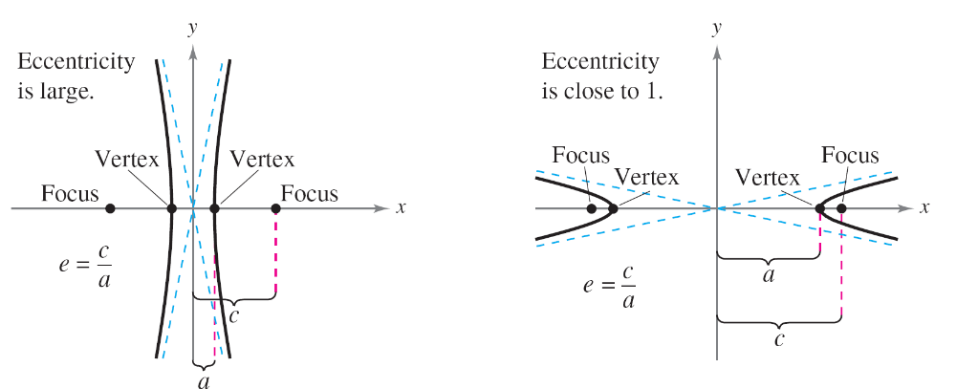
Hyperbolas
As with an ellipse, the eccentricity of a hyperbola is
e = c/a. Because c > a for hyperbolas, it follows that e > 1 for hyperbolas. If the eccentricity is large, then the branches of the hyperbola are nearly flat. If the eccentricity is close to 1, then the branches of the hyperbola are more pointed, as shown in Figure 10.17.
Figure 10.17

