Slide 1

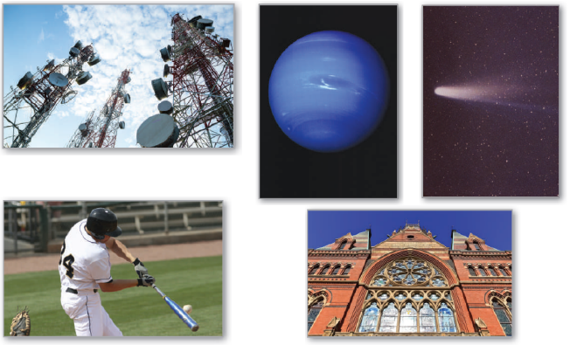
10
Conics, Parametric Equations, and Polar Coordinates
P
Copyright © Cengage Learning. All rights reserved.

Slide 2

Plane Curves and Parametric Equations
10.2
Copyright © Cengage Learning. All rights reserved.

Slide 3
Objectives
Sketch the graph of a curve given by a set of parametric equations.
Eliminate the parameter in a set of parametric equations.
Find a set of parametric equations to represent a curve.
Understand two classic calculus problems, the tautochrone and brachistochrone problems.

Slide 4
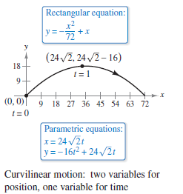
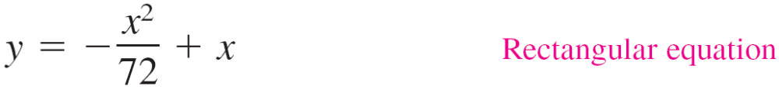
Plane Curves and Parametric Equations
Consider the path followed by an object that is propelled into the air at an angle of 45°.
For an initial velocity of the
object is 48 feet per second, the object travels the parabolic path given by the rectangular
equation
as shown in Figure 10.19.
Figure 10.19

Slide 5
Plane Curves and Parametric Equations
To determine this time, you can introduce a third variable t, called a parameter.
By writing both x and y as functions of t, you obtain the
parametric equations
and

Slide 6

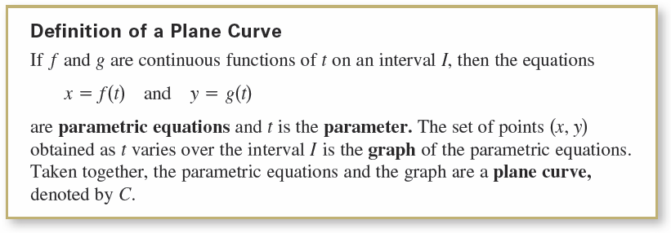
Plane Curves and Parametric Equations
From this set of equations, you can determine that at time t = 0, the object is at the point (0, 0). Similarly, at time t = 1, the object is at the point and so on.
For this particular motion problem, x and y are continuous functions of t, and the resulting path is called a plane curve.

Slide 7
Plane Curves and Parametric Equations
When sketching a curve represented by a set of parametric equations, you can plot points in the xy-plane.
Each set of coordinates (x, y) is determined from a value chosen for the parameter t.
By plotting the resulting points in order of increasing values of t, the curve is traced out in a specific direction. This is called the orientation of the curve.

Slide 8




Example 1 – Sketching a Curve
Sketch the curve described by the parametric equations
and
where
Solution:
For values of t on the given interval, the parametric equations yield the points (x, y) shown in the table.

Slide 9
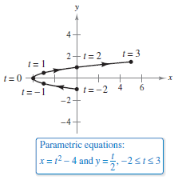
Example 1 – Solution
cont’d
By plotting these points in order of increasing values of t and using the continuity of f and g, you obtain the curve C shown in Figure 10.20. Note that the arrows on the curve
indicate its orientation as t increases from –2 to 3.
Figure 10.20

Slide 10
Eliminating the Parameter

Slide 11
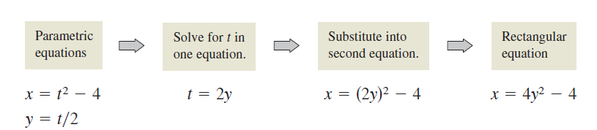
Eliminating the Parameter
Finding a rectangular equation that represents the graph of a set of parametric equations is called eliminating the parameter.
For instance, you can eliminate the parameter from the set of parametric equations in Example 1 as follows.

Slide 12
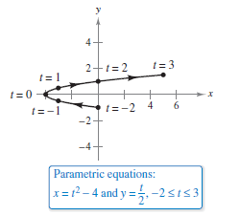
Eliminating the Parameter
Once you have eliminated the parameter, you can recognize that the equation x = 4y² – 4 represents a parabola with a horizontal axis and vertex at (–4, 0), as
shown in Figure 10.20.
Figure 10.20

Slide 13
Eliminating the Parameter
The range of x and y implied by the parametric equations may be altered by the change to rectangular form.
In such instances, the domain of the rectangular equation
must be adjusted so that its graph matches the graph of the parametric equations.

Slide 14
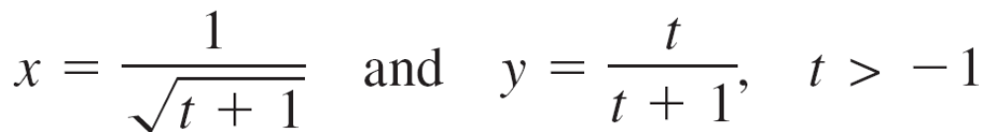
Example 2 – Adjusting the Domain
Sketch the curve represented by the equations
by eliminating the parameter and adjusting the domain of the resulting rectangular equation.

Slide 15
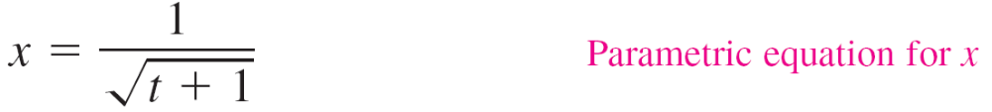
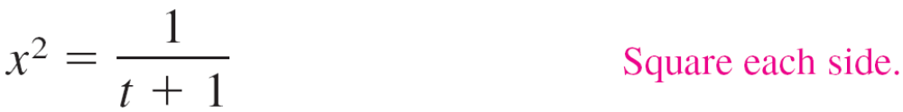
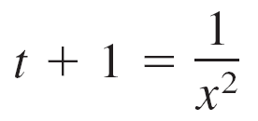


Example 2 – Solution
Begin by solving one of the parametric equations for t.
For instance, you can solve the first equation for t as follows.

Slide 16
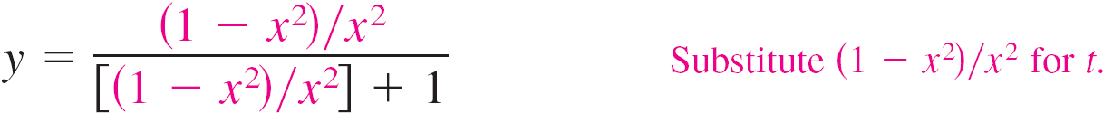
Example 2 – Solution
cont’d
Now, substituting into the parametric equation for y produces
The rectangular equation, y = 1 – x², is defined for all values of x, but from the parametric equation for x, you can see that the curve is defined only when t > –1.

Slide 17
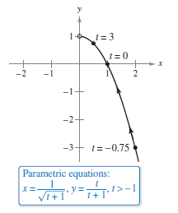
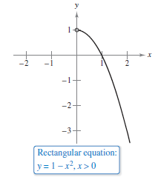
Example 2 – Solution
cont’d
This implies that you should restrict the domain of x to positive values, as shown in Figure 10.22.
Figure 10.22

Slide 18
Finding Parametric Equations

Slide 19

Example 4 – Finding Parametric Equations for a Given Graph
Find a set of parametric equations that represents the graph of y = 1 – x², using each of the following parameters.
a. t = x
b. The slope m = at the point (x, y)
Solution:
a. Letting x = t produces the parametric equations
x = t and y = 1 – x² = 1 – t².

Slide 20




Example 4 – Solution
cont’d
b. To write x and y in terms of the parameter m, you can
proceed as follows.
This produces a parametric equation for x. To obtain a parametric equation for y, substitute –m/2 for x in the original equation.

Slide 21
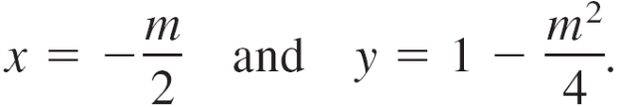
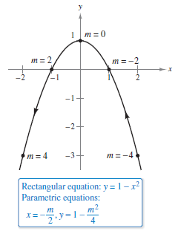
Example 4 – Solution
cont’d
So, the parametric equations are
In Figure 10.24, note that the resulting
curve has a right-to-left orientation as
determined by the increasing
values of slope m.
For part (a), the curve would have the
opposite orientation.
Figure 10.24

Slide 22
Example 5 – Parametric Equations for a Cycloid
Determine the curve traced by a point P on the circumference of a circle of radius a rolling along a straight line in a plane. Such a curve is called a cycloid.
Solution:
Let the parameter θ be the measure of the circle’s rotation, and let the point P = (x, y) begin at the origin.
When θ = 0, P is at the origin.
When θ = π, P is at a maximum point (πa, 2a).
When θ = 2π, P is back on the x-axis at (2πa, 0).

Slide 23

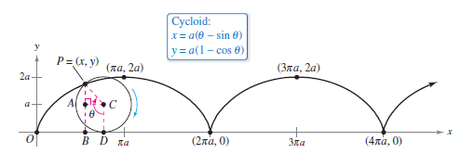
Example 5 – Solution
cont’d
From Figure 10.25, you can see that
Figure 10.25

Slide 24
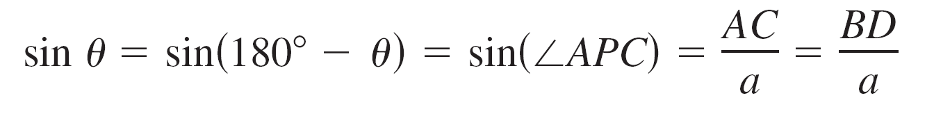
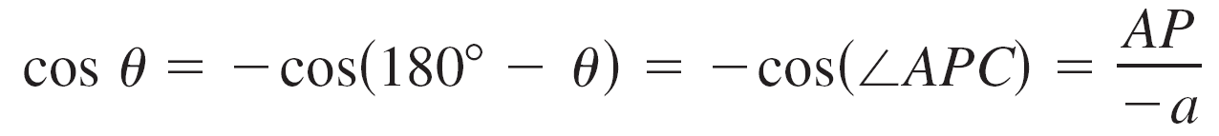

Example 5 – Solution
cont’d
So,
which implies that AP = –a cos θ and BD = a sin θ.
Because the circle rolls along the x-axis, you know that

Slide 25
Example 5 – Solution
cont’d
Furthermore, because BA = DC = a, you have
x = OD – BD = aθ – a sin θ
y = BA + AP = a – a cos θ.
So, the parametric equations are
x = a(θ – sin θ) and y = a(1 – cos θ).

Slide 26
Finding Parametric Equations
The cycloid in Figure 10.25 has sharp corners called cusps at the values x = 2nπa. Notice that the derivatives x'(θ) and y'(θ) are both zero at the points for which θ = 2nπ.
Figure 10.25

Slide 27
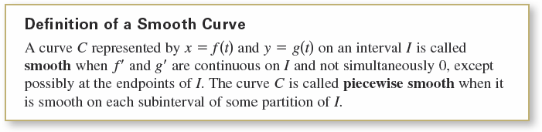
Finding Parametric Equations
Between these points, the cycloid is called smooth.

Slide 28
The Tautochrone and Brachistochrone Problems

Slide 29
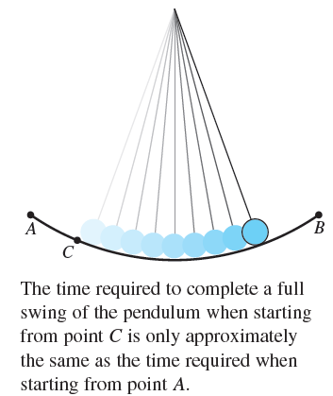
The Tautochrone and Brachistochrone Problems
The Cycloid is related to one of the most famous pairs of problems in the history of calculus.
The first problem (called the
tautochrone problem) began with
Galileo’s discovery that the time
required to complete a full swing of
a pendulum is approximately the
same whether it makes a large
movement at high speed or a
small movement at lower speed
(see Figure 10.26).
Figure 10.26

Slide 30
The Tautochrone and Brachistochrone Problems
Galileo realized that he could use this principle to construct a clock. However he was not able to conquer the mechanics of actual construction.
Christian Huygens (1629-1695) was the first to design and construct a working model. He realized that a pendulum does not take exactly the same time to complete swings of varying lengths.
But, in studying the problem, Huygens discovered that a ball rolling back and forth on an inverted cycloid does complete each cycle in exactly the same time.

Slide 31
The Tautochrone and Brachistochrone Problems
The second problem, which was posed by John Bernoulli in 1696, is called the brachistochrone problem—in Greek, brachys means short and chronos means time.
The problem was to determine the path down which a particle will slide from point A to point B in the shortest time.

Slide 32
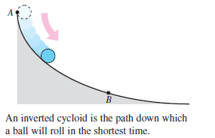
The Tautochrone and Brachistochrone Problems
The solution is not a straight line from A to B, but an
inverted cycloid passing through the points A and B, as
shown in Figure 10.27.
Figure 10.27

Slide 33
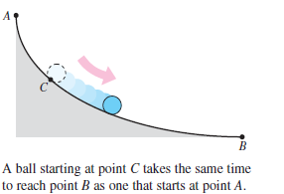
The Tautochrone and Brachistochrone Problems
The amazing part of the solution to the brachistochrone problem is that a particle starting at rest at any point C of the cycloid between A and B will take exactly the same time to reach B, as shown in Figure 10.28.
Figure 10.28

