Slide 1

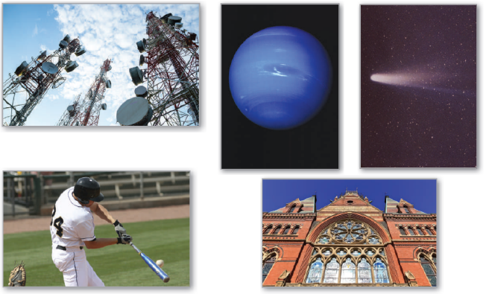
10
Conics, Parametric Equations,
and Polar Coordinates
P
Copyright © Cengage Learning. All rights reserved.

Slide 2

Parametric Equations and Calculus
10.3
Copyright © Cengage Learning. All rights reserved.

Slide 3
Objectives
Find the slope of a tangent line to a curve given by a set of parametric equations.
Find the arc length of a curve given by a set of parametric equations.
Find the area of a surface of revolution (parametric form).

Slide 4
Slope and Tangent Lines

Slide 5
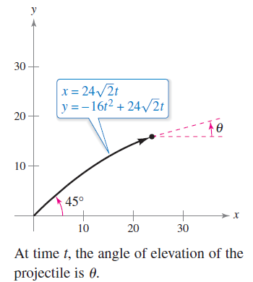
Slope and Tangent Lines
Consider the projectile represented by the parametric equations
as shown in Figure 10.29. You
know that these equations enable
you to locate the position of the
projectile at a given time.
You also know that the object is
initially projected at an angle of 45°, or
a slope of m = tan 45° = 1.
Figure 10.29

Slide 6
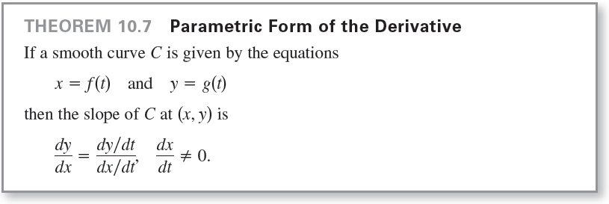
Slope and Tangent Lines
But how can you find the slope at some other time t?
The next theorem answers this question by giving a formula for the slope of the tangent line as a function of t.

Slide 7



Example 1 – Differentiation and Parametric Form
Find dy/dx for the curve given by x = sin t and y = cos t.
Solution:

Slide 8
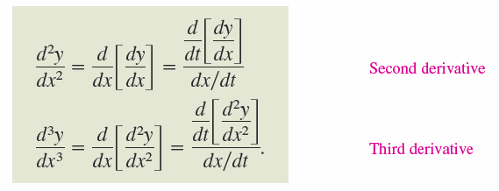
Slope and Tangent Lines
Because dy/dx is a function of t, you can use Theorem 10.7 repeatedly to find higher-order derivatives.
For instance,

Slide 9
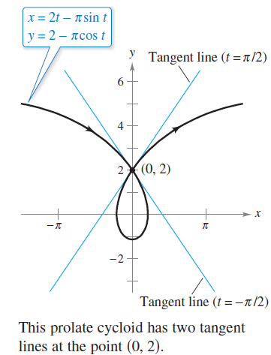
Example 3 – A Curve with Two Tangent Lines at a Point
The prolate cycloid given by
crosses itself at the point (0, 2),
as shown in Figure 10.32.
Find the equations of both
tangent lines at this point.
Figure 10.32

Slide 10
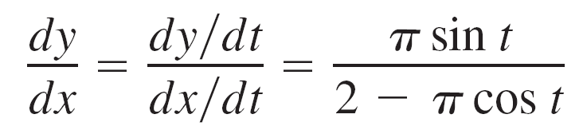
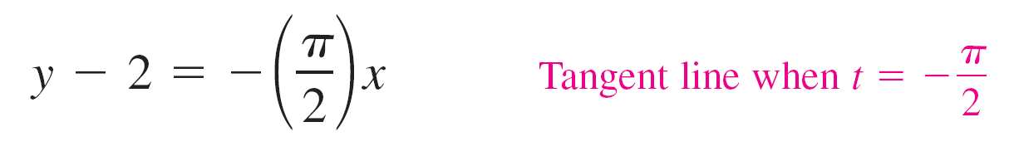
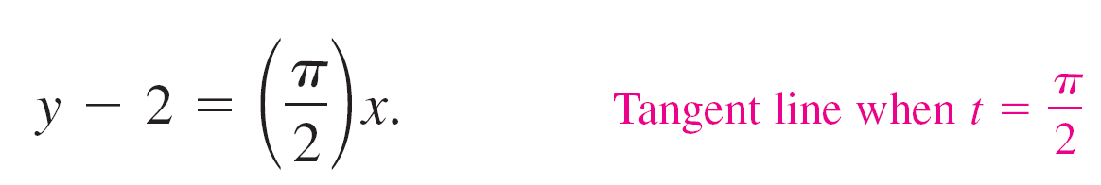
Example 3 – Solution
Because x = 0 and y = 2 when t = ±π/2, and
you have dy/dx = –π/2 when t = –π/2 and dy/dx = π/2 when t = π/2.
So, the two tangent lines at (0, 2) are
and

Slide 11
Arc Length

Slide 12
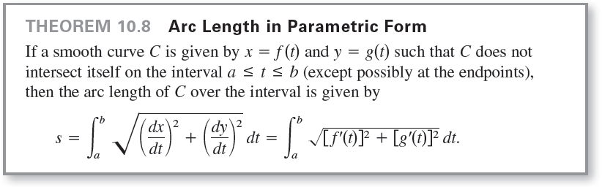
Arc Length

Slide 13
Arc Length
If a circle rolls along a line, then a point on its circumference will trace a path called a cycloid.
If the circle rolls around the circumference of another circle, the path of the point is an epicycloid.

Slide 14
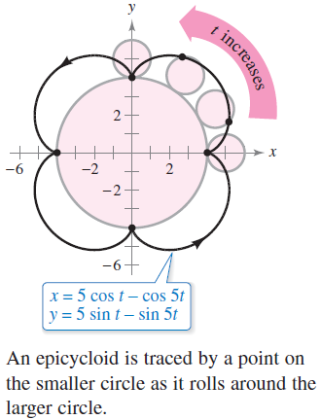
Example 4 – Finding Arc Length
A circle of radius 1 rolls around the circumference of a larger circle of radius 4, as shown in Figure 10.33. The epicycloid traced by a point on the circumference of the smaller circle is given by
Find the distance traveled by the point
in one complete trip about the larger circle.
Figure 10.33

Slide 15
Example 4 – Solution
Before applying Theorem 10.8, note in Figure 10.33 that the curve has sharp points when t = 0 and t = π/2.
Between these two points, dx/dt and dy/dt are not simultaneously 0.
So, the portion of the curve generated from t = 0 to t = π/2
is smooth.
To find the total distance traveled by the point, you can find the arc length of that portion lying in the first quadrant and multiply by 4.

Slide 16


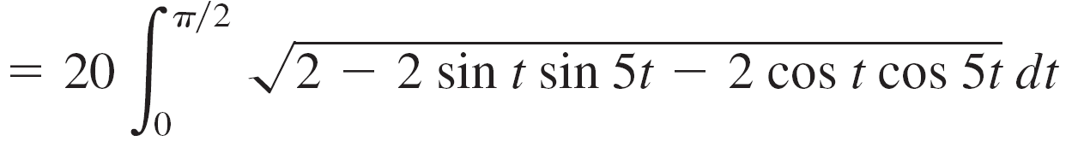


Example 4 – Solution
cont’d

Slide 17
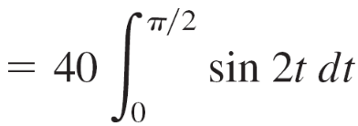
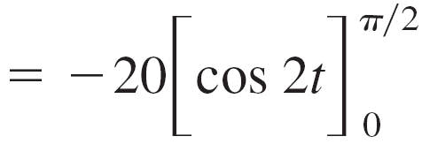

Example 4 – Solution
cont’d
For the epicycloid shown in Figure 10.33,
an arc length of 40 seems about right
because the circumference of a circle of
radius 6 is 2πr = 12π ≈ 37.7.
Figure 10.33

Slide 18
Area of a Surface of Revolution

Slide 19
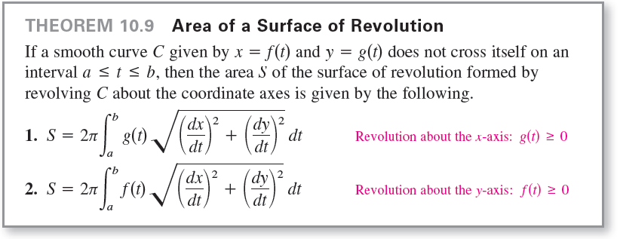
Area of a Surface of Revolution
You can use the formula for the area of a surface of revolution in rectangular form to develop a formula for surface area in parametric form.

Slide 20

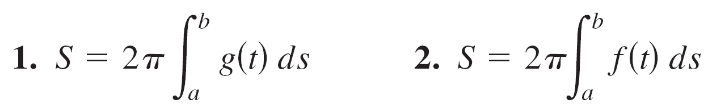
Area of a Surface of Revolution
These formulas are easy to remember if you think of the differential of arc length as
Then the formulas in Theorem 10.9 can be written as follows.

Slide 21

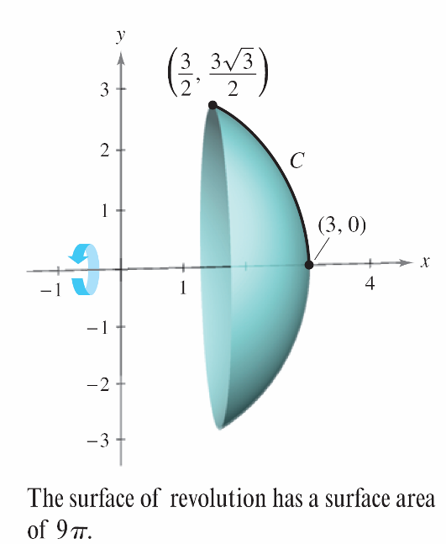
Example 5 – Finding the Area of a Surface of Revolution
Let C be the arc of the circle x² + y² = 9 from (3, 0) to
as shown in Figure 10.34.
Find the area of the surface
formed by revolving C about
the x-axis.
Figure 10.34

Slide 22
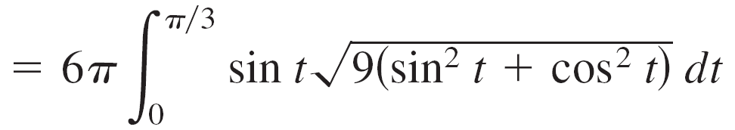
Example 5 – Solution
You can represent C parametrically by the equations
x = 3 cos t and y = 3 sin t, 0 ≤ t ≤ π/3.
(Note that you can determine the interval for t by observing that t = 0 when x = 3 and t = π/3 when x = 3/2.)
On this interval, C is smooth and y is nonnegative, and you can apply Theorem 10.9 to obtain a surface area of

Slide 23
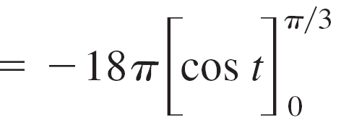
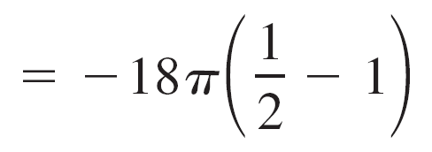
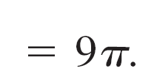
Example 5 – Solution
cont’d

