Slide 1


10
Conics, Parametric Equations, and Polar Coordinates
P
Copyright © Cengage Learning. All rights reserved.

Slide 2

Polar Coordinates and Polar Graphs
10.4
Copyright © Cengage Learning. All rights reserved.

Slide 3
Objectives
Understand the polar coordinate system.
Rewrite rectangular coordinates and equations in polar form and vice versa.
Sketch the graph of an equation given in polar form.
Find the slope of a tangent line to a polar graph.
Identify several types of special polar graphs.

Slide 4
Polar Coordinates

Slide 5
Polar Coordinates
So far, you have been representing graphs as collections of points (x, y) on the rectangular coordinate system.
The corresponding equations for these graphs have been in either rectangular or parametric form.
In this section, you will study a coordinate system called the polar coordinate system.

Slide 6
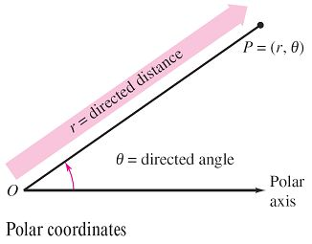
Polar Coordinates
To form the polar coordinate system in the plane,
fix a point O, called the pole (or origin), and construct from O an initial ray called the polar axis, as shown
in Figure 10.35.
Figure 10.35

Slide 7

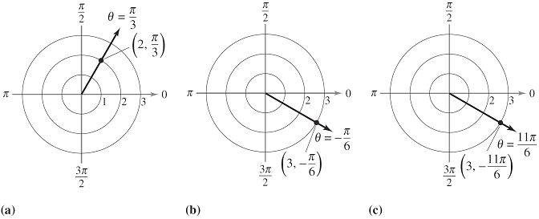
Polar Coordinates
Then each point P in the plane can be assigned polar coordinates (r, θ), as follows.
r = directed distance from O to P
θ = directed angle, counterclockwise from polar axis to segment
Figure 10.36 shows three points on the polar coordinate system.
Figure 10.36

Slide 8
Polar Coordinates
Notice that in this system, it is convenient to locate points with respect to a grid of concentric circles intersected by radial lines through the pole.
With rectangular coordinates, each point (x, y) has a unique representation. This is not true with polar coordinates.
For instance, the coordinates (r, θ), and (r, 2π + θ) represent the same point [see parts (b) and (c) in Figure 10.36].
Also, because r is a directed distance, the coordinates (r, θ) and (–r, θ + π) represent the same point.

Slide 9
Polar Coordinates
In general, the point (r, θ) can be written as
(r, θ) = (r, θ + 2nπ)
or
(r, θ) = (–r, θ + (2n + 1)π)
where n is any integer. Moreover, the pole is represented by (0, θ), where θ is any angle.

Slide 10
Coordinate Conversion

Slide 11
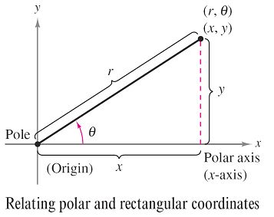


Coordinate Conversion
To establish the relationship between polar and rectangular coordinates, let the polar axis coincide with the positive
x-axis and the pole with the origin, as shown in Figure 10.37.
Because (x, y) lies on a circle of
radius r, it follows that r² = x² + y².
Moreover, for r > 0 the definitions
of the trigonometric functions
imply that
and
You can show that the same relationships hold for r < 0.
Figure 10.37

Slide 12
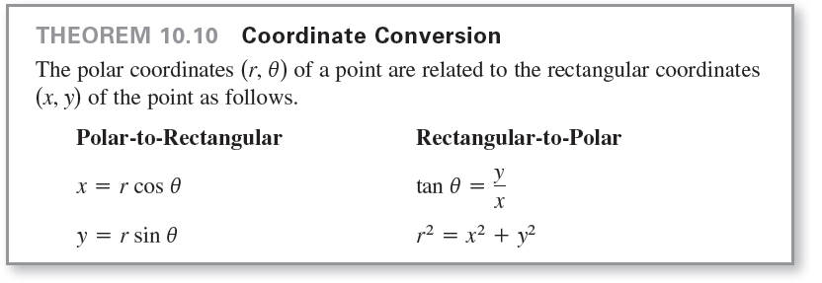
Coordinate Conversion

Slide 13
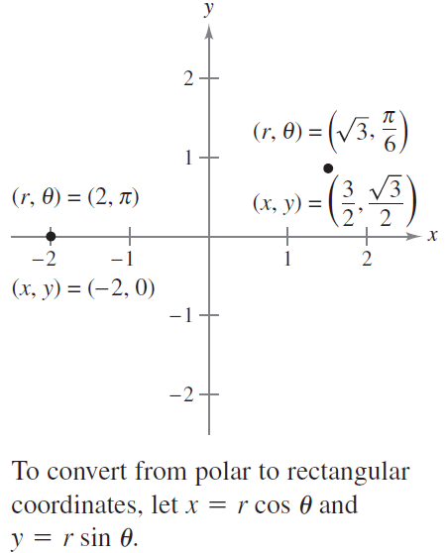




Example 1 – Polar-to-Rectangular Conversion
a. For the point (r, θ) = (2, π),
x = r cos θ = 2 cos π = –2 and y = r sin θ = 2 sin π = 0.
So, the rectangular coordinates are (x, y) = (–2, 0).
b. For the point (r, θ) =
and
So, the rectangular coordinates are
(x, y) =
See Figure 10.38.
Figure 10.38

Slide 14
Polar Graphs

Slide 15

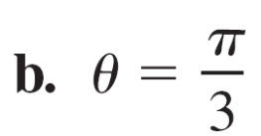
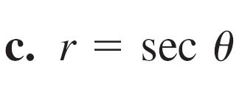
Example 3 – Graphing Polar Equations
Describe the graph of each polar equation. Confirm each description by converting to a rectangular equation.

Slide 16
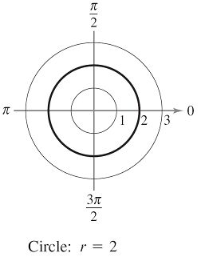
Example 3(a) – Solution
The graph of the polar equation
r = 2 consists of all points
that are two units from the pole.
So, this graph is a circle centered
at the origin with a radius of 2.
[See Figure 10.40(a).]
You can confirm this by using the
relationship r² = x² + y²
to obtain the rectangular equation
Figure 10.40(a)

Slide 17
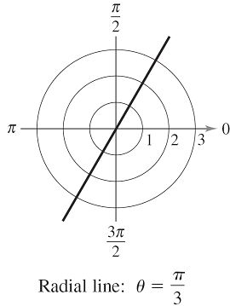
Example 3(b) – Solution
cont’d
The graph of the polar equation θ = π/3 consists of all
points on the line that makes an angle of π/3 with the
positive x-axis. [See Figure 10.40(b).]
You can confirm this by using the
relationship tan θ = y/x to obtain the
rectangular equation
Figure 10.40(b)

Slide 18
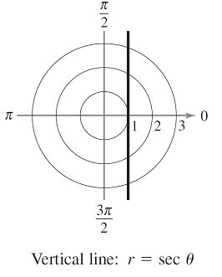

Example 3(c) – Solution
cont’d
The graph of the polar equation r = sec θ is not evident by
simple inspection, so you can begin by converting to
rectangular form using the relationship r cos θ = x.
From the rectangular equation,
you can see that the graph is a
vertical line.
[See Figure 10.40(c).]
Figure 10.40(c)

Slide 19

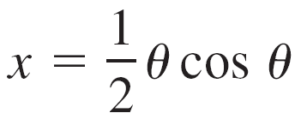
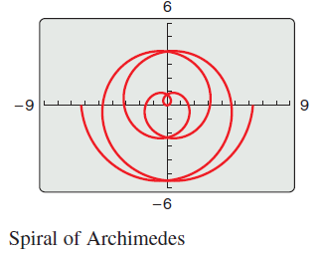
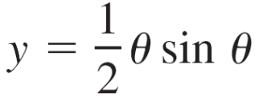
Polar Graphs
The graph of shown in Figure 10.41 was produced with a graphing utility in parametric mode. This equation was graphed using the parametric equations
with the values of θ varying
from –4π to 4π.
This curve is of the form r = aθ
and is called a spiral of Archimedes.
Figure 10.41

Slide 20
Slope and Tangent Lines

Slide 21
Slope and Tangent Lines
To find the slope of a tangent line to a polar graph, consider a differentiable function given by r = f(θ).
To find the slope in polar form, use the parametric equations
x = r cos θ = f(θ) cos θ and y = r sin θ = f(θ) sin θ.

Slide 22
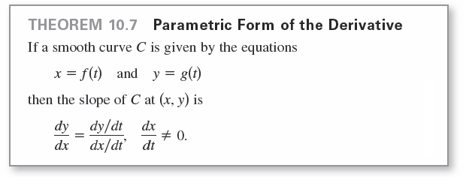

Slope and Tangent Lines
Using the parametric form of dy / dx given in Theorem 10.7, you have
which establishes the next theorem.

Slide 23
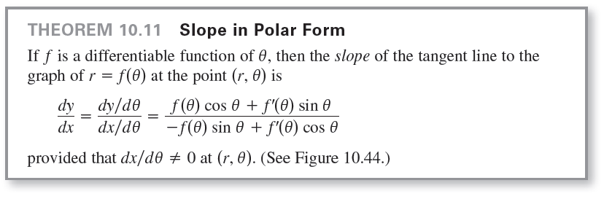
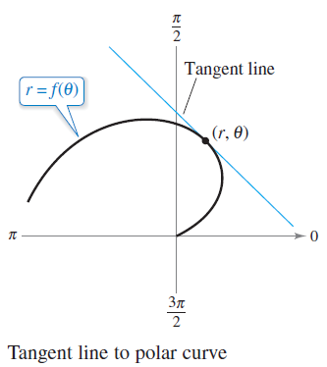
Slope and Tangent Lines
Figure 10.44

Slide 24
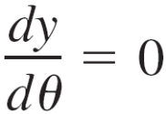
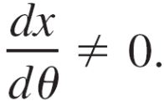
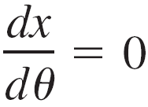
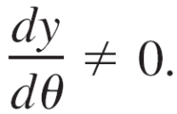
Slope and Tangent Lines
From Theorem 10.11, you can make the following observations.
1. Solutions of yield horizontal tangents, provided
that
2. Solutions of yield vertical tangents, provided
that
If dy / dθ and dx / dθ are simultaneously 0, then no conclusion can be drawn about tangent lines.

Slide 25
Example 5 – Finding Horizontal and Vertical Tangent Lines
Find the horizontal and vertical tangent lines of
r = sin θ, where
Solution:
Begin by writing the equation in parametric form.
x = r cos θ = sin θ cos θ
and
y = r sin θ = sin θ sin θ = sin² θ
Next, differentiate x and y with respect to θ and set each
derivative equal to 0.

Slide 26




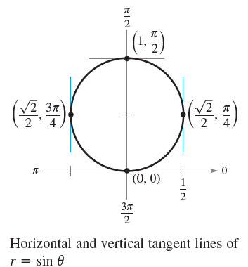


Example 5 – Solution
cont’d
So, the graph has vertical tangent
lines at and
and it has horizontal tangent lines
at (0, 0) and (1, π/2), as shown in
Figure 10.45.
Figure 10.45

Slide 27





Example 6 – Finding Horizontal and Vertical Tangent Lines
Find the horizontal and vertical tangent lines to the graph of
r = 2(1 – cos θ), where .
Solution:
Let y = r sin θ and then differentiate with respect to θ.

Slide 28

Example 6 – Solution
cont’d
Setting dy / dθ equal to 0, you can see that cos θ =
and cos θ = 1. So, dy / dθ = 0 when θ = 2π/3, 4π/3, and 0.

Slide 29




Example 6 – Solution
cont’d
Similarly, using x = r cos θ, you have
Setting dx / dθ equal to 0, you can see that sin θ = 0 and
cos θ = So, you can conclude that dx / dθ = 0 when
θ = 0, π, π/3, and 5π/3.

Slide 30
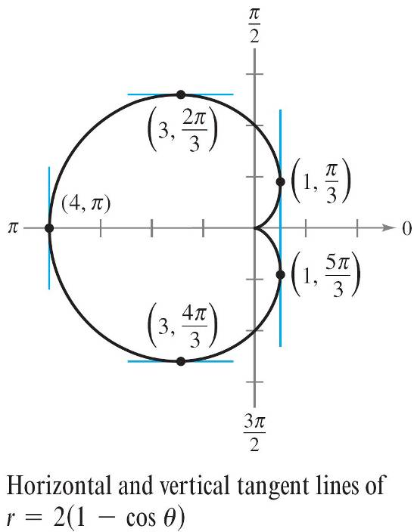
Example 6 – Solution
cont’d
From these results, and from the graph shown in
Figure 10.46, you can conclude that the graph has horizontal tangents at (3, 2π/3) and (3, 4π/3),
and has vertical tangents at
(1, π/3), (1, 5π/3), and (4, π).
This graph is called a cardioid.
Figure 10.46

Slide 31
Example 6 – Solution
cont’d
Note that both derivatives (dy / dθ and dx / dθ) are 0 when
θ = 0.
Using this information alone, you do not know whether
the graph has a horizontal or vertical tangent line at the
pole.
From Figure 10.46, however, you can see that the
graph has a cusp at the pole.

Slide 32

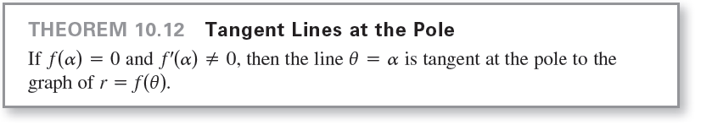
Slope and Tangent Lines
Theorem 10.11 has an important consequence. If the graph of r = f (θ) passes through the pole when θ = and
f'( )≠ 0, then the formula for dy/dx simplifies as follows.
So, the line θ = is tangent to the graph at the pole,
(0, ).

Slide 33
Special Polar Graphs

Slide 34
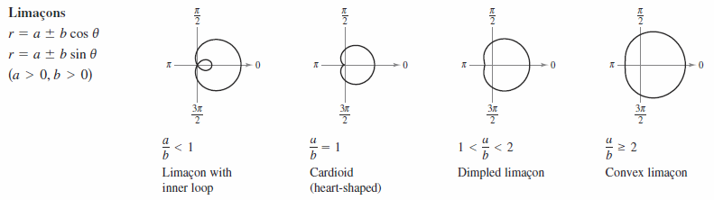
Special Polar Graphs
Several important types of graphs have equations that are
simpler in polar form than in rectangular form. For example,
the polar equation of a circle having a radius of a and
centered at the origin is simply r = a. Several other
types of graphs that have simpler equations in polar form
are shown below.

Slide 35
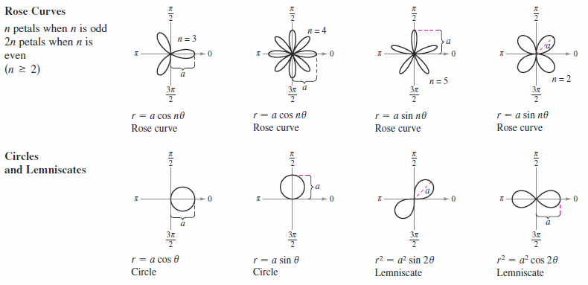
Special Polar Graphs
cont’d

