Slide 1

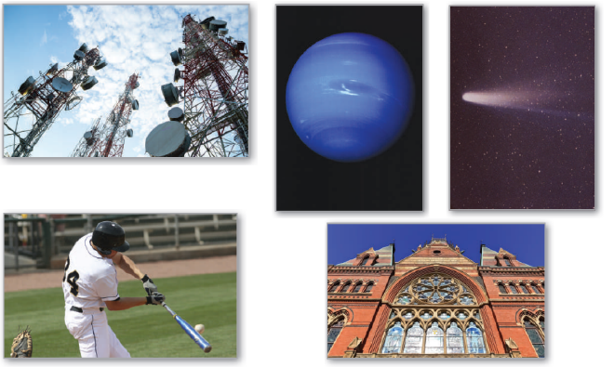
10
Conics, Parametric Equations, and Polar Coordinates
P
Copyright © Cengage Learning. All rights reserved.

Slide 2

Area and Arc Length in Polar Coordinates
10.5
Copyright © Cengage Learning. All rights reserved.

Slide 3
Objectives
Find the area of a region bounded by a polar graph.
Find the points of intersection of two polar graphs.
Find the arc length of a polar graph.
Find the area of a surface of revolution (polar form).

Slide 4
Area of a Polar Region

Slide 5
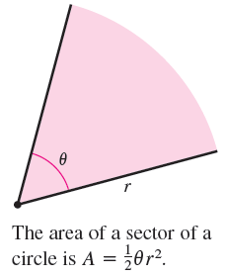


Area of a Polar Region
The development of a formula for the area of a polar region parallels that for the area of a region on the rectangular coordinate system but uses sectors of a circle instead of rectangles as the basic elements of area.
In Figure 10.48, note that the area of
a circular sector of radius r is
provided is measured in radians.
Figure 10.48

Slide 6
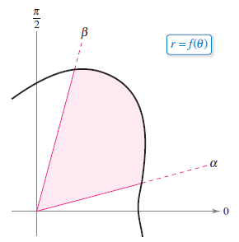
Area of a Polar Region
Consider the function r = f(θ), where f is continuous and nonnegative on the interval α ≤ θ ≤ β. The region bounded by the graph of f and the radial lines θ = α and θ = β is shown in Figure 10.49(a).
Figure 10.49(a)

Slide 7
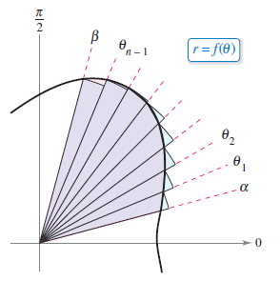
Area of a Polar Region
To find the area of this region, partition the interval [α, β] into n equal subintervals
α = θ₀ < θ₁ < θ₂ < . . . < θ_{n – 1} < θ_{n} = β.
Then approximate the area of the region by the sum of the areas of the n sectors, as shown in Figure 10.49(b).
Figure 10.49(b)

Slide 8



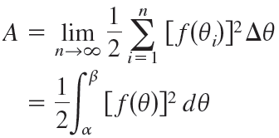
Area of a Polar Region
Radius of i th sector = f(θ_{i})
Central angle of i th sector
Taking the limit as n → produces
which leads to the next theorem.

Slide 9
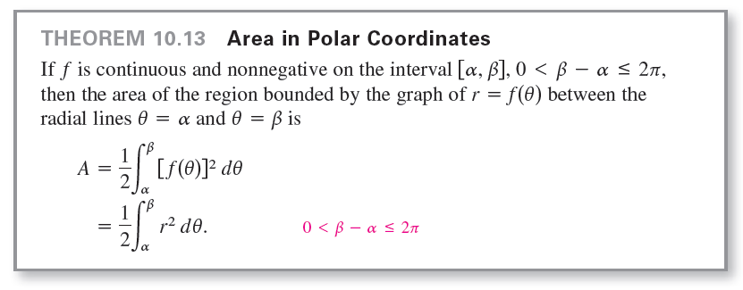
Area of a Polar Region

Slide 10
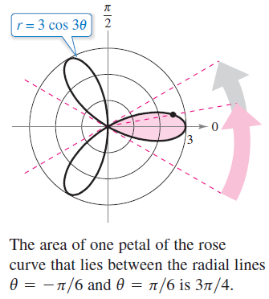
Example 1 – Finding the Area of a Polar Region
Find the area of one petal of the rose curve r = 3 cos 3θ.
Solution:
In Figure 10.50, you can see that the petal on the right is traced as θ increases from –π/6 to π/6.
Figure 10.50

Slide 11




Example 1 – Solution
cont’d
So, the area is

Slide 12
Points of Intersection of Polar Graphs

Slide 13
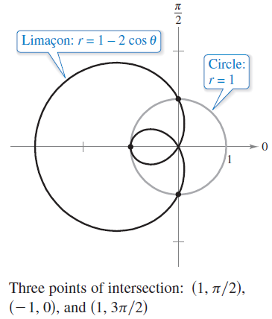
Points of Intersection of Polar Graphs
Because a point may be represented in different ways in polar coordinates, care must be taken in determining the points of intersection of two polar graphs.
For example, consider the points
of intersection of the graphs of
r = 1 – 2 cos θ and r = 1
as shown in Figure 10.52.
Figure 10.52

Slide 14
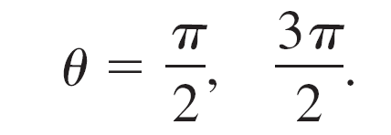
Points of Intersection of Polar Graphs
As with rectangular equations, you can attempt to find the points of intersection by solving the two equations simultaneously, as shown.
r = 1 – 2 cos θ
1 = 1 – 2 cos θ
cos θ = 0
The corresponding points of intersection are (1, π/2) and (1, 3π/2).
First equation
Substitute r = 1 from second equation
into first equation.
Simplify.
Solve for θ.

Slide 15
Points of Intersection of Polar Graphs
From Figure 10.52, however, you can see that there is a third point of intersection that did not show up when the two polar equations were solved simultaneously.
The reason the third point was not
found is that it does not occur with
the same coordinates in the two graphs.
On the graph of r = 1, the point
occurs with coordinates (1, π),
but on the graph of r = 1 – 2 cos θ
the point occurs with coordinates (–1, 0).
Figure 10.52

Slide 16
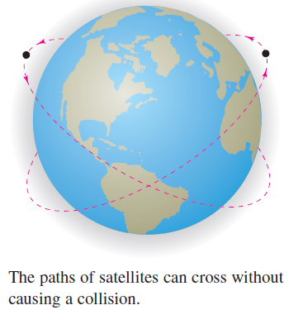
Points of Intersection of Polar Graphs
You can compare the problem of finding points of intersection of two polar graphs with that of finding collision points of two satellites in intersecting orbits about Earth, as shown in Figure 10.53.
The satellites will not collide as long
as they reach the points of intersection at different times (θ-values). Collisions
will occur only at the points of intersection that are “simultaneous
points”—those that are reached at
the same time (θ-value).
Figure 10.53.

Slide 17
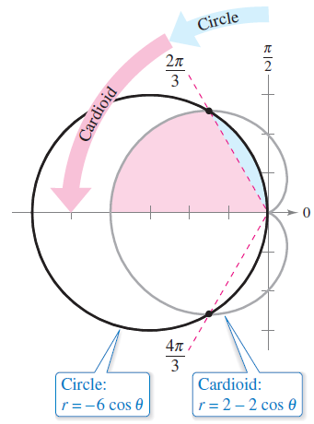
Example 3 – Finding the Area of a Region Between Two Curves
Find the area of the region common to the two regions bounded by the curves
r = –6 cos θ Circle
and
r = 2 – 2 cos θ. Cardioid
Solution:
Because both curves are symmetric
with respect to the x-axis, you can
work with the upper half-plane,
as shown in Figure 10.54.
Figure 10.54

Slide 18
Example 3 – Solution
cont’d
The blue shaded region lies between the circle and the radial line θ = 2π/3.
Because the circle has coordinates (0, π/2) at the pole, you can integrate between π/2 and 2π/3 to obtain the area of this region.
The region that is shaded red is bounded by the cardioid and the radial lines θ = 2π/3 and θ = π.
So, you can find the area of this second region by integrating between 2π/3 and π.
The sum of these two integrals gives the area of the common region lying above the radial line θ = π.

Slide 19
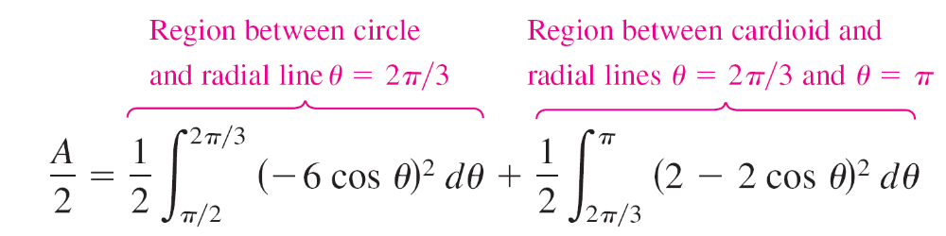
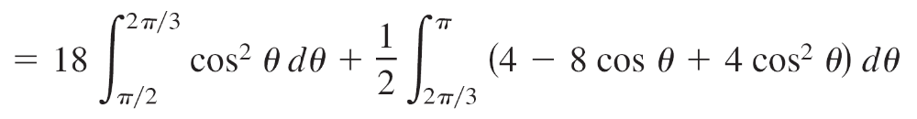
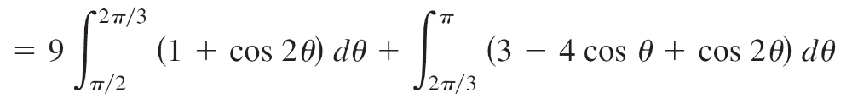
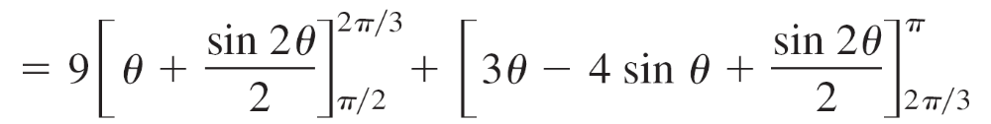
Example 3 – Solution
cont’d

Slide 20
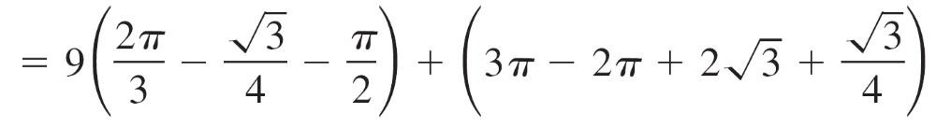
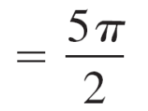
Example 3 – Solution
cont’d
Finally, multiplying by 2, you can conclude that the total area is
5π ≈ 15.7. Area of region inside circle and cardioid

Slide 21
Example 3 – Solution
cont’d
To check the reasonableness of this result, note that the area of the circular region is
πr² = 9π. Area of circle
So, it seems reasonable that the area of the region lying inside the circle and the cardioid is 5π.

Slide 22
Arc Length in Polar Form

Slide 23
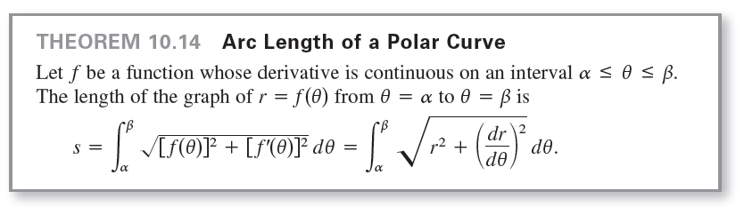
Arc Length in Polar Form
The formula for the length of a polar arc can be obtained from the arc length formula for a curve described by parametric equations.

Slide 24
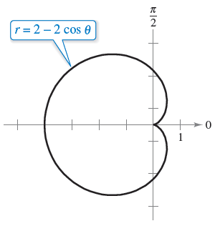
Example 4 – Finding the Length of a Polar Curve
Find the length of the arc from θ = 0 to θ = 2π for the cardioid
r = f(θ) = 2 – 2 cos θ
as shown in Figure 10.55.
Figure 10.55

Slide 25




Example 4 – Solution
Because f'(θ) = 2 sin θ, you can find the arc length as follows.

Slide 26
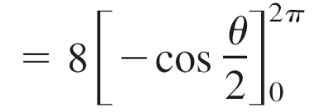


Example 4 – Solution
cont’d
Using Figure 10.55, you can determine the reasonableness of this answer by comparing it with the circumference of a circle.
For example, a circle of radius 5/2 has a circumference of
5π ≈ 15.7.

Slide 27


Example 4 – Solution
cont’d
Note that in the fifth step of the solution, it is legitimate to write
rather than
because sin (θ/2) ≥ 0 for 0 ≤ θ ≤ 2π.

Slide 28
Area of a Surface of Revolution

Slide 29
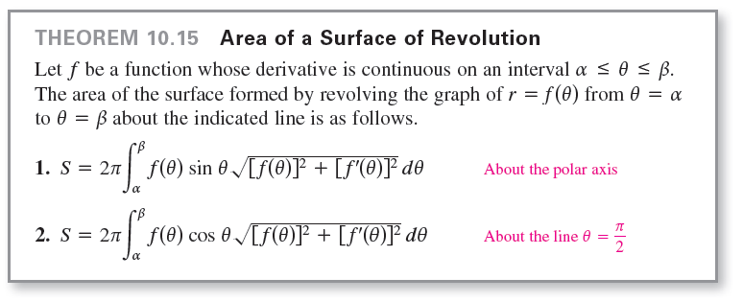
Area of a Surface of Revolution
The polar coordinate versions of the formulas for the area of a surface of revolution can be obtained from the parametric versions, using the equations x = r cos θ and
y = r sin θ.

Slide 30
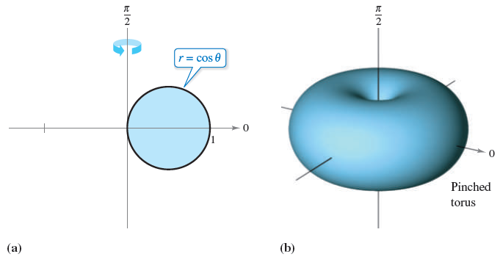
Example 5 – Finding the Area of a Surface of Revolution
Find the area of the surface formed by revolving the circle r = f(θ) = cos θ about the line θ = π/2, as shown in Figure 10.56.
Figure 10.56

Slide 31




Example 5 – Solution
Use the second formula in Theorem 10.15 with
f'(θ) = –sin θ. Because the circle is traced once as θ increases from 0 to π, you have

