Slide 1

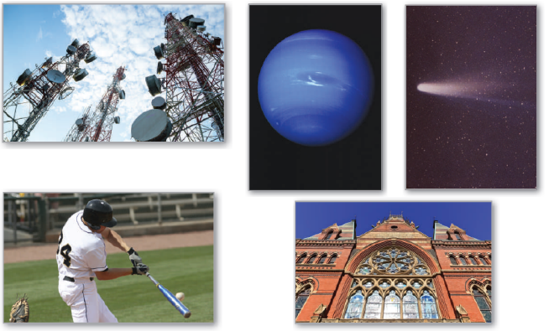
10
Conics, Parametric Equations,
and Polar Coordinates
P
Copyright © Cengage Learning. All rights reserved.

Slide 2

Polar Equations of Conics and Kepler’s Laws
10.6
Copyright © Cengage Learning. All rights reserved.

Slide 3
Objectives
Analyze and write polar equations of conics.
Understand and use Kepler’s Laws of planetary motion.

Slide 4
Polar Equations of Conics

Slide 5
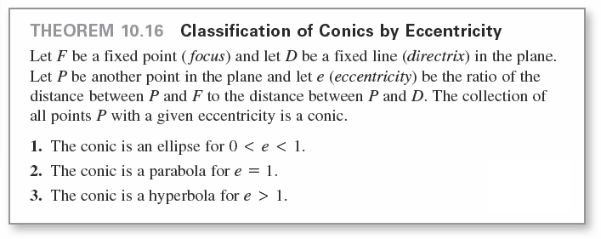
Polar Equations of Conics
The next theorem uses the concept of eccentricity to classify the three basic types of conics.

Slide 6
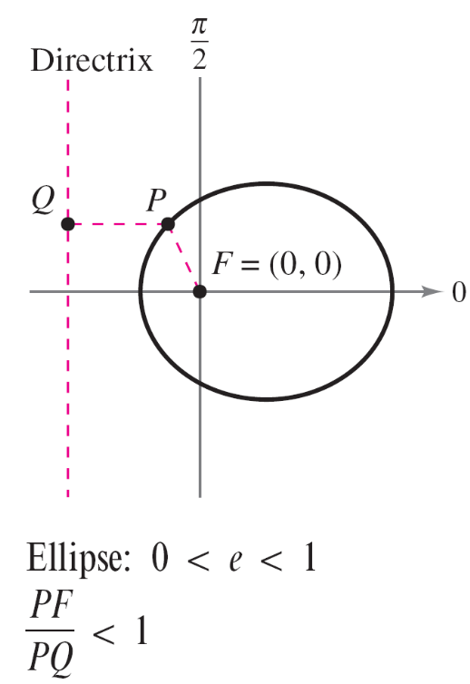
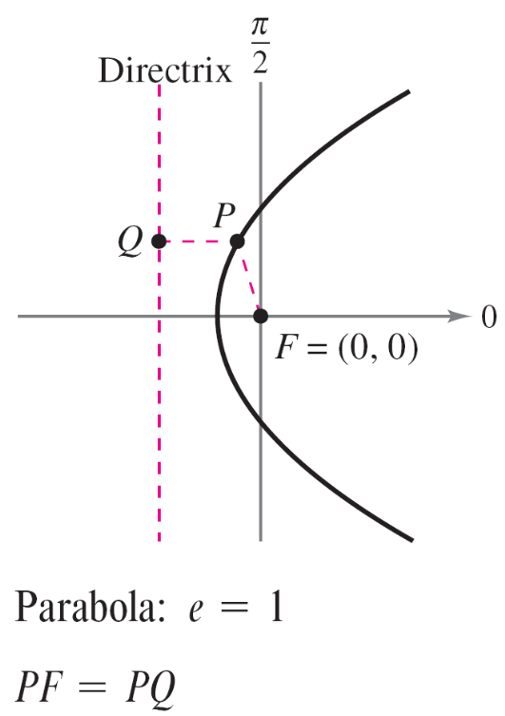
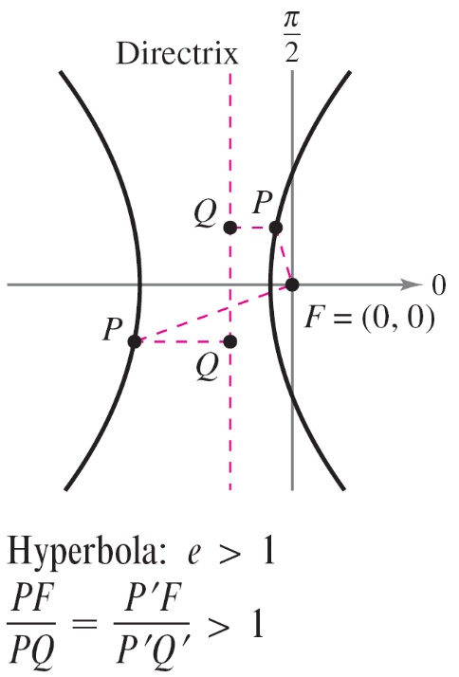
Polar Equations of Conics
In Figure 10.57, note that for each type of conic, the pole corresponds to the fixed point (focus) given in the definition.
Figure 10.57

Slide 7
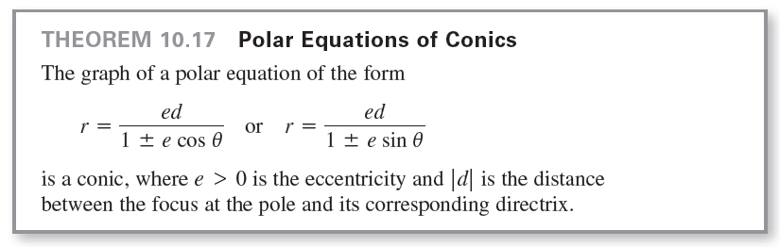
Polar Equations of Conics

Slide 8
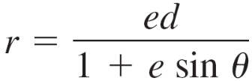
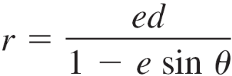
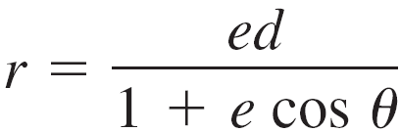
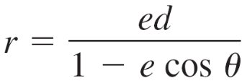
Polar Equations of Conics
The four types of equations indicated in Theorem 10.17
can be classified as follows, where d > 0.
a. Horizontal directrix above the pole:
b. Horizontal directrix below the pole:
c. Vertical directrix to the right of the pole:
d. Vertical directrix to the left of the pole:

Slide 9
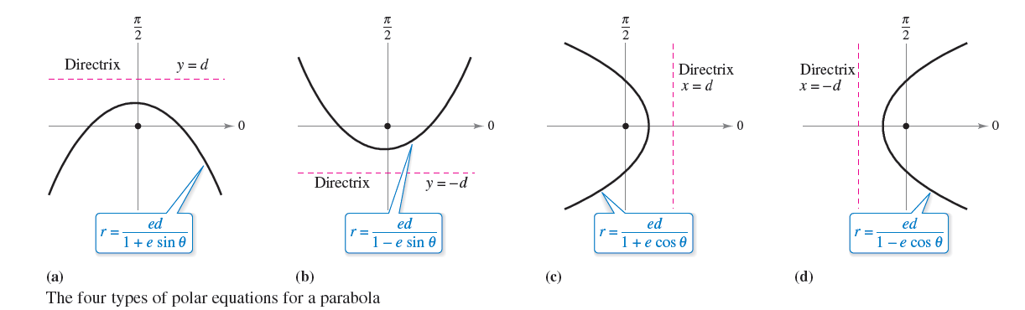
Polar Equations of Conics
Figure 10.59 illustrates these four possibilities for a parabola.
Figure 10.59

Slide 10
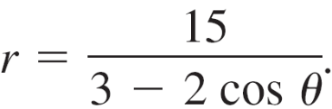
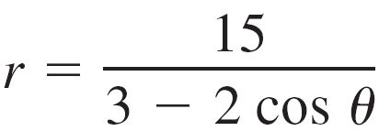

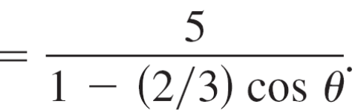


Example 1 – Determining a Conic from Its Equation
Sketch the graph of the conic
Solution:
To determine the type of conic, rewrite the equation as
So, the graph is an ellipse with .

Slide 11
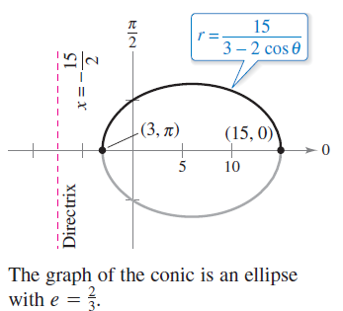
Example 1 – Solution
cont’d
You can sketch the upper half of the ellipse by plotting points from θ = 0 to θ = π, as shown in Figure 10.60. Then, using symmetry with respect to the polar axis, you can sketch the lower half.
Figure 10.60

Slide 12
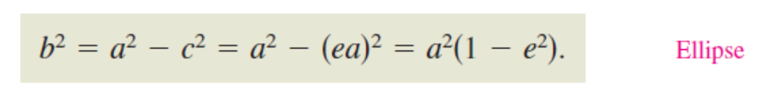
Polar Equations of Conics
For the ellipse in Figure 10.60, the major axis is horizontal and the vertices lie at (15, 0) and (3, π ).
So, the length of the major axis is 2a = 18. To find the length of the minor axis, you can use the equations e = c/a and b² = a² – c² to conclude that

Slide 13




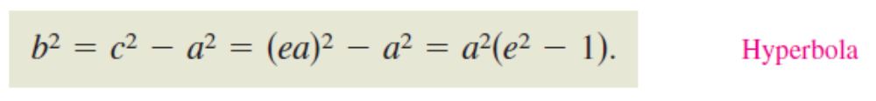
Polar Equations of Conics
Because , you have
which implies that . So, the length of the minor axis is . A similar analysis for hyperbolas yields

Slide 14
Kepler’s Laws

Slide 15
Kepler’s Laws
Kepler’s Laws, named after the German astronomer Johannes Kepler, can be used to describe the orbits of the planets about the sun.
1. Each planet moves in an elliptical orbit with the sun as a
focus.
2. A ray from the sun to the planet sweeps out equal areas
of the ellipse in equal times.
3. The square of the period is proportional to the cube of
the mean distance between the planet and the sun.

Slide 16
Kepler’s Laws
Although Kepler derived these laws empirically, they were later validated by Newton.
In fact, Newton was able to show that each law can be deduced from a set of universal laws of motion and gravitation that govern the movement of all heavenly bodies, including comets and satellites.

Slide 17
Example 3 – Halley’s Comet
Halley’s comet has an elliptical orbit with the sun at one focus and has an eccentricity of e ≈ 0.967. The length of the major axis of the orbit is approximately 35.88
astronomical units (AU). (An astronomical unit is defined as the mean distance between Earth and the sun, which is 93 million miles.) Find a polar equation for the orbit. How close does Halley’s comet come to the sun?

Slide 18
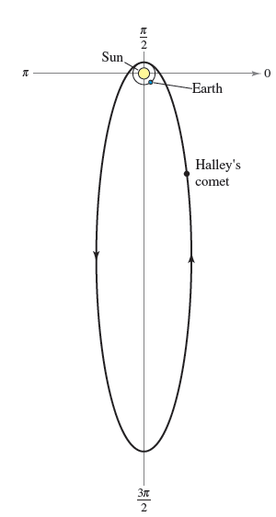
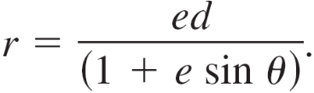
Example 3 – Solution
Using a vertical axis, you can choose an equation of the form
Because the vertices of the ellipse
occur when θ = π /2 and θ = 3π /2,
you can determine the length of the
major axis to be the sum of the
r-values of the vertices,
as shown in Figure 10.62.
Figure 10.62

Slide 19
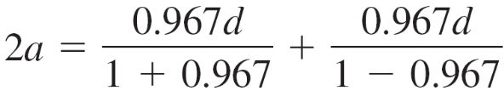



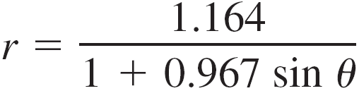
Example 3 – Solution
cont’d
That is,
So, and .
Using this value in the equation produces
where r is measured in astronomical units.
To find the closest point to the sun (the focus), you can write .

Slide 20


Example 3 – Solution
cont’d
Because c is the distance between the focus and the center, the closest point is

Slide 21
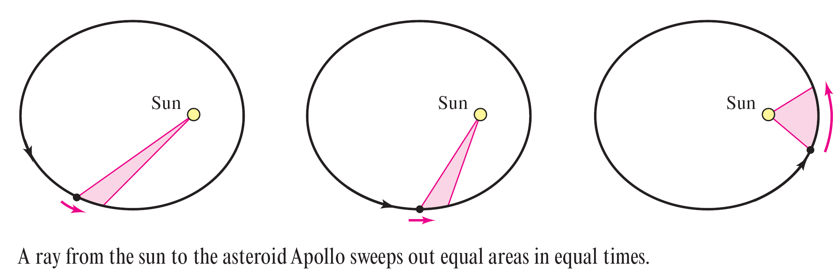
Kepler’s Laws
Kepler’s Second Law states that as a planet moves about the sun, a ray from the sun to the planet sweeps out equal areas in equal times. This law can also be applied to comets or asteroids with elliptical orbits. For example, Figure 10.63 shows the orbit of the asteroid Apollo about the sun.
Figure 10.63

Slide 22
Kepler’s Laws
Applying Kepler’s Second Law to this asteroid, you know that the closer it is to the sun, the greater its velocity, because a short ray must be moving quickly to sweep out as much area as a long ray.

Slide 23
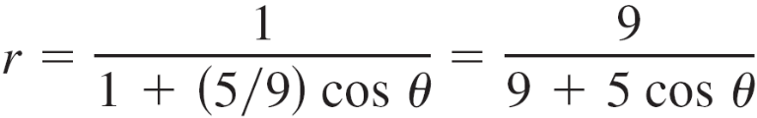
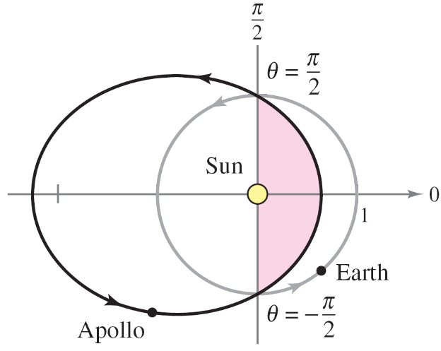
Example 4 – The Asteroid Apollo
The asteroid Apollo has a period of about 661 Earth days, and its orbit is approximated by the ellipse
where r is measured in astronomical units.
How long does it take Apollo to
move from the position
θ = –π /2 to θ = π /2, as shown in
Figure 10.64?
Figure 10.64

Slide 24
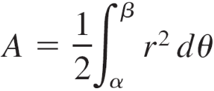
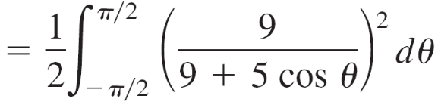

Example 4 – Solution
Begin by finding the area swept out as θ increases from –π /2 to π /2.
Using the substitution u = tan(θ /2), you obtain

Slide 25

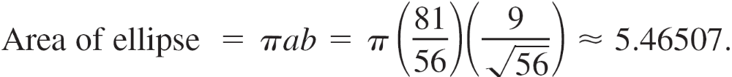
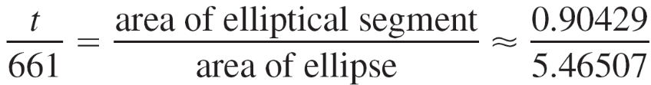
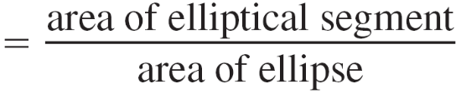

Example 4 – Solution
cont’d
Because the major axis of the ellipse has length 2a = 81/28
and the eccentricity is e = 5/9, you can determine that
.
So, the area of the ellipse is
Because the time required to complete the orbit is 661 days, you can apply Kepler’s Second Law to conclude that the time t required to move from the position θ = –π /2 to θ = π /2 is
which implies that

