Slide 1


11
Vectors and the Geometry of Space
P
Copyright © Cengage Learning. All rights reserved.

Slide 2

11.1
Vectors in the Plane
Copyright © Cengage Learning. All rights reserved.

Slide 3
Objectives
Write the component form of a vector.
Perform vector operations and interpret the results geometrically.
Write a vector as a linear combination of standard unit vectors.

Slide 4
Component Form of a Vector

Slide 5
Component Form of a Vector
Many quantities in geometry and physics, such as area, volume, temperature, mass, and time, can be characterized by a single real number that is scaled to appropriate units of measure. These are called scalar quantities, and the real number associated with each is called a scalar.
Other quantities, such as force, velocity, and acceleration, involve both magnitude and direction and cannot be characterized completely by a single real number.

Slide 6
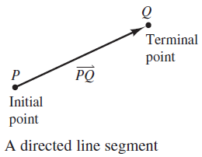

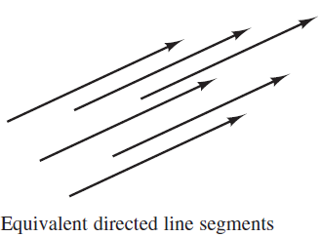

Component Form of a Vector
A directed line segment is used to
represent such a quantity, as shown
in Figure 11.1.
The directed line segment has
initial point P and terminal point
Q, and its length (or magnitude) is
denoted by
Directed line segments that have
the same length and direction are
equivalent, as shown in Figure 11.2.
Figure 11.1
Figure 11.2

Slide 7


Component Form of a Vector
The set of all directed line segments that are equivalent to a given directed line segment is a vector in the plane and is denoted by v = .
In typeset material, vectors are usually denoted by lowercase, boldface letters such as u, v, and w.
When written by hand, however, vectors are often denoted
by letters with arrows above them, such as and

Slide 8
Component Form of a Vector
Be sure that you understand that a vector represents a set of directed line segments (each having the same length and direction).
In practice, however, it is common not to distinguish between a vector and one of its representatives.

Slide 9
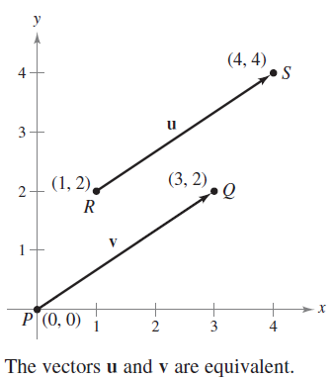
Example 1 – Vector Representation: Directed Line Segments
Let v be represented by the directed line segment from
(0, 0) to (3, 2), and let u be represented by the directed line segment from (1, 2) to (4, 4). Show that v and u are
equivalent.
Solution:
Let P(0, 0) and Q(3, 2) be the initial
and terminal points of v, and let
R(1, 2) and S(4, 4) be the initial and
terminal points of u, as shown
in Figure 11.3.
Figure 11.3

Slide 10


Example 1 – Solution
cont’d
You can use the Distance Formula to show that and
have the same length.
Both line segments have the same direction, because they both are directed toward the upper right on lines having the same slope.

Slide 11


Example 1 – Solution
cont’d
and
Because and have the same length and direction,
you can conclude that the two vectors are equivalent.
That is, v and u are equivalent.

Slide 12
Component Form of a Vector
The directed line segment whose initial point is the origin is often the most convenient representative of a set of equivalent directed line segments such as those shown in Figure 11.3.
Figure 11.3

Slide 13
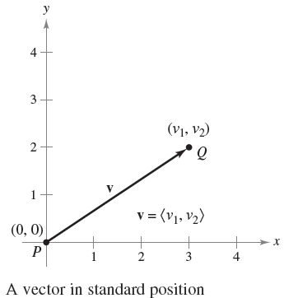
Component Form of a Vector
This representation of v is said to be in standard position. A directed line segment whose initial point is the origin can be uniquely represented by the coordinates of its terminal point Q(v₁, v₂), as shown in Figure 11.4.
Figure 11.4

Slide 14
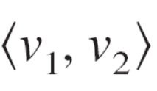
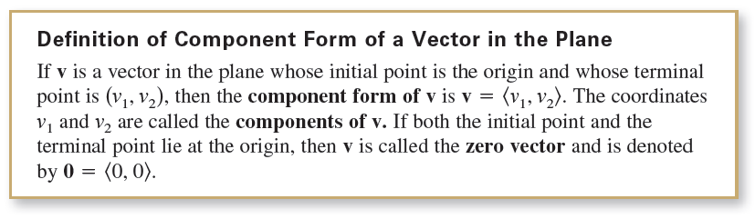
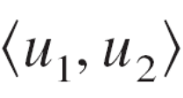
Component Form of a Vector
In the definition, note the difference in the notation between
the component form of a vector v = and the point
.
This definition implies that two vectors u = and
v = are equal if and only if u₁ = v₁ and u₂ = v₂.

Slide 15

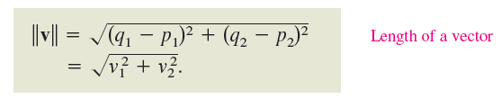
Component Form of a Vector
The procedures listed below can be used to convert directed line segments to component form or vice versa.
If P(p₁, p₂) and Q(q₁, q₂) are the initial and terminal points of a directed line segment, then the component form of the vector v represented by is
Moreover, from the Distance Formula, you can see that the length (or magnitude) of v is

Slide 16
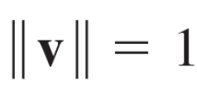
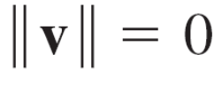
Component Form of a Vector
2. If v = , then v can be represented by the directed
line segment, in standard position, from P(0, 0) to
Q(v₁, v₂).
The length of v is called the norm of v. If , then
v is a unit vector.
Moreover, if and only if v is the zero vector 0.

Slide 17
Vector Operations

Slide 18
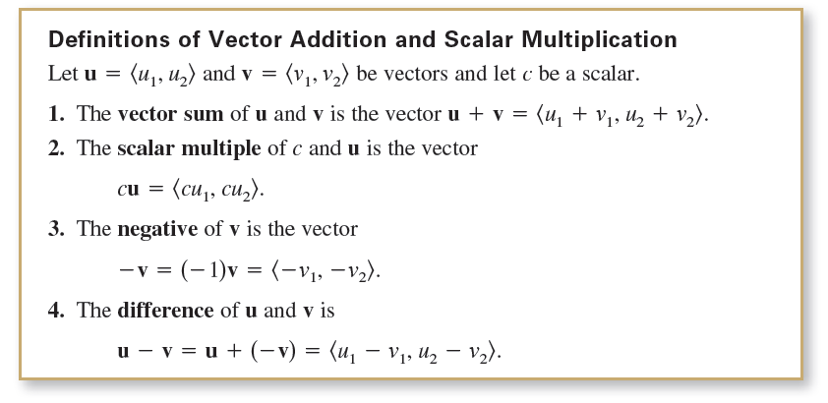
Vector Operations

Slide 19
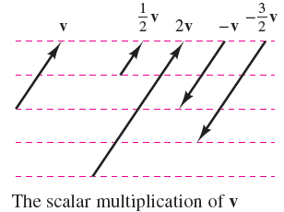
Vector Operations
Geometrically, the scalar multiple of a vector v and a scalar c is the vector that is |c| times as long as v, shown in Figure 11.6.
If c is positive, then cv has the same direction as v. If c is negative, then cv has the opposite direction.
Figure 11.6

Slide 20
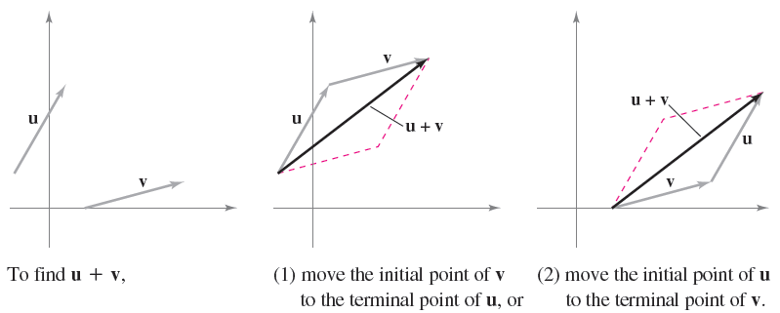
Vector Operations
The sum of two vectors can be represented geometrically by positioning the vectors (without changing their magnitudes or directions) so that the initial point of one coincides with the terminal point of the other, as shown in Figure 11.7.
Figure 11.7

Slide 21
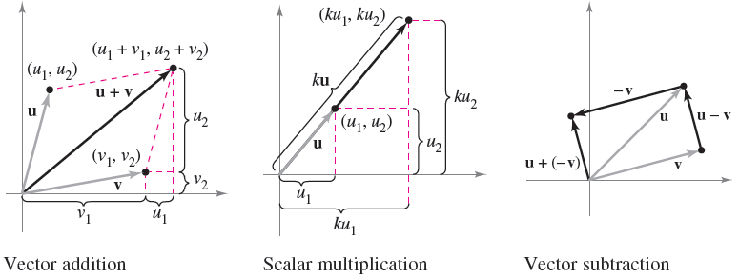
Vector Operations
The vector u + v, called the resultant vector, is the diagonal of a parallelogram having u and v as its adjacent sides. Figure 11.8 shows the equivalence of the geometric and algebraic definitions of vector addition and scalar multiplication and presents (at far right) a geometric interpretation of u – v.
Figure 11.8

Slide 22
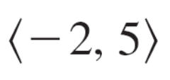
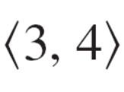


Example 3 – Vector Operations
For v = and w = , find each of the vectors.
Solution:
a.
b.

Slide 23


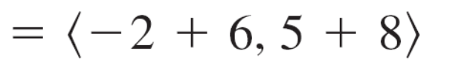

Example 3 – Solution
cont’d
c. Using 2w = you have

Slide 24
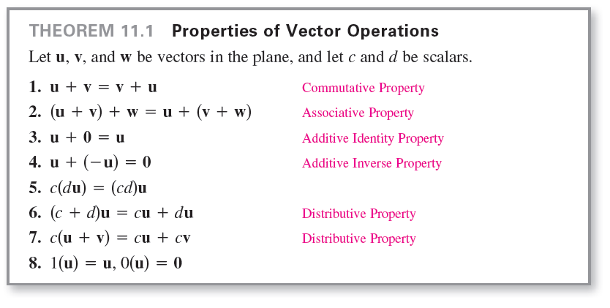
Vector Operations

Slide 25
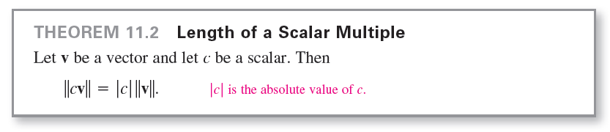
Vector Operations
Any set of vectors (with an accompanying set of scalars) that satisfies the eight properties listed in Theorem 11.1 is a vector space. The eight properties are the vector space axioms. So, this theorem states that the set of vectors in the plane (with the set of real numbers) forms a vector space.

Slide 26
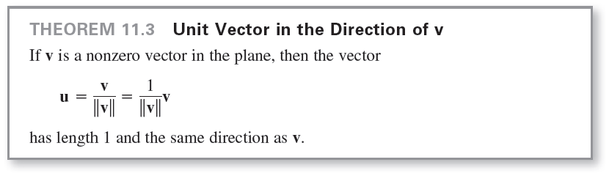
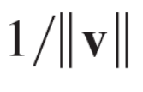
Vector Operations
In Theorem 11.3, u is called a unit vector in the direction of v. The process of multiplying v by to get a unit vector is called normalization of v.
In many applications of vectors, it is useful to find a unit vector that has the same direction as a given vector. The next theorem gives a procedure for doing this.

Slide 27
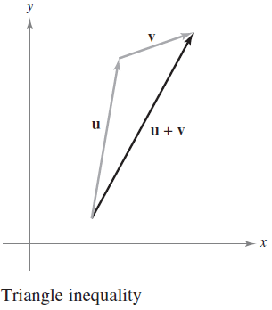
Vector Operations
Generally, the length of the sum of two vectors is not equal to the sum of their lengths.
To see this, consider the vectors u and v as shown in Figure 11.9.
Figure 11.9

Slide 28
Vector Operations
With u and v as two sides of a triangle, the length of the third side is ||u + v||, and
||u + v|| ≤ ||u|| + ||v||.
Equality occurs only when the vectors u and v have the same direction.
This result is called the triangle inequality for vectors.

Slide 29
Standard Unit Vectors

Slide 30



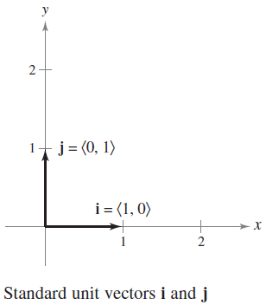
Standard Unit Vectors
The unit vectors and are called the standard unit vectors in the plane and are denoted by
as shown in Figure 11.10.
Figure 11.10

Slide 31
Standard Unit Vectors
These vectors can be used to represent any vector uniquely, as follows.
The vector v = v₁i + v₂ j is called a linear combination
of i and j.
The scalars v₁ and v₂ are called the horizontal and vertical components of v.

Slide 32





Example 5 – Writing a Linear Combination of Unit Vectors
Let u be the vector with initial point (2, –5) and terminal point (–1, 3), and let v = 2i – j. Write each vector as a linear combination of i and j.
a. u b. w = 2u – 3v
Solution:
a. u =
b. w =

Slide 33
Standard Unit Vectors
Vectors have many applications in physics and engineering. One example is force.
A vector can be used to represent force, because force has both magnitude and direction.
If two or more forces are acting on an object, then the resultant force on the object is the vector sum of the vector forces.

Slide 34
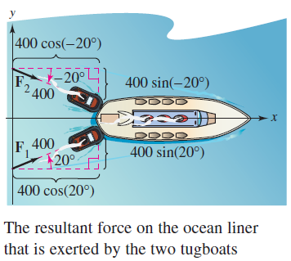
Example 7 – Finding the Resultant Force
Two tugboats are pushing an ocean liner, as shown in Figure 11.12. Each boat is exerting a force of 400 pounds. What is the resultant force on the ocean liner?
Figure 11.12

Slide 35




Example 7 – Solution
Using Figure 11.12, you can represent the forces exerted
by the first and second tugboats as
F₁ =
=
F₂ =
=

Slide 36

Example 7 – Solution
cont’d
The resultant force on the ocean liner is
F = F₁ + F₂
=
=
So, the resultant force on the ocean liner is approximately 752 pounds in the direction of the positive x-axis.

Slide 37
Standard Unit Vectors
In surveying and navigation, a bearing is a direction that measures the acute angle that a path or line of sight makes with a fixed north-south line.
In air navigation, bearings are measured in degrees clockwise from north.

