Slide 1


11
Vectors and the Geometry of Space
P
Copyright © Cengage Learning. All rights reserved.

Slide 2

Space Coordinates and Vectors in Space
11.2
Copyright © Cengage Learning. All rights reserved.

Slide 3
Objectives
Understand the three-dimensional rectangular coordinate system.
Analyze vectors in space.

Slide 4
Coordinates in Space

Slide 5
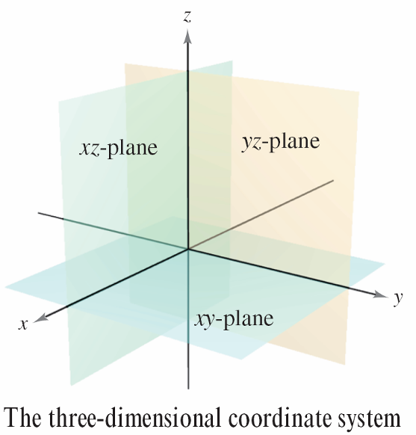
Coordinates in Space
Before extending the concept of a vector to three dimensions, you must be able to identify points in the three-dimensional coordinate system. You can construct this system by passing a z-axis perpendicular to both the x-and y-axes at the origin, as shown in
Figure 11.14.
Taken as pairs, the axes determine three coordinate planes: the xy-plane, the xz-plane, and the yz-plane.
Figure 11.14

Slide 6
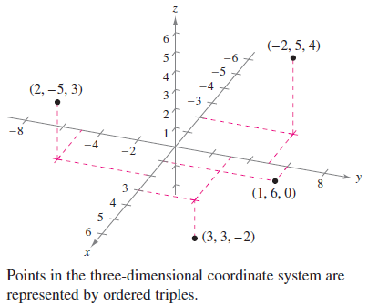
Coordinates in Space
These three coordinate planes separate three-space into eight octants.
The first octant is the one for which all three coordinates are positive. In this three dimensional system, a point P in space is determined by an ordered triple (x, y, z), where x, y, and z are as follows.
x = directed distance from yz-plane to P
y = directed distance from xz-plane to P
z = directed distance from xy-plane to P
Several points are shown in Figure 11.15.
Figure 11.15

Slide 7
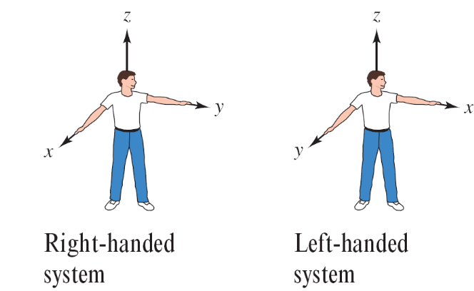
Coordinates in Space
A three-dimensional coordinate system can have either a right-handed or a left-handed orientation. To determine the orientation of a system, imagine that you are standing at the origin, with your arms pointing in the direction of the positive x- and y-axes and with the positive z-axis pointing up, as shown in Figure 11.16.
The system is right-handed or
left-handed depending on which
hand points along the x-axis.
In this text, you will work
exclusively with the right
handed system.
Figure 11.16

Slide 8
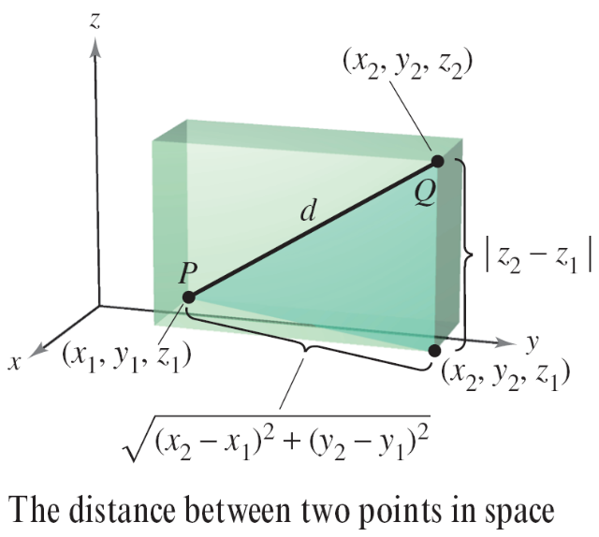
Coordinates in Space
Many of the formulas established for the two-dimensional coordinate system can be extended to three dimensions.
For example, to find the distance between two points in space, you can use the Pythagorean Theorem twice, as shown in Figure 11.17.
Figure 11.17

Slide 9

Coordinates in Space
By doing this, you will obtain the formula for the distance between the points (x₁, y₁, z₁) and (x₂, y₂, z₂).

Slide 10



Example 1 – Finding the Distance Between Two Points in Space
Find the distance between the points (2, –1, 3) and
(1, 0, –2).
Solution:

Slide 11
Coordinates in Space
A sphere with center at (x₀, y₀, z₀) and radius r is defined to be the set of all points (x, y, z) such that the distance between (x, y, z) and (x₀, y₀, z₀) is r.
You can use the Distance Formula to find the standard equation of a sphere of radius r, centered at (x₀, y₀, z₀).

Slide 12
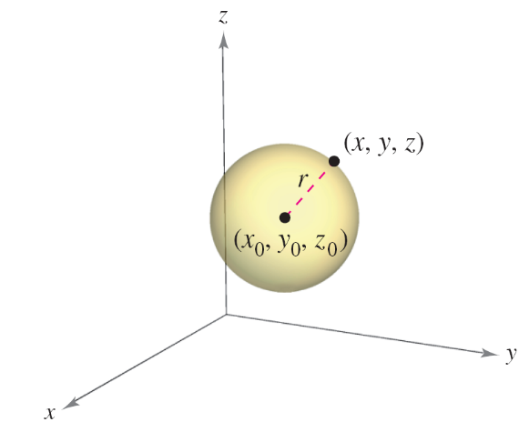
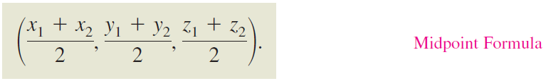
Coordinates in Space
If (x, y, z) is an arbitrary point on the sphere, then the equation of the sphere is
as shown in Figure 11.18.
Moreover, the midpoint of the
line segment joining the
points (x₁, y₁, z₁) and (x₂, y₂, z₂)
has coordinates
Figure 11.18

Slide 13
Vectors in Space

Slide 14
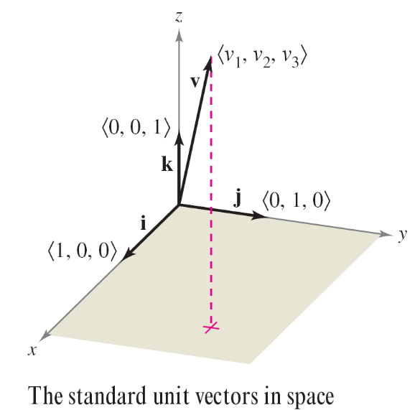

Vectors in Space
In space, vectors are denoted by ordered triples
v = v₁, v₂, v₃ . The zero vector is denoted by
0 = 0, 0, 0 . Using the unit vectors i = 1, 0, 0 ,
j = 0, 1, 0 , and k = 0, 0,1 the standard unit vector
notation for v is
as shown in Figure 11.19.
Figure 11.19

Slide 15
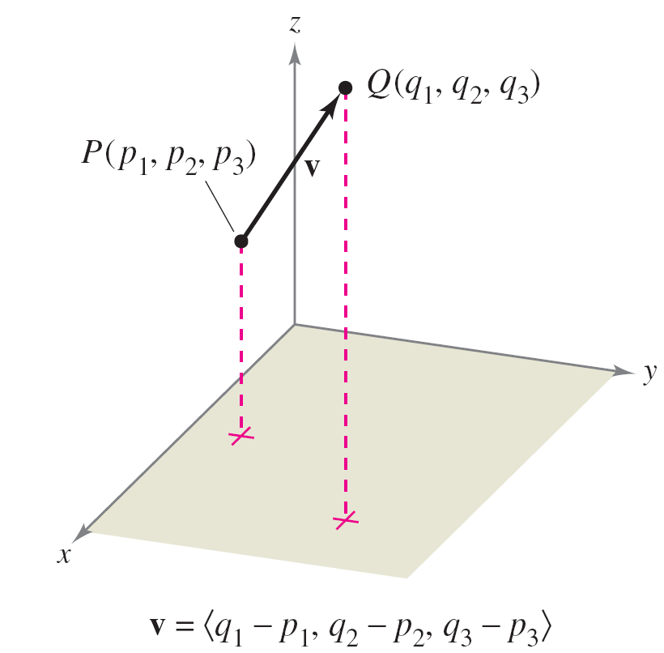
Vectors in Space
If v is represented by the directed line segment from P(p₁, p₂, p₃) to Q(q₁, q₂, q₃), as shown in Figure 11.20, then the component form of v is written by subtracting the coordinates of the initial point from the coordinates of the terminal point, as follows.
v = v₁, v₂, v₃
= q₁ – p_{1,} q₂ – p_{2,} q₃ – p₃
Figure 11.20

Slide 16
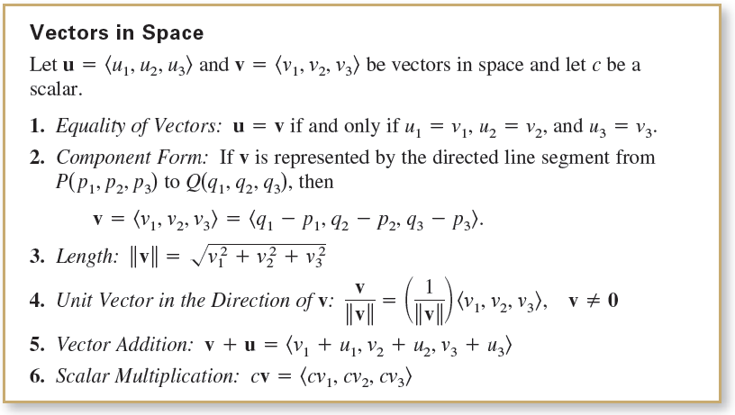
Vectors in Space

Slide 17
Example 3 – Finding the Component Form of a Vector in Space
Find the component form and magnitude of the vector v having initial point (–2, 3 ,1) and terminal point (0,–4, 4). Then find a unit vector in the direction of v.
Solution:
The component form of v is
v = q₁ – p_{1,} q₂ – p_{2,} q₃ – p₃ = 0 – (–2), –4 – 3, 4 – 1
= 2, –7, 3
which implies that its magnitude is

Slide 18
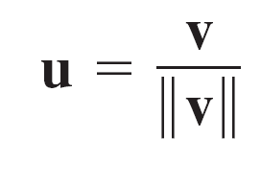
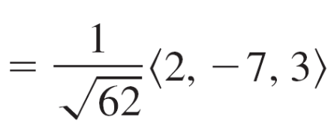
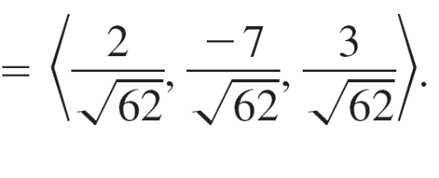
Example 3 – Solution
cont’d
The unit vector in the direction of v is

Slide 19
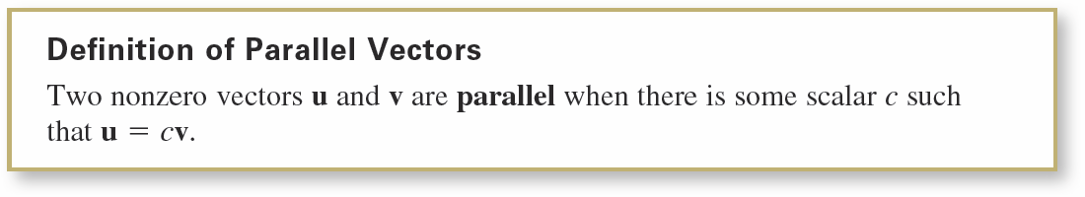
Vectors in Space
Recall from the definition of scalar multiplication that positive scalar multiples of a nonzero vector v have the same direction as v, whereas negative multiples have the direction opposite of v.
In general, two nonzero vectors u and v are parallel when there is some scalar c such that u = cv.

Slide 20
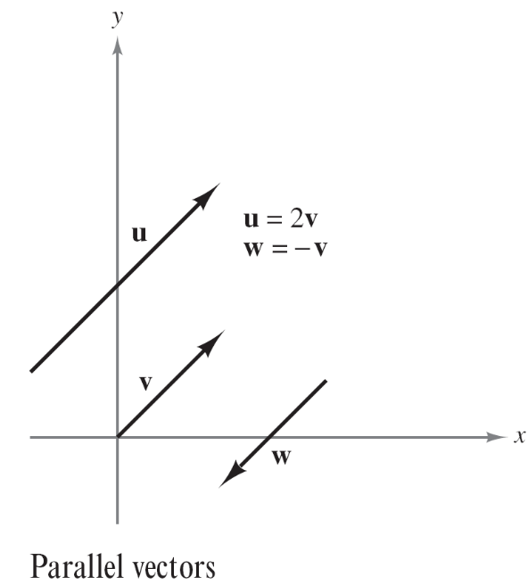
Vectors in Space
For example, in Figure 11.21, the vectors u, v, and w are
parallel because
u = 2v and w = –v.
Figure 11.21

Slide 21

Example 4 – Parallel Vectors
Vector w has initial point (2, –1, 3) and terminal point
(–4, 7, 5). Which of the following vectors is parallel to w?
u = 3, –4, –1
v = 12, –16, 4
Solution:
Begin by writing w in component form.
w = – 4 – 2, 7 – (– 1), 5 – 3 = – 6, 8, 2
a. Because u = 3, – 4, – 1 = – – 6, 8, 2 = – w, you can conclude that u is parallel to w.

Slide 22




Example 4 – Solution
cont’d
b. In this case, you want to find a scalar c such that
To find c, equate the corresponding components and
solve as shown.
Note that c = –2 for the first two components and c = 2
for the third component.
This means that the equation
has no solution, and the vectors are not parallel.

