Slide 1


11
Vectors and the Geometry of Space
P
Copyright © Cengage Learning. All rights reserved.

Slide 2

The Dot Product of Two Vectors
11.3
Copyright © Cengage Learning. All rights reserved.

Slide 3
Objectives
Use properties of the dot product of two vectors.
Find the angle between two vectors using the dot product.
Find the direction cosines of a vector in space.
Find the projection of a vector onto another vector.
Use vectors to find the work done by a constant force.

Slide 4
The Dot Product

Slide 5
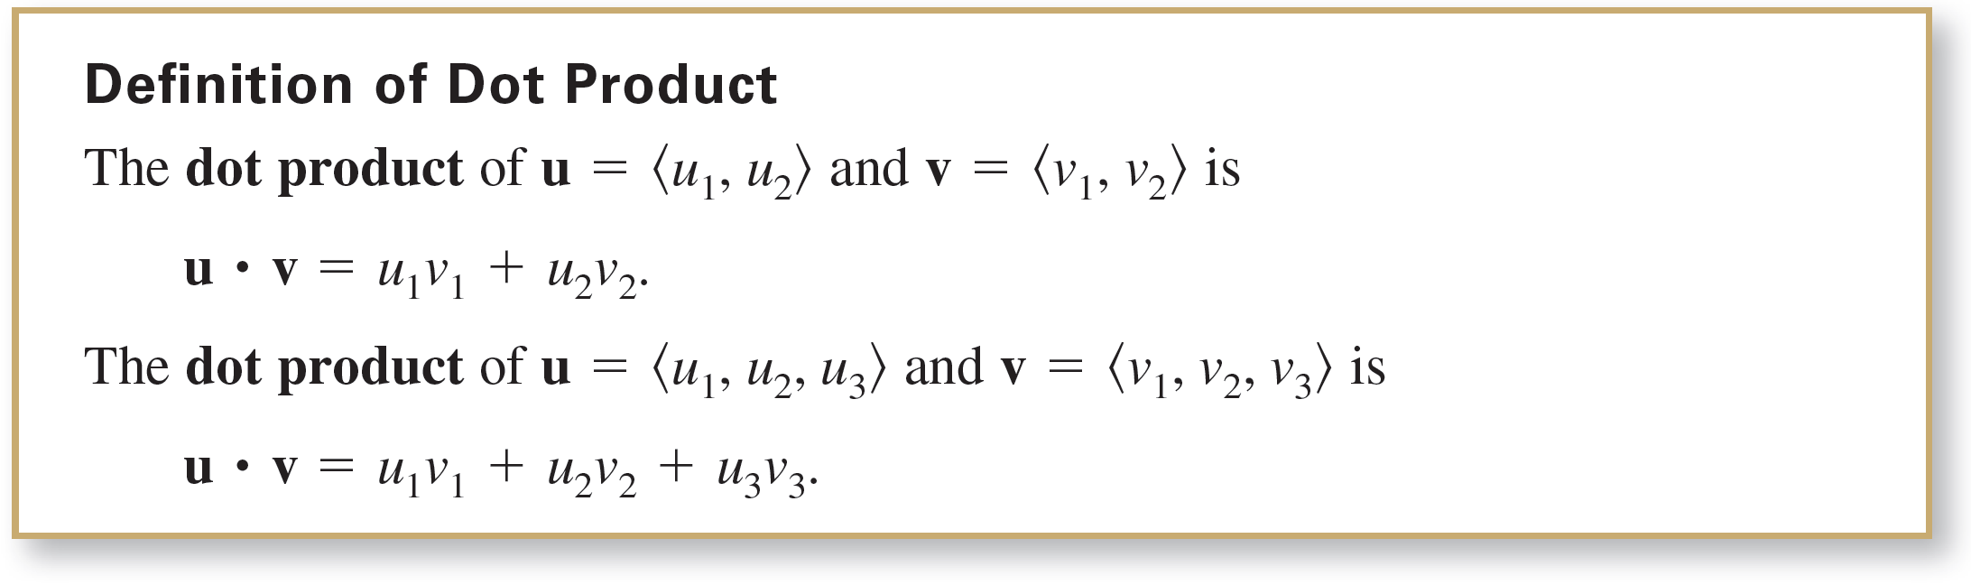
The Dot Product
You have studied two operations with vectors—vector addition and multiplication by a scalar—each of which yields another vector. In this section you will study a third vector operation, the dot product. This product yields a scalar, rather than a vector.

Slide 6
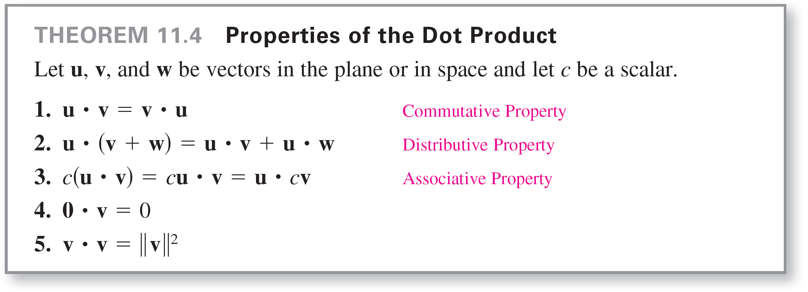
The Dot Product

Slide 7



Example 1 – Finding Dot Products
Let , and .
a.
b.
c.
d.
Notice that the result of part (b) is a vector quantity, whereas the results of the other three parts are scalar quantities.

Slide 8
Angle Between Two Vectors

Slide 9
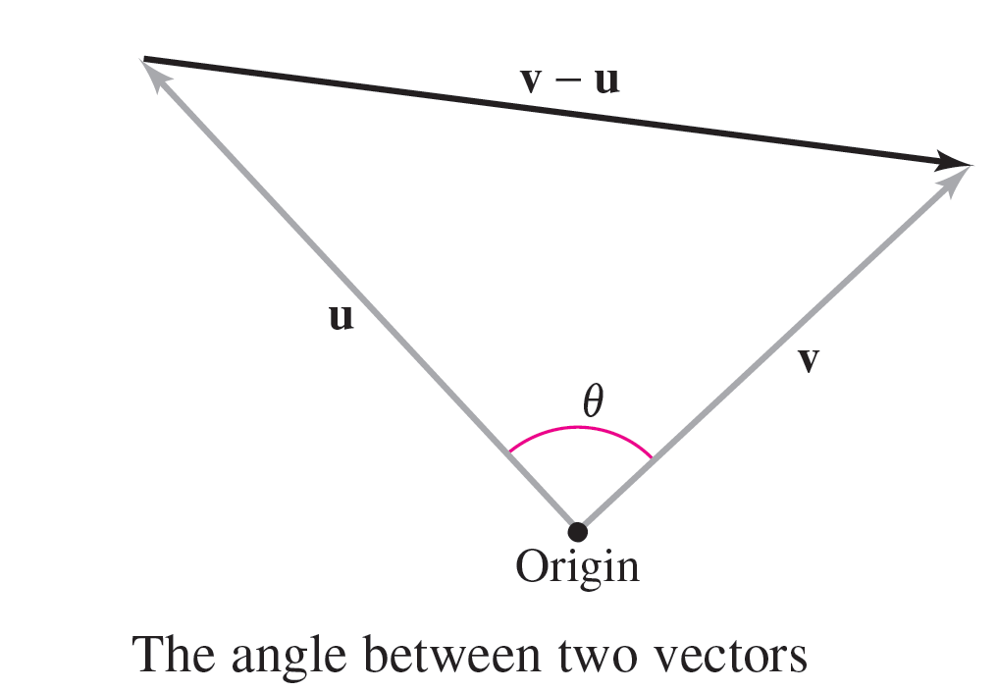
Angle Between Two Vectors
The angle between two nonzero vectors is the angle θ, 0 ≤ θ ≤ π, between their respective standard position vectors, as shown in Figure 11.24. The next theorem shows how to find this angle using the dot product.
Figure 11.24

Slide 10
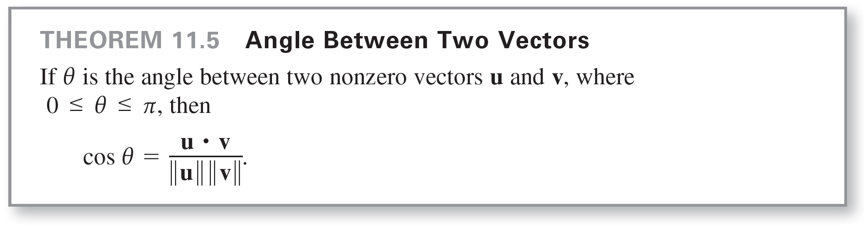
Angle Between Two Vectors
Note in Theorem 11.5 that because ||u|| and ||v|| are always positive, u  v and cos θ will always have the same sign.

Slide 11
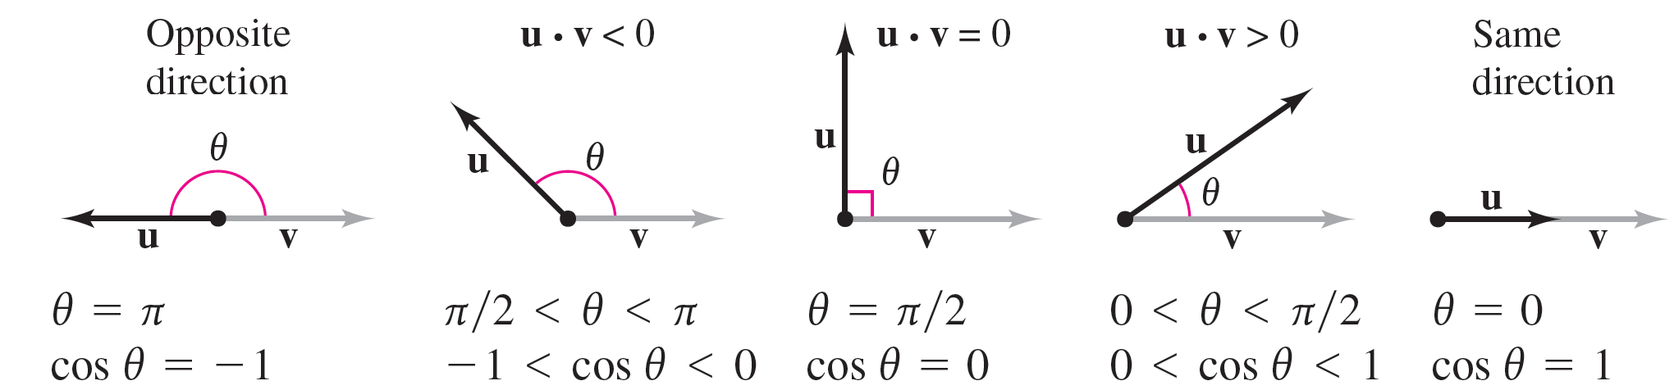
Angle Between Two Vectors
Figure 11.25 shows the possible orientations of two vectors.
Figure11.25

Slide 12
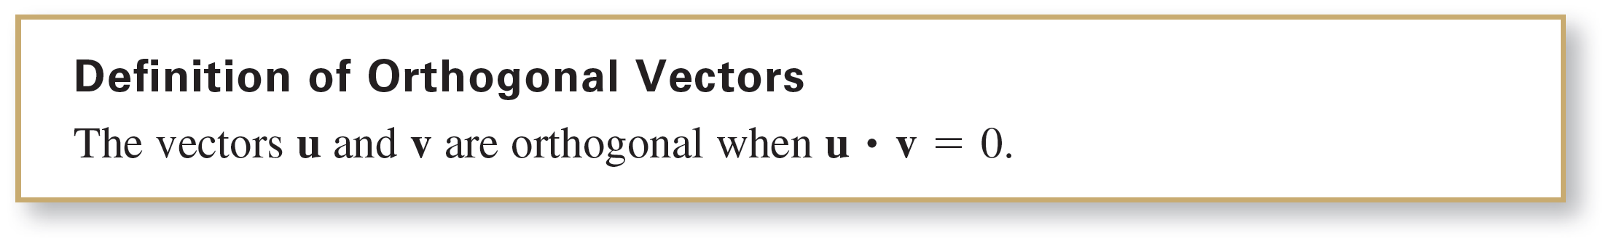
Angle Between Two Vectors
From Theorem 11.5, you can see that two nonzero vectors meet at a right angle if and only if their dot product is zero. Two such vectors are said to be orthogonal.

Slide 13
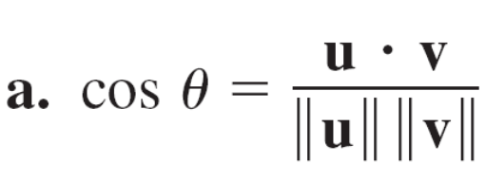
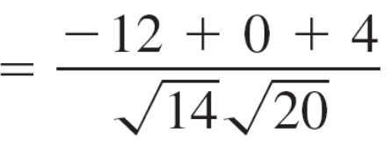
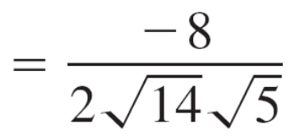
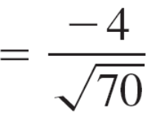
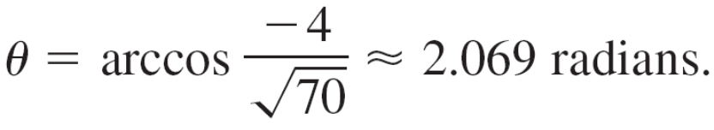
Example 2 – Finding the Angle Between Two vectors
For u = 3, –1, 2 , v = –4, 0 ,2 , w = 1, –1, –2 , and
z = 2, 0, –1 , find the angle between each pair of vectors.
a. u and v b. u and w c. v and z
Solution:
Because u  v < 0,

Slide 14
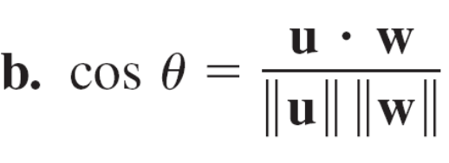
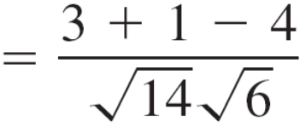
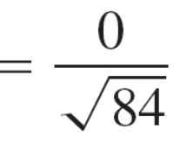
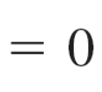
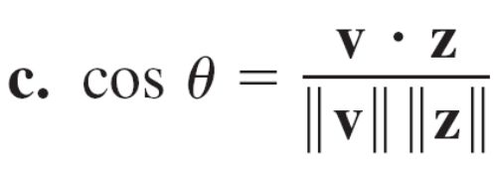
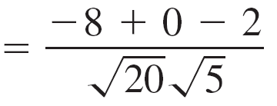
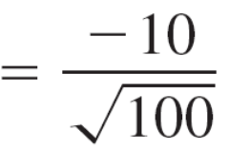
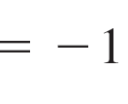
Example 2 – Solution
cont’d
Because u  w = 0 , u and w are orthogonal. So, θ = π/2.
Consequently, θ = π. Note that v and z are parallel,
with v = –2z.

Slide 15

Angle Between Two Vectors
When the angle between two vectors is known, rewriting Theorem 11.5 in the form
produces an alternative way to calculate the dot product.

Slide 16
Direction Cosines

Slide 17
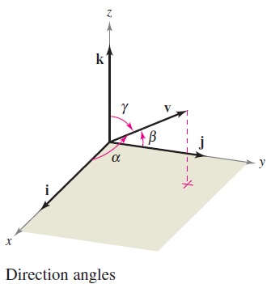
Direction Cosines
In space it is convenient to measure direction in terms of the angles between the nonzero vector v and the three unit vectors i, j, and k, and as shown in Figure 11.26.
Figure 11.26

Slide 18
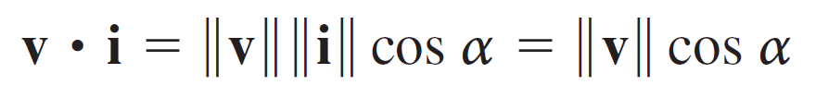
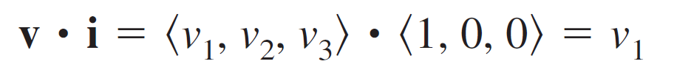
Direction Cosines
The angles α, β and γ are the direction angles of v, and cos α, cos β, and cos γ are the direction cosines of v.
Because
and
it follows that cos α = v₁/||v||.

Slide 19
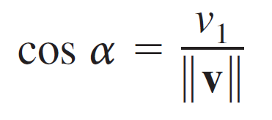
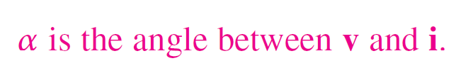
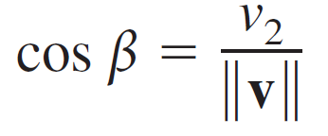

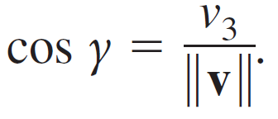

Direction Cosines
By similar reasoning with the unit vectors j and k, you have

Slide 20
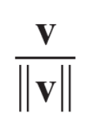
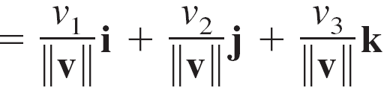

Direction Cosines
Consequently, any non zero vector v in space has the normalized form
and because v/ || v || is a unit vector, it follows that

Slide 21
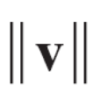
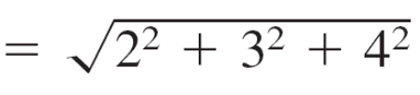

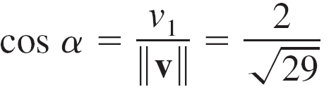
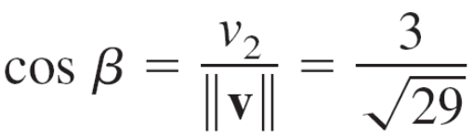

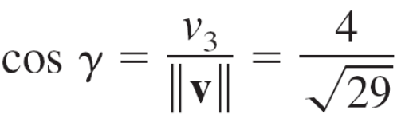

Example 4 – Finding Direction Angles
Find the direction cosines and angles for the vector v = 2i + 3j + 4k, and show that cos² α + cos² β + cos² γ = 1.
Solution:
Because
you can write the following.

Slide 22
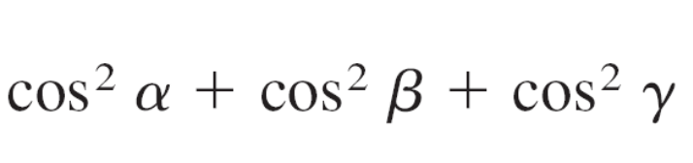
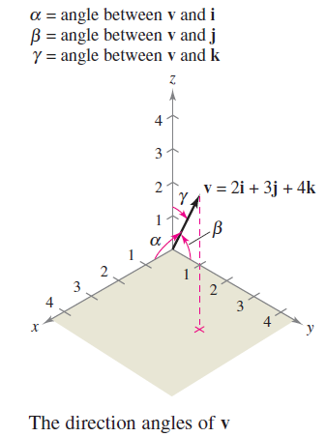
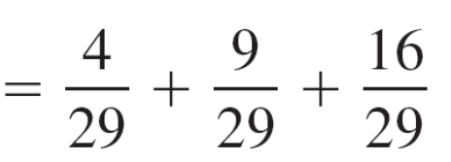
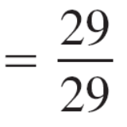

Example 4 – Solution
cont’d
Furthermore, the sum of the squares of the direction cosines is
See Figure 11.27.
Figure 11.27

Slide 23
Projections and Vector Components

Slide 24
Projections and Vector Components
You have already seen applications in which two vectors are added to produce a resultant vector.
Many applications in physics and engineering pose the reverse problem—decomposing a vector into the sum of two vector components.
The following physical example enables you to see the usefulness of this procedure.

Slide 25
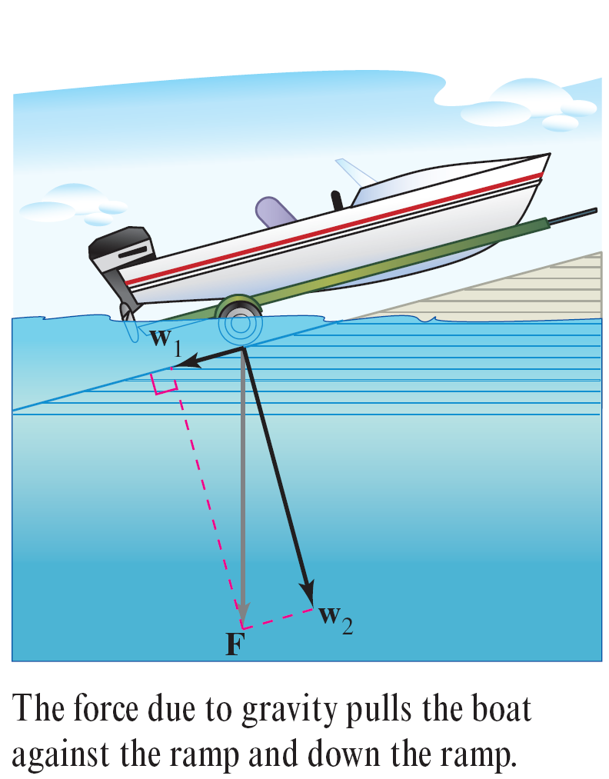
Projections and Vector Components
Consider a boat on an inclined ramp, as shown in Figure 11.28. The force F due to gravity pulls the boat down the ramp and against the ramp. These two forces, w₁and w₂, are orthogonal—they are called the vector components of F.
Figure 11.28

Slide 26
Projections and Vector Components
The forces w₁ and w₂ help you analyze the effect of gravity on the boat. For example, w₁ indicates the force necessary to keep the boat from rolling down the ramp, whereas w₂
indicates the force that the tires must withstand.

Slide 27
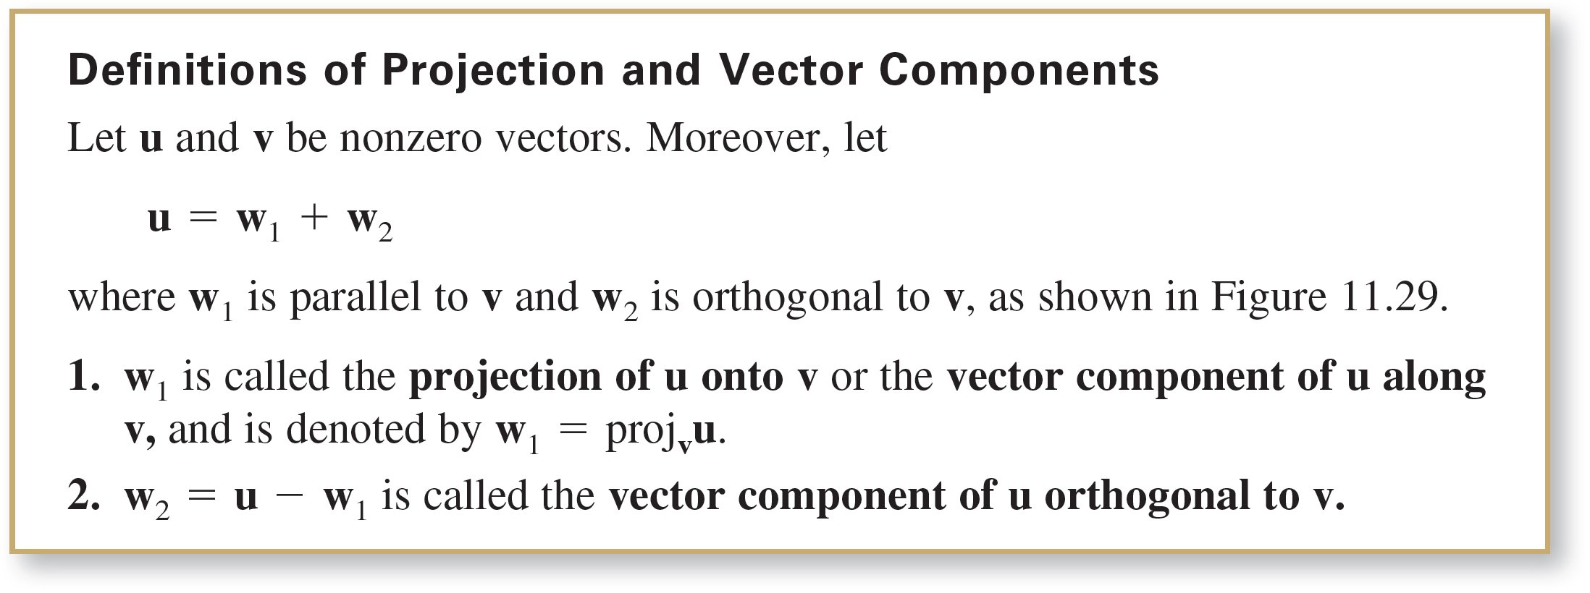
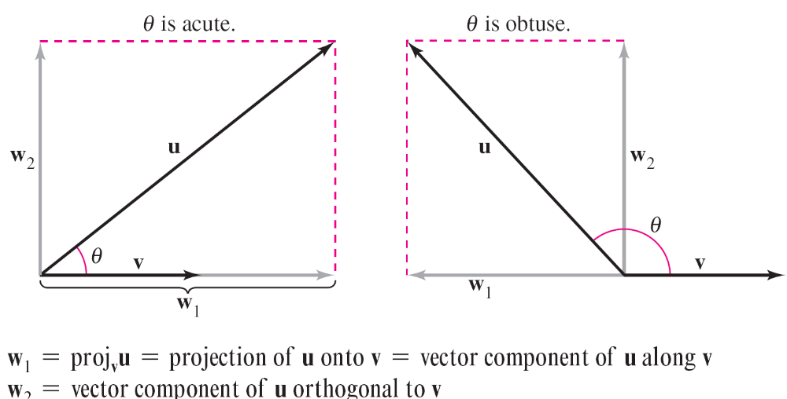
Projections and Vector Components
Figure 11.29

Slide 28



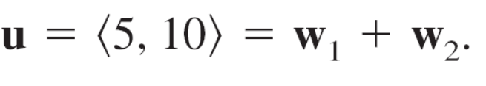



Example 5 – Finding a Vector Component of u Orthogonal to v
Find the vector component of that is orthogonal to , given that
and
Solution:
Because u = w₁ + w₂ , where w₁ is parallel to v, it follows that w₂ is the vector component of u orthogonal to v.
So, you have

Slide 29
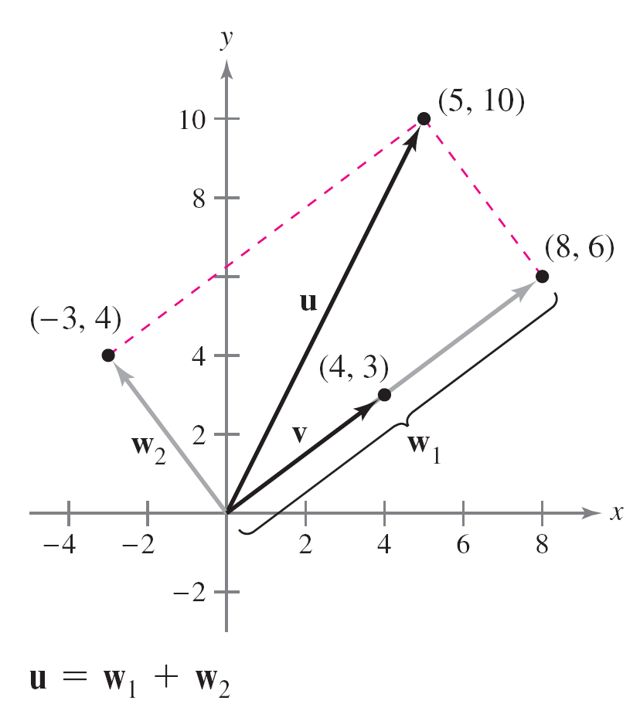
Example 5 – Solution
cont’d
Check to see that w₂ is orthogonal to v, as shown in Figure 11.30.
Figure 11.30

Slide 30
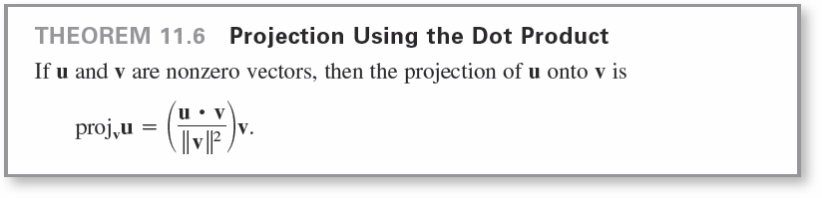
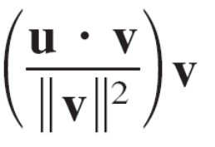
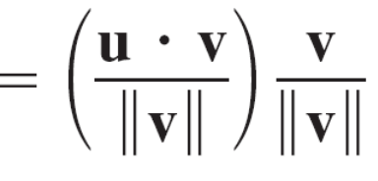
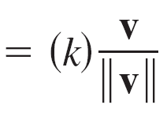
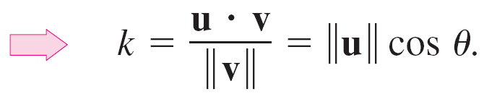
Projections and Vector Components
The projection of u onto v can be written as a scalar multiple of a unit vector in the direction of v .That is,
The scalar k is called the component of u in the direction of v.

Slide 31



Example 6 – Decomposing a Vector into Vector Components
Find the projection of u onto v and the vector component of u orthogonal to v for
u = 3i – 5j + 2k and v = 7i + j – 2k.
Solution:
The projection of u onto v is
w₁ = proj_{v} u = v
= (7i + j – 2k)
=

Slide 32

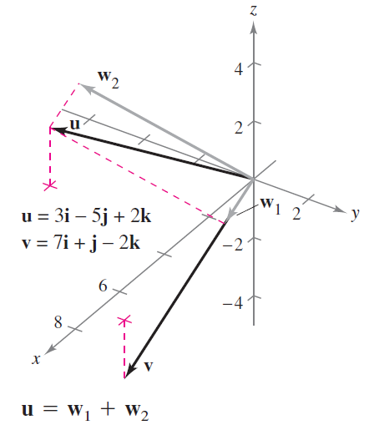

Example 6 – Solution
cont’d
The vector component of u orthogonal to v is the vector
w₂ = u – w₁
= (3i – 5j + 2k) –
=
See Figure 11.31.
Figure 11.31

Slide 33
Work

Slide 34

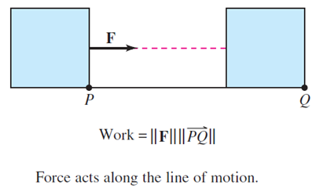
Work
The work W done by the constant force F acting along the line of an object is given by
W = (magnitude of force)(distance) =
as shown in Figure 11.33(a).
Figure 11.33(a)

Slide 35
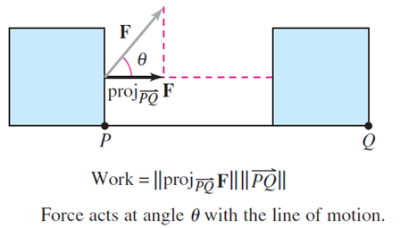
Work
When the constant force F is not directed along the line of motion, you can see from Figure 11.33(b) that the work W done by the force is
Figure 11.33(b)

Slide 36

Work
This notion of work is summarized in the next definition.

Slide 37

Example 8 – Finding Work
To close a sliding door, a person pulls a rope with a constant force of 50 pounds at a constant angle of 60°, as shown in Figure 11.34.
Find the work done in moving the door 12 feet to its closed position.
Figure 11.34

Slide 38



Example 8 – Solution
Using a projection, you can calculate the work as follows.
W =
=
=
= 300 foot - pounds

