Slide 1


11
Vectors and the Geometry of Space
P
Copyright © Cengage Learning. All rights reserved.

Slide 2

The Cross Product of Two Vectors in Space
11.4
Copyright © Cengage Learning. All rights reserved.

Slide 3
Objectives
Find the cross product of two vectors in space.
Use the triple scalar product of three vectors in space.

Slide 4
The Cross Product

Slide 5
The Cross Product
Many applications in physics, engineering, and geometry involve finding a vector in space that is orthogonal to two given vectors.
In this section, you will study a product that will yield such a vector.
It is called the cross product, and it is most conveniently defined and calculated using the standard unit vector form.
Because the cross product yields a vector, it is also called the vector product.

Slide 6
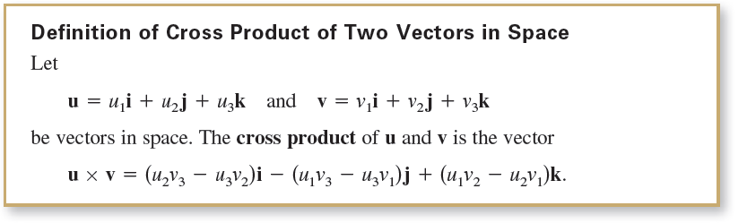
The Cross Product
It is important to note that this definition applies only to three-dimensional vectors.

Slide 7
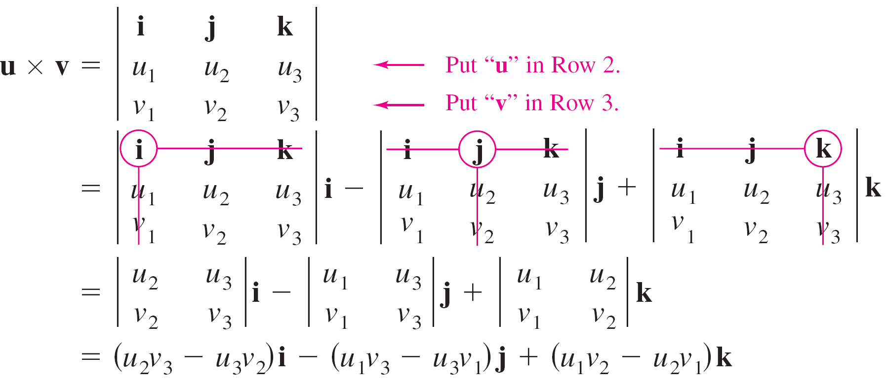
The Cross Product
A convenient way to calculate u × v is to use the determinant form with cofactor expansion shown below.

Slide 8
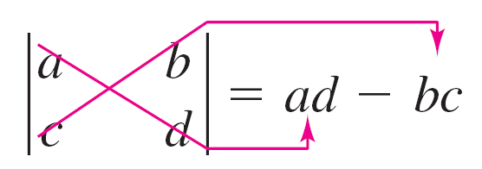


The Cross Product
Note the minus sign in front of the j-component. Each of the three 2 × 2 determinants can be evaluated by using the diagonal pattern
.
Here are a couple of examples.
and

Slide 9
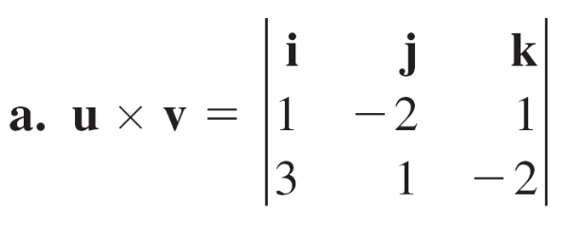
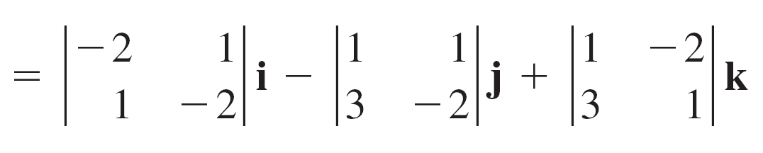

Example 1 – Finding the Cross Product
For u = i – 2j + k and v = 3i + j – 2k, find each of the following.
u × v b. v × u c. v × v
Solution:

Slide 10
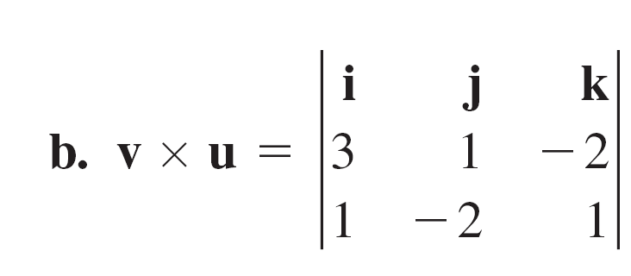
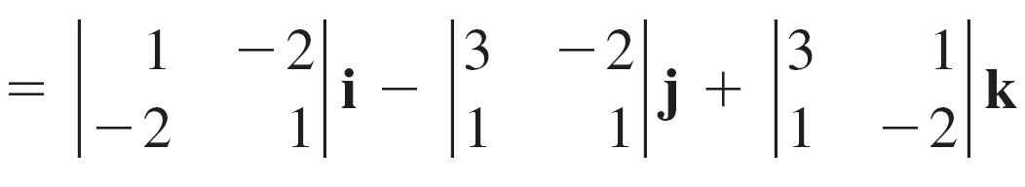
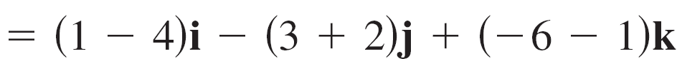

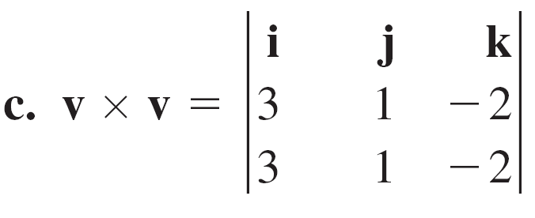

Example 1 – Solution
cont’d
Note that this result is the negative of that in part (a).

Slide 11
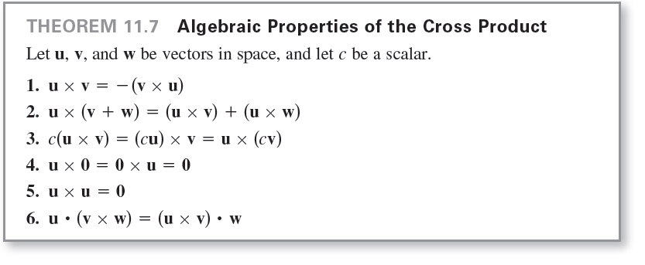
The Cross Product

Slide 12
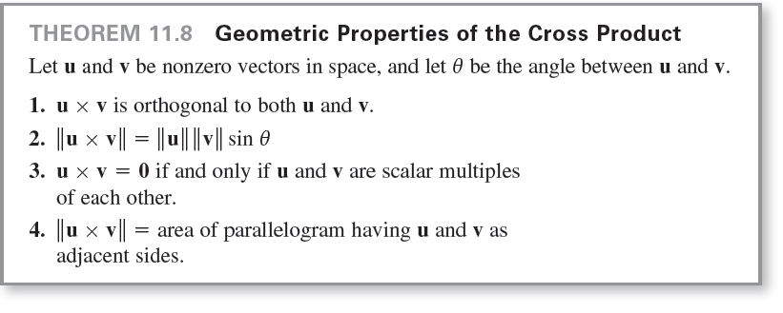
The Cross Product

Slide 13
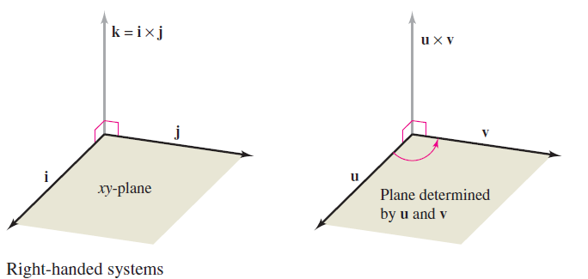
The Cross Product
Both u × v and v × u are perpendicular to the plane determined by u and v. One way to remember the orientations of the vectors u, v, and u × v is to compare them with the unit vectors i, j, and k = i × j, as shown in Figure 11.36.
The three vectors u, v, and u × v form a right-handed system, whereas the three vectors u, v, and v × u form a left-handed system.
Figure 11.36

Slide 14
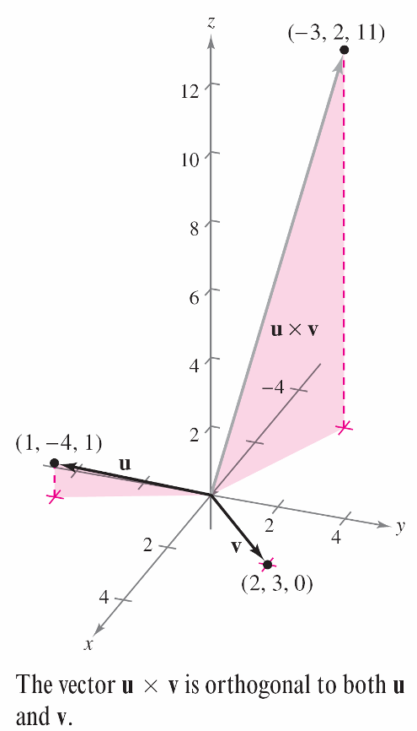
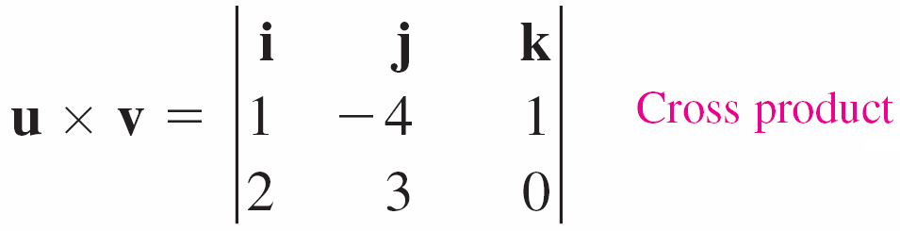

Example 2 – Using the Cross Product
Find a unit vector that is orthogonal to
both u = i – 4j + k and v = 2i + 3j.
Solution:
The cross product u × v, as shown in
Figure 11.37, is orthogonal to both
u and v.
Figure 11.37

Slide 15
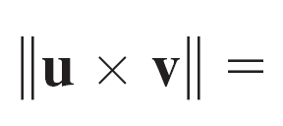
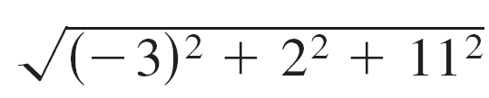
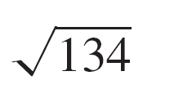
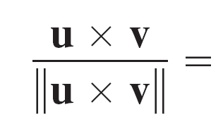
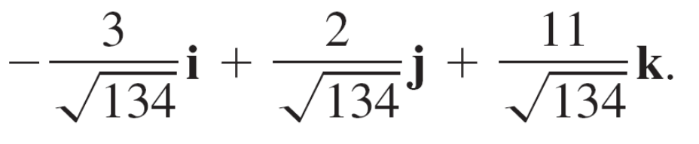
Example 2 – Solution
cont’d
Because
a unit vector orthogonal to both u and v is

Slide 16
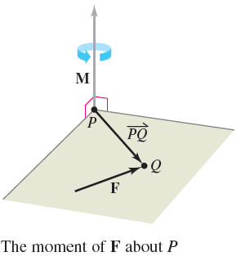
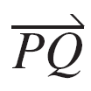
The Cross Product
In physics, the cross product can be used to measure torque—the moment M of a force F about a point P, as shown in Figure 11.39. If the point of application of the force is Q, then the moment of F about P is
The magnitude of the moment M measures
the tendency of the vector to rotate
counterclockwise (using the right-hand
rule) about an axis directed along the
vector M.
Figure 11.39

Slide 17
The Triple Scalar Product

Slide 18
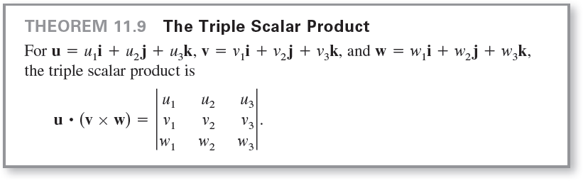
The Triple Scalar Product
For vectors u, v, and w in space, the dot product of
u and v × w
u  (v × w)
is called the triple scalar product, as defined in
Theorem 11.9.

Slide 19
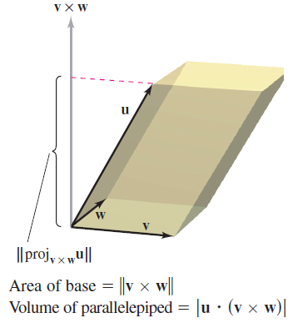
The Triple Scalar Product
If the vectors u, v, and w do not lie in the same plane, then the triple scalar product u  (v × w) can be used to determine the volume of the parallelepiped (a polyhedron, all of whose faces are parallelograms) with u, v, and w as adjacent edges, as shown in Figure 11.41.
Figure 11.41

Slide 20
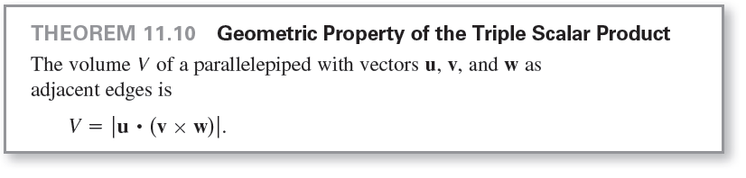
The Triple Scalar Product

Slide 21
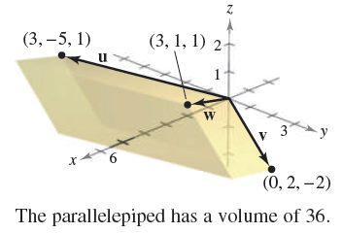
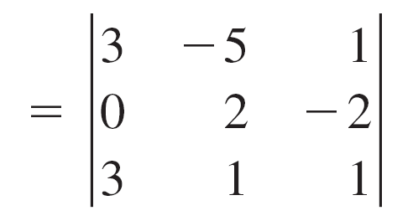
Example 5 – Volume by the Triple Scalar Product
Find the volume of the parallelepiped shown in Figure 11.42 having u = 3i – 5j + k, v = 2j – 2k, and w = 3i + j + k as adjacent edges.
Solution:
By Theorem 11.10, you have
Figure 11.42

Slide 22
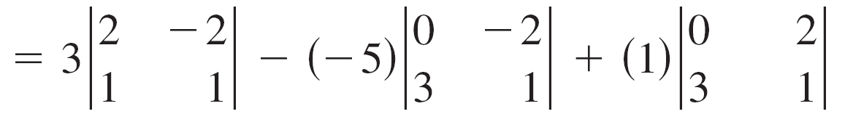
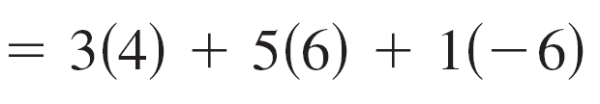
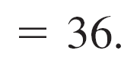
Example 5 – Solution
cont’d

Slide 23

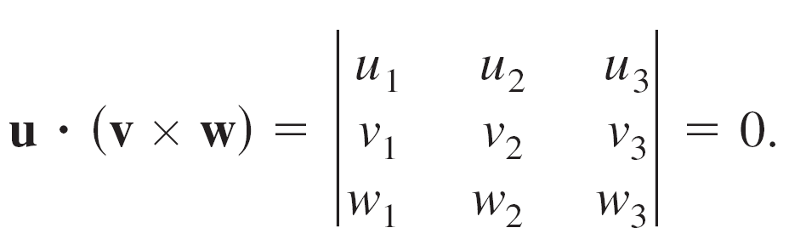
The Triple Scalar Product
A natural consequence of Theorem 11.10 is that the volume of the parallelepiped is 0 if and only if the three vectors are coplanar.
That is, when the vectors
have the same initial point, they lie in the same plane if and only if

