Slide 1


11
Vectors and the Geometry of Space
P
Copyright © Cengage Learning. All rights reserved.

Slide 2

Lines and Planes in Space
11.5
Copyright © Cengage Learning. All rights reserved.

Slide 3
Objectives
Write a set of parametric equations for a line in space.
Write a linear equation to represent a plane in space.
Sketch the plane given by a linear equation.
Find the distances between points, planes, and lines in space.

Slide 4
Lines in Space

Slide 5

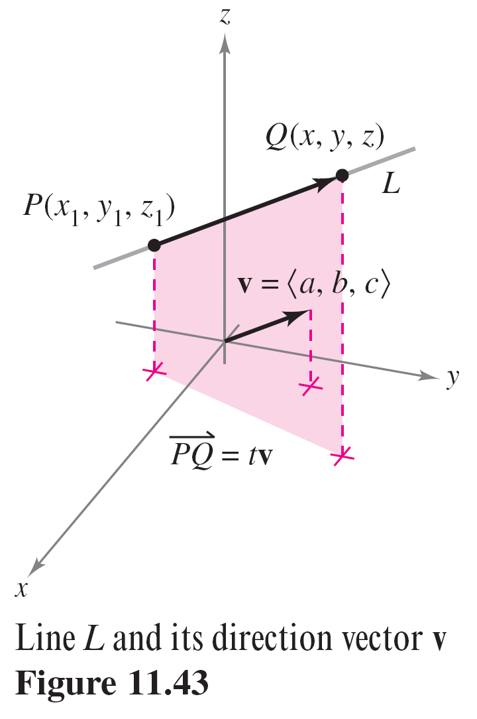

Lines in Space
In Figure 11.43, consider the line L through the point P(x₁, y₁, z₁) and parallel to the vector .
The vector v is a direction vector for the line L, and
a, b, and c are direction numbers.
One way of describing the line L is to
say that it consists of all points
Q(x, y, z) for which the vector
is parallel to v.
Figure 11.43

Slide 6
Lines in Space
This means that is a scalar multiple of v and you can write = t v, where t is a scalar (a real number).
By equating corresponding components, you can obtain parametric equations of a line in space.

Slide 7
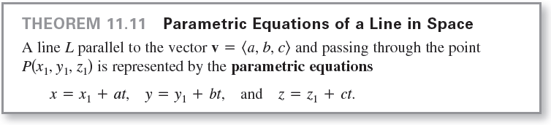

Lines in Space
If the direction numbers a, b, and c are all nonzero, then you can eliminate the parameter t in the parametric equations to obtain symmetric equations of the line.

Slide 8

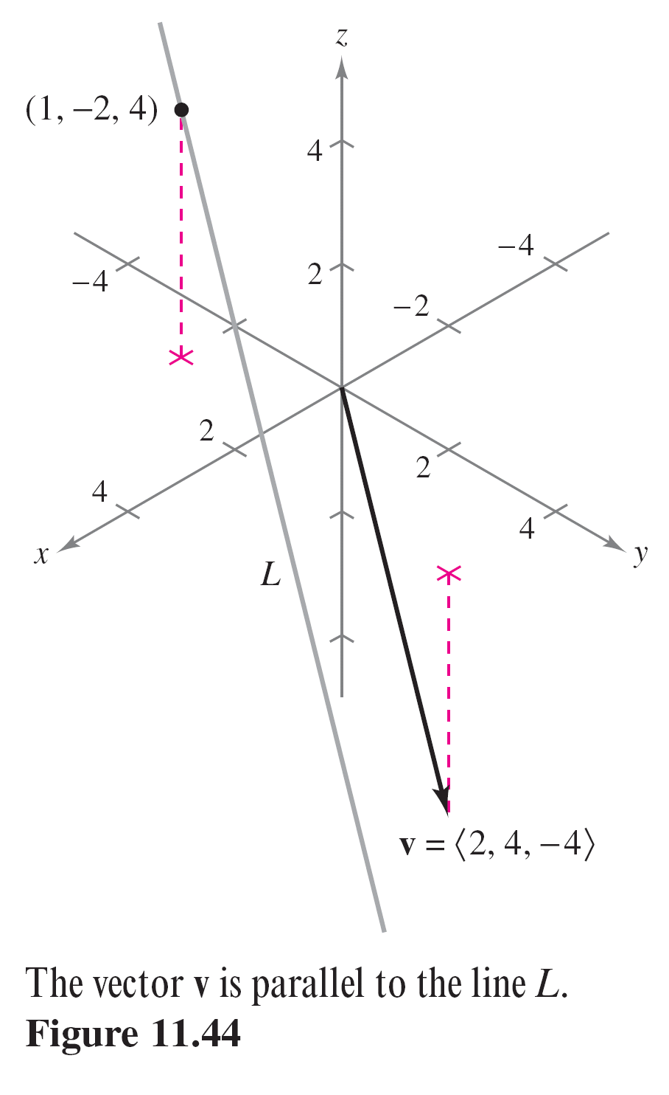
Example 1 – Finding Parametric and Symmetric Equations
Find parametric and symmetric equations of the line L that passes through the point (1, –2, 4 ) and is parallel to
, as shown in Figure 11.44.
Figure 11.44

Slide 9

Example 1 – Solution
To find a set of parametric equations of the line, use the coordinates x₁ = 1, y₁ = –2, and z₁ = 4 and direction numbers a = 2, b = 4, and c = –4.
x = 1 + 2t, y = –2 + 4t, z = 4 – 4t
Because a, b, and c are all nonzero, a set of symmetric equations is

Slide 10
Planes in Space

Slide 11
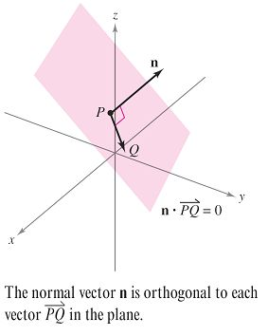

Planes in Space
Consider the plane containing the point P(x₁, y₁, z₁) having a nonzero normal vector n = as shown in
Figure 11.45. This plane consists of all points Q(x, y, z) for which vector is orthogonal to n.
Using the dot product, you can write
the following.
The third equation of the plane is said
to be in standard form.
Figure 11.45

Slide 12
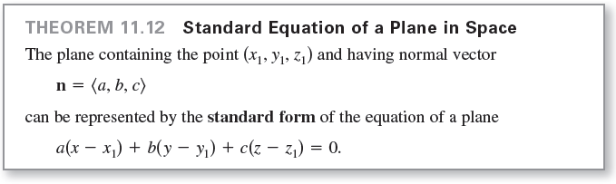

Planes in Space
By regrouping terms, you obtain the general form of the equation of a plane in space.
Given the general form of the equation of a plane, it is easy to find a normal vector to the plane. Simply use the coefficients of x, y, and z and write n = .

Slide 13
Example 3 – Finding an Equation of a Plane in Three-Space
Find the general equation of the plane containing the points (2, 1, 1), (1, 4, 1), and (–2, 0, 4).
Solution:
To apply Theorem 11.12 you need a point in the plane and a vector that is normal to the plane.
There are three choices for the point, but no normal vector is given.

Slide 14
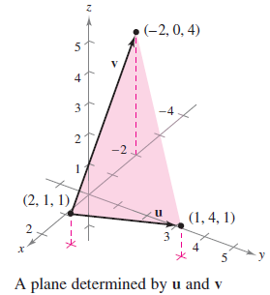


Example 3 – Solution
cont'd
To obtain a normal vector, use the
cross product of vectors u and v
extending from the point (2, 1, 1) to
the points (1, 4, 1) and (–2, 0, 4),
as shown in Figure 11.46.
The component forms of u and v are
and
So, it follows that a vector normal to the given plane is
Figure 11.46

Slide 15



Example 3 – Solution
cont'd
Using the direction numbers for n and the point (x₁, y₁, z₁) = (2, 1, 1), you can determine an equation of the plane in standard form to be
a(x – x₁) + b(y – y₁) + c(z – z₁) = 0
9(x – 2) + 3(y – 1) + 13(z – 1) = 0.
By regrouping terms, the general form is
9x − 18 + 3y − 3 + 13z – 13 = 0
9x + 3y + 13z – 34 = 0.

Slide 16
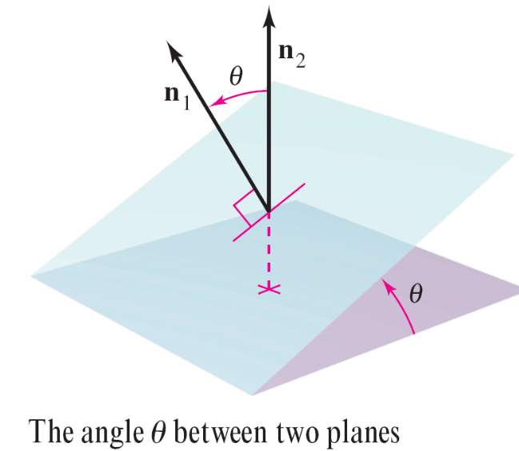
Planes in Space
Two distinct planes in three-space either are parallel or intersect in a line. For two planes that intersect, you can
determine the angle (0 ≤ θ ≤ π/2) between them from the angle between their normal vectors, as shown in
Figure 11.47.
Figure 11.47

Slide 17

Planes in Space
Specifically, if vectors n₁ and n₂ are normal to two intersecting planes, then the angle θ between the normal vectors is equal to the angle between the two planes and is
Consequently, two planes with normal vectors n₁ and n₂ are
1. perpendicular when n₁  n₂ = 0.
2. parallel when n₁ is a scalar multiple of n₂.

Slide 18
Sketching Planes in Space

Slide 19
Sketching Planes in Space
If a plane in space intersects one of the coordinate planes, then the line of intersection is called the trace of the given plane in the coordinate plane.
To sketch a plane in space, it is helpful to find its points of intersection with the coordinate axes and its traces in the coordinate planes.

Slide 20


Sketching Planes in Space
For example, consider the plane
3x + 2y + 4z = 12.
You can find the xy-trace by letting z = 0 and sketching the line
3x + 2y = 12
in the xy-plane.
This line intersects the x-axis at (4, 0, 0) and the y-axis at (0, 6, 0).

Slide 21
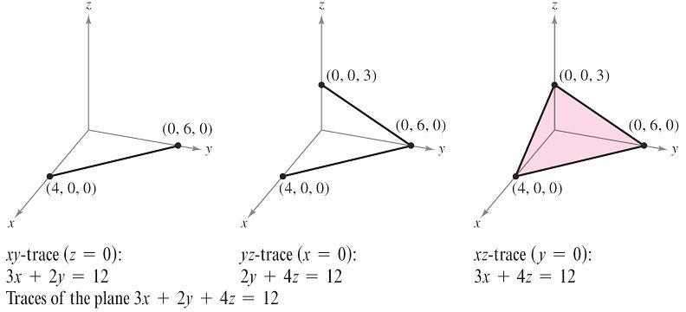
Sketching Planes in Space
In Figure 11.49, this process is continued by finding the yz-trace and the xz-trace and then shading the triangular region lying in the first octant.
Figure 11.49

Slide 22
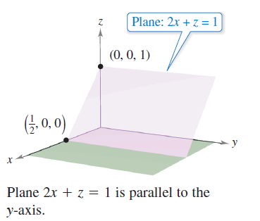
Sketching Planes in Space
If an equation of a plane has a missing variable, such as 2x + z = 1 then the plane must be parallel to the axis represented by the missing variable, as shown in Figure 11.50.
Figure 11.50

Slide 23
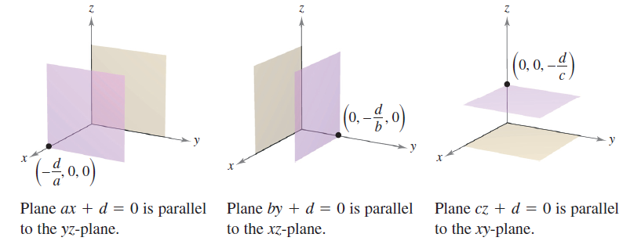
Sketching Planes in Space
If two variables are missing from an equation of a plane, such as ax + d = 0 then it is parallel to the coordinate plane represented by the missing variables, as shown in
Figure 11.51.
Figure 11.51

Slide 24
Distances Between Points, Planes, and Lines

Slide 25
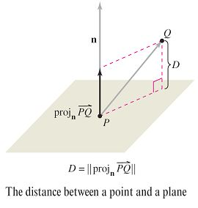
Distances Between Points, Planes, and Lines
Consider two types of problems involving distance in space:
1. finding the distance between a point and a plane
2. finding the distance between a point and a line
The distance D between a point Q and
a plane is the length of the shortest line
segment connecting Q to the plane,
as shown in Figure 11.52.
Figure 11.52

Slide 26

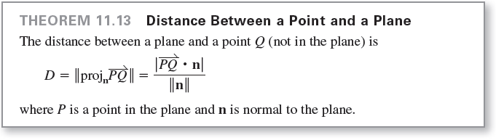
Distances Between Points, Planes, and Lines
For any point P in the plane, you can find this distance by projecting the vector onto the normal vector n.
The length of this projection is the desired distance.

Slide 27

Distances Between Points, Planes, and Lines
To find a point in the plane ax + by + cz + d = 0, where
a ≠ 0, let y = 0 and z = 0.
Then, from the equation ax + d = 0, you can conclude that the point
lies in the plane.

Slide 28



Example 5 – Finding the Distance Between a Point and a Plane
Find the distance between the point Q(1, 5, –4) and the plane given by 3x – y + 2z = 6.
Solution:
You know that is normal to the plane.
To find a point in the plane, let y = 0 and z = 0, and obtain the point P(2, 0, 0).
The vector from P to Q is

Slide 29





Example 5 – Solutions
cont'd
Using the Distance Formula given in Theorem 11.13 produces

Slide 30
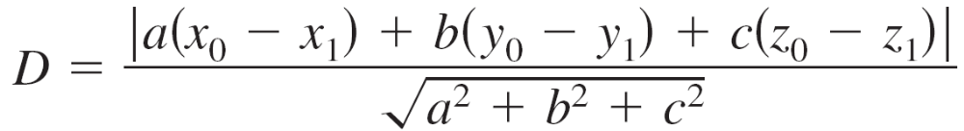

Distances Between Points, Planes, and Lines
From Theorem 11.13, you can determine that the distance between the point Q(x₀, y₀, z₀) and the plane
ax + by + cz + d = 0 is
or
where P(x₁, y₁, z₁) is a point in the plane and
d = –(ax₁ + by₁ + cz₁).

Slide 31
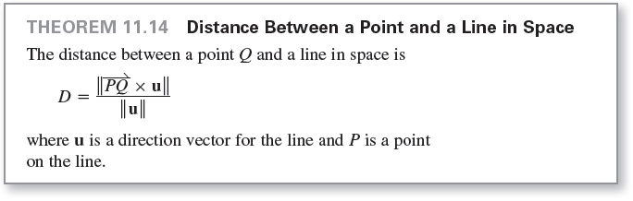
Distances Between Points, Planes, and Lines
The formula for the distance between a point and a line in space resembles that for the distance between a point and a plane—except that you replace the dot product with the length of the cross product and the normal vector n with a direction vector for the line.

