Slide 1


11
Vectors and the Geometry of Space
P
Copyright © Cengage Learning. All rights reserved.

Slide 2

11.6
Surfaces in Space
Copyright © Cengage Learning. All rights reserved.

Slide 3
Objectives
Recognize and write equations of cylindrical surfaces.
Recognize and write equations of quadric surfaces.
Recognize and write equations of surfaces of revolution.

Slide 4
Cylindrical Surfaces

Slide 5
Cylindrical Surfaces
You have already studied two special types of surfaces.
A third type of surface in space is called a cylindrical surface, or simply a cylinder.

Slide 6
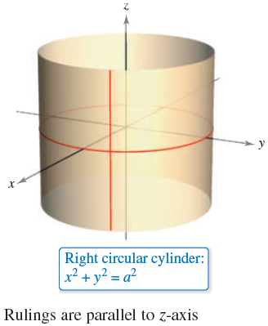
Cylindrical Surfaces
To define a cylinder, consider the familiar right circular cylinder shown in Figure 11.56.
The cylinder was generated by a
vertical line moving around the
circle x² + y² = a² in the
xy-plane.
Figure 11.56

Slide 7
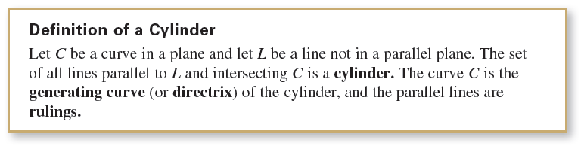
Cylindrical Surfaces
This circle is a generating curve for the cylinder, as indicated in the following definition.

Slide 8
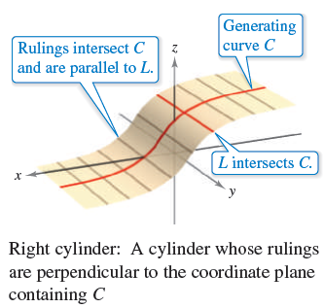
Cylindrical Surfaces
Without loss of generality, you can assume that C lies in one of the three coordinate planes. Moreover, the text restricts the discussion to right cylinders––cylinders whose rulings are perpendicular to the coordinate plane containing C, as shown in Figure 11.57.
Note that the rulings
intersect C and are parallel
to the line L.
Figure 11.57

Slide 9
Cylindrical Surfaces
For the right circular cylinder shown in Figure 11.56, the equation of the generating curve in the xy-plane is
x² + y² = a².
To find an equation of the cylinder, note that you can generate any one of the rulings by fixing the values of x and y and then allowing z to take on all real values.
In this sense, the value of z is arbitrary and is, therefore, not included in the equation.

Slide 10
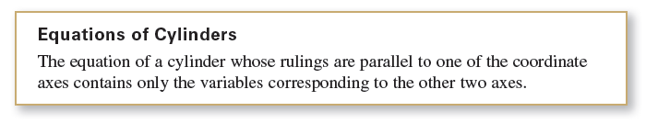
Cylindrical Surfaces
In other words, the equation of this cylinder is simply the equation of its generating curve.
x² + y² = a² Equation of cylinder in space

Slide 11
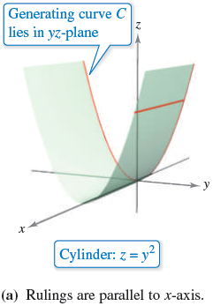
Example 1 – Sketching a Cylinder
Sketch the surface represented by each equation.
a. z = y² b. z = sin x, 0 ≤ x ≤ 2π
Solution:
a. The graph is a cylinder whose generating
curve, z = y², is a parabola in the yz-plane.
The rulings of the cylinder are parallel to
the x-axis, as shown in Figure11.58(a).
Figure 11.58

Slide 12
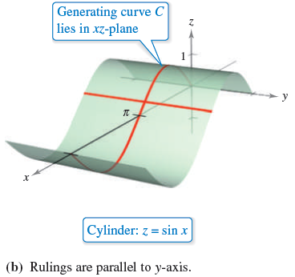
Example 1 – Solution
cont’d
b. The graph is a cylinder generated by the sine curve in the xz-plane.
The rulings are parallel to the y-axis, as shown in
Figure 11.58(b).
Figure 11.58

Slide 13
Quadric Surfaces

Slide 14
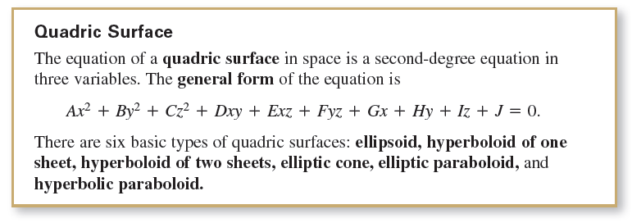
Quadric Surfaces
The fourth basic type of surface in space is a quadric surface. Quadric surfaces are the three-dimensional analogs of conic sections.

Slide 15
Quadric Surfaces
The intersection of a surface with a plane is called the trace of the surface in the plane. To visualize a surface in space, it is helpful to determine its traces in some
well-chosen planes.
The traces of quadric surfaces are conics. These traces, together with the standard form of the equation of each quadric surface, are shown in the following table.

Slide 16
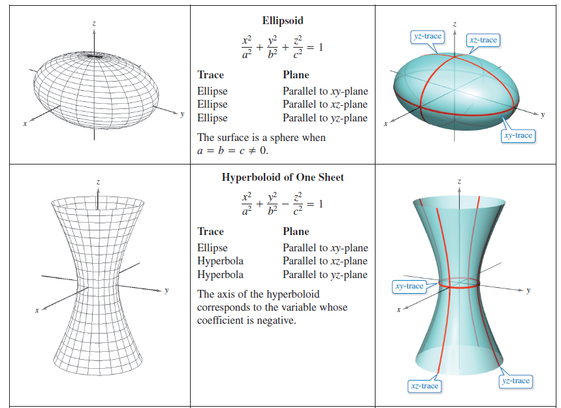
Quadric Surfaces

Slide 17
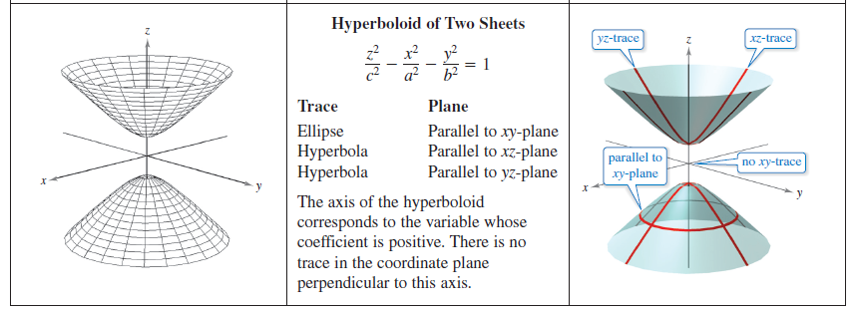
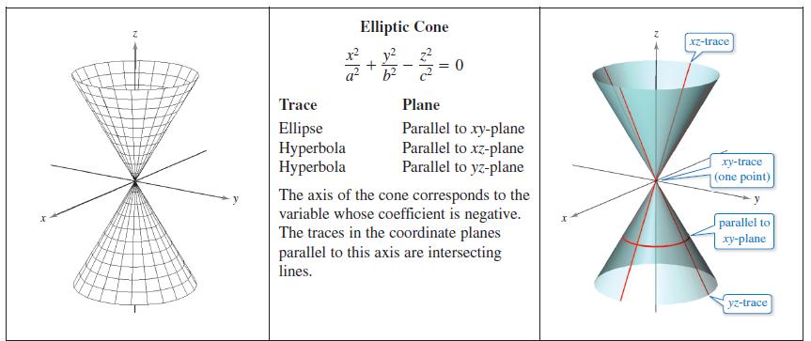
Quadric Surfaces
cont’d

Slide 18
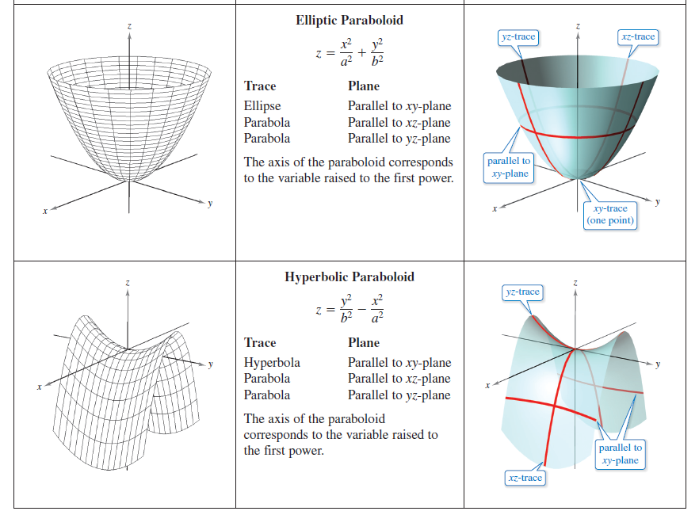
Quadric Surfaces
cont’d

Slide 19
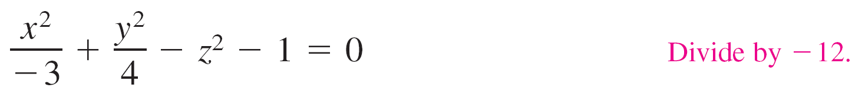

Example 2 – Sketching a Quadric Surface
Classify and sketch the surface
4x² – 3y² + 12z² + 12 = 0.
Solution:
Begin by writing the equation in standard form.
You can conclude that the surface is a hyperboloid of two sheets with the y-axis as its axis.

Slide 20
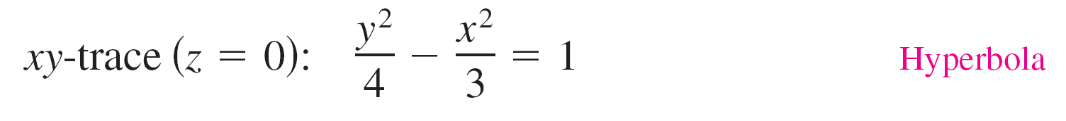
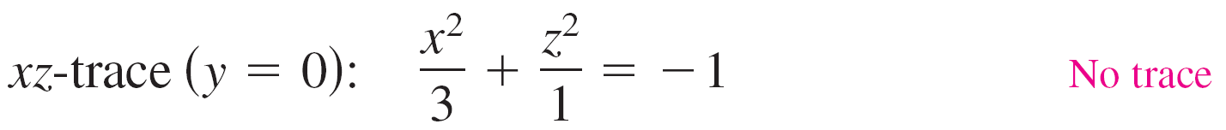
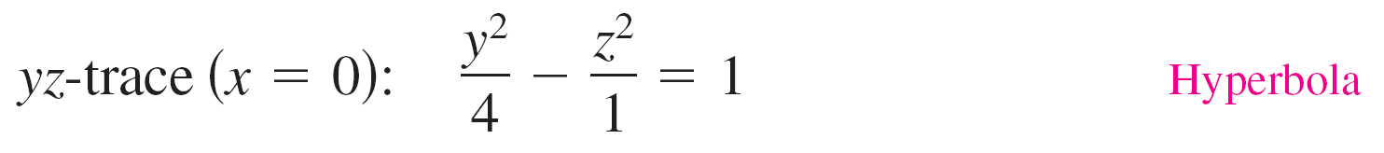
Example 2 – Solution
cont’d
To sketch the graph of this surface, it helps to find the traces in the coordinate planes.

Slide 21
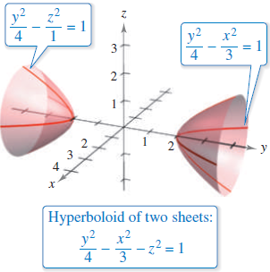
Example 2 – Solution
cont’d
The graph is shown in Figure 11.59.
Figure 11.59

Slide 22
Surfaces of Revolution

Slide 23
Surfaces of Revolution
The fifth special type of surface you will study is a surface of revolution.
You will now look at a procedure for finding its equation.
Consider the graph of the radius function
y = r(z) Generating curve
in the yz-plane.

Slide 24
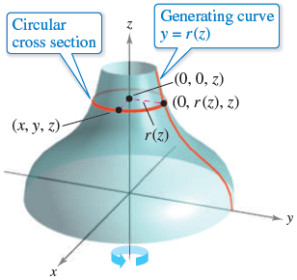
Surfaces of Revolution
When this graph is revolved about the z-axis, it forms a surface of revolution, as shown in Figure 11.62.
The trace of the surface in the plane z = z₀ is a circle
whose radius is r (z₀) and whose equation is
x² + y² = [r(z₀)]². Circular trace in plane: z = z₀
Replacing z₀ with z produces an equation
that is valid for all values of z.
Figure 11.62

Slide 25
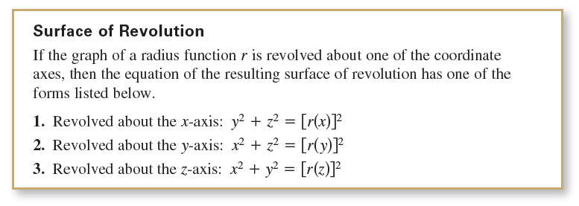
Surfaces of Revolution
In a similar manner, you can obtain equations for surfaces of revolution for the other two axes, and the results are summarized as follows.

Slide 26
Example 5 – Finding an Equation for a Surface of Revolution
Find an equation for the surface of revolution formed by
revolving
(a) the graph of y = 1 / z about the z-axis
and
(b) the graph of 9x² = y³ about the y-axis.

Slide 27
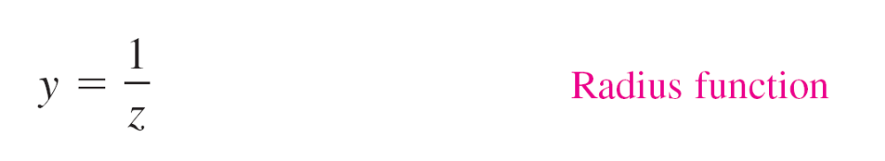
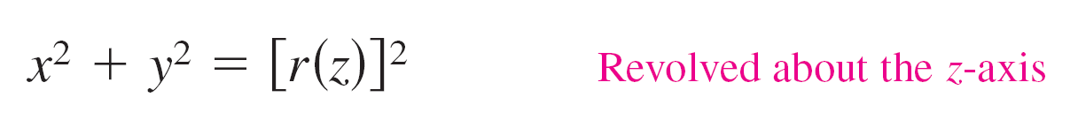
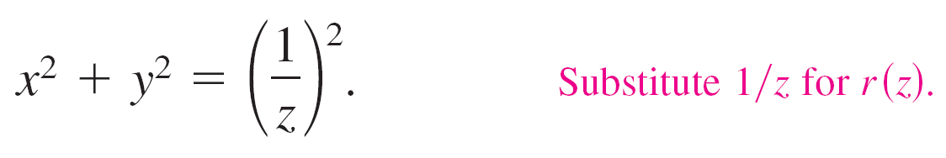
Example 5(a) – Solution
An equation for the surface of revolution formed by revolving the graph of
about the z-axis is

Slide 28
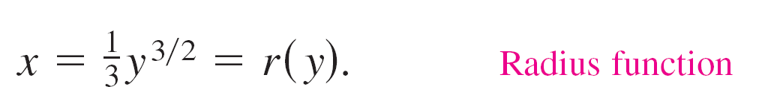
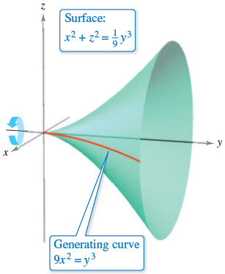
Example 5(b) – Solution
cont’d
To find an equation for the surface formed by revolving the graph of 9x² = y³ about the y-axis, solve for x in terms of y to obtain
So, the equation for this surface is
The graph is shown in Figure 11.63.
Figure 11.63

