Slide 1


11
Vectors and the Geometry of Space
P
Copyright © Cengage Learning. All rights reserved.

Slide 2

Cylindrical and Spherical Coordinates
11.7
Copyright © Cengage Learning. All rights reserved.

Slide 3
Objectives
Use cylindrical coordinates to represent surfaces in space.
Use spherical coordinates to represent surfaces in space.

Slide 4
Cylindrical Coordinates

Slide 5
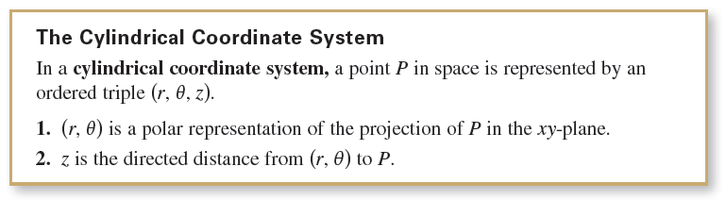
Cylindrical Coordinates
The cylindrical coordinate system, is an extension of polar coordinates in the plane to three-dimensional space.

Slide 6
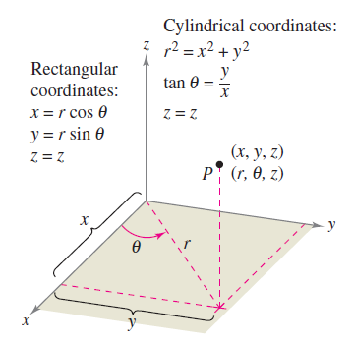


Cylindrical Coordinates
To convert from rectangular to cylindrical coordinates
(or vice versa), use the conversion guidelines for polar coordinates listed below and illustrated in Figure 11.66.
Cylindrical to rectangular:
Rectangular to cylindrical:
Figure 11.66

Slide 7
Cylindrical Coordinates
The point (0, 0, 0) is called the pole. Moreover, because the representation of a point in the polar coordinate system is not unique, it follows that the representation in the cylindrical coordinate system is also not unique.

Slide 8
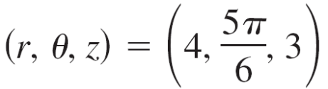
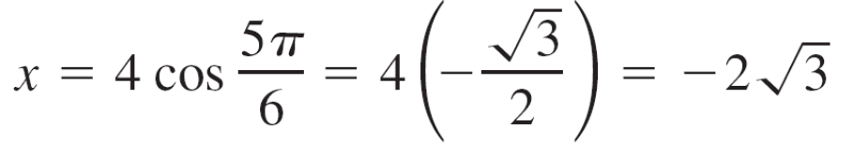
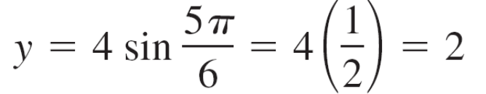

Example 1 – Cylindrical-to-Rectangular Conversion
Convert the point (r, θ, z) = to rectangular coordinates.
Solution:
Using the cylindrical-to-rectangular conversion equations produces

Slide 9

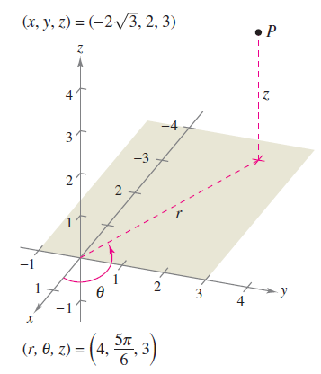
Example 1 – Solution
cont’d
So, in rectangular coordinates, the point is
as shown in Figure 11.67.
Figure 11.67

Slide 10
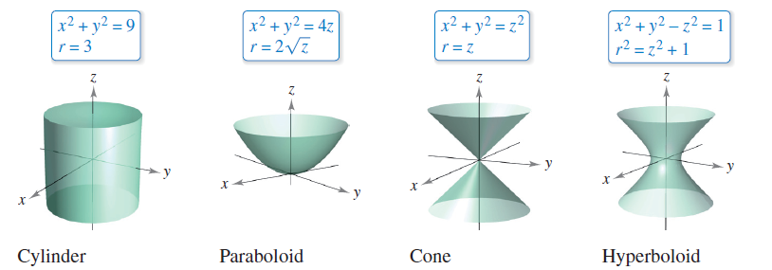
Cylindrical Coordinates
Cylindrical coordinates are especially convenient for representing cylindrical surfaces and surfaces of revolution with the z-axis as the axis of symmetry, as shown in Figure 11.69.
Figure 11.69

Slide 11
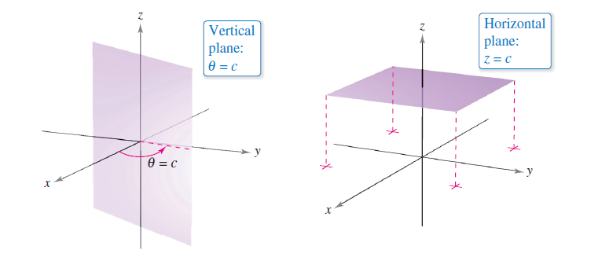
Cylindrical Coordinates
Vertical planes containing the z-axis and horizontal planes also have simple cylindrical coordinate equations, as shown in Figure 11.70.
Figure 11.70

Slide 12
Spherical Coordinates

Slide 13
Spherical Coordinates
In the spherical coordinate system, each point is represented by an ordered triple: the first coordinate is a distance, and the second and third coordinates are angles.
This system is similar to the latitude-longitude system used to identify points on the surface of Earth.

Slide 14
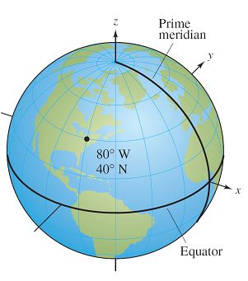
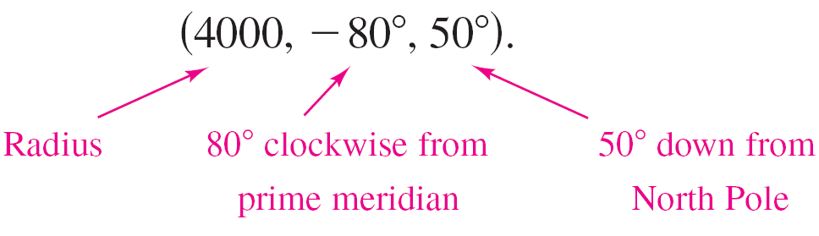
Spherical Coordinates
For example, the point on the
surface of Earth whose latitude
is 40°North (of the equator) and
whose longitude is 80° West
(of the prime meridian) is shown
in Figure 11.74. Assuming that
Earth is spherical and has a
radius of 4000 miles, you would
label this point as
Figure 11.74

Slide 15
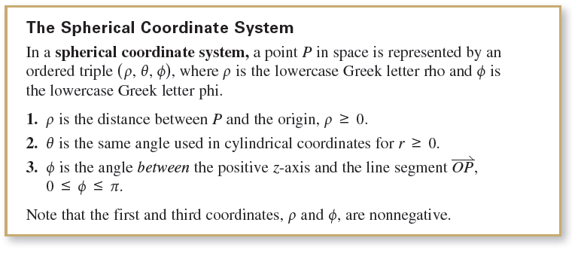
Spherical Coordinates

Slide 16
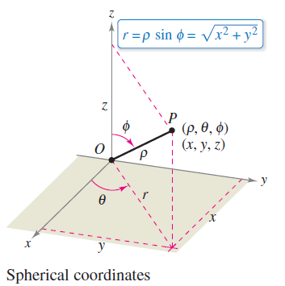


Spherical Coordinates
The relationship between rectangular
and spherical coordinates is illustrated in
Figure 11.75. To convert from one system
to the other, use the conversion
guidelines listed below.
Spherical to rectangular:
Rectangular to spherical:
Figure 11.75

Slide 17


Spherical Coordinates
To change coordinates between the cylindrical and spherical systems, use the following.
Spherical to cylindrical (r ≥ 0):
Cylindrical to spherical (r ≥ 0):

Slide 18
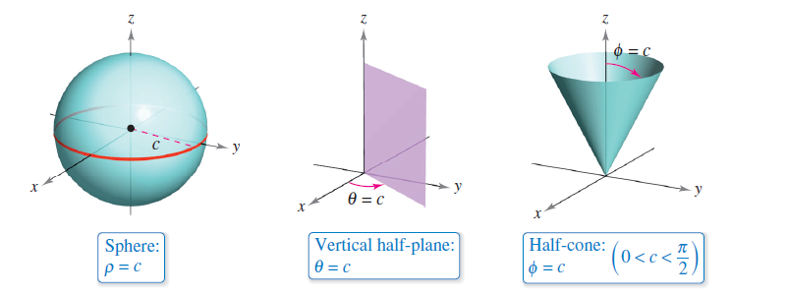
Spherical Coordinates
The spherical coordinate system is useful primarily for surfaces in space that have a point or center of symmetry. For example, Figure 11.76 shows three surfaces with
simple spherical equations.
Figure 11.76

Slide 19

Example 5 – Rectangular-to-Spherical Conversion
Find an equation in spherical coordinates for the surface represented by each rectangular equation.
a. Cone: x² + y² = z²
b. Sphere: x² + y² + z² – 4z = 0
Solution:
a. Use the spherical-to-rectangular equations
and substitute in the rectangular equation as shown.

Slide 20




Example 5 – Solution
cont’d
So, you can conclude that
The equation Φ = π/4 represents the upper half-cone, and the equation Φ = 3π/4 represents the lower half-cone.

Slide 21



Example 5 – Solution
cont’d
b. Because and the rectangular equation has the following spherical form.
Temporarily discarding the possibility that ρ = 0, you have the spherical equation

Slide 22
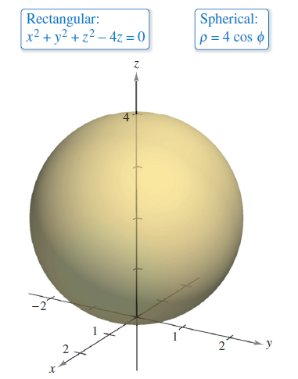
Example 5 – Solution
cont’d
Note that the solution set for this equation includes a point for which ρ = 0, so nothing is lost by discarding the factor ρ.
The sphere represented by the equation ρ = 4 cos Φ
is shown in Figure 11.77.
Figure 11.77

