Slide 1


12
P
Vector-Valued Functions
Copyright © Cengage Learning. All rights reserved.

Slide 2

12.1
Vector-Valued Functions
Copyright © Cengage Learning. All rights reserved.

Slide 3
Objectives
Analyze and sketch a space curve given by a vector-valued function.
Extend the concepts of limits and continuity to vector-valued functions.

Slide 4
Space Curves and Vector-Valued Functions

Slide 5
Space Curves and Vector-Valued Functions
A plane curve is defined as the set of ordered pairs
(f(t), g(t)) together with their defining parametric equations
x = f(t) and y = g(t), where f and g are continuous functions of t on an interval I.
This definition can be extended naturally to three-dimensional space. A space curve C is the set of all ordered triples (f(t), g(t), h(t)) together with their defining parametric equations
x = f(t), y = g(t), and z = h(t)
where f, g, and h are continuous functions of t on an interval I.

Slide 6
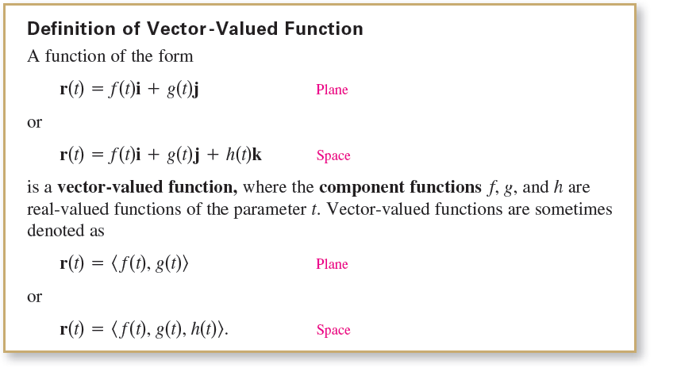
Space Curves and Vector-Valued Functions
A new type of function, called a vector-valued function, is introduced. This type of function maps real numbers to vectors.

Slide 7
Space Curves and Vector-Valued Functions
Technically, a curve in the plane or in space consists of a
collection of points and the defining parametric equations.
Two different curves can have the same graph.
For instance, each of the curves
r(t) = sin t i + cos t j and r(t) = sin t² i + cos t² j
has the unit circle as its graph, but these equations do not
represent the same curve—because the circle is traced out
in different ways on the graphs.

Slide 8
Space Curves and Vector-Valued Functions
Be sure you see the distinction between the vector-valued
function r and the real-valued functions f, g, and h.
All are functions of the real variable t, but r(t) is a vector,
whereas f(t), g(t), and h(t) are real numbers (for each specific
value of t).
Real-valued functions are sometimes called scalar
functions to distinguish them from vector-valued functions.

Slide 9
Space Curves and Vector-Valued Functions
Vector-valued functions serve dual roles in the representation of curves.
By letting the parameter t represent time, you can use a vector-valued function to represent motion along a curve.
Or, in the more general case, you can use a vector-valued function to trace the graph of a curve.

Slide 10
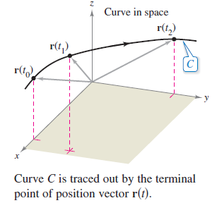
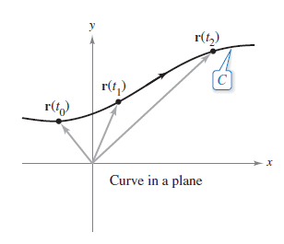
Space Curves and Vector-Valued Functions
In either case, the terminal point of the position vector r(t) coincides with the point (x, y) or (x, y, z) on the curve given by the parametric equations, as shown in Figure 12.1.
Figure 12.1

Slide 11

Space Curves and Vector-Valued Functions
The arrowhead on the curve indicates the curve’s orientation by pointing in the direction of increasing values of t.
Unless stated otherwise, the domain of a vector-valued function r is considered to be the intersection of the domains of the component functions f, g, and h.
For instance, the domain of
is the interval (0, 1].

Slide 12
Example 2 – Sketching a Space Curve
Sketch the space curve represented by the vector-valued function
r(t) = 4cos t i + 4sin t j + t k, 0 ≤ t ≤ 2π. Vector-valued function
Solution:
From the first two parametric equations
x = 4 cos t and y = 4 sin t
you can obtain x² + y² = 16. Rectangular equation
This means that the curve lies on a right circular cylinder of
radius 4, centered about the z-axis. To locate the curve on this cylinder, you can use the third parametric equation
z = t.

Slide 13
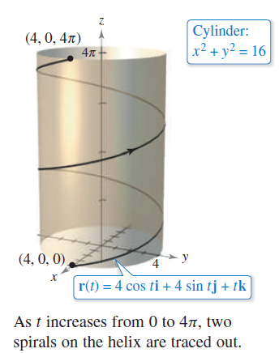
Example 2 – Solution
cont’d
In Figure 12.3, note that as t increases from 0 to 4π, the point (x, y, z) spirals up the cylinder to produce a helix.
Figure 12.3

Slide 14
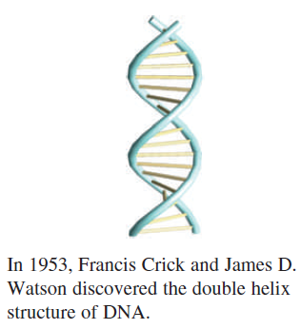
Example 2 – Solution
cont’d
A real-life example of a helix is shown in the drawing below.

Slide 15
Limits and Continuity

Slide 16
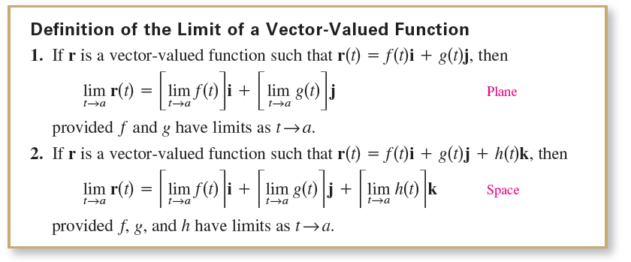
Limits and Continuity

Slide 17
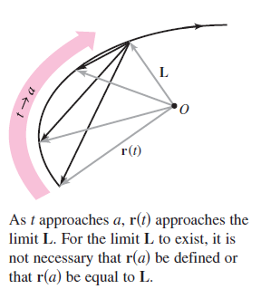
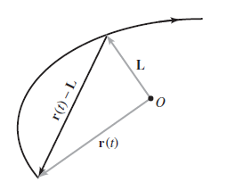
Limits and Continuity
If r(t) approaches the vector L as t → a, then the length of the vector r(t) – L approaches 0. That is,
||r(t) – L|| → 0 as t → a.
This is illustrated graphically in Figure 12.6.
Figure 12.6

Slide 18
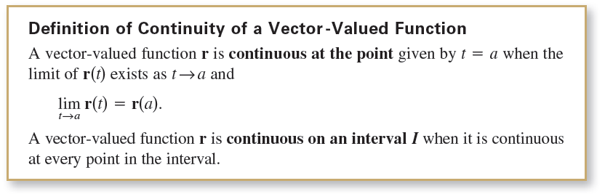
Limits and Continuity
The next definition extends the notion of continuity to
vector-valued functions.

Slide 19
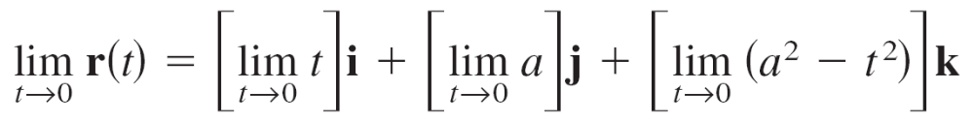


Example 5 – Continuity of Vector-Valued Function
Discuss the continuity of the vector-valued function
r(t) = t i + a j + (a² – t²)k a is a constant.
at t = 0.
Solution:
As t approaches 0, the limit is

Slide 20
Example 5 – Solution
cont’d
Because
r(0) = (0)i + (a)j + (a²)k
= aj + a²k
you can conclude that r is continuous at t = 0.
By similar reasoning, you can conclude that the vector-valued function r is continuous at all real-number values of t.

Slide 21
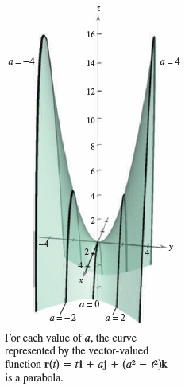


Limits and Continuity
For each value of a, the curve represented by the vector-valued function in Example 5,
is a parabola. You can think of each
parabola as the intersection of the
vertical plane y = a and the hyperbolic
paraboloid
as shown in Figure 12.7.
Figure 12.7

