Slide 1


12
P
Vector-Valued Functions
Copyright © Cengage Learning. All rights reserved.

Slide 2

Differentiation and Integration of Vector-Valued Functions
12.2
Copyright © Cengage Learning. All rights reserved.

Slide 3
Objectives
Differentiate a vector-valued function.
Integrate a vector-valued function.

Slide 4
Differentiation of Vector-Valued Functions

Slide 5
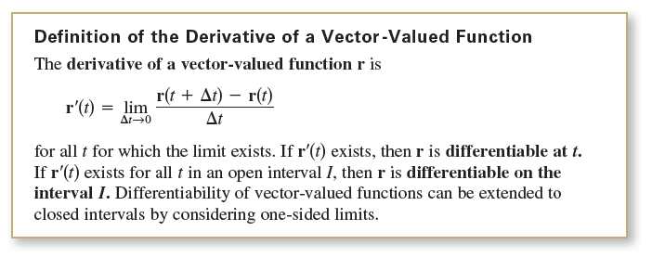
Differentiation of Vector-Valued Functions
The definition of the derivative of a vector-valued function parallels the definition for real-valued functions.

Slide 6





Differentiation of Vector-Valued Functions
Differentiation of vector-valued functions can be done on a component-by-component basis. To see why this is true, consider the function r(t) = f(t)i + g(t)j.
Applying the definition of the derivative produces the following.

Slide 7
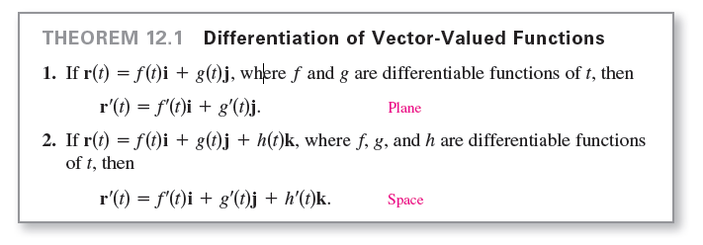
Differentiation of Vector-Valued Functions
This important result is listed in the theorem shown below..

Slide 8
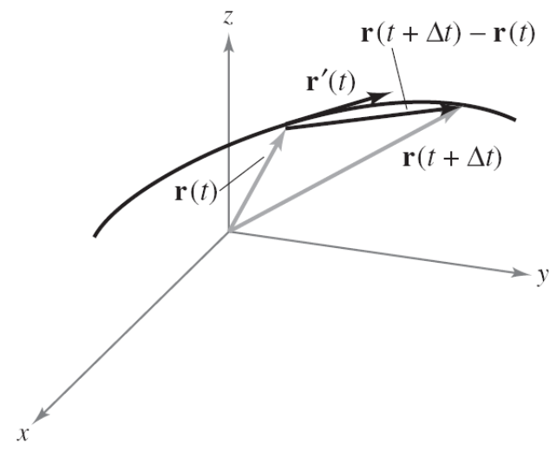
Differentiation of Vector-Valued Functions
Note that the derivative of the vector-valued function r is itself a vector-valued function.
You can see from Figure 12.8
that r′(t) is a vector tangent to
the curve given by r(t) and
pointing in the direction of
increasing t-values.
Figure 12.8

Slide 9
Example 1 – Differentiation of a Vector-Valued Function
For the vector-valued function r(t) = t i + (t² + 2)j find r′(t). Then sketch the plane curve represented by r(t) and the graphs of r(1) and r′(1).
Solution:
Differentiate on a component-by-component basis to obtain
r′(t) = i + 2t j. Derivative
From the position vector r(t), you can write the parametric equations x = t and y = t² + 2.
The corresponding rectangular equation is y = x² + 2.
When t = 1, r(1) = i + 3j and r′(1) = i + 2j.

Slide 10
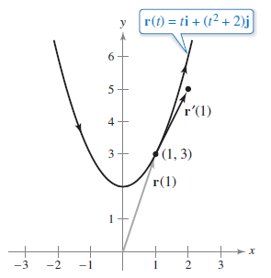
Example 1 – Solution
cont’d
In Figure 12.9, r(1) is drawn starting at the origin, and r′(1) is drawn starting at the terminal point of r(1). Note that at (1, 3), the vector r′(1) is tangent to the curve given by r(t) and is pointing in the direction of increasing t-values.
Figure 12.9

Slide 11
Differentiation of Vector-Valued Functions
The parametrization of the curve represented by the vector-valued function
r(t) = f(t)i + g(t)j + h(t)k
is smooth on an open interval Ι when f ′, g′, and h′ are continuous on Ι and r′(t) ≠ 0 for any value of t in the interval Ι.

Slide 12
Example 3 – Finding Intervals on Which a Curve Is Smooth
Find the intervals on which the epicycloid C given by
r(t) = (5 cos t – cos 5t)i + (5 sin t – sin 5t)j, 0 ≤ t ≤ 2π
is smooth.
Solution:
The derivative of r is
r′(t) = (– 5 sin t + 5 sin 5t)i + (5 cos t – 5 cos 5t)j.
In the interval [0, 2π ], the only values of t for which
r′(t) = 0i + 0j
are t = 0, π /2, π, 3π /2, and 2π.

Slide 13
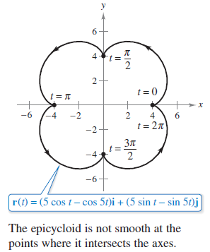
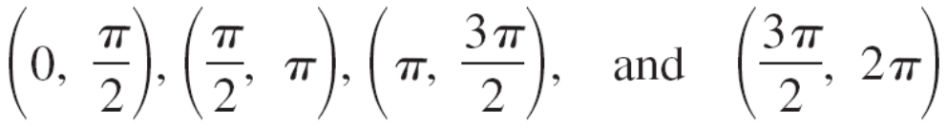
Example 3 – Solution
cont’d
Therefore, you can conclude that C is smooth on the
intervals
as shown in Figure 12.10.
Figure 12.10

Slide 14
Differentiation of Vector-Valued Functions
In Figure 12.10, note that the curve is not smooth at points at which the curve makes abrupt changes in direction.
Such points are called cusps or nodes.

Slide 15
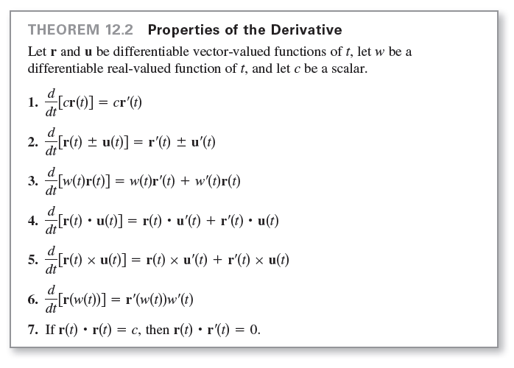
Differentiation of Vector-Valued Functions

Slide 16



Example 4 – Using Properties of the Derivative
For find each
derivative.
a.
b.

Slide 17





Example 4(a) – Solution
Because and u′(t) = 2t i – 2j, you have

Slide 18

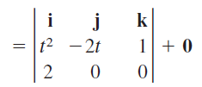



Example 4(b) – Solution
cont’d
Because u′(t) = 2t i – 2j and u′′(t) = 2i, you have

Slide 19
Integration of Vector-Valued Functions

Slide 20
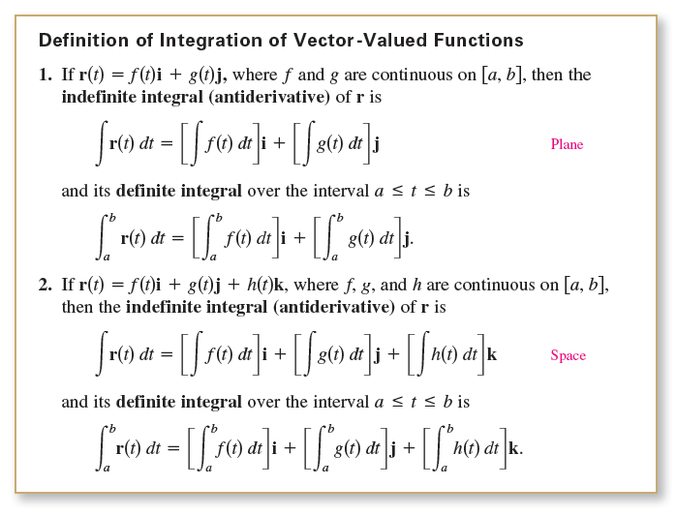
Integration of Vector-Valued Functions
The following definition is a consequence of the definition of the derivative of a vector-valued function.

Slide 21
Integration of Vector-Valued Functions
The antiderivative of a vector-valued function is a family of vector-valued functions all differing by a constant vector C.
For instance, if r(t) is a three-dimensional vector-valued function, then for the indefinite integral ∫r(t) dt, you obtain three constants of integration
where F′(t) = f(t), G′(t) = g(t), and H′(t) = h(t).

Slide 22
Integration of Vector-Valued Functions
These three scalar constants produce one vector constant of integration
∫r(t) dt = [F(t) + C₁]i + [G(t) + C₂]j + [H(t) + C₃]k
= [F(t)i + G(t)j + H(t)k] + [C₁i + C₂ j + C₃k]
= R(t) + C
where R′(t) = r(t).

Slide 23
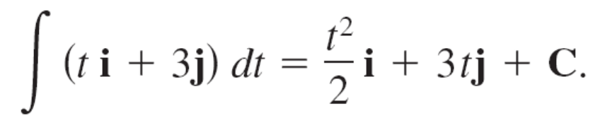
Example 5 – Integrating a Vector-Valued Function
Find the indefinite integral
∫(t i + 3j) dt.
Solution:
Integrating on a component-by-component basis produces

