Slide 1

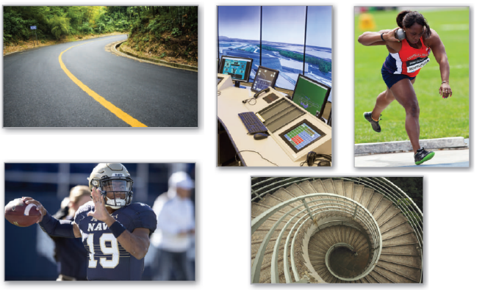
12
P
Vector-Valued Functions
Copyright © Cengage Learning. All rights reserved.

Slide 2

12.3
Velocity and Acceleration
Copyright © Cengage Learning. All rights reserved.

Slide 3
Objectives
Describe the velocity and acceleration associated with a vector-valued function.
Use a vector-valued function to analyze projectile motion.

Slide 4

Velocity and Acceleration
As an object moves along a curve in the plane, the coordinates x and y of its center of mass are each functions of time t.
Rather than using the letters f and g to represent these two functions, it is convenient to write x = x(t) and y = y(t).
So, the position vector r(t) takes the form
r(t) = x(t)i + y(t)j.

Slide 5

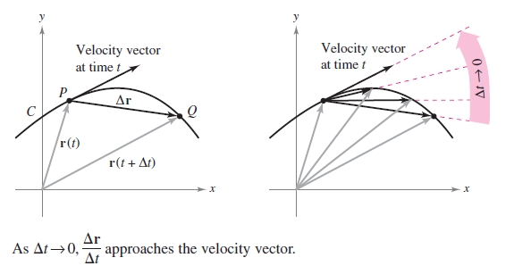
Velocity and Acceleration
To find the velocity and acceleration vectors at a given time t, consider a point Q(x(t + t), y(t + t)) that is approaching the point P(x(t), y(t)) along the curve C
given by
r(t) = x(t)i + y(t)j, as shown in Figure 12.11.
Figure 12.11

Slide 6


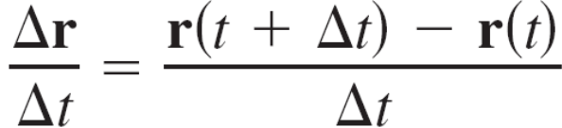
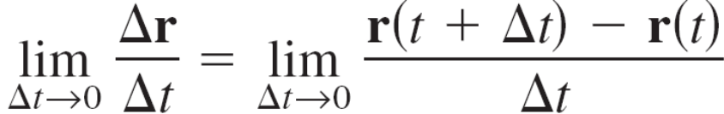
Velocity and Acceleration
As t 0, the direction of the vector (denoted by r) approaches the direction of motion at time t.
r = r(t + t) – r(t)
When this limit exists, it is defined as the velocity vector or tangent vector to the curve at point P.

Slide 7
Velocity and Acceleration
Note that this is the same limit used to define r'(t). So, the direction of r'(t) gives the direction of motion at time t.
Moreover, the magnitude of the vector r'(t)
gives the speed of the object at time t.

Slide 8
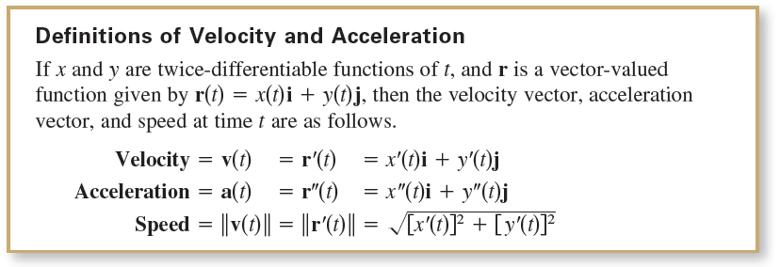
Velocity and Acceleration
Similar to how r'(t) is used to find velocity, you can use r''(t) to find acceleration, as indicated in the following definitions.

Slide 9
Velocity and Acceleration
For motion along a space curve, the definitions are similar.
That is, for
r(t) = x(t)i + y(t)j + z(t)k
you have the following.
Velocity = v(t) = r'(t) = x'(t)i + y'(t)j + z'(t)k
Acceleration = a(t) = r''(t) = x''(t)i + y''(t)j + z''(t)k
Speed =

Slide 10
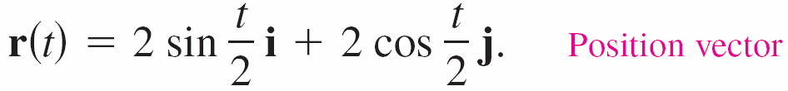





Example 1 – Velocity and Acceleration Along a Plane Curve
Find the (a) velocity vector, (b) speed, and (c) acceleration vector for the particle that moves along the plane curve C described by
Solution:
a.
b.
c.

Slide 11
Projectile Motion

Slide 12
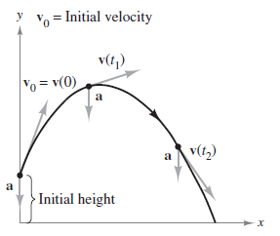
Projectile Motion
You now have the machinery to derive the parametric equations for the path of a projectile.
Assume that gravity is the only force
acting on the projectile after it is
launched. So, the motion occurs
in a vertical plane, which can be
represented by the xy-coordinate
system with the origin as a point
on Earth’s surface, as shown
in Figure 12.17.
Figure 12.17

Slide 13

Projectile Motion
For a projectile of mass m, the force due to gravity is
F = – mgj
where the acceleration due to gravity is
g = 32 feet per second per second, or
9.8 meters per second per second.
By Newton’s Second Law of Motion, this same force produces an acceleration a = a(t), and satisfies the equation F = ma.
Consequently, the acceleration of the projectile is given by ma = – mgj, which implies that
a = –gj.

Slide 14

Example 5 – Derivation of the Position Vector for a Projectile
A projectile of mass m is launched from an initial position r₀ with an initial velocity v₀. Find its position vector as a function of time.
Solution:
Begin with the acceleration a(t) = –gj and integrate twice.
v(t) = a(t) dt = –gj dt = –gtj + C₁
r(t) = v(t) dt = (–gtj + C₁)dt = gt²j + C₁t + C₂

Slide 15

Example 5 – Solution
cont’d
You can use the initial conditions v(0) = v₀ and r(0) = r₀ to solve for the constant vectors C₁ and C₂.
Doing this produces C₁ = v₀ and C₂ = r₀.
Therefore, the position vector is

Slide 16
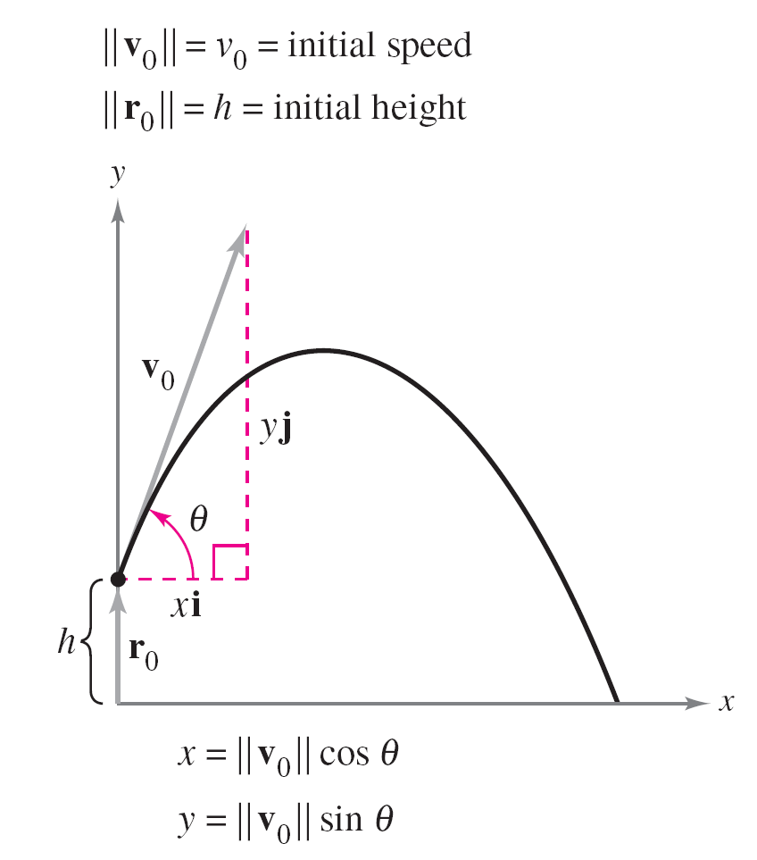
Projectile Motion
In many projectile problems, the constant vectors r₀ and v₀
are not given explicitly.
Often you are given the initial
height h, the initial speed v₀,
and the angle θ at which the
projectile is launched,
as shown in Figure 12.18.
Figure 12.18

Slide 17
Projectile Motion
From the given height, you can deduce that r₀ = hj. Because the speed gives the magnitude of the initial velocity, it follows that v₀ = ||v₀|| and you can write
v₀ = xi + yj
= (||v₀|| cos θ)i + (||v₀|| sin θ)j
= v₀ cos θi + v₀ sin θj.

Slide 18



Projectile Motion
So, the position vector can be written in the form

Slide 19
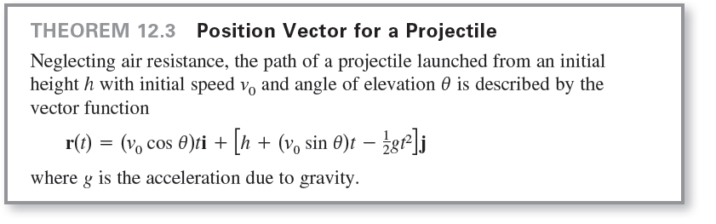
Projectile Motion

Slide 20
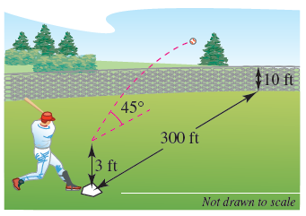
Example 6 – Describing the Path of a Baseball
A baseball is hit 3 feet above ground level at 100 feet per second and at an angle of 45° with respect to the ground, as shown in Figure 12.19. Find the maximum height reached by the baseball. Will it clear a 10-foot-high fence located 300 feet from home plate?
Figure 12.19

Slide 21
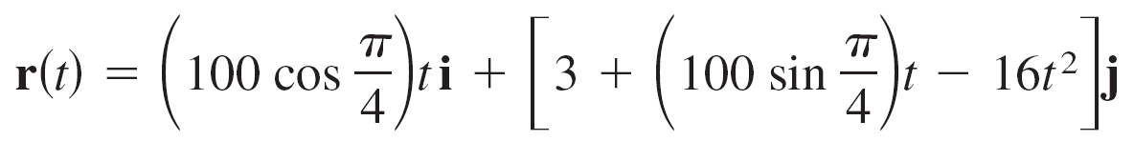
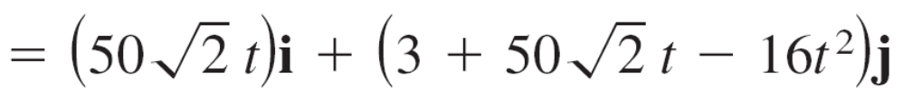

Example 6 – Solution
You are given h = 3, v₀ = 100, and θ = 45°.
So, using Theorem 12.3 with g = 32 feet per second per second produces
The velocity vector is

Slide 22

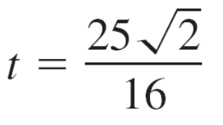

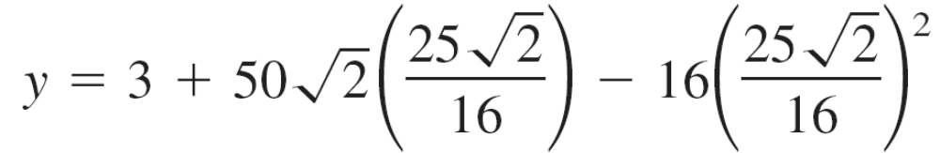
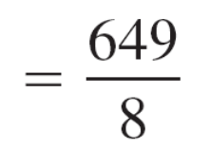

Example 6 – Solution
cont’d
The maximum height occurs when
is equal to 0, which implies that
So, the maximum height reached by the ball is

Slide 23


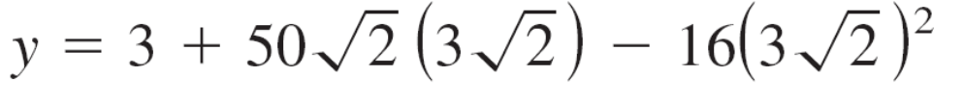
Example 6 – Solution
cont’d
The ball is 300 feet from where it was hit when
Solving this equation for t produces
At this time, the height of the ball is
= 303 – 288
= 15 feet.
Therefore, the ball clears the 10-foot fence for a home run.

