Slide 1


12
P
Vector-Valued Functions
Copyright © Cengage Learning. All rights reserved.

Slide 2

Tangent Vectors and Normal Vectors
12.4
Copyright © Cengage Learning. All rights reserved.

Slide 3
Objectives
Find a unit tangent vector and a principal unit
normal vector at a point on a space curve.
Find the tangential and normal components of
acceleration.

Slide 4
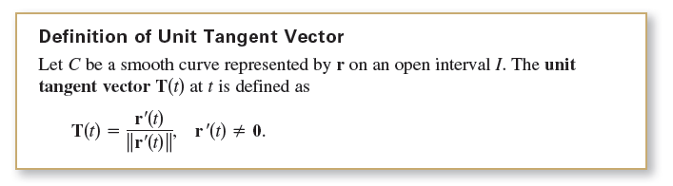
Tangent Vectors and Normal Vectors
The velocity vector points in the direction of motion. This observation leads to the next definition, which applies to any smooth curve—not just to those for which the parameter represents time.
We know that a curve is smooth on an interval when r' is continuous and nonzero on the interval. So, “smoothness”
is sufficient to guarantee that a curve has a unit tangent vector.

Slide 5
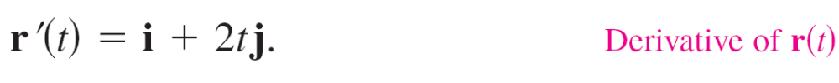
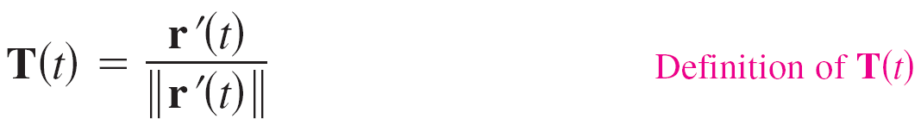
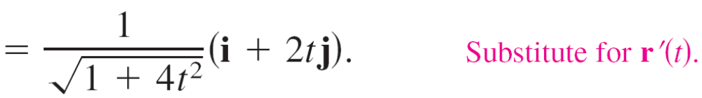
Example 1 – Finding the Unit Tangent Vector
Find the unit tangent vector to the curve given by
r(t) = t i + t² j
when t = 1.
Solution:
The derivative of r(t) is
So, the unit tangent vector is

Slide 6
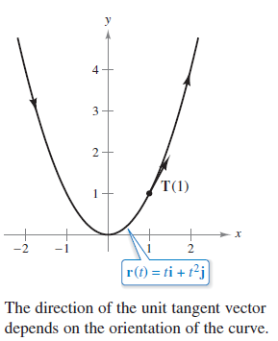
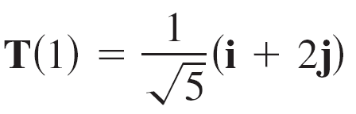
Example 1 – Solution
cont’d
When t = 1, the unit tangent vector is
as shown in Figure 12.20.
Figure 12.20

Slide 7
Tangent Vectors and Normal Vectors
The tangent line to a curve at a point is the line that passes through the point and is parallel to the unit tangent vector.
In Example 2, the unit tangent vector is used to find the tangent line at a point on a helix.

Slide 8
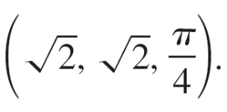
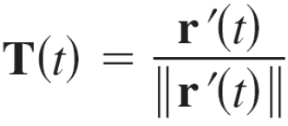
Example 2 – Finding the Tangent Line at a Point on a Curve
Find T(t) and then find a set of parametric equations for the tangent line to the helix given by
r(t) = 2 cos t i + 2 sin t j + t k
at the point
Solution:
The derivative of r(t) is r'(t) = –2 sin t i + 2 cos t j + k which
implies that
Therefore, the unit tangent vector is

Slide 9
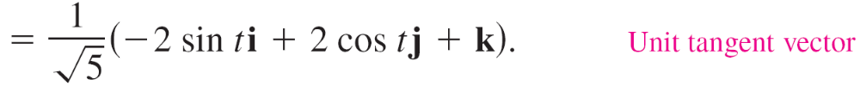

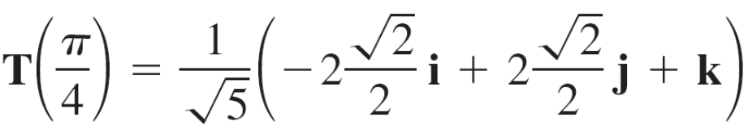
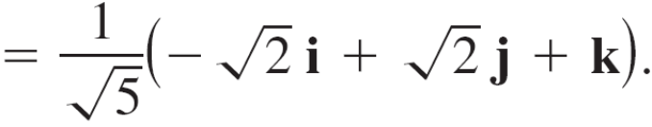
Example 2 – Solution
cont’d
At the point and the unit tangent vector is

Slide 10







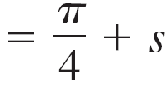
Example 2 – Solution
cont’d
Using the direction numbers
and the point you can obtain the parametric equations (given with parameter s) listed below.

Slide 11
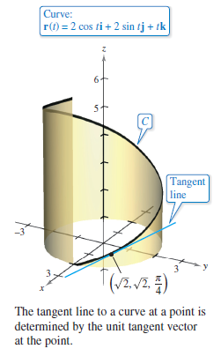
Example 2 – Solution
cont’d
This tangent line is shown in Figure 12.21.
Figure 12.21

Slide 12

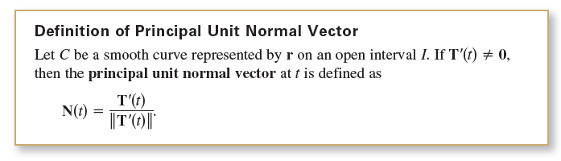
Tangent Vectors and Normal Vectors
In Example 2, there are infinitely many vectors that are orthogonal to the tangent vector T(t). One of these is the vector T'(t) . This follows the property
T(t)  T(t) = ||T(t)||² =1 T(t)  T'(t) = 0
By normalizing the vector T'(t), you obtain a special vector called the principal unit normal vector, as indicated in the next definition.

Slide 13




Example 3 – Finding the Principle Unit Normal Vector
Find N(t) and N(1) for the curve represented by
r(t) = 3t i + 2t² j.
Solution:
By differentiating, you obtain
which implies that
So, the unit tangent vector is

Slide 14
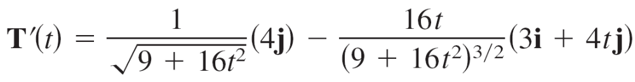
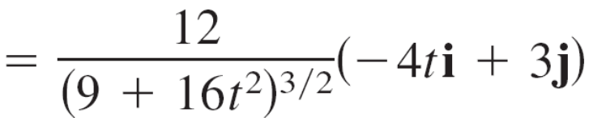
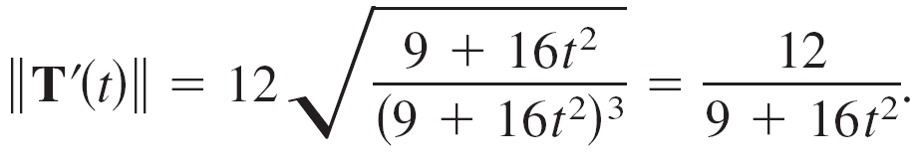
Example 3 – Solution
cont’d
Differentiate T(t) with respect to t to obtain
which implies that

Slide 15
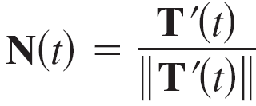
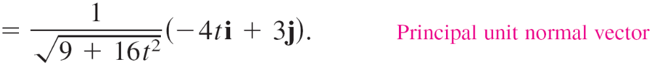
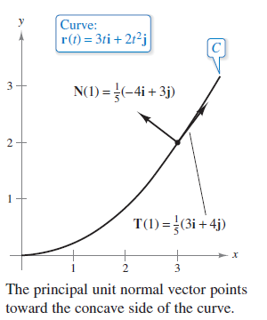
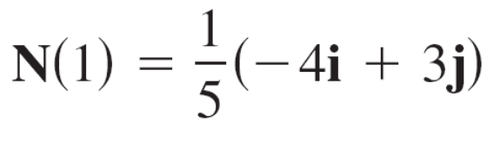
Example 3 – Solution
cont’d
Therefore, the principal unit normal vector is
When t = 1, the principal unit normal
vector is
as shown in Figure 12.22.
Figure 12.22

Slide 16

Tangent Vectors and Normal Vectors
The principal unit normal vector can be difficult to evaluate algebraically. For plane curves, you can simplify the algebra by finding
T(t) = x(t)i + y(t)j Unit tangent vector
and observing that N(t) must be either

Slide 17

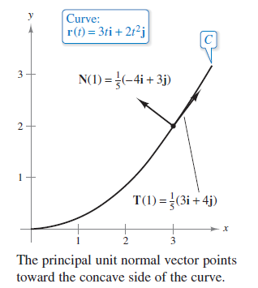
Tangent Vectors and Normal Vectors
Because it follows that both N₁(t) and N₂(t) are unit normal vectors.
The principal unit normal vector N is the one that points toward the concave side of the curve, as shown in Figure 12.22.
Figure 12.22

Slide 18
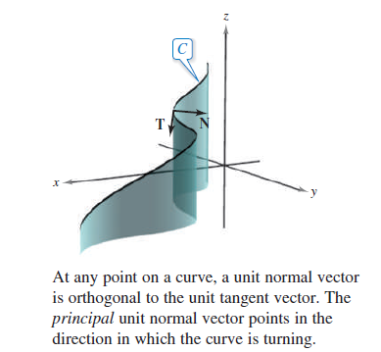
Tangent Vectors and Normal Vectors
This also holds for curves in space.
That is, for an object moving along a curve C in space, the vector T(t) points in the direction the object is moving, whereas the vector N(t) is orthogonal to T(t) and points in the direction in which the object is turning, as shown in Figure 12.23.
Figure 12.23

Slide 19
Tangential and Normal Components of Acceleration

Slide 20
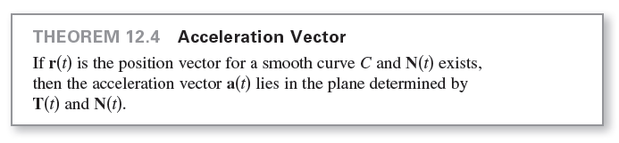
Tangential and Normal Components of Acceleration
In general, part of the acceleration (the tangential component) acts in the line of motion, and part of it (the normal component) acts perpendicular to the line of motion. In order to determine these two components, you can use the unit vectors T(t) and N(t), which serve in much the same way as do i and j in representing vectors in the plane.
The following theorem states that the acceleration vector lies in the plane determined by T(t) and N(t).

Slide 21


Tangential and Normal Components of Acceleration
The coefficients of T and N in the proof of Theorem 12.4 are called the tangential and normal components of acceleration and are denoted by
So, you can write

Slide 22
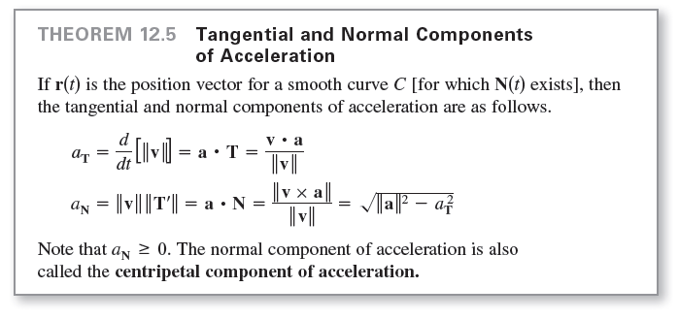
Tangential and Normal Components of Acceleration
The following theorem lists some convenient formulas for a_{T} and a_{N}.

Slide 23
Example 5 – Tangential and Normal Components of Acceleration
Find the tangential and normal components of acceleration for the position vector given by r(t) = 3t i – t j + t² k.
Solution:
Begin by finding the velocity, speed, and acceleration.

Slide 24
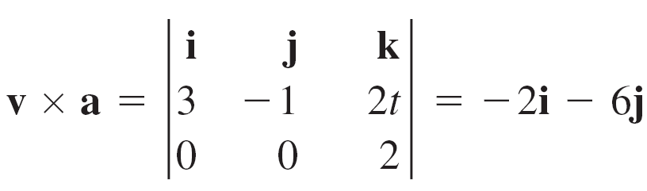
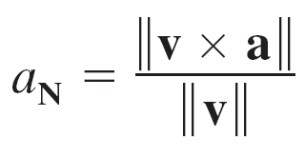
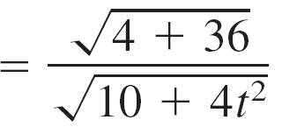
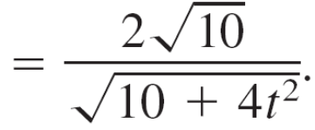

Example 5 – Solution
cont’d
By Theorem 12.5, the tangential component of acceleration is
and because
the normal component of acceleration is

