Slide 1


12
P
Vector-Valued Functions
Copyright © Cengage Learning. All rights reserved.

Slide 2

12.5
Arc Length and Curvature
Copyright © Cengage Learning. All rights reserved.

Slide 3
Objectives
Find the arc length of a space curve.
Use the arc length parameter to describe a plane curve or space curve.
Find the curvature of a curve at a point on the curve.
Use a vector-valued function to find frictional force.

Slide 4
Arc Length

Slide 5
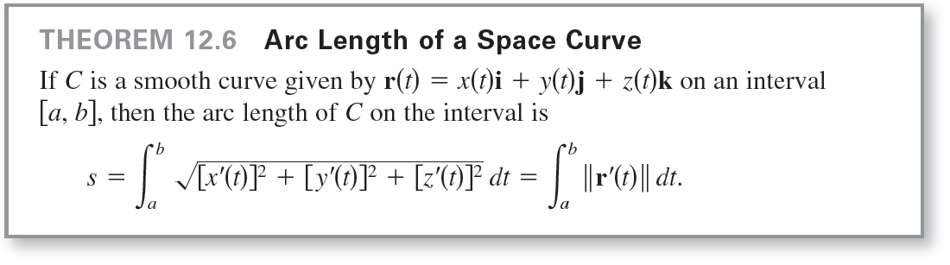
Arc Length
The formula for the arc length of a plane curve has a natural extension to a smooth curve in space, as stated in the next theorem.

Slide 6
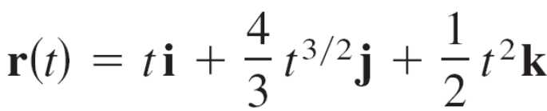
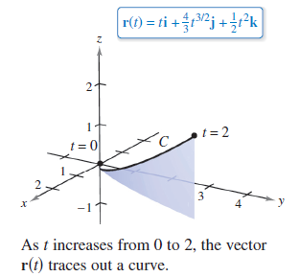
Example 1 – Finding the Arc Length of a Curve in Space
Find the arc length of the curve given by
from t = 0 to t = 2, as shown in Figure 12.28.
Figure 12.28

Slide 7

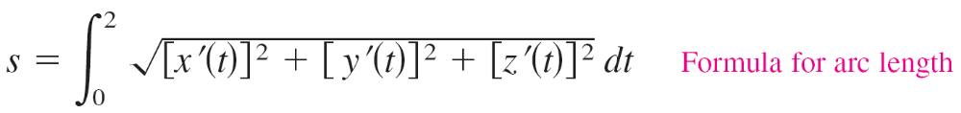
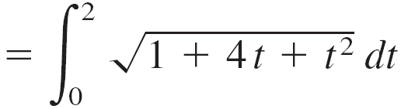
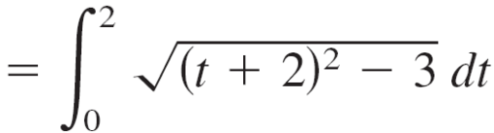

Example 1 – Solution
Using x(t) = t, y(t) = t ^{3/2}, and z(t) = t ², you obtain x′(t) = 1, y′(t) = 2t^{1/2}, and z′(t) = t.
So, the arc length from t = 0 and t = 2 is given by

Slide 8
Arc Length Parameter

Slide 9
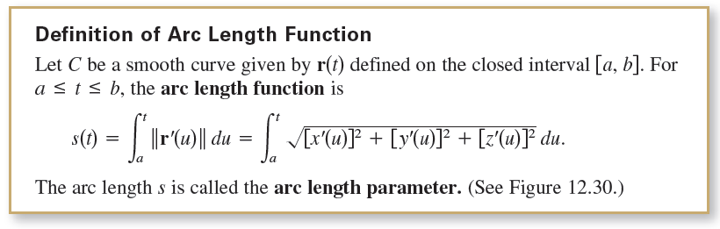
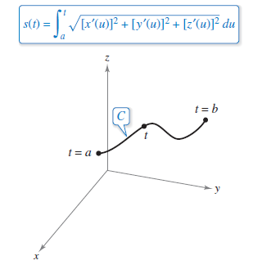
Arc Length Parameter
Figure 12.30

Slide 10
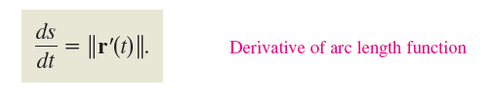

Arc Length Parameter
Using the definition of the arc length function and the Second Fundamental Theorem of Calculus, you can conclude that
In differential form, you can write

Slide 11
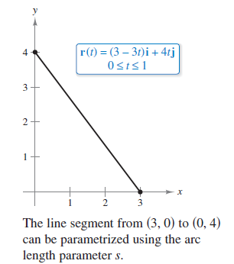
Example 3 – Finding the Arc Length Function for a Line
Find the arc length function s(t) for the line segment given by
r(t) = (3 – 3t)i + 4t j, 0 ≤ t ≤ 1
and write r as a function of the parameter s. (See Figure 12.31.)
Figure 12.31

Slide 12

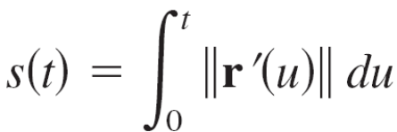
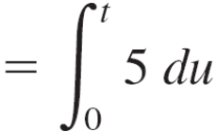

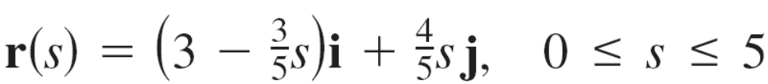
Example 3 – Solution
Because r′(t) = –3i + 4j and
you have
Using s = 5t (or t = s/5), you can rewrite r using the arc length parameter as follows.

Slide 13
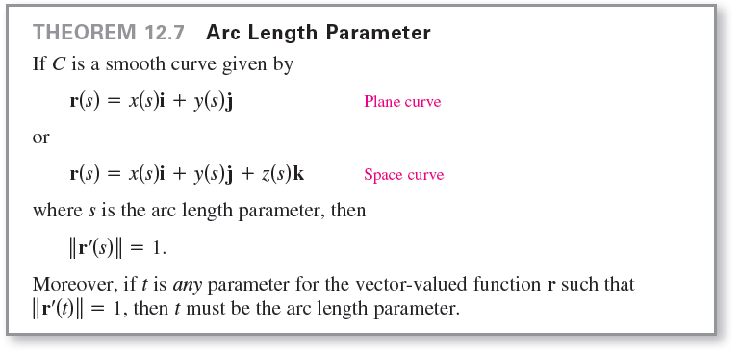
Arc Length Parameter

Slide 14
Curvature

Slide 15
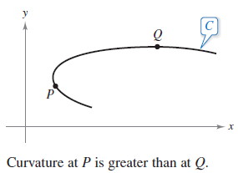
Curvature
An important use of the arc length parameter is to find curvature—the measure of how sharply a curve bends.
For instance, in Figure 12.32, the curve bends more sharply at P than at Q, and you can say that the curvature is greater at P than at Q.
Figure 12.32

Slide 16
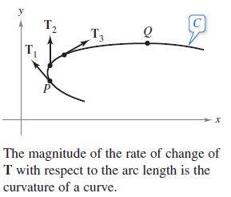
Curvature
You can calculate curvature by calculating the magnitude of the rate of change of the unit tangent vector T with respect to the arc length s, as shown in Figure 12.33.
Figure 12.33

Slide 17
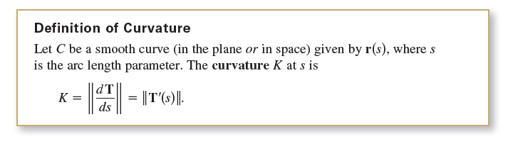
Curvature
A circle has the same curvature at any point. Moreover, the curvature and the radius of the circle are inversely related. That is, a circle with a large radius has a small curvature, and a circle with a small radius has a large curvature.

Slide 18
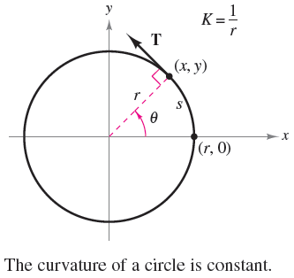
Example 4 – Finding the Curvature of a Circle
Show that the curvature of a circle of radius r is K = 1/r.
Solution: Without loss of generality, you can consider the circle to be centered at the origin.
Let (x, y) be any point on the circle and let s be the length of the arc from (r, 0) to (x, y), as shown in Figure 12.34.
Figure 12.34

Slide 19

Example 4 – Solution
cont’d
By letting θ be the central angle of the circle, you can represent the circle by
Using the formula for the length of a circular arc s = rθ, you can rewrite r(θ ) in terms of the arc length parameter as follows.

Slide 20


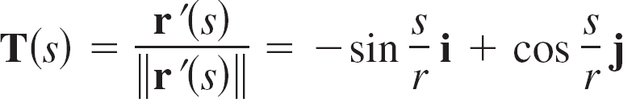
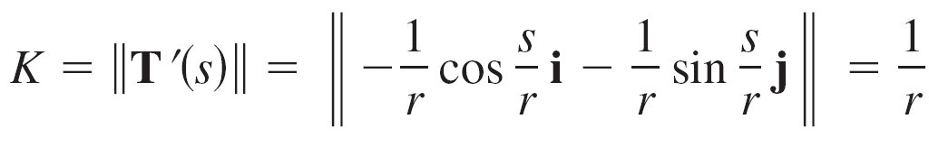
Example 4 – Solution
cont’d
So, , and it follows that ,
which implies that the unit tangent vector is
and the curvature is
at every point on the circle.

Slide 21
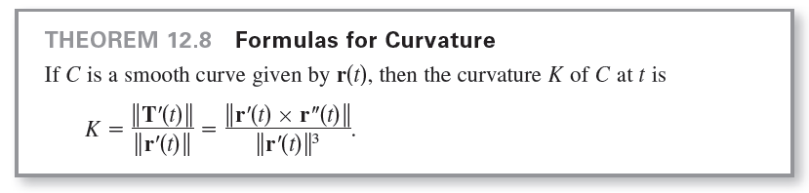

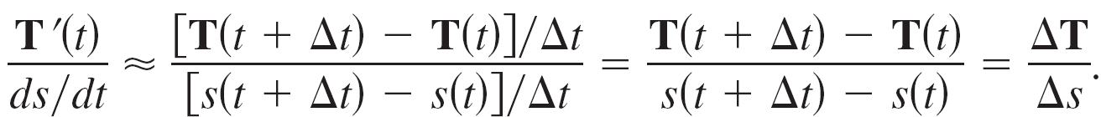
Curvature
Because , the first formula implies that curvature is the ratio of the rate of change of the unit tangent vector T to the rate of change of the arc length. To see that this is reasonable, let Δt be a “small number.” Then,

Slide 22
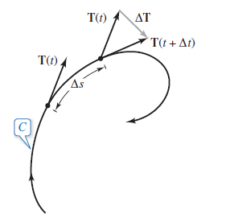
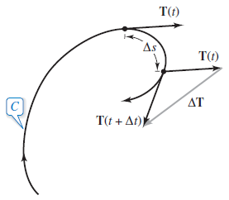
Curvature
In other words, for a given Δs, the greater the length of ΔT, the more the curve bends at t, as shown in Figure 12.35.
Figure 12.35

Slide 23








Example 5 – Finding the Curvature of a Space Curve
Find the curvature of the curve given by
Solution: It is not apparent whether this parameter represents arc length, so you should use the formula

Slide 24

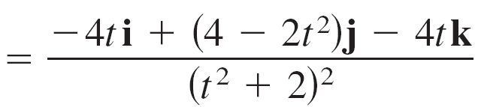
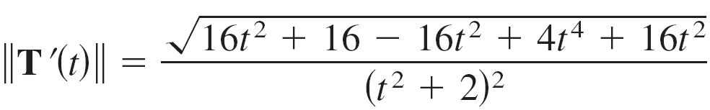


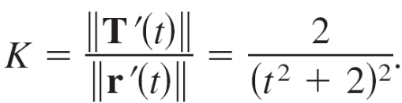

Example 5 – Solution
cont’d
Therefore,

Slide 25
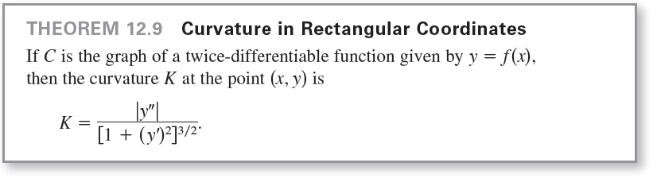
Curvature

Slide 26
Curvature
Let C be a curve with curvature K at point P. The circle passing through point P with radius r = 1/K is called the circle of curvature when the circle lies on the concave side of the curve and shares a common tangent line with the curve at point P.
The radius is called the radius of curvature at P, and the center of the circle is called the center of curvature.

Slide 27
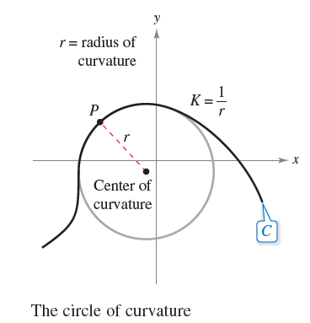
Curvature
The circle of curvature gives you a nice way to estimate the curvature K at a point P on a curve graphically. Using a compass, you can sketch a circle that lies against the concave side of the curve at point P, as shown in
Figure 12.36.
If the circle has a radius of r, then
you can estimate the curvature to
be K = 1/r.
Figure 12.36

Slide 28

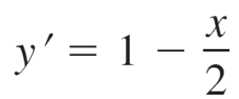

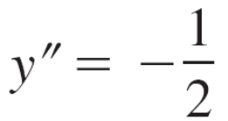
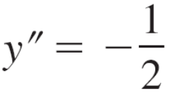
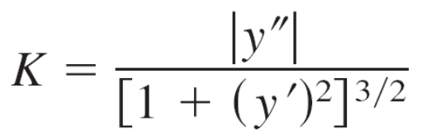
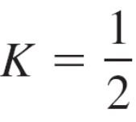
Example 6 – Finding Curvature in Rectangular Coordinates
Find the curvature of the parabola given by
at x = 2. Sketch the circle of curvature at (2, 1).
Solution: The curvature at x = 2 is as follows.

Slide 29

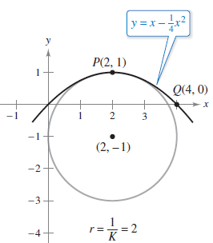
Example 6 – Solution
cont’d
Because the curvature at P(2, 1) is , it follows that the
radius of the circle of curvature at that point is 2.
So, the center of curvature is (2, –1), as shown in
Figure 12.37.
[In the figure, note that the curve
has the greatest curvature at P.]
Figure 12.37

Slide 30
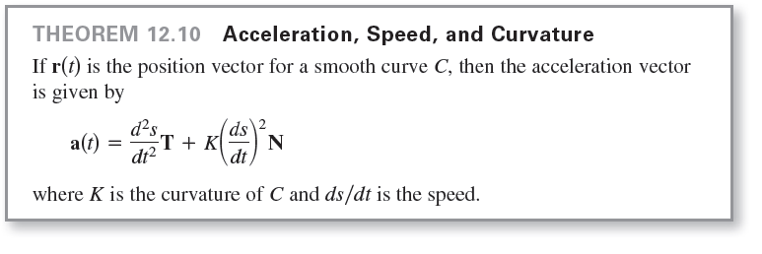
Curvature

Slide 31

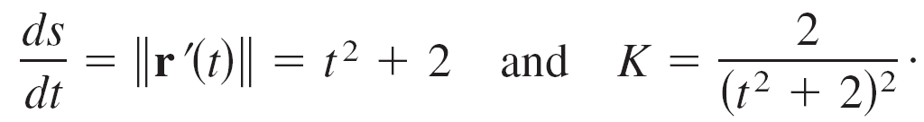
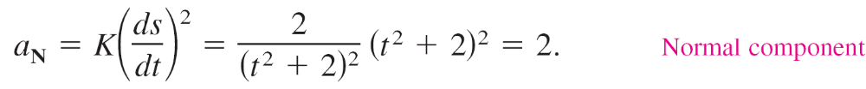
Example 7 – Tangential and Normal Components of Acceleration
Find a_{T} and a_{N} for the curve given by
Solution: From Example 5, you know that
Therefore,
and

Slide 32
Application

Slide 33
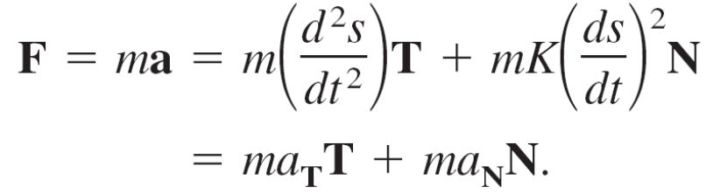
Application
There are many applications in physics and engineering dynamics that involve the relationships among speed, arc length, curvature, and acceleration. One such application concerns frictional force.
A moving object with mass m is in contact with a stationary object. The total force required to produce an acceleration a along a given path is
The portion of this total force that is supplied by the stationary object is called the force of friction.

Slide 34
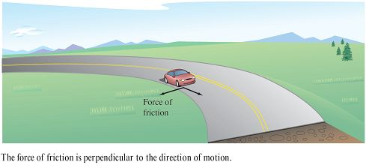
Application
For example, when a car moving with constant speed is rounding a turn, the roadway exerts a frictional force that keeps the car from sliding off the road.
If the car is not sliding, the frictional force is perpendicular to the direction of motion and has magnitude equal to the normal component of acceleration, as shown in
Figure 12.39. The potential frictional force of a road around a turn can be increased by banking the roadway.
Figure 12.39

Slide 35
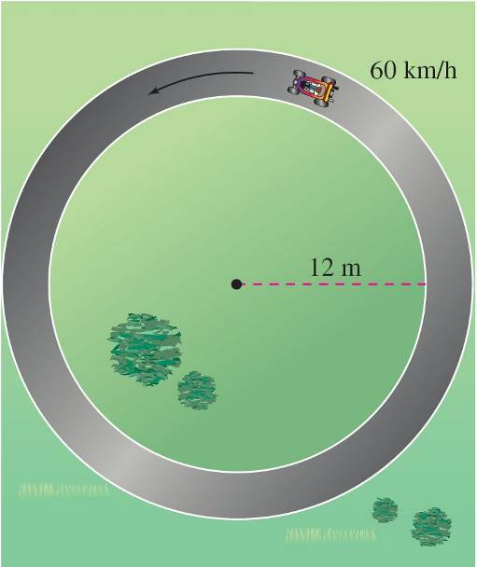
Example 8 – Frictional Force
A 360-kilogram go-cart is driven at a speed of
60 kilometers per hour around a circular racetrack of radius
12 meters, as shown in Figure 12.40. To keep the cart from skidding off course, what frictional force must the track surface exert on the tires?
Figure 12.40

Slide 36
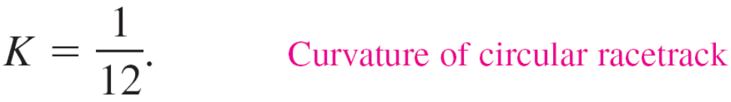
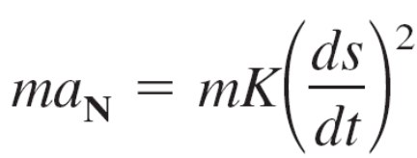
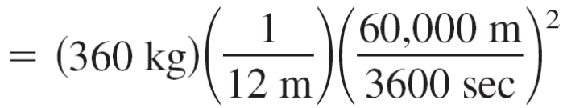

Example 8 – Solution
The frictional force must equal the mass times the normal component of acceleration.
For this circular path, you know that the curvature is
Therefore, the frictional force is

Slide 37
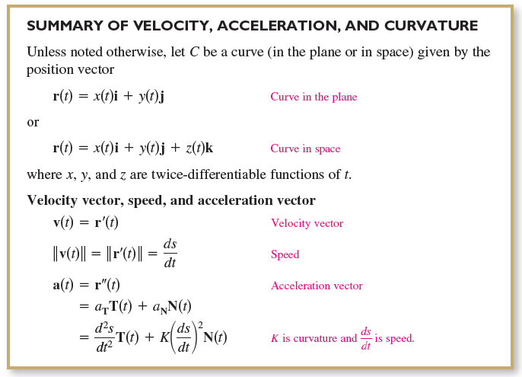
Application

Slide 38
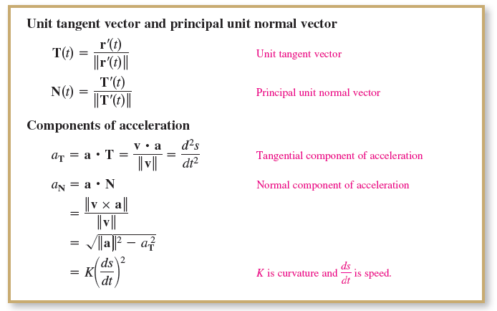
Application
cont’d

Slide 39
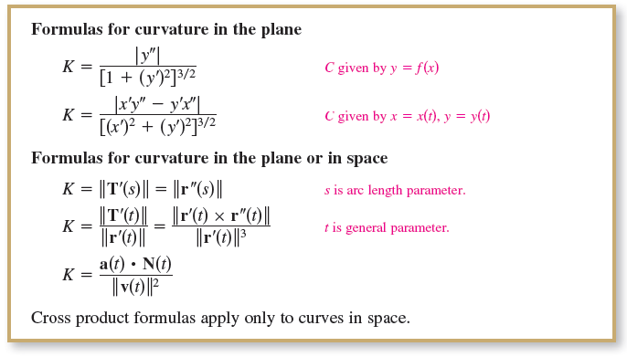
Application
cont’d

