Slide 1


13
P
Functions of Several Variables
Copyright © Cengage Learning. All rights reserved.

Slide 2

13.2
Limits and Continuity
Copyright © Cengage Learning. All rights reserved.

Slide 3
Objectives
Understand the definition of a neighborhood in the plane.
Understand and use the definition of the limit of a function of two variables.
Extend the concept of continuity to a function of two variables.
Extend the concept of continuity to a function of three variables.

Slide 4
Neighborhoods in the Plane

Slide 5
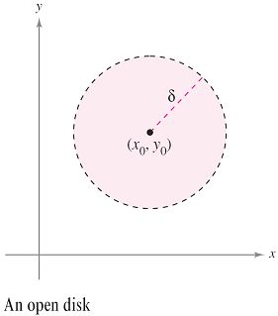

Neighborhoods in the Plane
Using the formula for the distance between two points (x, y)
and (x₀, y₀) in the plane, you can define the
δ-neighborhood about (x₀, y₀) to be the disk centered at
(x₀, y₀) with radius δ > 0
as shown in Figure 13.17.
Figure 13.17

Slide 6
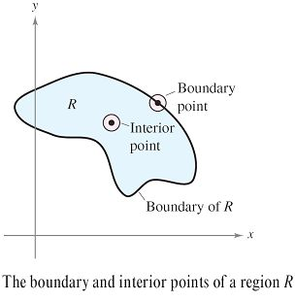
Neighborhoods in the Plane
When this formula contains the less than inequality sign, <,
the disk is called open, and when it contains the less than
or equal to inequality sign, ≤, the disk is called closed. This corresponds to the use of < and ≤ to define open and closed intervals.
Let the region R be a set of points
in the plane. A point (x₀, y₀) in R is
an interior point of R if there exists
a δ-neighborhood about (x₀, y₀) that
lies entirely in R, as shown in
Figure 13.18.
Figure 13.18

Slide 7
Neighborhoods in the Plane
If every point in R is an interior point, then R is an open
region. A point (x₀, y₀) is a boundary point of R if every
open disk centered at (x₀, y₀) contains points inside R and
points outside R. If R contains all its boundary points, then
R is a closed region.

Slide 8
Limit of a Function of Two Variables

Slide 9
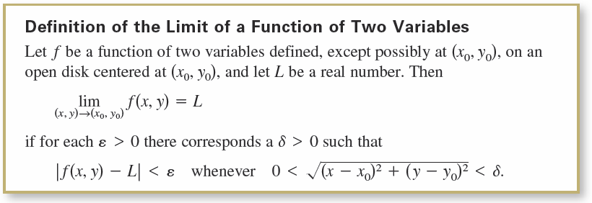
Limit of a Function of Two Variables

Slide 10
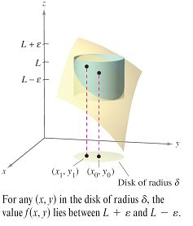
Limit of a Function of Two Variables
Graphically, the definition of the limit of a function of two variables implies that for any point (x, y) ≠ (x₀, y₀) in the disk of radius δ, the value f(x, y) lies between L + ε and
L – ε, as shown in Figure 13.19.
Figure 13.19

Slide 11
Limit of a Function of Two Variables
The definition of the limit of a function of two variables is
similar to the definition of the limit of a function of a single
variable, yet there is a critical difference.
To determine whether a function of a single variable has a limit, you need only test the approach from two directions—from the right and from the left.
When the function approaches the same limit from the right and from the left, you can conclude that the limit exists.

Slide 12
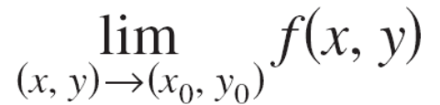
Limit of a Function of Two Variables
For a function of two variables, however, the statement
(x, y) → (x₀, y₀)
means that the point (x, y) is allowed to approach (x₀, y₀)
from any direction.
If the value of
is not the same for all possible approaches, or paths, to
(x₀, y₀), then the limit does not exist.

Slide 13

Example 1 – Verifying a Limit by the Definition
Show that
Solution:
Let f(x, y) = x and L = a.
You need to show that for each ε > 0, there exists a
δ-neighborhood about (a, b) such that
|f(x, y) – L| = |x – a| < ε
whenever (x, y) ≠ (a, b) lies in the neighborhood.

Slide 14




Example 1 – Solution
cont’d
You can first observe that from
it follows that
So, you can choose δ = ε, and the limit is verified.

Slide 15
Limit of a Function of Two Variables
Limits of functions of several variables have the same properties regarding sums, differences, products, and quotients as do limits of functions of single variables.

Slide 16
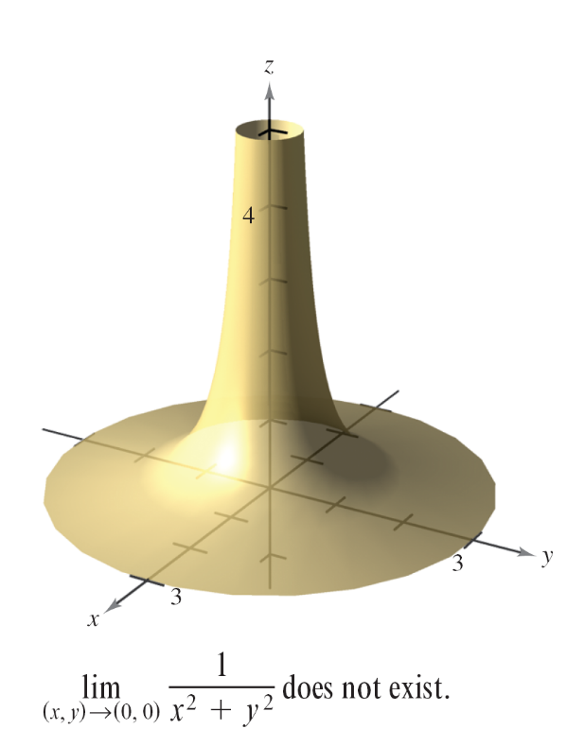
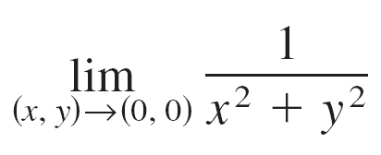
Limit of a Function of Two Variables
For some functions, it is easy to recognize that a limit does not exist.
For instance, it is clear that the limit
does not exist because the values
of f(x, y) increase without bound
as (x, y) approaches (0, 0) along
any path (see Figure 13.21).
Figure 13.21

Slide 17
Continuity of a Function of Two Variables

Slide 18
Continuity of a Function of Two Variables
The limit of f(x, y) = 5x²y/(x² + y²) as (x, y) → (1, 2) can be
evaluated by direct substitution.
That is, the limit is f(1, 2) = 2.
In such cases, the function f is said to be continuous at the point (1, 2).

Slide 19
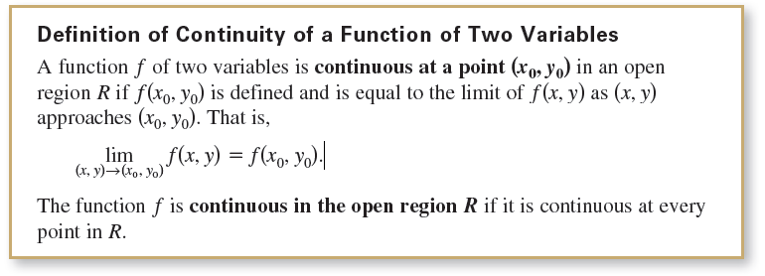
Continuity of a Function of Two Variables

Slide 20
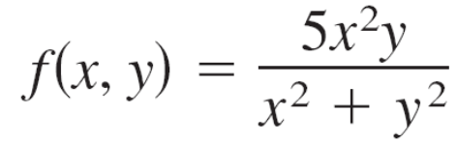
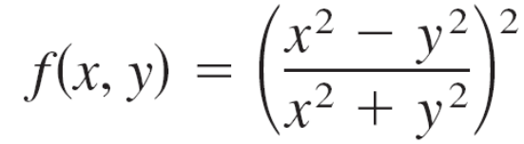
Continuity of a Function of Two Variables
The function
is not continuous at (0, 0). Because the limit at this point exists, however, you can remove the discontinuity by defining f at (0, 0) as being equal to its limit there. Such a discontinuity is called removable.
The function
is not continuous at (0, 0), and this discontinuity is
nonremovable.

Slide 21
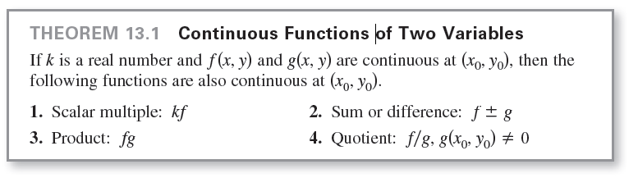
Continuity of a Function of Two Variables
Theorem 13.1 establishes the continuity of polynomial and
rational functions at every point in their domains.
Furthermore, the continuity of other types of functions can
be extended naturally from one to two variables.

Slide 22
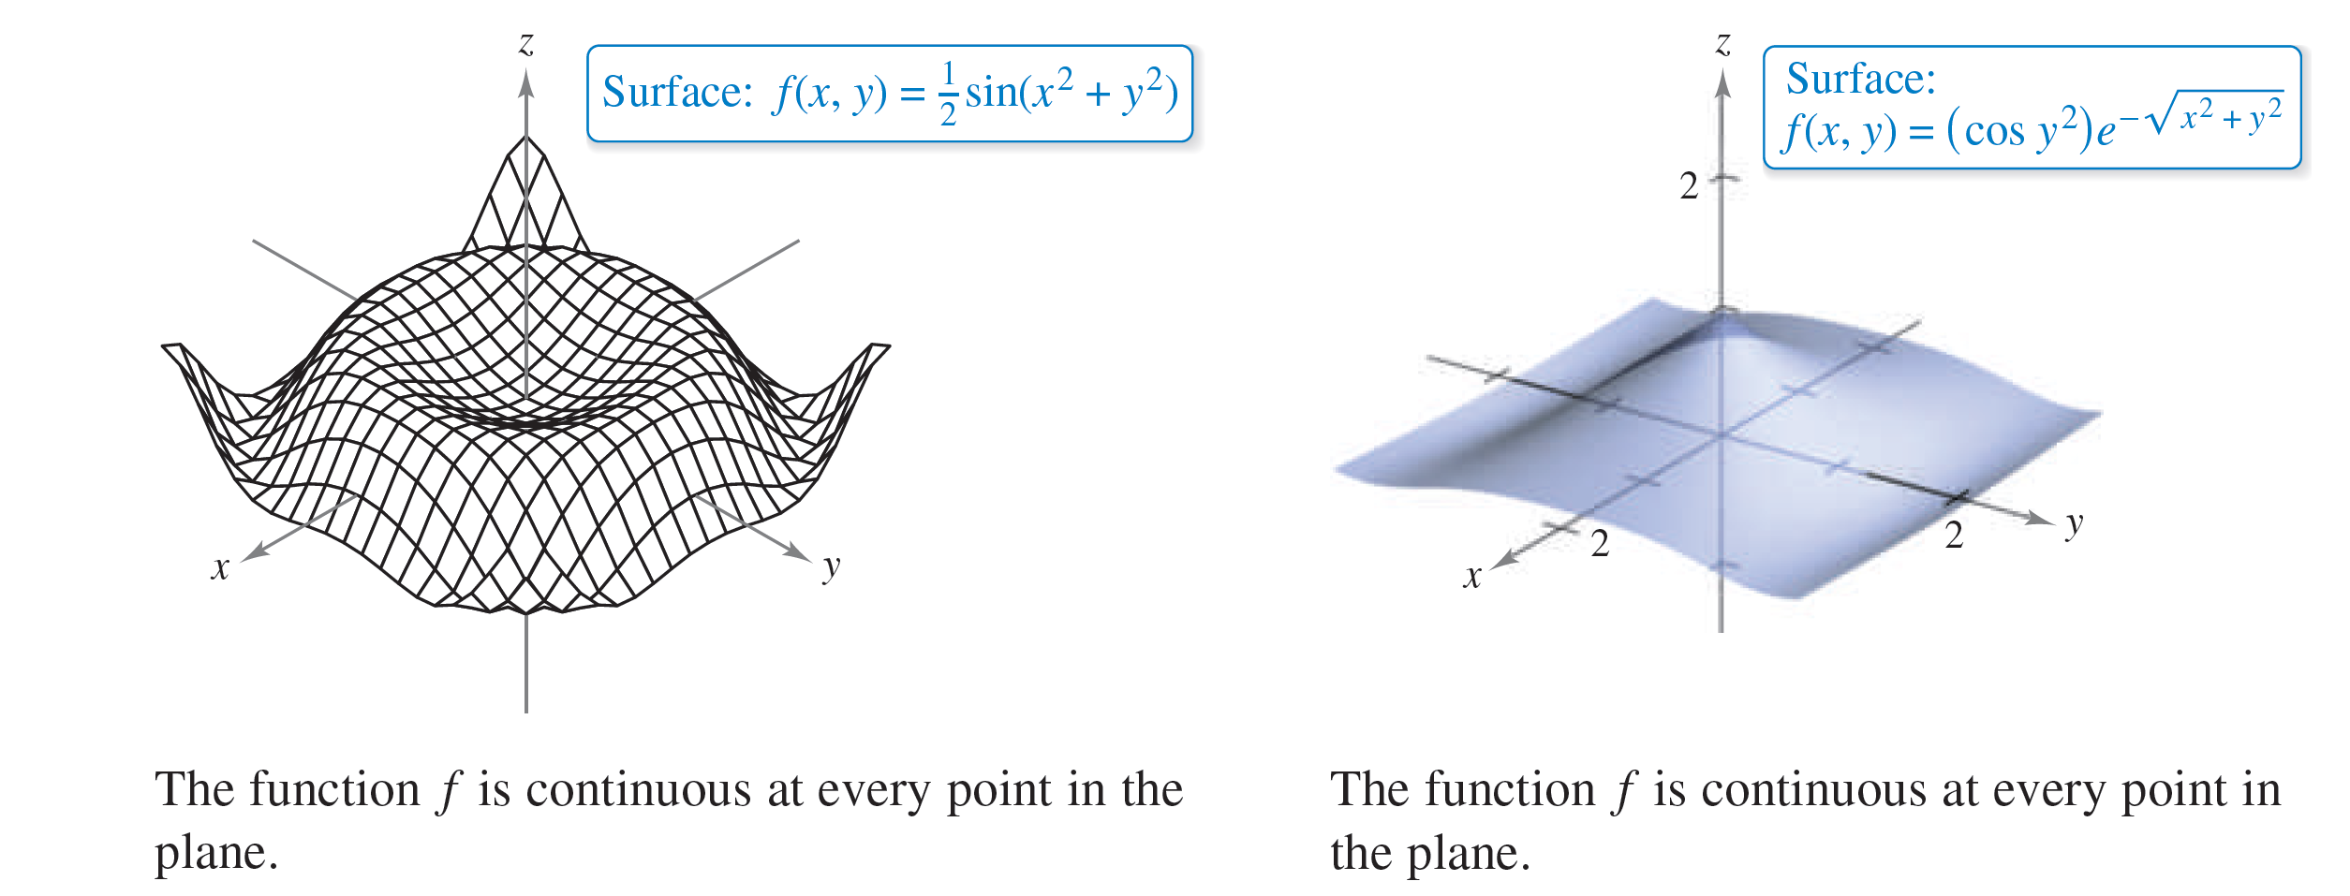
Continuity of a Function of Two Variables
For instance, the functions whose graphs are shown in
Figures 13.23 and 13.24 are continuous at every point in
the plane.
Figure 13.23
Figure 13.24

Slide 23
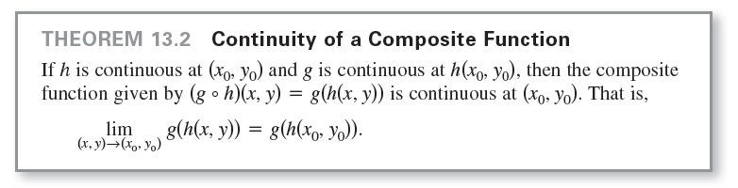
Continuity of a Function of Two Variables
Note in Theorem 13.2 that h is a function of two variables and g is a function of one variable.

Slide 24
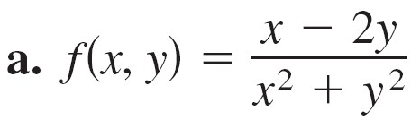
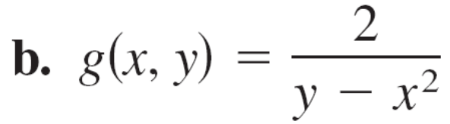
Example 5 – Testing for Continuity
Discuss the continuity of each function.

Slide 25
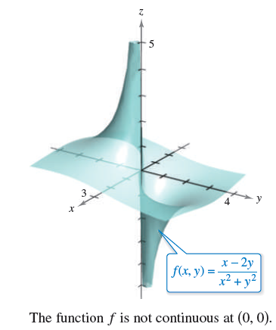
Example 5(a) – Solution
Because a rational function is continuous at every point in
its domain, you can conclude that f is continuous at each
point in the xy-plane except at (0, 0), as shown in
Figure 13.25.
Figure 13.25

Slide 26
Example 5(b) – Solution
cont’d
The function g(x, y) = 2/(y – x²) is continuous except at the points at which the denominator is 0. These points are given by the equation
y – x² = 0.
So, you can conclude that the function is continuous at all points except those lying on the parabola y = x².

Slide 27
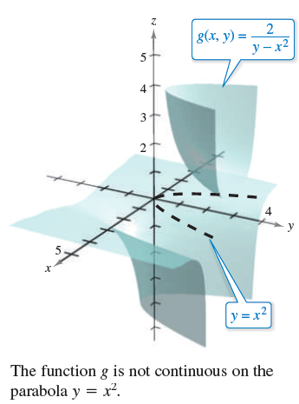
Example 5(b) – Solution
cont’d
Inside this parabola, you have y > x², and the surface represented by the function lies above the xy-plane, as shown in Figure 13.26.
Outside the parabola, y < x², and the surface lies below the
xy-plane.
Figure 13.26

Slide 28
Continuity of a Function of Three Variables

Slide 29

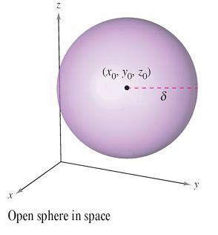
Continuity of a Function of Three Variables
The definitions of limits and continuity can be extended to functions of three variables by considering points (x, y, z) within the open sphere
The radius of this sphere is δ, and
the sphere is centered at (x₀, y₀, z₀),
as shown in Figure 13.27.
Figure 13.27

Slide 30
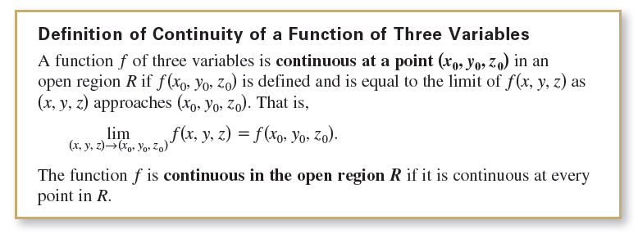
Continuity of a Function of Three Variables
A point (x₀, y₀, z₀) in a region R in space is an interior
point of R if there exists a δ-sphere about (x₀, y₀, z₀) that
lies entirely in R. If every point in R is an interior point, then
R is called open.

Slide 31

Example 6 – Testing Continuity of a Function of Three Variables
Discuss the continuity of
Solution:
The function f is continuous except at the points at which the denominator is 0, which are given by the equation
So, f is continuous at each point in space except at the points on the paraboloid

