Slide 1


13
P
Functions of Several Variables
Copyright © Cengage Learning. All rights reserved.

Slide 2

13.3
Partial Derivatives
Copyright © Cengage Learning. All rights reserved.

Slide 3
Objectives
Find and use partial derivatives of a function of two variables.
Find and use partial derivatives of a function of three or more variables.
Find higher-order partial derivatives of a function of two or three variables.

Slide 4
Partial Derivatives of a Function of Two Variables

Slide 5
Partial Derivatives of a Function of Two Variables
You can determine the rate of change of a function f with respect to one of its several independent variables.
This process is called partial differentiation, and the result is referred to as the partial derivative of f with respect to the chosen independent variable.

Slide 6
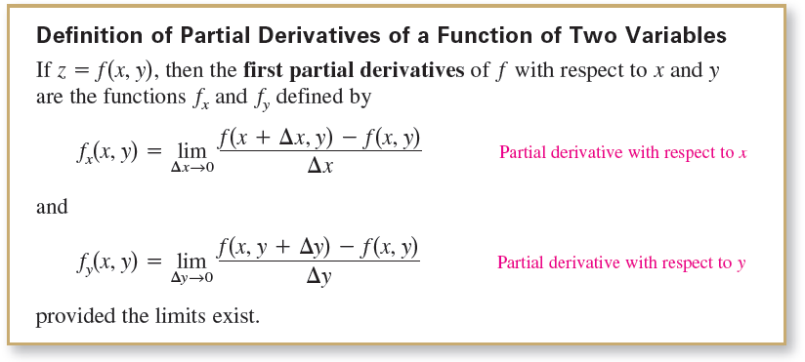
Partial Derivatives of a Function of Two Variables
This definition indicates that if z = f(x, y), then to find f_{x}, you consider y constant and differentiate with respect to x.
Similarly, to find f_{y}, you consider x constant and differentiate with respect to y.

Slide 7




Example 1 – Finding Partial Derivatives
a. To find f_{x} for f (x, y) = 3x – x²y² + 2x³y, consider y to be constant and differentiate with respect to x.
To find f_{y}, consider x to be constant and differentiate with respect to y.

Slide 8




Example 1 – Finding Partial Derivatives
cont’d
b. To find f_{x} for (x, y) = (ln x)(sin x²y), consider y to be
constant and differentiate with respect to x.
To find f_{y}, consider x to be constant and differentiate with respect to y.

Slide 9
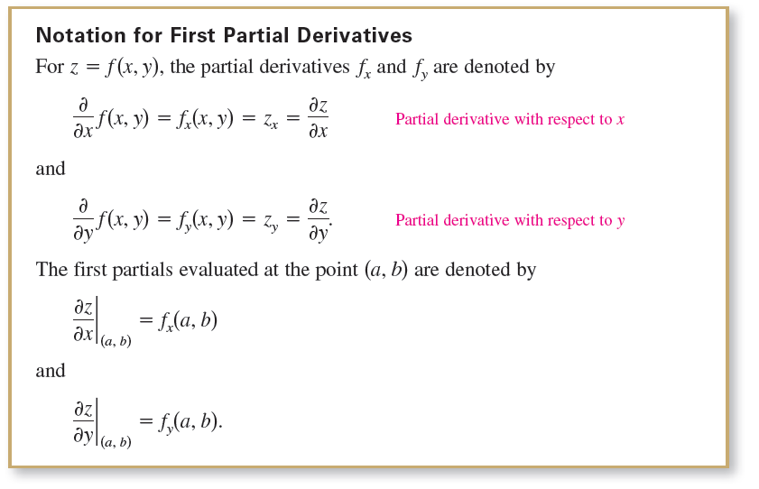
Partial Derivatives of a Function of Two Variables

Slide 10
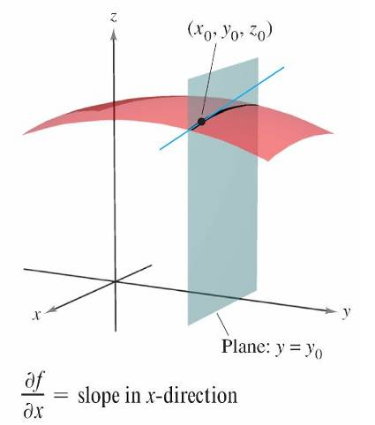
Partial Derivatives of a Function of Two Variables
The partial derivatives of a function of two variables,
z = f(x, y), have a useful geometric interpretation. If y = y₀, then z = f(x, y₀) represents the curve formed by intersecting the surface z = f(x, y) with the plane y = y₀, as shown in Figure 13.28.
Figure 13.28

Slide 11
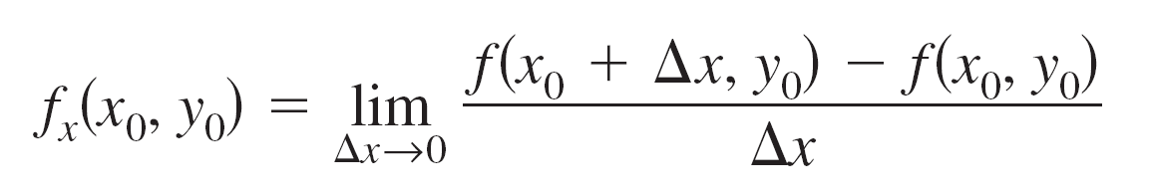
Partial Derivatives of a Function of Two Variables
Therefore,
represents the slope of this curve at the point
(x₀, y₀, f(x₀, y₀)).
Note that both the curve and the tangent line lie in the plane y = y₀.

Slide 12
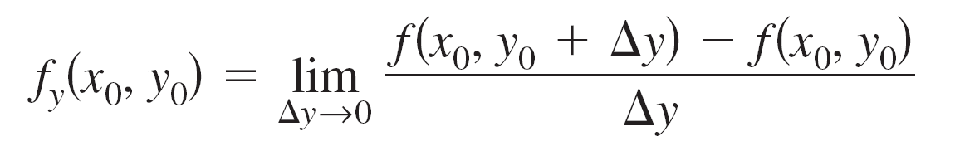
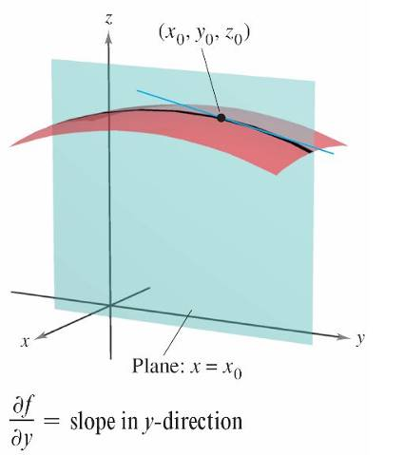
Partial Derivatives of a Function of Two Variables
Similarly,
represents the slope of the curve given by the intersection of z = f(x, y) and the plane x = x₀ at (x₀, y₀, f(x₀, y₀)), as shown in Figure 13.29.
Figure 13.29

Slide 13
Partial Derivatives of a Function of Two Variables
Informally, the values of ∂f/∂x and ∂f/∂y at the point
(x₀, y₀, z₀) denote the slopes of the surface in the
x- and y-directions, respectively.

Slide 14
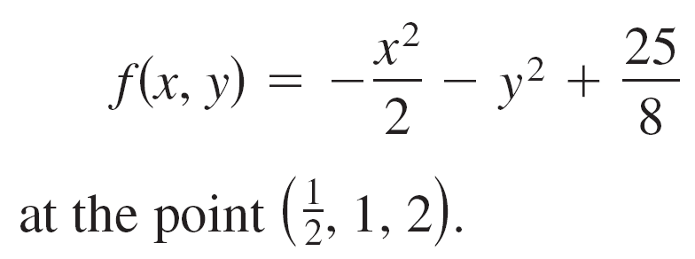
Example 3 – Finding the Slopes of a Surface
Find the slopes in the x-direction and in the y-direction of the surface
at the point
Solution:
The partial derivatives of f with respect to x and y are

Slide 15

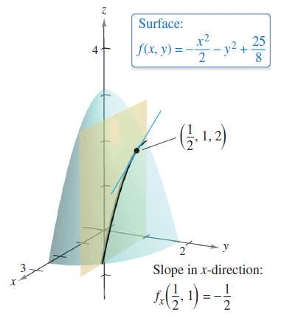
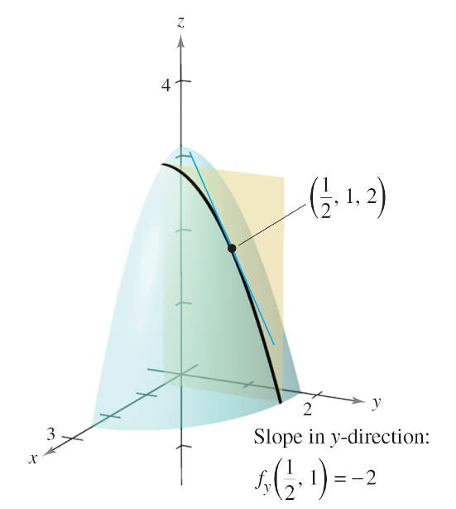
Example 3 – Solution
cont’d
So, in the x-direction, the slope is
and in the y-direction, the slope is
Figure 13.30
Figure 13.31

Slide 16
Partial Derivatives of a Function of Three or More Variables

Slide 17
Partial Derivatives of a Function of Three or More Variables
The concept of a partial derivative can be extended naturally to functions of three or more variables. For instance, if w = f(x, y, z), then there are three partial derivatives, each of which is formed by holding two of the variables constant.
That is, to define the partial derivative of w with respect to x, consider y and z to be constant and differentiate with respect to x.
A similar process is used to find the derivatives of w with respect to y and with respect to z.

Slide 18
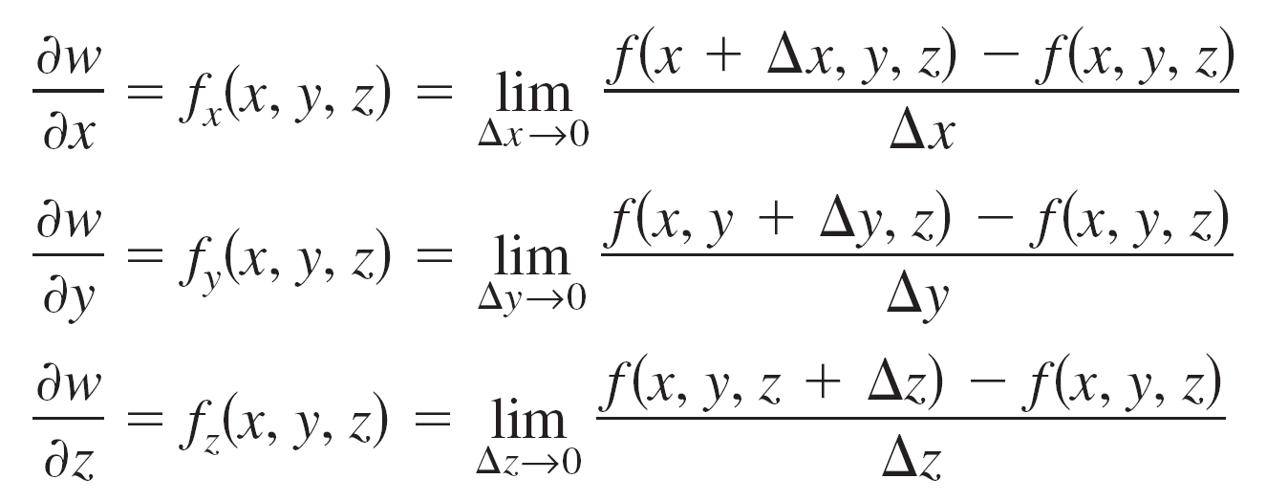
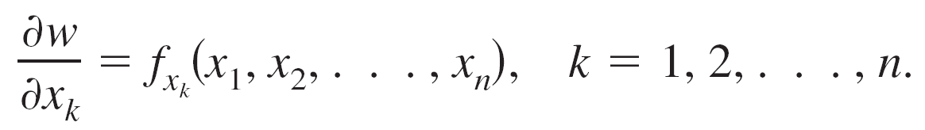
Partial Derivatives of a Function of Three or More Variables
In general, if w = f(x₁, x₂, . . . , x_{n}), then there are n partial derivatives denoted by
To find the partial derivative with respect to one of the variables, hold the other variables constant and differentiate with respect to the given variable.

Slide 19
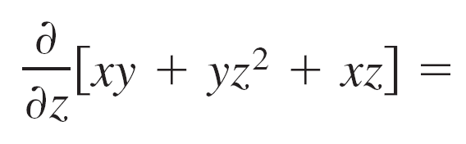

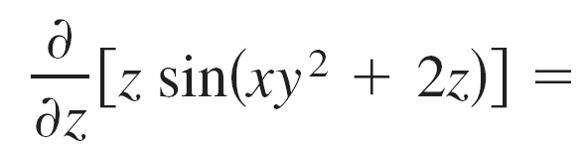
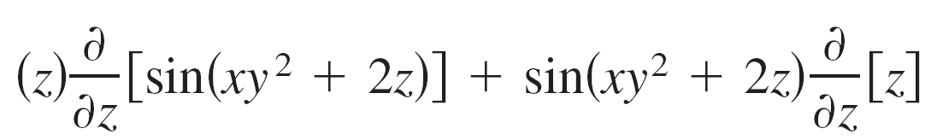
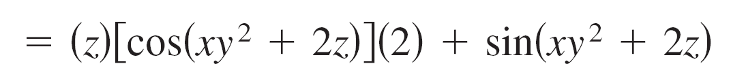
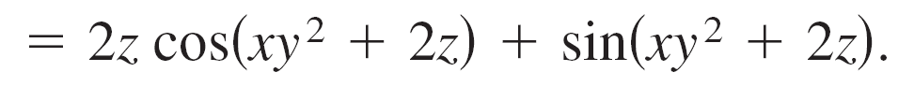
Example 6 – Finding Partial Derivatives
a. To find the partial derivative of f(x, y, z) = xy + yz² + xz with respect to z, consider x and y to be constant and obtain
b. To find the partial derivative of f(x, y, z) = z sin(xy² + 2z) with respect to z, consider x and y to be constant. Then, using the Product Rule, you obtain

Slide 20

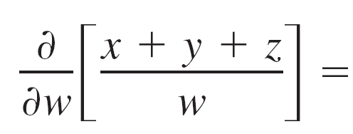
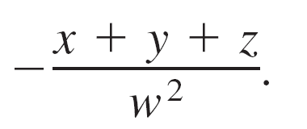
Example 6 – Finding Partial Derivatives
cont’d
c. To find the partial derivative of
with respect to w, consider x, y, and z to be constant
obtain

Slide 21
Higher-Order Partial Derivatives

Slide 22



Higher-Order Partial Derivatives
The function z = f(x, y) has the following second partial derivatives.
1. Differentiate twice with respect to x:
2. Differentiate twice with respect to y:
3. Differentiate first with respect to x and then with respect
to y:

Slide 23

Higher-Order Partial Derivatives
4. Differentiate first with respect to y and then with respect to x:
The third and fourth cases are called mixed partial derivatives.

Slide 24
Example 7 – Finding Second Partial Derivatives
Find the second partial derivatives of
f(x, y) = 3xy² – 2y + 5x²y² and determine the value of
f_{xy}(–1, 2).
Solution:
Begin by finding the first partial derivatives with respect to x and y.
f_{x}(x, y) = 3y² + 10xy² and f_{y}(x, y) = 6xy – 2 + 10x²y
Then, differentiate each of these with respect to x and y.
f_{xx}(x, y) = 10y² and f_{yy}(x, y) = 6x + 10x²

Slide 25
Example 7 – Solution
cont’d
f_{xy}(x, y) = 6y + 20xy and f_{yx}(x, y) = 6y + 20xy
At (–1, 2), the value of f_{xy} is f_{xy}(–1, 2) = 12 – 40 = –28.

Slide 26
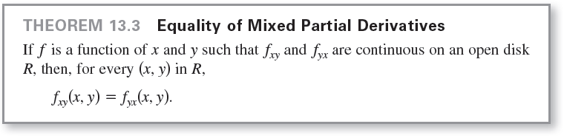
Higher-Order Partial Derivatives

Slide 27
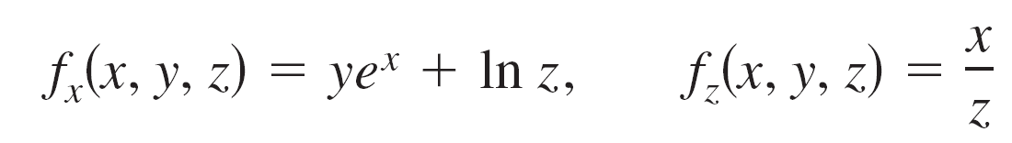
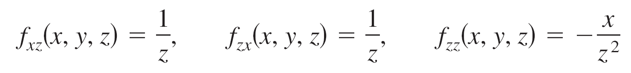
Example 8 – Finding Higher-Order Partial Derivatives
Show that f_{xz} = f_{zx} and f_{xzz} = f_{zxz} = f_{zzx} for the function
f(x, y, z) = ye^{x} + x ln z.
Solution: First partials:
Second partials (note that the first two are equal):
Third partials (note that all three are equal):

