Slide 1


13
P
Functions of Several Variables
Copyright © Cengage Learning. All rights reserved.

Slide 2

13.4
Differentials
Copyright © Cengage Learning. All rights reserved.

Slide 3
Objectives
Understand the concepts of increments and differentials.
Extend the concept of differentiability to a function of two variables.
Use a differential as an approximation.

Slide 4
Increments and Differentials

Slide 5

Increments and Differentials
For y = f(x), the differential of y was defined as
dy = f′(x)dx.
Similar terminology is used for a function of two variables,
z = f(x, y). That is, ∆x and ∆y are the increments of x and y,
and the increment of z is

Slide 6
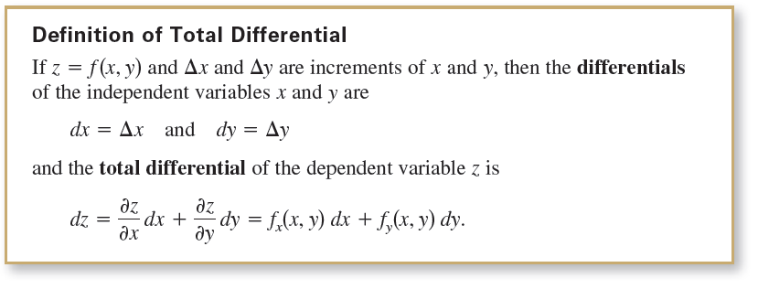

Increments and Differentials
This definition can be extended to a function of three or
more variables. For instance, if w = f(x, y, z, u), then
dx = ∆x, dy = ∆y, dz = ∆z, du = ∆u, and the total differential of w is

Slide 7





Example 1 – Finding the Total Differential
Find the total differential for each function.
a. z = 2x sin y – 3x²y² b. w = x² + y² + z²
Solution:
a. The total differential dz for is
b. The total differential dw for is

Slide 8
Differentiability

Slide 9
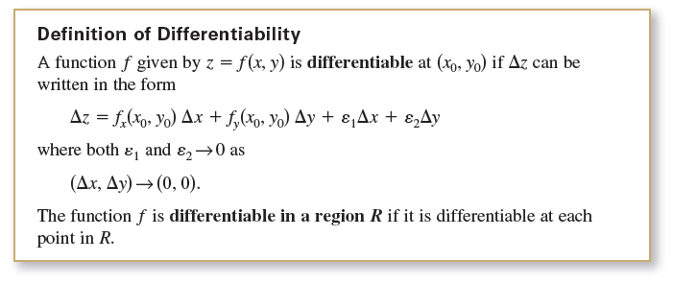
Differentiability
For a differentiable function given by y = f (x), you can use the differential dy = f′(x)dx as an approximation (for small ∆x) of the value ∆y = f (x + ∆x) – f (x).
When a similar approximation is possible for a function of two variables, the function is said to be differentiable. This is stated explicitly in the following definition.

Slide 10
Example 2 – Showing That a Function Is Differentiable
Show that the function
f (x, y) = x² + 3y
is differentiable at every point in the plane.
Solution:
Letting z = f (x, y), the increment of z at an arbitrary point (x, y) in the plane is
∆z = f (x + ∆x, y + ∆y) – f (x, y) Increment of z
= (x + ∆x)² + 3(y + ∆y) − (x² + 3y)
= x² + 2x∆x + (∆x²) + 3y + 3∆y – x² – 3y
= 2x∆x + (∆x)² + 3∆y

Slide 11
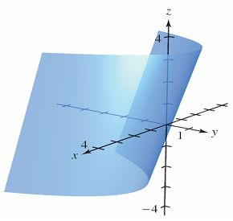
Example 2 – Solution
cont’d
= 2x(∆x) + 3(∆y) + ∆x(∆x) + 0(∆y)
= f_{x}(x, y) ∆x + f_{y}(x, y) ∆y + ε₁∆x + ε₂∆y
where ε₁= ∆x and ε₂= 0.
Because ε₁ → 0 and ε₂ → 0 as
(∆x, ∆y) → (0, 0), it follows that
f is differentiable at every
point in the plane.
The graph of f is shown in
Figure 13.34.
Figure 13.34

Slide 12
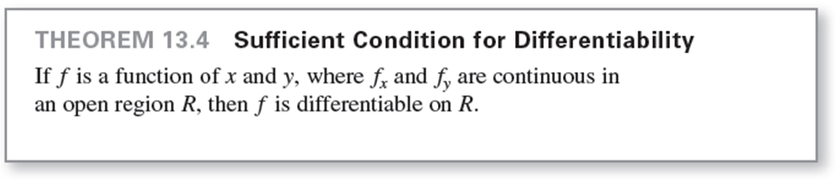
Differentiability

Slide 13
Approximation by Differentials

Slide 14
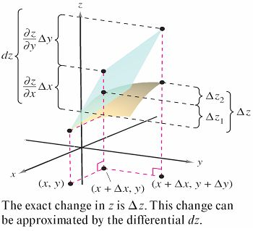
Approximation by Differentials
Theorem 13.4 tells you that you can choose (x + ∆x, y + ∆y) close enough to (x, y) to make ε₁∆x and ε₂∆y insignificant. In other words, for small ∆x and ∆y, you can use the approximation
∆z ≈ dz.
This approximation is illustrated
graphically in Figure 13.35.
Figure 13.35

Slide 15
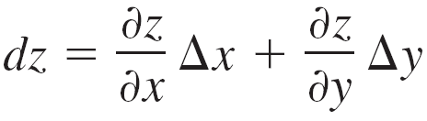
Approximation by Differentials
The partial derivatives ∂z/∂x and ∂z/∂y can be interpreted as the slopes of the surface in the x- and y-directions.
This means that
represents the change in height of a plane that is tangent to the surface at the point (x, y, f(x, y)).
Because a plane in space is represented by a linear equation in the variables x, y, and z, the approximation of ∆z by dz is called a linear approximation.

Slide 16

Example 3 – Using a Differential as an Approximation
Use the differential dz to approximate the change in
z = as (x, y) moves from the point (1, 1) to the point (1.01, 0.97). Compare this approximation with the exact change in z.
Solution:
Letting (x, y) = (1, 1) and (x + ∆x, y + ∆y) = (1.01, 0.97) produces
dx = ∆x = 0.01 and dy = ∆y = –0.03.

Slide 17





Example 3 – Solution
cont’d
So, the change in z can be approximated by
When x = 1 and y = 1, you have

Slide 18
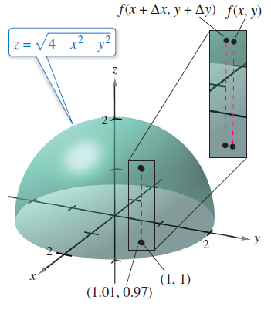

Example 3 – Solution
cont’d
In Figure 13.36, you can see that the exact change corresponds to the difference in the heights of two points on the surface of a hemisphere.
This difference is given by
∆z = f(1.01, 0.97) – f(1, 1)
≈ 0.0137.
Figure 13.36

Slide 19
Approximation by Differentials
A function of three variables w = f(x, y, z) is differentiable at (x, y, z) provided that
∆w = f(x + ∆x, y + ∆y, z + ∆z) – f(x, y, z)
can be written in the form
∆w = f_{x}∆x + f_{y}∆y + f_{z}∆z + ε₁∆x + ε₂∆y + ε₃∆z
where ε₁, ε₂, and ε₃ → 0 as (∆x, ∆y, ∆z) → (0, 0, 0).
With this definition of differentiability, Theorem 13.4 has the following extension for functions of three variables: If f is a function of x, y, and z, where f_{x}, f_{y}, and f_{z} are continuous in an open region R, then f is differentiable on R.

Slide 20
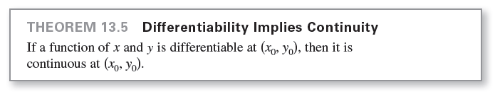
Approximation by Differentials
As is true for a function of a single variable, when a function in two or more variables is differentiable at a point, it is also continuous there.

Slide 21

Example 5 – A Function That Is Not Differentiable
For the function,
show that f_{x}(0, 0) and f_{y}(0, 0) both exist, but that f is not
differentiable at (0, 0).

Slide 22
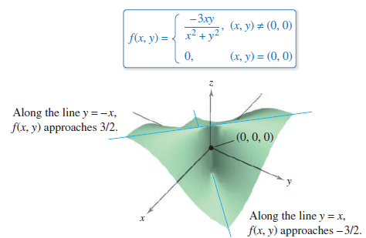
Example 5 – Solution
You can show that f is not differentiable at (0, 0) by showing that it is not continuous at this point.
To see that f is not continuous
at (0, 0), look at the values of
f(x, y) along two different
approaches to (0, 0), as
shown in Figure 13.38.
Figure 13.38

Slide 23
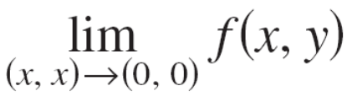
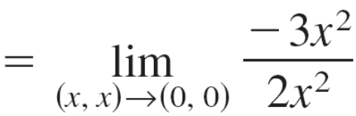
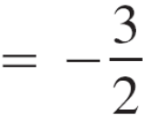
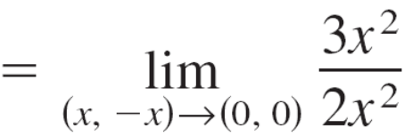
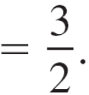

Example 5 – Solution
cont’d
Along the line y = x, the limit is
whereas along y = –x you have
So, the limit of f(x, y) as (x, y) → (0, 0) does not exist, and you can conclude that f is not continuous at (0, 0).
Therefore, by Theorem 13.5, you know that f is not differentiable at (0, 0).

Slide 24
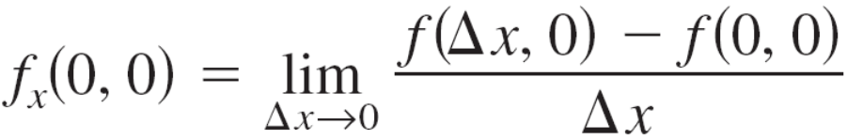
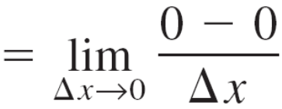

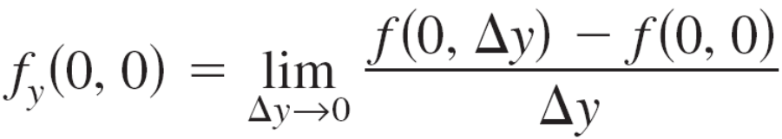
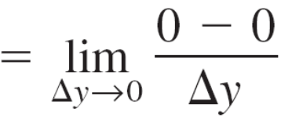

Example 5 – Solution
cont’d
On the other hand, by the definition of the partial derivatives f_{x} and f_{y} you have
and
So, the partial derivatives at (0, 0) exist.

