Slide 1


13
P
Functions of Several Variables
Copyright © Cengage Learning. All rights reserved.

Slide 2

Chain Rules for Functions of Several Variables
13.5
Copyright © Cengage Learning. All rights reserved.

Slide 3
Objectives
Use the Chain Rules for functions of several variables.
Find partial derivatives implicitly.

Slide 4
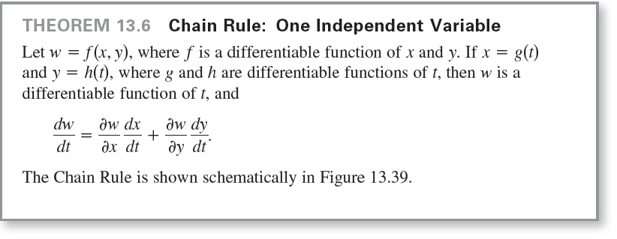
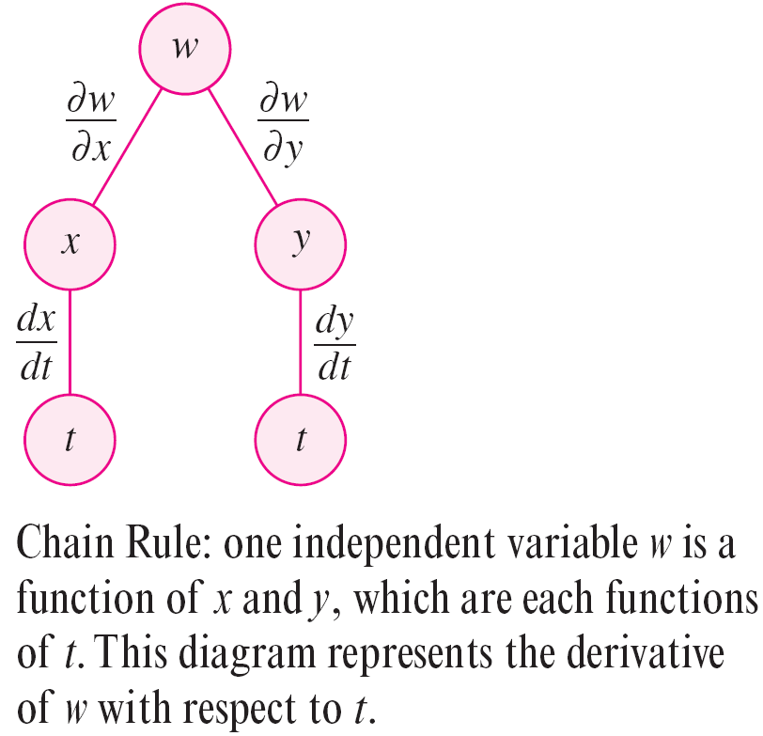
Chain Rules for Functions of Several Variables
Figure 13.39

Slide 5
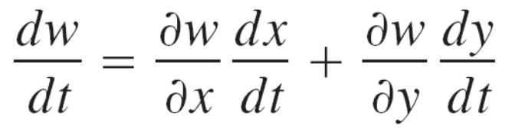

Example 1 – Chain Rule: One Independent Variable
Let w = x²y – y², where x = sin t and y = e^{t}. Find dw/dt
when t = 0.
Solution:
By the Chain Rule for one independent variable, you have

Slide 6
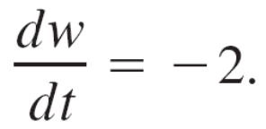
Example 1 – Solution
cont’d
When t = 0, it follows that

Slide 7


Chain Rules for Functions of Several Variables
The Chain Rule in Theorem 13.6 can provide alternative techniques for solving many problems in single-variable calculus. For instance, in Example 1, you could have used single-variable techniques to find dw/dt by first writing w as a function of t,
and then differentiating as usual.

Slide 8


Chain Rules for Functions of Several Variables
The Chain Rule in Theorem 13.6 can be extended to any number of variables. For example, if each x_{i} is a differentiable function of a single variable t, then for
you have

Slide 9
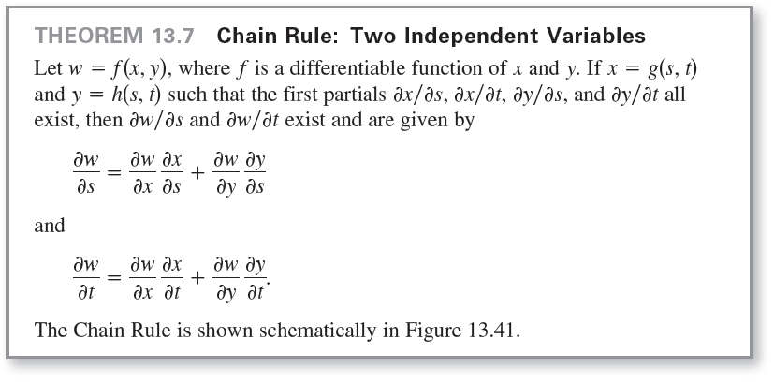
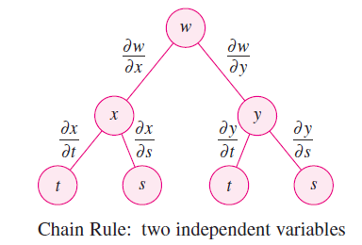
Chain Rules for Functions of Several Variables
Figure 13.41

Slide 10
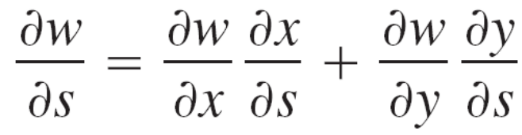
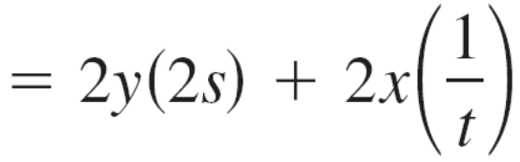
Example 4 – The Chain Rule with Two Independent Variables
Use the Chain Rule to find ∂w/∂s and ∂w/∂t for w = 2xy
where x = s² + t ² and y = s/t.
Solution:
Using Theorem 13.7, you can hold t constant and differentiate with respect to s to obtain

Slide 11
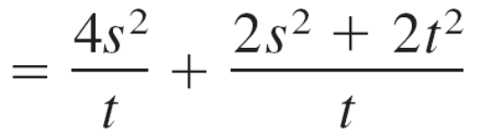
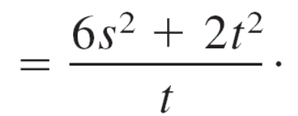
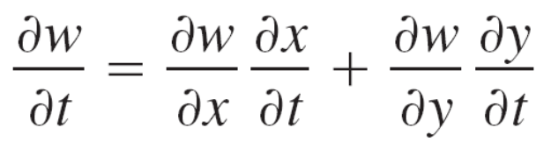
Example 4 – Solution
cont’d
Similarly, holding s constant gives

Slide 12
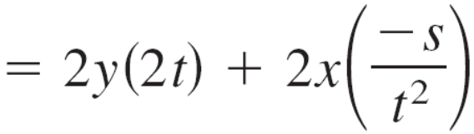
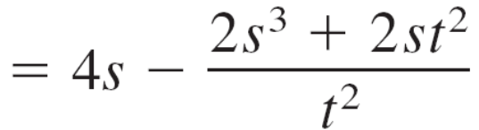
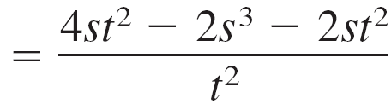
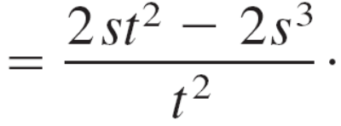
Example 4 – Solution
cont’d

Slide 13
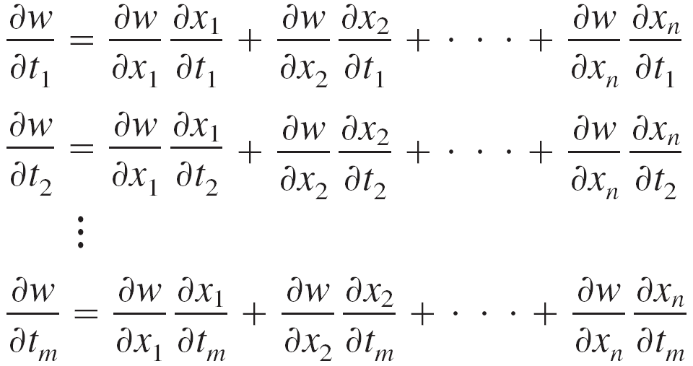
Chain Rules for Functions of Several Variables
The Chain Rule in Theorem 13.7 can also be extended to any number of variables. For example, if w is a differentiable function of the n variables x₁, x₂, . . . , x_{n}
where each x_{i} is a differentiable function of the m variables t₁, t₂, . . . , t_{m}, then for w = f (x₁, x₂, . . . , x_{n}) you obtain the following.

Slide 14
Implicit Partial Differentiation

Slide 15
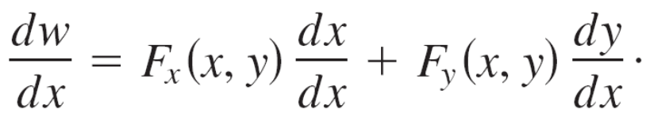
Implicit Partial Differentiation
This section concludes with an application of the Chain Rule
to determine the derivative of a function defined implicitly.
Let x and y be related by the equation F (x, y) = 0, where
y = f (x) is a differentiable function of x. To find dy/dx, you
could use the techniques discussed in Section 2.5. You will
see, however, that the Chain Rule provides a convenient
alternative. Consider the function w = F (x, y) = F (x, f (x)).
You can apply Theorem 13.6 to obtain

Slide 16
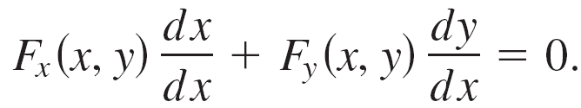
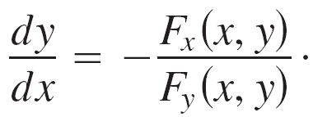
Implicit Partial Differentiation
Because w = F (x, y) = 0 for all x in the domain of f, you
know that dw/dx = 0 and you have
Now, if F_{y} (x, y) ≠ 0, you can use the fact that dx/dx = 1 to
conclude that
A similar procedure can be used to find the partial derivatives
of functions of several variables that are defined implicitly.

Slide 17
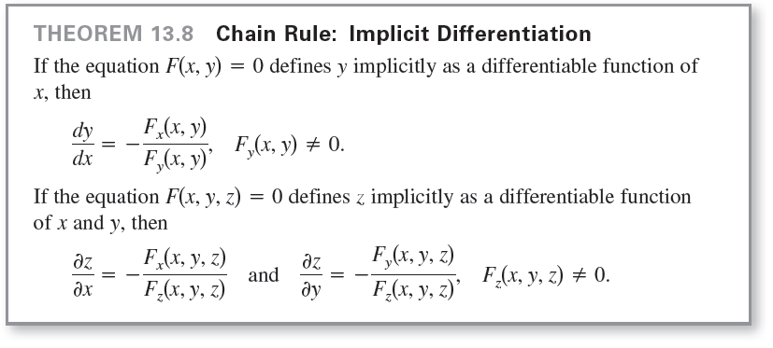
Implicit Partial Differentiation

Slide 18
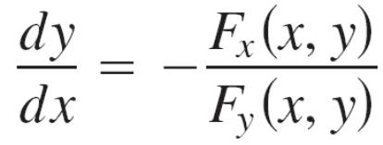
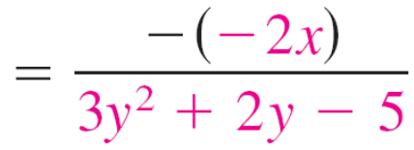
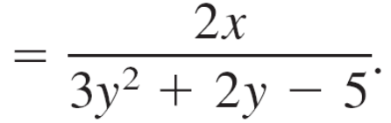
Example 6 – Finding a Derivative Implicitly
Find dy/dx for y³ + y² – 5y – x² + 4 = 0.
Solution:
Begin by letting
F (x, y) = y³ + y² – 5y – x² + 4.
Then
F_{x} (x, y) = –2x and F_{y} (x, y) = 3y² + 2y – 5.
Using Theorem 13.8, you have

