Slide 1


13
P
Functions of Several Variables
Copyright © Cengage Learning. All rights reserved.

Slide 2

Directional Derivatives and Gradients
13.6
Copyright © Cengage Learning. All rights reserved.

Slide 3
Objectives
Find and use directional derivatives of a function of two variables.
Find the gradient of a function of two variables.
Use the gradient of a function of two variables in applications.
Find directional derivatives and gradients of functions of three variables.

Slide 4
Directional Derivative

Slide 5
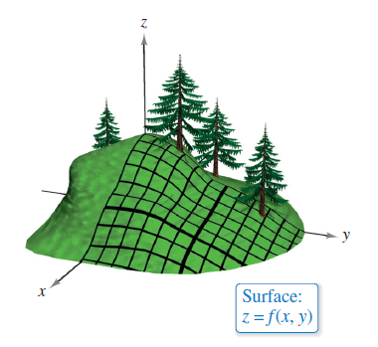
Directional Derivative
You are standing on the hillside represented by z = f (x, y) in Figure 13.42 and want to determine the hill’s incline toward the z-axis. You already know how to determine the slopes in two different directions—the slope in the
y-direction is given by the partial derivative f_{y}(x, y), and the slope in the x-direction is given by the partial derivative f_{x}(x, y).
In this section, you will see
that these two partial
derivatives can be used to
find the slope in any direction.
Figure 13.42

Slide 6
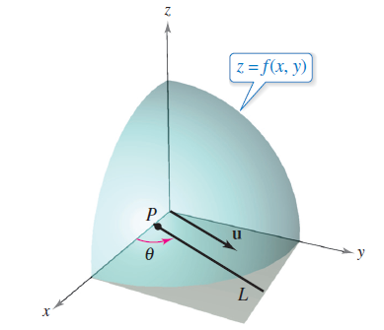
Directional Derivative
To determine the slope at a point on a surface, you will define a new type of derivative called a directional derivative.
Begin by letting z = f (x, y) be a surface and P(x₀, y₀) be a point in the domain of f, as shown in Figure 13.43.
The “direction” of the directional
derivative is given by a unit vector
u = cos θ i + sin θ j
where θ is the angle the vector
makes with the positive x-axis.
Figure 13.43

Slide 7
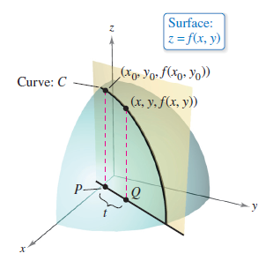
Directional Derivative
To find the desired slope, reduce the problem to two dimensions by intersecting the surface with a vertical plane passing through the point P and parallel to u, as shown in Figure 13.44.
This vertical plane intersects the
surface to form a curve C.
The slope of the surface at
(x₀, y₀, f(x₀, y₀)) in the direction
of u is defined as the slope of
the curve C at that point.
Figure 13.44

Slide 8
Directional Derivative
Informally, you can write the slope of the curve C as a limit that looks much like those used in single-variable calculus.
The vertical plane used to form C intersects the xy-plane in a line L, represented by the parametric equations
x = x₀ + t cos θ and y = y₀ + t sin θ
so that for any value of t, the point Q(x, y) lies on the line L.
For each of the points P and Q, there is a corresponding point on the surface.
(x₀, y₀, f (x₀, y₀)) Point above P
(x, y, f (x, y)) Point above Q

Slide 9
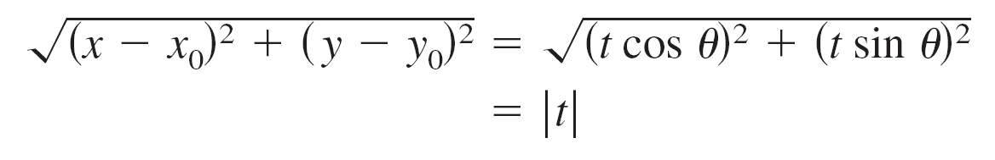
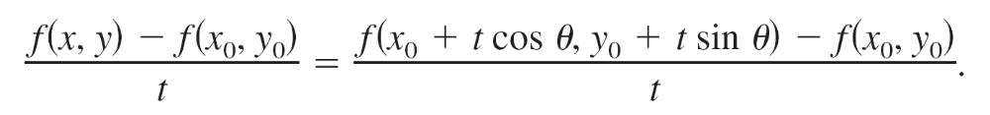
Directional Derivative
Moreover, because the distance between P and Q is
you can write the slope of the secant line through (x₀, y₀, f(x₀, y₀)) and (x, y, f(x, y)) as
Finally, by letting t approach 0, you arrive at the following definition.

Slide 10
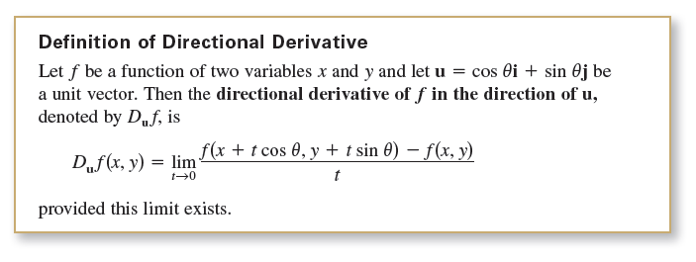
Directional Derivative
Calculating directional derivatives by this definition is similar to finding the derivative of a function of one variable by the limit process. A simpler formula for finding directional derivatives involves the partial derivatives f_{x} and f_{y} .

Slide 11
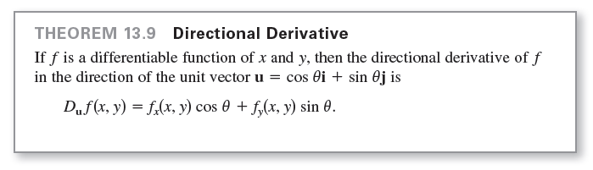
Directional Derivative

Slide 12
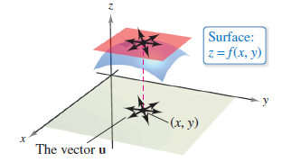
Directional Derivative
There are infinitely many directional derivatives of a surface at a given point—one for each direction specified by u, as shown in Figure 13.45.
Figure 13.45

Slide 13
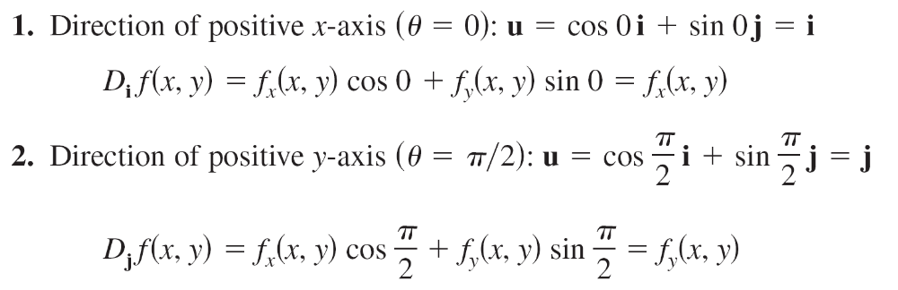
Directional Derivative
Two of these are the partial derivatives f_{x} and f_{y}.

Slide 14
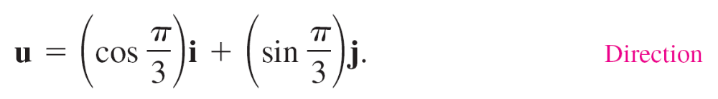
Example 1 – Finding a Directional Derivative
Find the directional derivative of
at (1, 2) in the direction of
Solution:
Because f_{x}(x,y) = –2x and f_{y}(x,y) = –y/2 are continuous, f is differentiable, and you can apply Theorem 13.9.

Slide 15
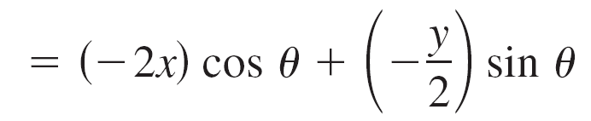
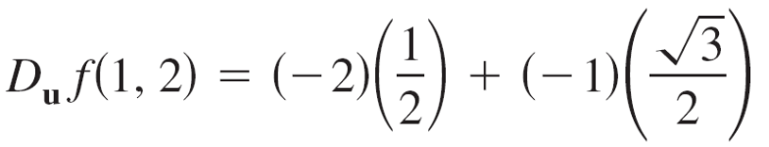
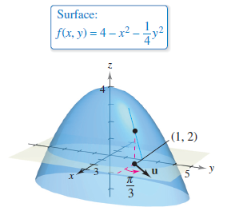
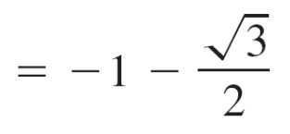


Example 1 – Solution
cont’d
Evaluating at θ = π/3, x = 1, and y = 2 produces
Figure 13.46

Slide 16
The Gradient of a Function of Two Variables

Slide 17
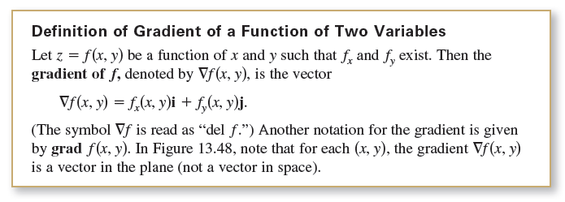
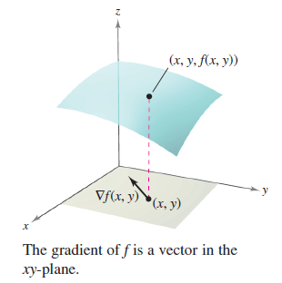
The Gradient of a Function of Two Variables
The gradient of a function of two variables is a vector-valued function of two variables.
Figure 13.48

Slide 18
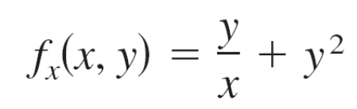
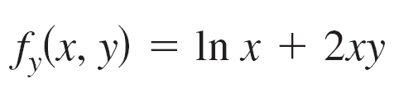


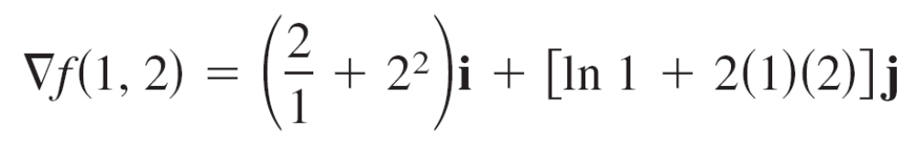

Example 3 – Finding the Gradient of a Function
Find the gradient of f (x, y) = y ln x + xy² at the point (1, 2).
Solution:
Using
and
you have
At the point (1, 2), the gradient is

Slide 19
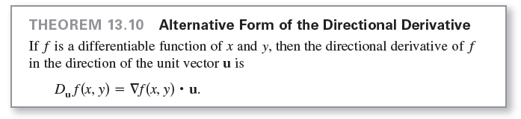
The Gradient of a Function of Two Variables
Because the gradient of f is a vector, you can write the directional derivative of f in the direction of u as
In other words, the directional derivative is the dot product of the gradient and the direction vector.

Slide 20
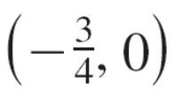
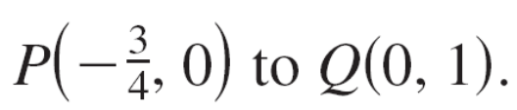

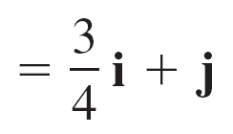
Example 4 – Using ∇ f(x, y) to Find a Directional Derivative
Find the directional derivative of
f(x, y) = 3x² – 2y²
at in the direction from
Solution:
Because the partials of f are continuous, f is differentiable and you can apply Theorem 13.10.
A vector in the specified direction is

Slide 21

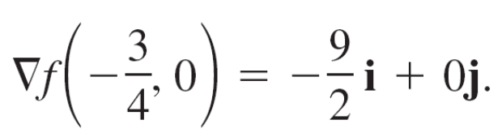

Example 4 – Solution
cont’d
And a unit vector in this direction is
Because ∇f(x, y) = f_{x}(x, y)i + f_{y}(x, y)j = 6xi – 4yj, the gradient
at is

Slide 22
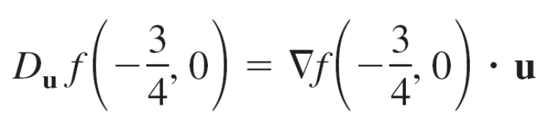
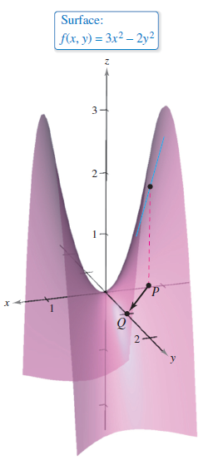
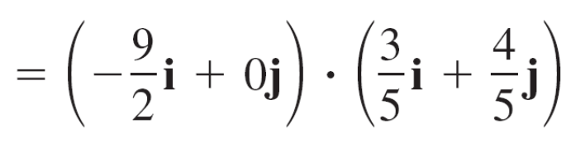
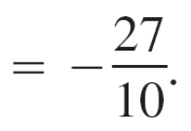
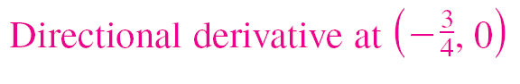
Example 4 – Solution
cont’d
Consequently, at , the directional derivative is
See Figure 13.49.
Figure 13.49

Slide 23
Applications of the Gradient

Slide 24
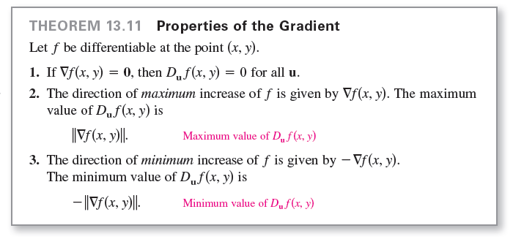
Applications of the Gradient

Slide 25
Example 5 – Finding the Direction of Maximum Increase
The temperature in degrees Celsius on the surface of a metal plate is
T(x, y) = 20 – 4x² – y²
where x and y are measured in centimeters. In what direction from (2, –3) does the temperature increase most rapidly? What is this rate of increase?
Solution:
The gradient is
∇T(x, y) = T_{x}(x, y)i + T_{y}(x, y)j
= –8xi – 2yj.

Slide 26
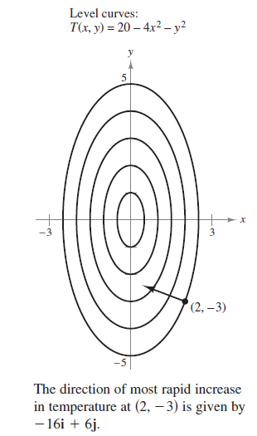



Example 5 – Solution
cont’d
It follows that the direction of maximum
increase is given by
∇T(2, –3) = –16i + 6j
as shown in Figure 13.51,
and the rate of increase is
||∇T(2, –3)||
Figure 13.51

Slide 27
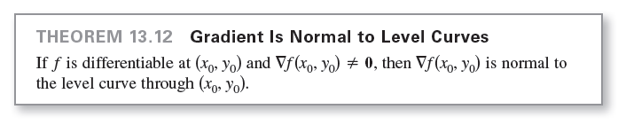
Applications of the Gradient

Slide 28
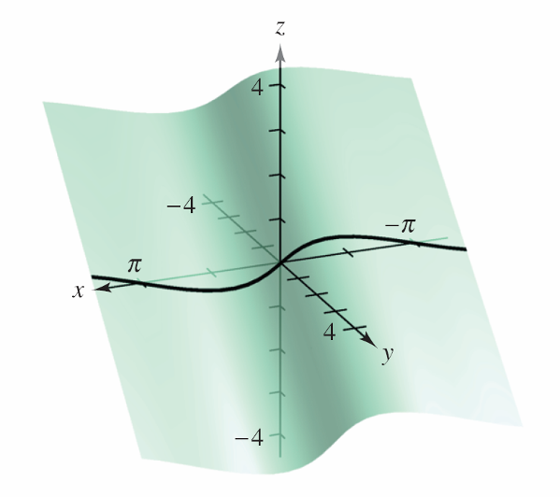

Example 7 – Finding a Normal Vector to a Level Curve
Sketch the level curve corresponding to c = 0 for the function given by f(x, y) = y – sin x and find a normal vector at several points on the curve.
Solution:
The level curve for c = 0 is given by
as shown in Figure 13.53(a).
Figure 13.53(a)

Slide 29

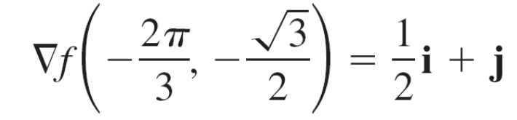
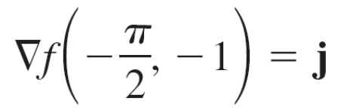
Example 7 – Solution
cont’d
Because the gradient of f at (x, y) is
∇f (x, y) = f_{x}(x, y)i + f_{y}(x, y)j
= –cos xi + j
you can use Theorem 13.12 to conclude that ∇f(x, y) is normal to the level curve at the point (x, y).
Some gradient are

Slide 30
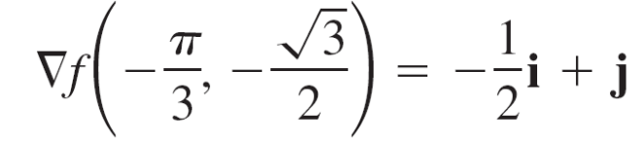

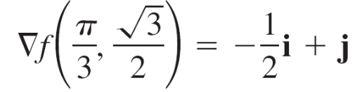
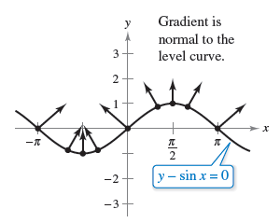
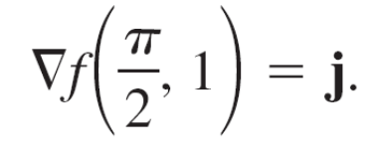

Example 7 – Solution
cont’d
and
These are shown in Figure 13.53(b).
Figure 13.53(b)

Slide 31
Functions of Three Variables

Slide 32
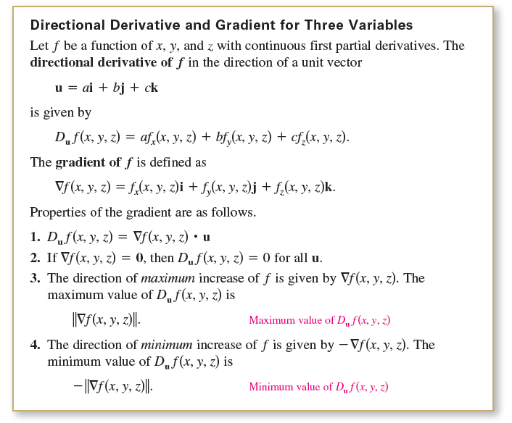
Functions of Three Variables

Slide 33
Example 8 – Finding the Gradient of a Function
Find ∇f (x, y, z) for the function
f (x, y, z) = x² + y² – 4z
and find the direction of maximum increase of f at the point
(2, –1, 1).
Solution:
The gradient is
∇f (x, y, z) = f_{x}(x, y, z)i + f_{y}(x, y, z)j + f_{z}(x, y, z)k
= 2xi + 2yj – 4k.

Slide 34
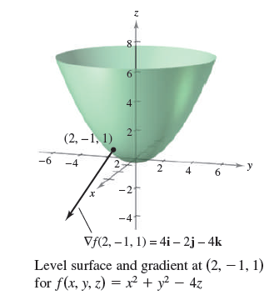
Example 8 – Solution
cont’d
So, it follows that the direction of maximum increase at
(2, –1, 1) is
∇f (2, –1, 1) = 4i – 2j – 4k. See Figure 13.54.
Figure 13.54

