Slide 1


13
P
Functions of Several Variables
Copyright © Cengage Learning. All rights reserved.

Slide 2

Tangent Planes and Normal Lines
13.7
Copyright © Cengage Learning. All rights reserved.

Slide 3
Objectives
Find equations of tangent planes and normal lines to surfaces.
Find the angle of inclination of a plane in space.
Compare the gradients ∇f(x, y) and ∇F(x, y, z).

Slide 4
Tangent Plane and Normal Line to a Surface

Slide 5
Tangent Plane and Normal Line to a Surface
You have represented the surfaces in space primarily by equations of the form
z = f(x, y). Equation of a surface S
In the development to follow, however, it is convenient to use the more general representation F(x, y, z) = 0.
For a surface S given by z = f(x, y), you can convert to the general form by defining F as
F(x, y, z) = f(x, y) – z.

Slide 6
Tangent Plane and Normal Line to a Surface
Because f(x, y) – z = 0, you can consider S to be the level
surface of F given by
F(x, y, z) = 0. Alternative equation of surface S

Slide 7
Example 1 – Writing an Equation of a Surface
For the function
F(x, y, z) = x² + y² + z² – 4
describe the level surface given by F(x, y, z) = 0.
Solution:
The level surface given by F(x, y, z) = 0 can be written as
x² + y² + z² = 4
which is a sphere of radius 2 whose center is at the origin.

Slide 8
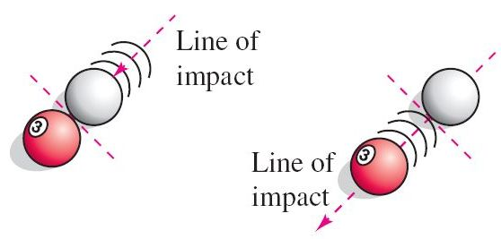
Tangent Plane and Normal Line to a Surface
Normal lines are equally important in analyzing surfaces and solids. For example, consider the collision of two billiard balls. When a stationary ball is struck at a point P on its surface, it moves along the line of impact determined by P and the center of the ball.
The impact can occur in two ways. When the cue ball is moving along the line of impact, it stops dead and imparts
all of its momentum to the stationary ball, as shown in
Figure 13.55.
Figure 13.55

Slide 9
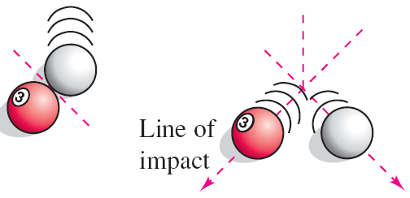
Tangent Plane and Normal Line to a Surface
When the cue ball is not moving along the line of impact, it is deflected to one side or the other and retains part of its momentum.
The part of the momentum that is transferred to the stationary ball occurs along the line of impact, regardless of the direction of the cue ball, as shown in Figure 13.56.
This line of impact is called the
normal line to the surface of
the ball at the point P.
Figure 13.56

Slide 10
Tangent Plane and Normal Line to a Surface
In the process of finding a normal line to a surface, you are also able to solve the problem of finding a tangent plane to the surface.
Let S be a surface given by
F(x, y, z) = 0
and let P(x₀, y₀, z₀) be a point on S.
Let C be a curve on S through P that is defined by the vector-valued function
r(t) = x(t)i + y(t)j + z(t)k.
Then, for all t,
F(x(t), y(t), z(t)) = 0.

Slide 11
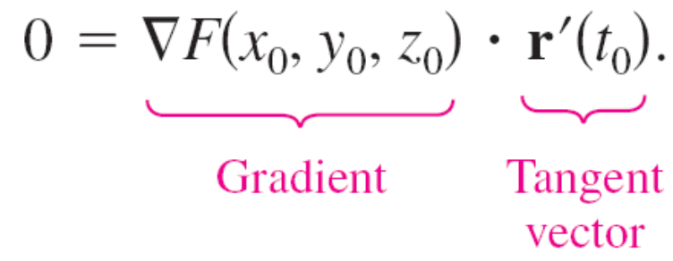
Tangent Plane and Normal Line to a Surface
If F is differentiable and x′(t), y′(t), and z′(t) all exist, then it follows from the Chain Rule that
0 = F′(t)
= F_{x}(x, y, z)x′(t) + F_{y}(x, y, z)y′(t) + F_{z}(x, y, z)z′(t)
At (x₀, y₀, z₀), the equivalent vector form is

Slide 12
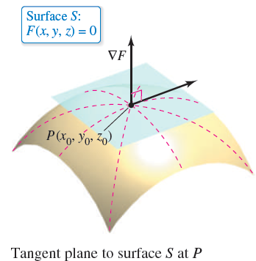
Tangent Plane and Normal Line to a Surface
This result means that the gradient at P is orthogonal to the tangent vector of every curve on S through P. So, all tangent lines on S lie in a plane that is normal to ∇F(x₀, y₀, z₀) and contains P, as shown in Figure 13.57.
Figure 13.57

Slide 13
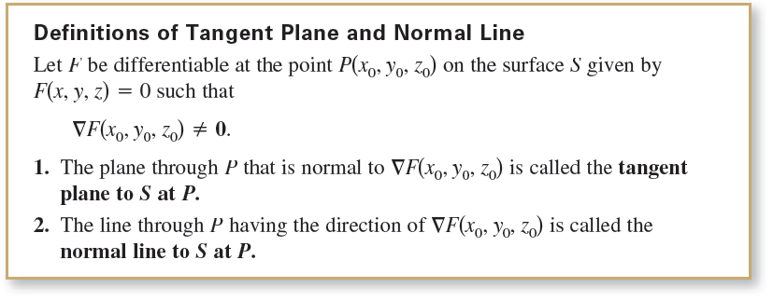

Tangent Plane and Normal Line to a Surface
To find an equation for the tangent plane to S at (x_{0,} y_{0,} z₀), let (x, y, z) be an arbitrary point in the tangent plane. Then the vector
lies in the tangent plane.

Slide 14
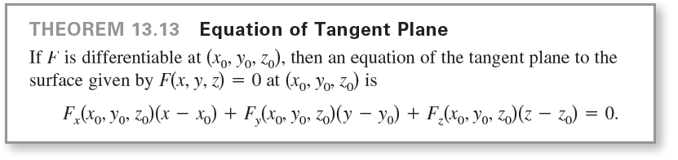
Tangent Plane and Normal Line to a Surface
Because ∇F(x₀, y₀, z₀) is normal to the tangent plane at (x₀, y₀, z₀), it must be orthogonal to every vector in the tangent plane, and you have
∇F(x₀, y₀, z₀) ∙ v = 0
which leads to the next theorem.

Slide 15
Example 2 – Finding an Equation of a Tangent Plane
Find an equation of the tangent plane to the hyperboloid
z² – 2x² – 2y² = 12
at the point (1, –1, 4).
Solution:
Begin by writing the equation of the surface as
z² – 2x² – 2y² – 12 = 0.
Then, considering
F(x, y, z) = z² – 2x² – 2y² – 12
you have
F_{x}(x, y, z) = –4x, F_{y}(x, y, z) = –4y and F_{z}(x, y, z) = 2z.

Slide 16
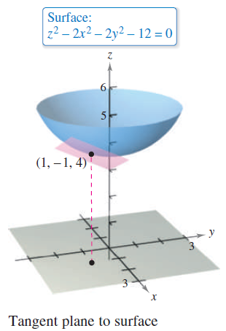
Example 2 – Solution
cont’d
At the point (1, –1, 4), the partial derivatives are
F_{x}(1, –1, 4) = –4, F_{y}(1, –1, 4) = 4, and F_{z}(1, –1, 4) = 8.
So, an equation of the tangent plane
at (1, –1, 4) is
–4(x – 1) + 4(y + 1) + 8(z – 4) = 0
–4x + 4 + 4y + 4 + 8z – 32 = 0
–4x + 4y + 8z – 24 = 0
x – y – 2z + 6 = 0.
Figure 13.58 shows a portion of the
hyperboloid and tangent plane.
Figure 13.58

Slide 17

Tangent Plane and Normal Line to a Surface
To find the equation of the tangent plane at a point on a surface given by z = f(x, y), you can define the function F by
F(x, y, z) = f(x, y) – z.
Then S is given by the level surface F(x, y, z) = 0, and by Theorem 13.13, an equation of the tangent plane to S at the point (x₀, y₀, z₀) is

Slide 18
The Angle of Inclination of a Plane

Slide 19
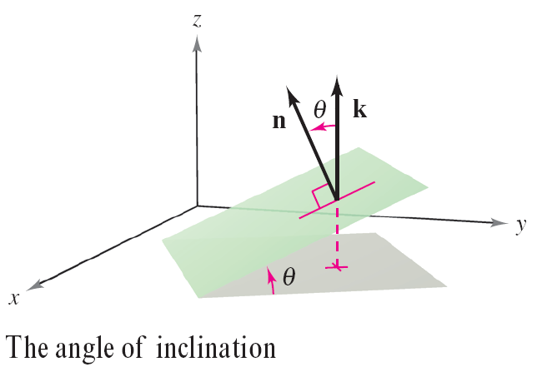
The Angle of Inclination of a Plane
Another use of the gradient ∇F(x, y, z) is to determine the angle of inclination of the tangent plane to a surface.
The angle of inclination of a plane is defined as the angle θ (0 ≤ θ ≤ π/2) between the given plane and the xy-plane, as shown in Figure 13.62. (The angle of inclination of a horizontal plane is defined as zero.)
Figure 13.62

Slide 20

The Angle of Inclination of a Plane
Because the vector k is normal to the xy-plane, you can use the formula for the cosine of the angle between two planes to conclude that the angle of inclination of a plane with normal vector n is

Slide 21
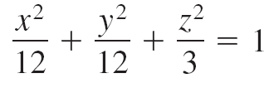
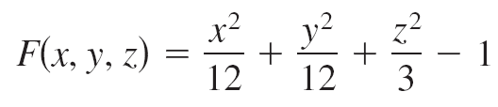

Example 6 – Finding the Angle of Inclination of a Tangent Plane
Find the angle of inclination of the tangent plane to the ellipsoid
at the point (2, 2, 1).
Solution:
Begin by letting
Then, the gradient of F at the point (2, 2, 1) is

Slide 22
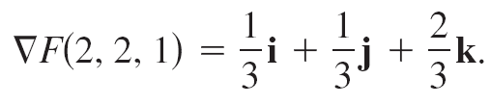
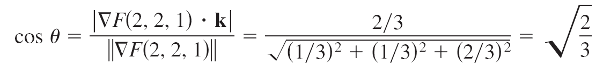
Example 6 – Solution
cont’d
Because ∇F(2, 2, 1) is normal to the tangent plane and k is normal to the xy-plane, it follows that the angle of inclination of the tangent plane is

Slide 23
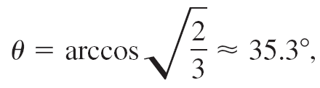
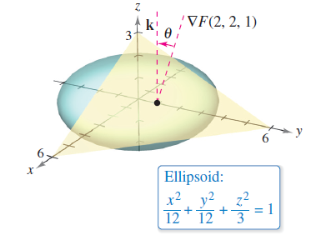
Example 6 – Solution
cont’d
which implies that
as shown in Figure 13.63.
Figure 13.63

Slide 24
A Comparison of the Gradients ∇f(x, y) and ∇F(x, y, z)

Slide 25
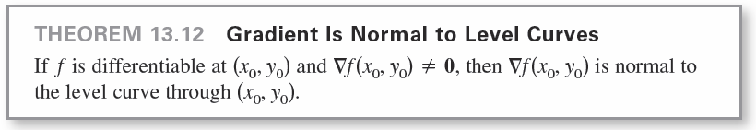
A Comparison of the Gradients ∇f(x, y) and ∇F(x, y, z)
This section concludes with a comparison of the gradients ∇f(x, y) and ∇F(x, y, z).
We know that the gradient of a function f of two variables is normal to the level curves of f.
Specifically, Theorem 13.12 states that if f is differentiable at (x₀, y₀) and ∇f(x₀, y₀) ≠ 0, then ∇f(x₀, y₀) is normal to the level curve through (x₀, y₀).

Slide 26
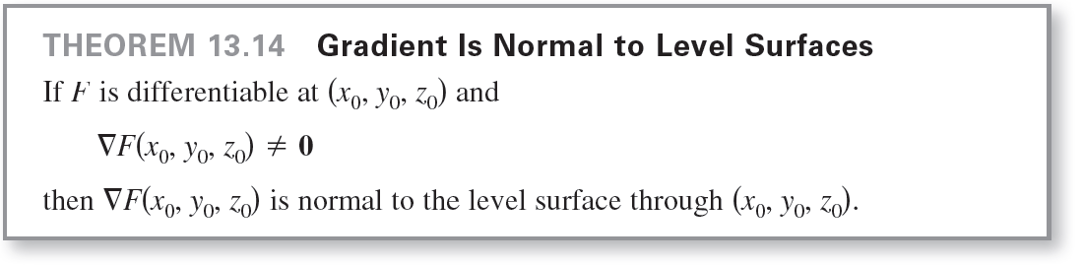
A Comparison of the Gradients ∇f(x, y) and ∇F(x, y, z)
Having developed normal lines to surfaces, we can now extend this result to a function of three variables.

