Slide 1


13
P
Functions of Several Variables
Copyright © Cengage Learning. All rights reserved.

Slide 2

Extrema of Functions of Two Variables
13.8
Copyright © Cengage Learning. All rights reserved.

Slide 3
Objectives
Find absolute and relative extrema of a function of two variables.
Use the Second Partials Test to find relative extrema of a function of two variables.

Slide 4
Absolute Extrema and Relative Extrema

Slide 5
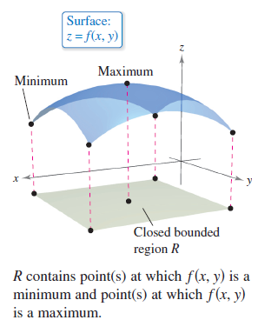
Absolute Extrema and Relative Extrema
Consider the continuous function f of two variables, defined on a closed bounded region R in the xy-plane. The values f(a, b) and f(c, d) such that
f(a, b) ≤ f(x, y) ≤ f(c, d) (a, b) and (c, d) are in R.
for all (x, y) in R are called the
minimum and maximum of f in the
region R, as shown in Figure 13.64.
Figure 13.64

Slide 6
Absolute Extrema and Relative Extrema
A region in the plane is closed when it contains all of its boundary points.
The Extreme Value Theorem deals with a region in the plane that is both closed and bounded.
A region in the plane is called bounded when it is a subregion of a closed disk in the plane.

Slide 7
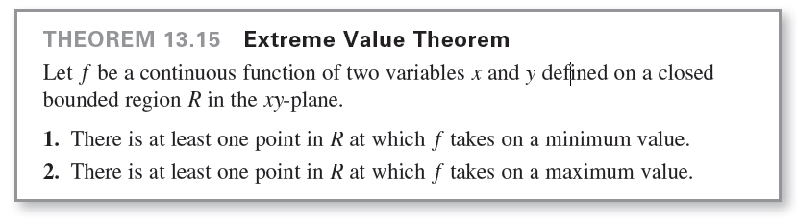
Absolute Extrema and Relative Extrema

Slide 8
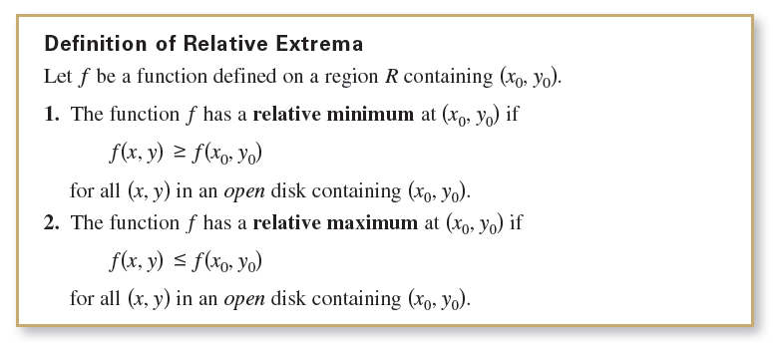
Absolute Extrema and Relative Extrema
A minimum is also called an absolute minimum and a maximum is also called an absolute maximum. As in single-variable calculus, there is a distinction made between absolute extrema and relative extrema.

Slide 9
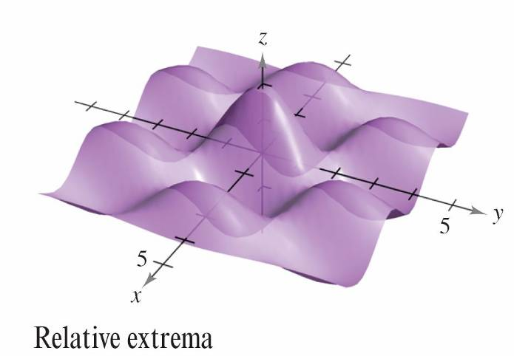
Absolute Extrema and Relative Extrema
To say that f has a relative maximum at (x₀, y₀) means that the point (x₀, y₀, z₀) is at least as high as all nearby points on the graph of z = f(x, y).
Similarly, f has a relative minimum at (x₀, y₀) when
(x₀, y₀, z₀) is at least as low as all nearby points on the graph. (See Figure 13.65.)
Figure 13.65

Slide 10
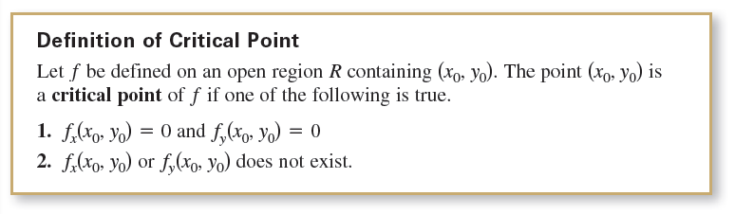
Absolute Extrema and Relative Extrema
To locate relative extrema of f, you can investigate the points at which the gradient of f is 0 or the points at which one of the partial derivatives does not exist. Such points are called critical points of f.

Slide 11
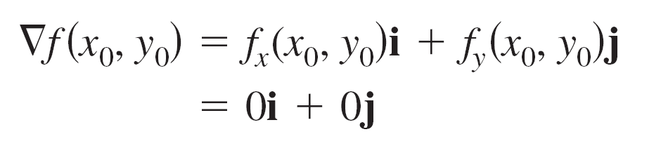
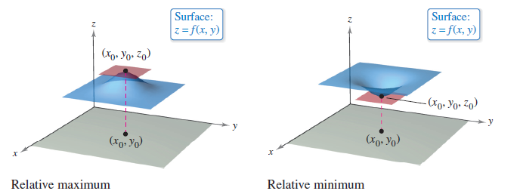
Absolute Extrema and Relative Extrema
If f is differentiable and
then every directional derivative at (x₀, y₀) must be 0. This implies that the function has a horizontal tangent plane at the point (x₀, y₀), as shown in Figure 13.66.
Figure 13.66

Slide 12
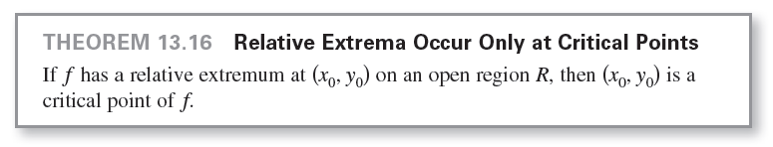
Absolute Extrema and Relative Extrema
It appears that such a point is a likely location of a relative extremum.
This is confirmed by Theorem 13.16.

Slide 13
Example 1 – Finding a Relative Extremum
Determine the relative extrema of
f(x, y) = 2x² + y² + 8x – 6y + 20.
Solution:
Begin by finding the critical points of f.
Because
f_{x}(x, y) = 4x + 8 Partial with respect to x
and
f_{y}(x, y) = 2y – 6 Partial with respect to y
are defined for all x and y, the only critical points are those for which both first partial derivatives are 0.

Slide 14
Example 1 – Solution
cont’d
To locate these points, set f_{x}(x, y) and f_{y}(x, y) equal to 0, and solve the equations
4x + 8 = 0 and 2y – 6 = 0
to obtain the critical point (–2, 3).
By completing the square for f, you can see that for all
(x, y) ≠ (–2, 3)
f(x, y) = 2(x + 2)² + (y – 3)² + 3 > 3.
So, a relative minimum of f occurs at (–2, 3).

Slide 15
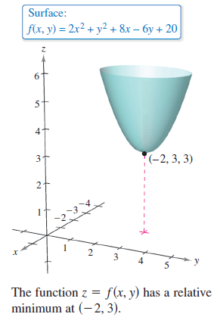
Example 1 – Solution
cont’d
The value of the relative minimum is f (–2, 3) = 3, as shown in Figure 13.67.
Figure 13.67

Slide 16
The Second Partials Test

Slide 17
The Second Partials Test
To find relative extrema, you need only examine values of f(x, y) at critical points. However, as is true for a function of one variable, the critical points of a function of two variables do not always yield relative maxima or minima.
Some critical points yield saddle points, which are neither relative maxima nor relative minima.

Slide 18
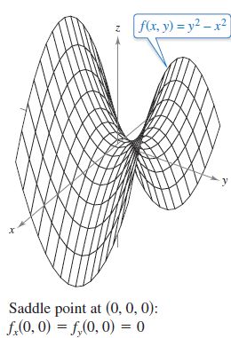
The Second Partials Test
As an example of a critical point that does not yield a relative extremum, consider the hyperbolic paraboloid
f(x, y) = y² – x²
as shown in Figure 13.69.
Figure 13.69

Slide 19
The Second Partials Test
At the point (0, 0), both partial derivatives
f_{x}(x, y) = – 2x and f_{y}(x, y) = 2y
are 0.
The function f does not, however, have a relative extremum at this point because in any open disk centered at (0, 0), the function takes on both negative values (along the x-axis) and positive values (along the y-axis).
So, the point (0, 0, 0) is a saddle point of the surface.

Slide 20
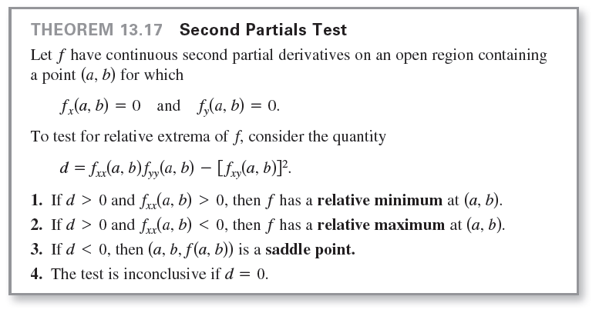
The Second Partials Test

Slide 21
Example 3 – Using the Second Partials Test
Find the relative extrema of
f(x, y) = –x³ + 4xy – 2y² + 1.
Solution:
Begin by finding the critical points of f.
Because
f_{x}(x, y) = –3x² + 4y
and
f_{y}(x, y) = 4x – 4y
exist for all x and y, the only critical points are those for which both first partial derivatives are 0.

Slide 22

Example 3 – Solution
cont’d
To locate these points, set f_{x}(x, y) and f_{y}(x, y) equal to 0 to obtain
–3x² + 4y = 0 and 4x – 4y = 0.
From the second equation, you know that x = y, and, by substitution into the first equation, you obtain two solutions:
y = x = 0 and

Slide 23
Example 3 – Solution
cont’d
Because
it follows that, for the critical point (0, 0),
and, by the Second Partials Test, you can conclude that
(0, 0, 1) is a saddle point of f.

Slide 24
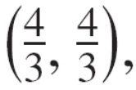
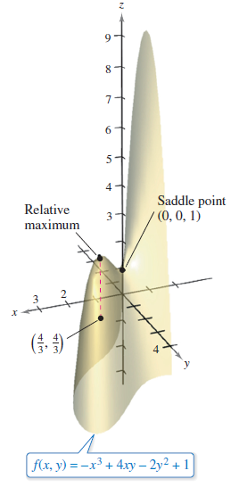
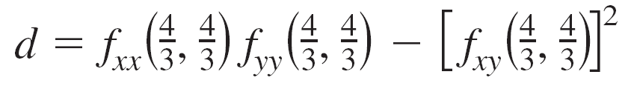





Example 3 – Solution
cont’d
Furthermore, for the critical point
and because you can
conclude that f has a relative maximum at
as shown in Figure 13.70.
Figure 13.70

Slide 25
The Second Partials Test
Absolute extrema of a function can occur in two ways.
First, some relative extrema also happen to be absolute extrema. For instance, in Example 1, f(–2, 3) is an absolute minimum of the function. (On the other hand, the relative maximum found in Example 3 is not an absolute maximum of the function.)
Second, absolute extrema can occur at a boundary point of the domain.

