Slide 1


13
P
Functions of Several Variables
Copyright © Cengage Learning. All rights reserved.

Slide 2

13.9
Applications of Extrema
Copyright © Cengage Learning. All rights reserved.

Slide 3
Objectives
Solve optimization problems involving functions of several variables.
Use the method of least squares.

Slide 4
Applied Optimization Problems

Slide 5
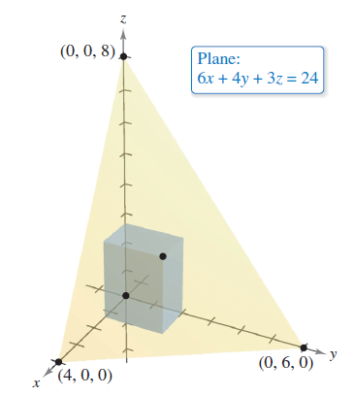
Example 1 – Finding Maximum Volume
A rectangular box is resting on the xy-plane with one vertex at the origin. The opposite vertex lies in the plane
6x + 4y + 3z = 24
as shown in Figure 13.73.
Find the maximum volume
of the box.
Figure 13.73

Slide 6

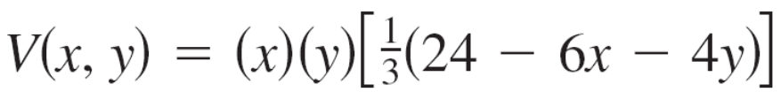

Example 1 – Solution
Let x, y, and z represent the length, width, and height of the box.
Because one vertex of the box lies in the plane 6x + 4y + 3z = 24, you know that . So, you can write the volume xyz of the box as a function of two variables.

Slide 7
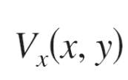
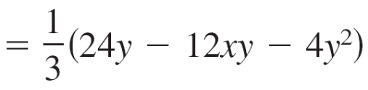
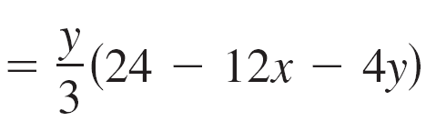
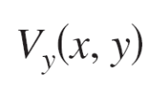
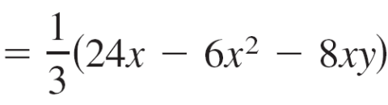
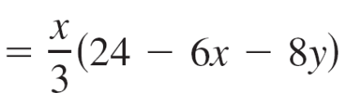

Example 1 – Solution
cont’d
Next, find the first partial derivatives of V.
Note that the first partial derivatives are defined for all x and y. So, by setting V_{x}(x, y) and V_{y}(x, y) equal to 0 and solving the equations y (24 – 12x – 4y) = 0 and
x (24 – 6x – 8y) = 0, you obtain the critical points (0, 0),
(4, 0), (0, 6), and
At (0, 0), (4, 0), and (0, 6), the volume is 0, so these points do not yield a maximum volume.

Slide 8
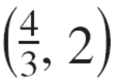


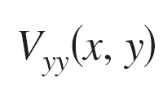
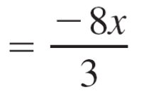
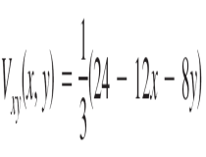
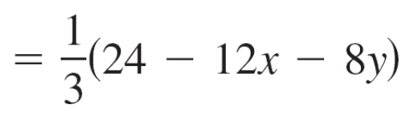
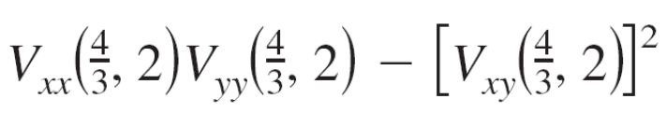
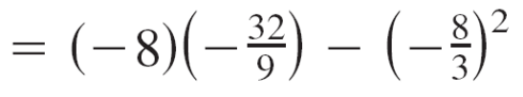
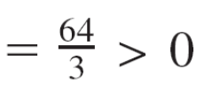
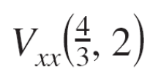

Example 1 – Solution
cont’d
At the point , you can apply the Second Partials Test.
Because
and

Slide 9
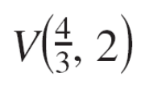
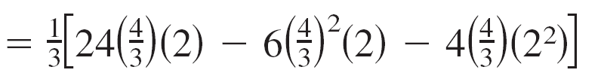
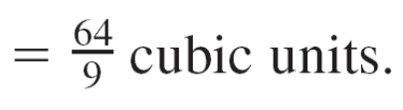
Example 1 – Solution
cont’d
You can conclude from the Second Partials Test that the maximum volume is
Note that the volume is 0 at the boundary points of the triangular domain of V.

Slide 10
The Method of Least Squares

Slide 11
The Method of Least Squares
Many examples involved mathematical models. For example, a quadratic model for profit.
There are several ways to develop such models; one is called the method of least squares.
In constructing a model to represent a particular phenomenon, the goals are simplicity and accuracy.
Of course, these goals often conflict.

Slide 12
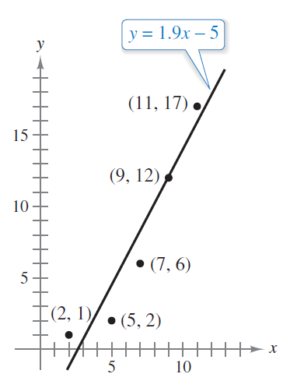
The Method of Least Squares
For instance, a simple linear model for the points in Figure 13.74 is
y = 1.9x – 5.
Figure 13.74

Slide 13
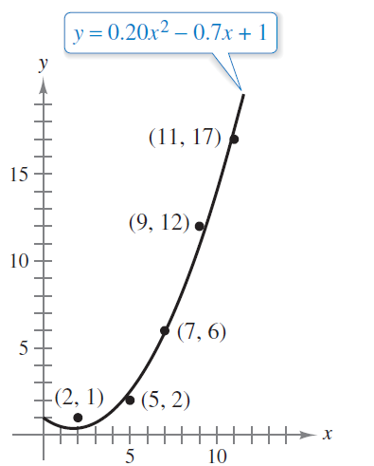
The Method of Least Squares
However, Figure 13.75 shows that by choosing the slightly more complicated quadratic model
y = 0.20x² – 0.7x + 1
you can achieve greater accuracy.
Figure 13.75

Slide 14

The Method of Least Squares
As a measure of how well the model y = f(x) fits the collection of points
{(x₁, y₁), (x₂, y₂), (x₃, y₃),. . . , (x_{n}, y_{n})}
you can add the squares of the differences between the actual y-values and the values given by the model to obtain the sum of the squared errors

Slide 15
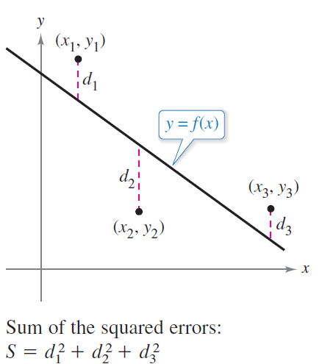
The Method of Least Squares
Graphically, S can be interpreted as the sum of the squares of the vertical distances between the graph of f and the given points in the plane, as shown in Figure 13.76.
If the model is perfect, then
S = 0. However, when
perfection is not feasible,
you can settle for a model
that minimizes S.
Figure 13.76

Slide 16
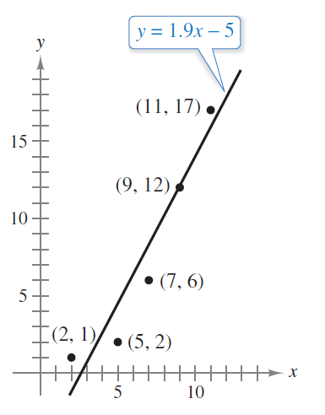
The Method of Least Squares
For instance, the sum of the squared errors for the linear model in Figure 13.74 is S = 17.6.
Statisticians call the linear model that
minimizes S the least squares
regression line.
The proof that this line actually
minimizes S involves the minimizing
of a function of two variables.
Figure 13.74

Slide 17
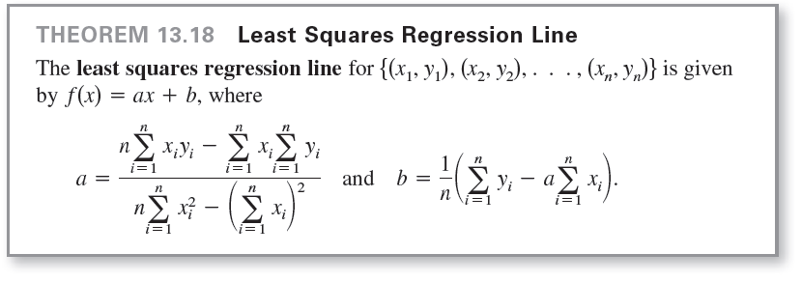
The Method of Least Squares

Slide 18
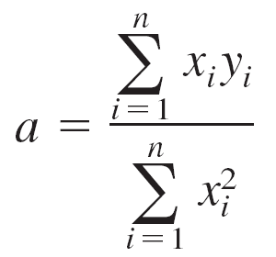
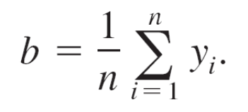
The Method of Least Squares
If the x-values are symmetrically spaced about the y-axis, then Σ x_{i} = 0 and the formulas for a and b simplify to
and
This simplification is often possible with a translation of the x-values.
For instance, given that the x-values in a data collection consist of the values 9, 10, 11, 12, and 13, you could let 11 be represented by 0.

Slide 19
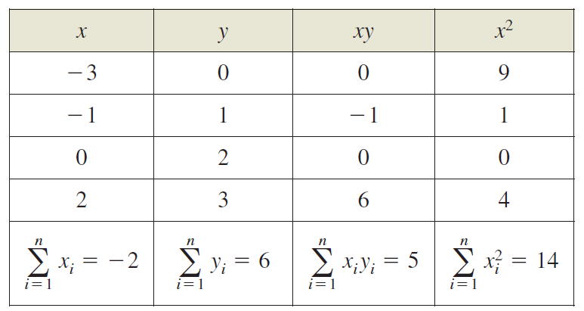
Example 3 – Finding the Least Squares Regression Line
Find the least squares regression line for the points (–3, 0), (–1, 1), (0, 2), and (2, 3).
Solution:
The table shows the calculations involved in finding the least squares regression line using n = 4.

Slide 20
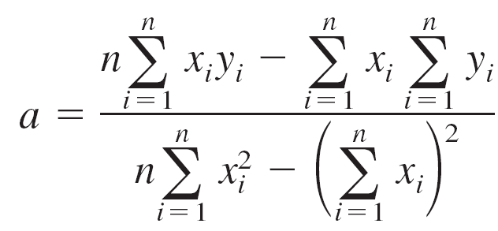
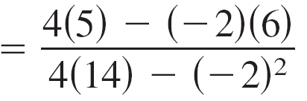
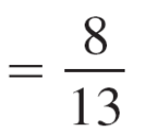
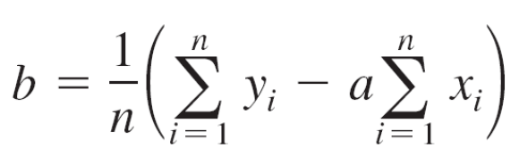
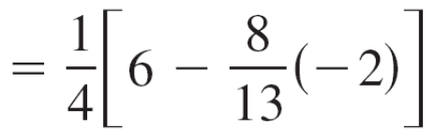
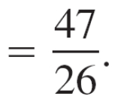
Example 3 – Solution
cont’d
Applying Theorem 13.18 produces
and

Slide 21

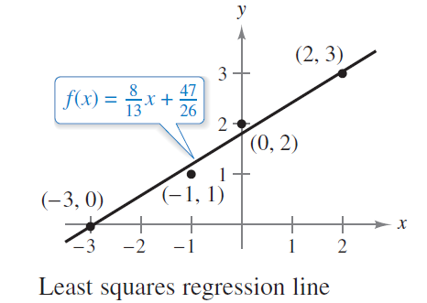
Example 3 – Solution
cont’d
The least squares regression line is
as shown in Figure 13.77.
Figure 13.77

