Slide 1

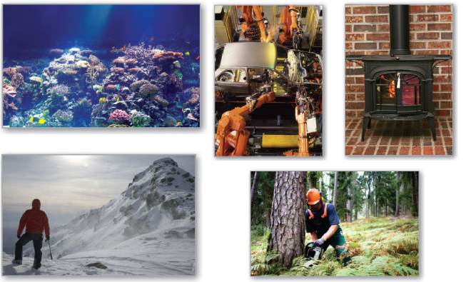
13
P
Functions of Several Variables
Copyright © Cengage Learning. All rights reserved.

Slide 2

13.10
Lagrange Multipliers
Copyright © Cengage Learning. All rights reserved.

Slide 3
Objectives
Understand the Method of Lagrange Multipliers.
Use Lagrange multipliers to solve constrained optimization problems.
Use the Method of Lagrange Multipliers with two constraints.

Slide 4
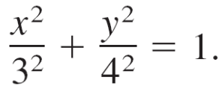
Lagrange Multipliers
Many optimization problems have restrictions, or
constraints, on the values that can be used to produce the
optimal solution. Such constraints tend to complicate
optimization problems because the optimal solution can
occur at a boundary point of the domain. In this section,
you will study an ingenious technique for solving such
problems. It is called the Method of Lagrange Multipliers.
To see how this technique works, consider the problem of finding the rectangle of maximum area that can be
inscribed in the ellipse

Slide 5
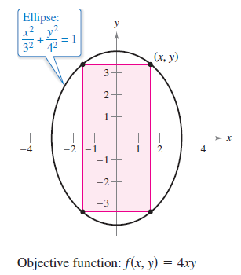
Lagrange Multipliers
Let (x, y) be the vertex of the rectangle in the first quadrant,
as shown in Figure 13.78.
Figure 13.78

Slide 6
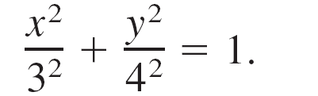
Lagrange Multipliers
Because the rectangle has sides of lengths 2x and 2y, its area is given by
f(x, y) = 4xy. Objective function
You want to find x and y such that f(x, y) is a maximum.
Your choice of (x, y) is restricted to first-quadrant points that lie on the ellipse
Constraint

Slide 7
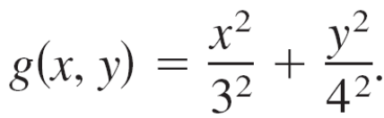
Lagrange Multipliers
Now, consider the constraint equation to be a fixed level
curve of
The level curves of f represent a family of hyperbolas
f(x, y) = 4xy = k.
In this family, the level curves that meet the constraint
correspond to the hyperbolas that intersect the ellipse.
Moreover, to maximize f(x, y), you want to find the
hyperbola that just barely satisfies the constraint.

Slide 8
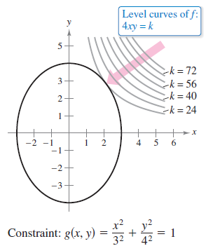
Lagrange Multipliers
The level curve that does this is the one that is tangent to the ellipse, as shown in Figure 13.79.
Figure 13.79

Slide 9
Lagrange Multipliers
To find the appropriate hyperbola, use the fact that two curves are tangent at a point if and only if their gradients are parallel.
This means that ∇f(x, y) must be a scalar multiple of
∇g(x, y) at the point of tangency.
In the context of constrained optimization problems, this scalar is denoted by λ (the lowercase Greek letter lambda).

Slide 10
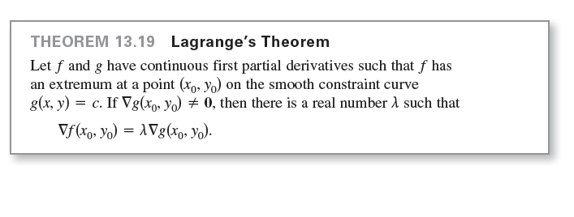
Lagrange Multipliers
∇f(x, y) = λ∇g(x, y)
The scalar λ is called a Lagrange multiplier. Theorem 13.19 gives the necessary conditions for the existence of such multipliers.

Slide 11
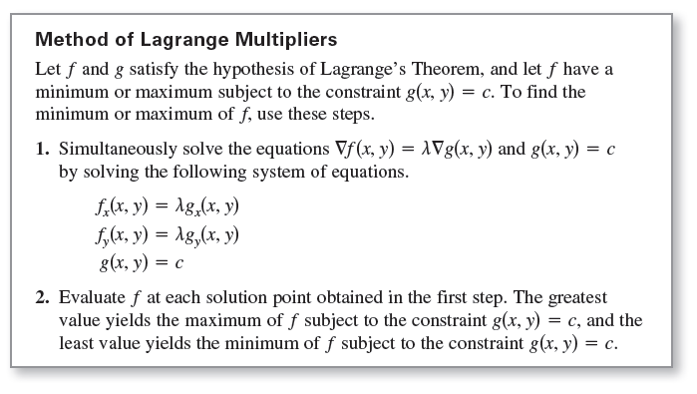
Lagrange Multipliers

Slide 12
Constrained Optimization Problems

Slide 13
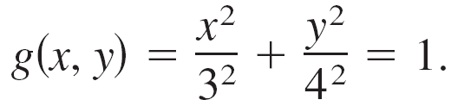
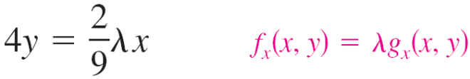
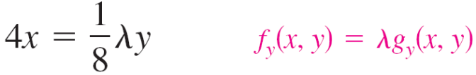
Example 1 – Using a Lagrange Multiplier with One Constraint
Find the maximum value of f(x, y) = 4xy, where x > 0 and
y > 0, subject to the constraint (x²/3²) + (y²/4²) = 1.
Solution:
To begin, let
By equating ∇f(x, y) = 4yi + 4xj and
λ∇g(x, y) = (2λx/9)i + (λy/8)j, you obtain the following system of equations.

Slide 14
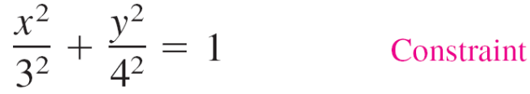


Example 1 – Solution
cont’d
From the first equation, you obtain λ = 18y/x, and
substitution into the second equation produces
Substituting this value for x² into the third equation
produces

Slide 15
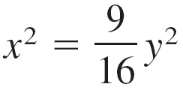
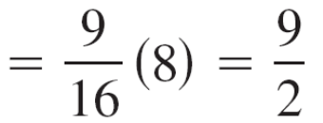

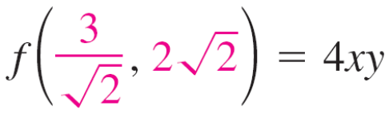
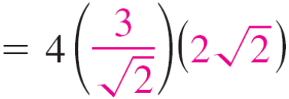

Example 1 – Solution
cont’d
Because y > 0, choose the positive value and find that
Because x > 0, choose the positive value. So, the maximum value of f is

Slide 16
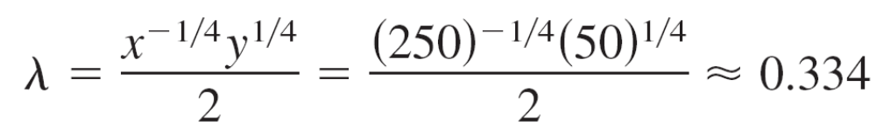
Constrained Optimization Problems
Economists call the Lagrange multiplier obtained in a
production function the marginal productivity of money.
For instance, if the marginal productivity of money is λ
and x represents the units of labor and y represents the
units of capital then the marginal productivity of
money at x = 250 and y = 50 is
which means that for each additional dollar spent on
production, an additional 0.334 unit of the product can be
produced.

Slide 17
The Method of Lagrange Multipliers with Two Constraints

Slide 18
The Method of Lagrange Multipliers with Two Constraints
For optimization problems involving two constraint functions g and h, you can introduce a second Lagrange
multiplier, μ (the lowercase Greek letter mu), and then
solve the equation
∇f = λ∇g + μ∇h
where the gradient vectors are not parallel, as illustrated in
Example 5.

Slide 19
Example 5 – Optimization with Two Constraints
Let T(x, y, z) = 20 + 2x + 2y + z² represent the temperature
at each point on the sphere x² + y² + z² = 11.
Find the extreme temperatures on the curve formed by the intersection of the plane x + y + z = 3 and the sphere.
Solution:
The two constraints are
g(x, y, z) = x² + y² + z² = 11
and
h(x, y, z) = x + y + z = 3.

Slide 20


Example 5 – Solution
cont’d
Using
and
you can write the following system of equations.

Slide 21
Example 5 – Solution
cont’d
By subtracting the second equation from the first, you can
obtain the following system.
λ(x – y) = 0
2z(1 – λ) – μ = 0
x² + y² + z² = 11
x + y + z = 3
From the first equation, you can conclude that λ = 0 or x = y.
If λ = 0, you can show that the critical points are
(3, –1, 1) and (–1, 3, 1).

Slide 22


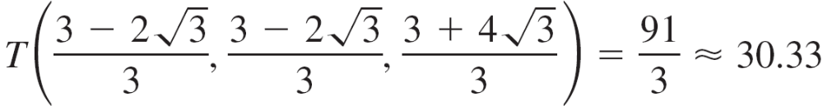
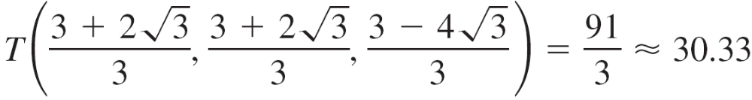

Example 5 – Solution
cont’d
For λ ≠ 0, then x = y and you can show that the critical points occur when x = y = and z =
Finally, to find the optimal solutions, compare the temperatures at the four critical points.
So, T = 25 is the minimum temperature and is the maximum temperature on the curve.

