Slide 1


14
P
Multiple Integration
Copyright © Cengage Learning. All rights reserved.

Slide 2

Iterated Integrals and Area in the Plane
14.1
Copyright © Cengage Learning. All rights reserved.

Slide 3
Objectives
Evaluate an iterated integral.
Use an iterated integral to find the area of a plane region.

Slide 4
Iterated Integrals

Slide 5
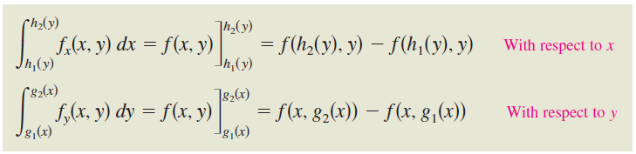
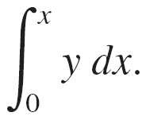
Iterated Integrals
Note that the variable of integration cannot appear in either
limit of integration.
For instance, it makes no sense to write

Slide 6




Example 1 – Integrating with Respect to y
Evaluate
Solution:
Considering x to be constant and integrating with respect to y, you have

Slide 7





Example 2 – The Integral of an Integral
Evaluate
Solution:
Using the result of Example 1, you have

Slide 8
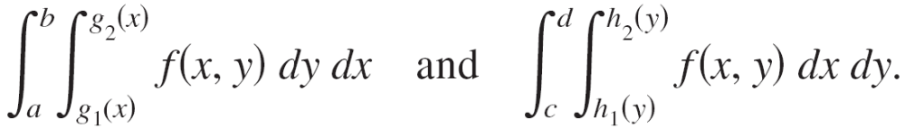
Iterated Integrals
The integral in Example 2 is an iterated integral. The brackets used in Example 2 are normally not written.
Instead, iterated integrals are usually written simply as
The inside limits of integration can be variable with respect to the outer variable of integration.
However, the outside limits of integration must be constant with respect to both variables of integration.

Slide 9
Iterated Integrals
After performing the inside integration, you obtain a “standard” definite integral, and the second integration produces a real number.
The limits of integration for an iterated integral identify two sets of boundary intervals for the variables.

Slide 10
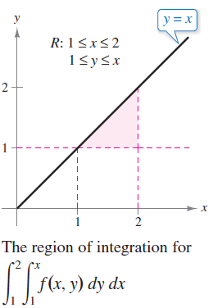
Iterated Integrals
For instance, in Example 2, the outside limits indicate that x lies in the interval 1 ≤ x ≤ 2 and the inside limits indicate that y lies in the interval 1 ≤ y ≤ x. Together, these two intervals determine the region of integration R of the iterated integral, as shown in Figure 14.1.
Figure 14.1

Slide 11
Area of a Plane Region

Slide 12
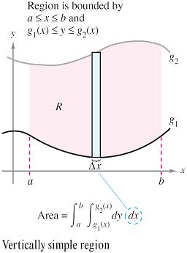
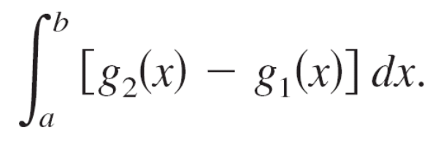

Area of a Plane Region
Consider the plane region R bounded by a ≤ x ≤ b and
g₁(x) ≤ y ≤ g₂(x), as shown in Figure 14.2.
The area of R is
Using the Fundamental Theorem
of Calculus, you can rewrite the
integrand g₂(x) – g₁(x) as a
definite integral.
Figure 14.2

Slide 13
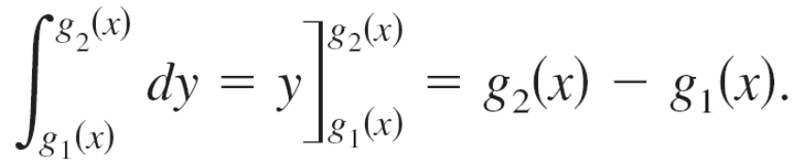
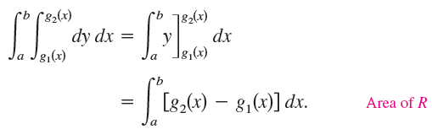
Area of a Plane Region
Specifically, consider x to be fixed and let y vary from
g₁(x) to g₂(x), you can write
Combining these two integrals, you can write the area of
the region R as an iterated integral

Slide 14
Area of a Plane Region
Placing a representative rectangle in the region R helps
determine both the order and the limits of integration. A
vertical rectangle implies the order dy dx, with the inside limits of integration corresponding to
the upper and lower bounds of the
rectangle, as shown in Figure 14.2.
This type of region is called
vertically simple, because the
outside limits of integration represent
the vertical lines x = a and x = b.
Figure 14.2

Slide 15
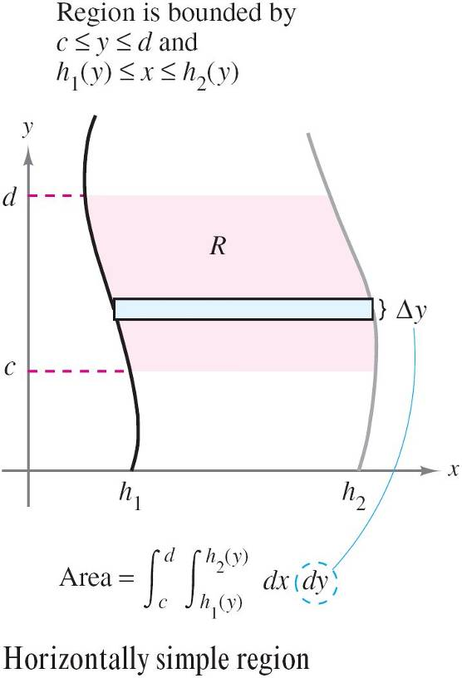
Area of a Plane Region
Similarly, a horizontal rectangle implies the order dx dy,
with the inside limits of integration determined by the left and right bounds of the rectangle,
as shown in Figure 14.3.
This type of region is
horizontally simple, because
the outside limits of integration
represent the horizontal lines
y = c and y = d.
Figure 14.3

Slide 16
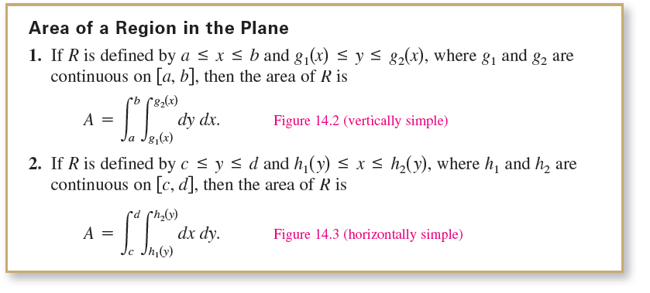
Area of a Plane Region

Slide 17
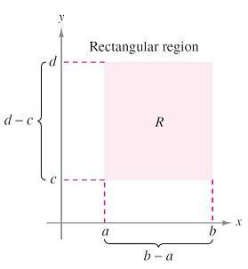
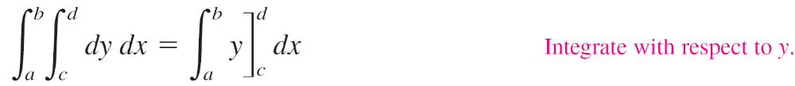
Example 3 – The Area of a Rectangular Region
Use an iterated integral to represent the area of the
rectangle shown in Figure 14.4.
Solution:
The region shown in Figure 14.4 is both
vertically simple and horizontally simple,
so you can use either order of integration.
By choosing the order dy dx, you obtain
the following.
Figure 14.4

Slide 18
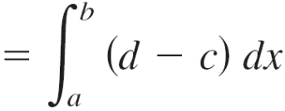
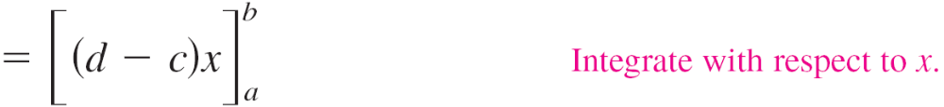

Example 3 – Solution
cont’d
Notice that this answer is consistent with what you know from geometry.

