Slide 1


14
P
Multiple Integration
Copyright © Cengage Learning. All rights reserved.

Slide 2

Double Integrals and Volume
14.2
Copyright © Cengage Learning. All rights reserved.

Slide 3
Objectives
Use a double integral to represent the volume of a solid region and use properties of double integrals.
Evaluate a double integral as an iterated integral.
Find the average value of a function over a region.

Slide 4
Double Integrals and Volume of a Solid Region

Slide 5
Double Integrals and Volume of a Solid Region
You know that a definite integral over an interval uses a
limit process to assign measures to quantities such as area, volume, arc length, and mass.
In this section, you will use a similar process to define the
double integral of a function of two variables over a region in the plane.

Slide 6
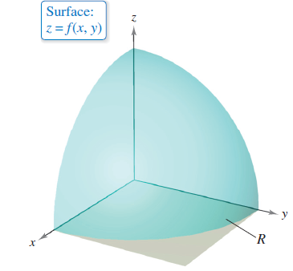
Double Integrals and Volume of a Solid Region
Consider a continuous function f such that f(x, y) ≥ 0 for all
(x, y) in a region R in the xy-plane. The goal is to find the
volume of the solid region lying between the surface
given by
z = f(x, y) Surface lying above the xy-plane
and the xy-plane, as shown in Figure 14.8.
Figure 14.8

Slide 7
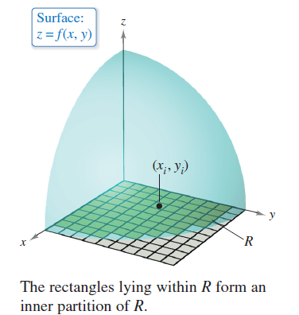
Double Integrals and Volume of a Solid Region
You can begin by superimposing a rectangular grid over
the region, as shown in Figure 14.9.
The rectangles lying entirely within R form an inner partition Δ, whose norm ||Δ|| is defined as the length of the longest
diagonal of the n rectangles.
Figure 14.9

Slide 8
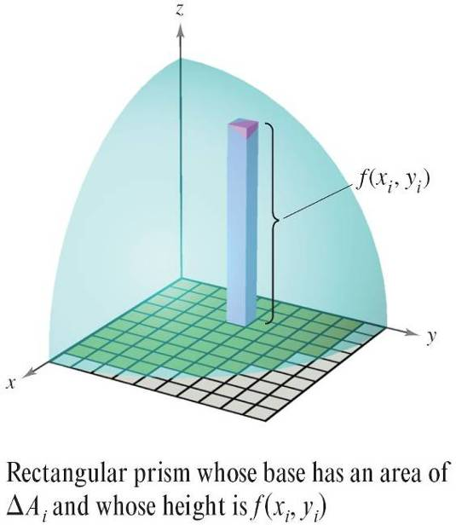
Double Integrals and Volume of a Solid Region
Next, choose a point (x_{i}, y_{i}) in each
rectangle and form the rectangular
prism whose height is
f(x_{i}, y_{i}) Height of ith prism
as shown in Figure 14.10.
Because the area of the ith rectangle is
ΔA_{i} Area of ith rectangle
it follows that the volume of the ith prism is
f(x_{i}, y_{i}) ΔA_{i} Volume of ith prism
Figure 14.10

Slide 9
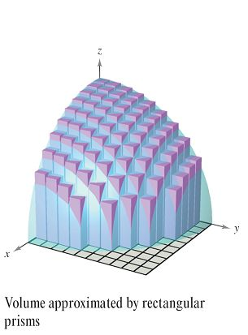
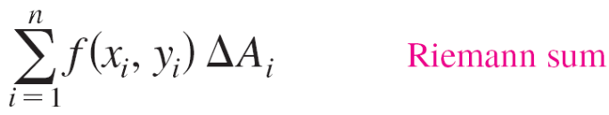
Double Integrals and Volume of a Solid Region
And you can approximate the volume of the solid region by
the Riemann sum of the volumes of all n prisms,
as shown in Figure 14.11.
This approximation can be improved
by tightening the mesh of the grid to
form smaller and smaller rectangles,
as shown in Example 1.
Figure 14.11

Slide 10
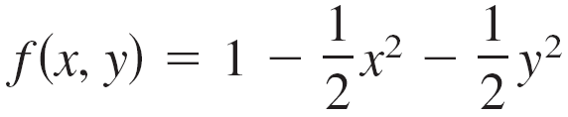

Example 1 – Approximating the Volume of a Solid
Approximate the volume of the solid lying between the
paraboloid
and the square region R given by 0 ≤ x ≤ 1, 0 ≤ y ≤ 1.
Use a partition made up of squares whose sides have a
length of

Slide 11
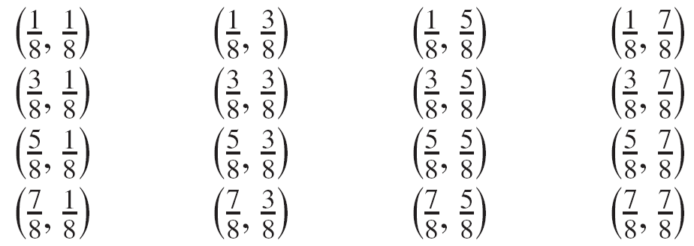
Example 1 – Solution
Begin by forming the specified partition of R.
For this partition, it is convenient to choose the centers of the subregions as the points at which to evaluate f(x, y).

Slide 12

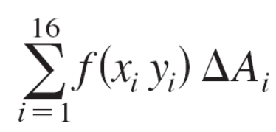
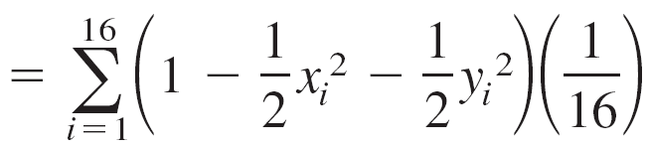
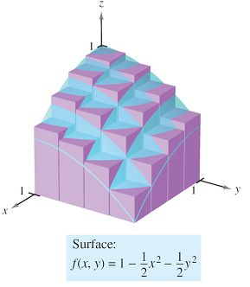

Example 1 – Solution
cont’d
Because the area of each square is you can
approximate the volume by the sum
This approximation is shown
graphically in Figure 14.12.
The exact volume of the solid is .
Figure 14.12

Slide 13

Example 1 – Solution
cont’d
You can obtain a better approximation by using a finer
partition.
For example, with a partition of squares with sides of
length the approximation is 0.668.

Slide 14
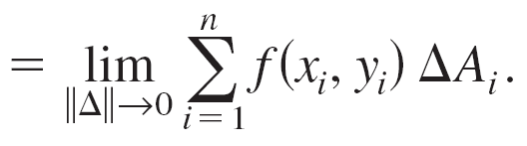
Double Integrals and Volume of a Solid Region
In Example 1, note that by using finer partitions, you obtain better approximations of the volume. This observation suggests that you could obtain the exact volume by taking a limit. That is,
Volume

Slide 15
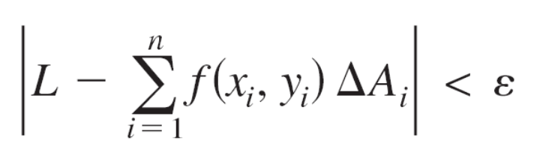
Double Integrals and Volume of a Solid Region
The precise meaning of this limit is that the limit is equal to L if for every ε > 0, there exists a δ > 0 such that
for all partitions Δ of the plane region R (that satisfy ||Δ|| < δ) and for all possible choices of x_{i} and y_{i} in the ith region.

Slide 16
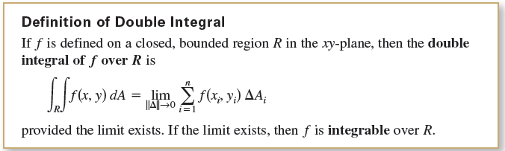
Double Integrals and Volume of a Solid Region
Using the limit of a Riemann sum to define volume is a special case of using the limit to define a double integral.
The general case, however, does not require that the function be positive or continuous.
Having defined a double integral, you will see that a definite
integral is occasionally referred to as a single integral.

Slide 17
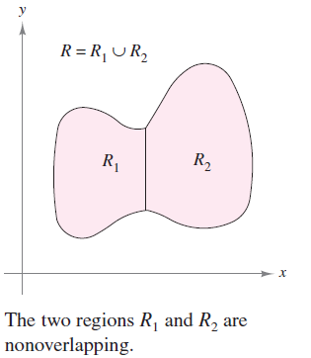
Double Integrals and Volume of a Solid Region
Sufficient conditions for the double integral of f on the
region R to exist are that R can be written as a union of a
finite number of nonoverlapping subregions
(see Figure 14.13) that are vertically or horizontally simple
and that f is continuous on the
region R.
This means that the intersection
of two nonoverlapping regions is a
set that has an area of 0. In Figure 14.13,
the area of the line segment common
to R₁ and R₂ is 0.
Figure 14.13

Slide 18
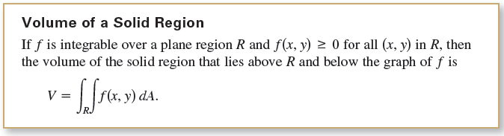
Double Integrals and Volume of a Solid Region
A double integral can be used to find the volume of a solid
region that lies between the xy-plane and the surface given
by z = f(x, y).

Slide 19
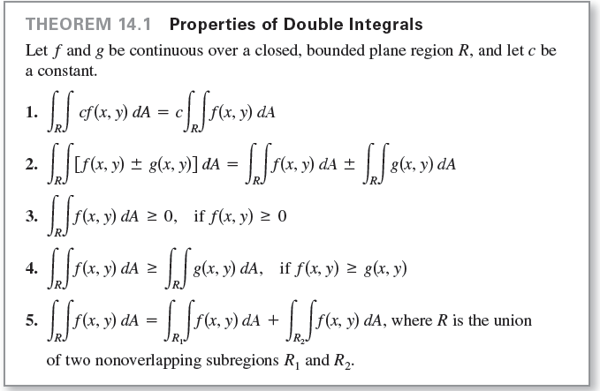
Double Integrals and Volume of a Solid Region
Double integrals share many properties of single integrals.

Slide 20
Evaluation of Double Integrals

Slide 21
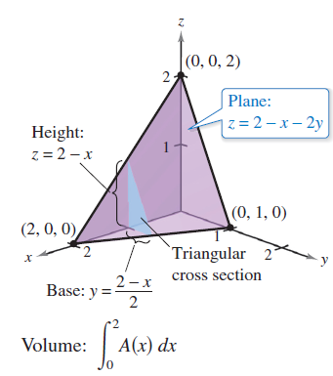
Evaluation of Double Integrals
Consider the solid region bounded by the plane
z = f(x, y) = 2 – x – 2y and the three coordinate planes, as
shown in Figure 14.14.
Figure 14.14

Slide 22
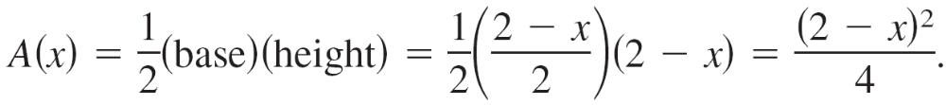
Evaluation of Double Integrals
Each vertical cross section taken parallel to the yz-plane is a triangular region whose base has a length of y = (2 – x)/2 and whose height is z = 2 – x.
This implies that for a fixed value of x, the area of the triangular cross section is

Slide 23
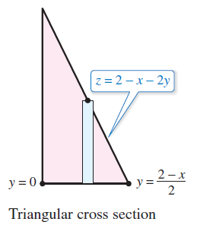
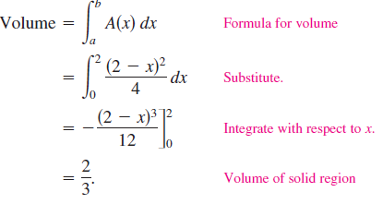
Evaluation of Double Integrals
By the formula for the volume of a solid with known cross
sections, the volume of the solid is
This procedure works no matter how A(x) is obtained. In particular, you can find A(x) by integration, as shown in Figure 14.15.
Figure 14.15

Slide 24
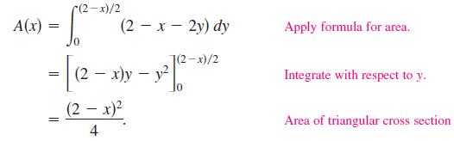

Evaluation of Double Integrals
That is, you consider x to be constant and integrate
z = 2 – x – 2y from 0 to (2 – x)/2 to obtain
Combining these results, you have the iterated integral

Slide 25
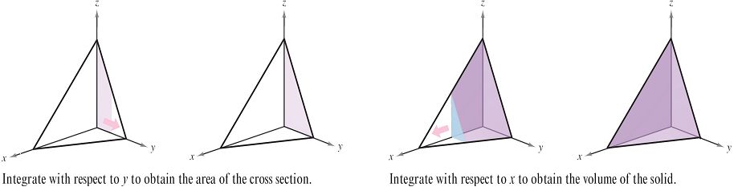
Evaluation of Double Integrals
To understand this procedure better, it helps to imagine the
integration as two sweeping motions. For the inner
integration, a vertical line sweeps out the area of a cross
section. For the outer integration, the triangular cross
section sweeps out the volume, as shown in Figure 14.16.
Figure 14.16

Slide 26
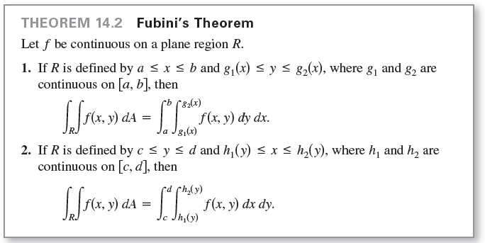
Evaluation of Double Integrals

Slide 27
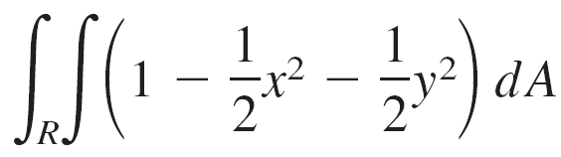
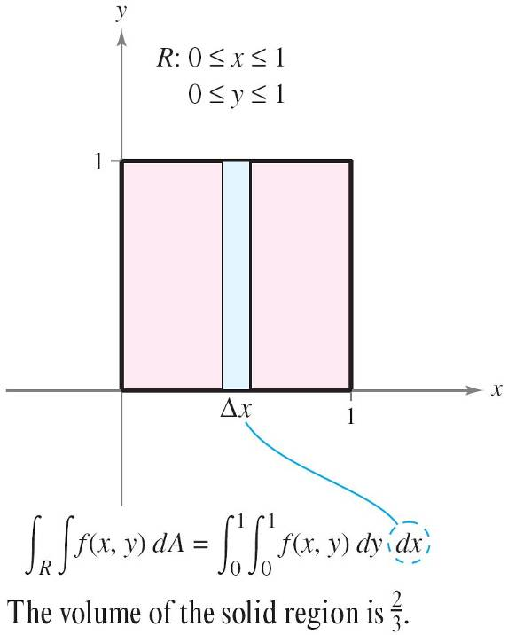
Example 2 – Evaluating a Double Integral as an Iterated Integral
Evaluate
where R is the region given by 0 ≤ x ≤ 1, 0 ≤ y ≤ 1.
Solution:
Because the region R is a square,
it is both vertically and horizontally simple,
and you can use either order of integration.
Choose dy dx by placing a vertical
representative rectangle in the region
as shown in the figure at the right.

Slide 28
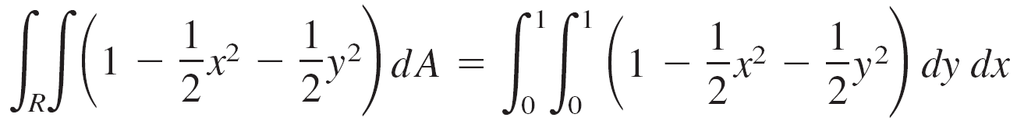
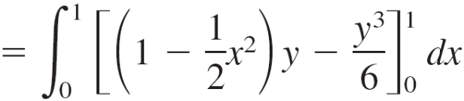
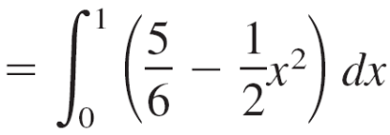
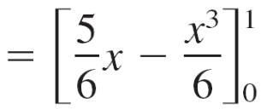
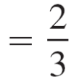
Example 2 – Solution
cont’d
This produces the following.

Slide 29
Average Value of a Function

Slide 30
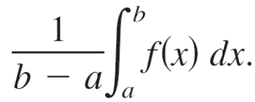
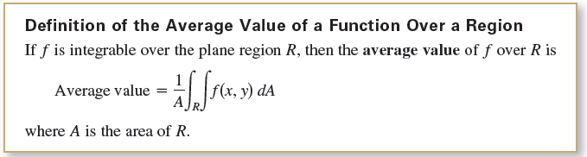
Average Value of a Function
For a function f in one variable, the average value of f on
the interval [a, b] is
Given a function f in two variables, you can find the average value of f over the plane region R as shown in the following definition.

Slide 31

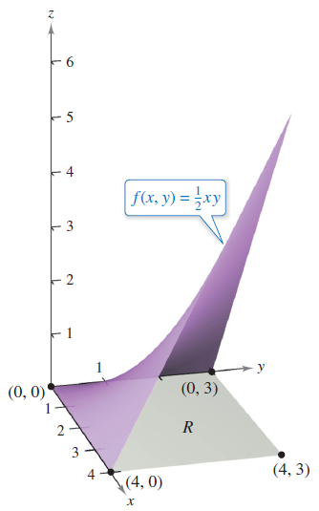
Example 6 – Finding the Average Value of a Function
Find the average value of f(x, y) = over the plane region R, where R is a rectangle with vertices (0, 0), (4, 0), (4, 3),
and (0, 3).
Solution:
The area of the rectangular region
R is A = (4)(3) = 12 as shown in
Figure 14.22.
Figure 14.22

Slide 32


Example 6 – Solution
cont’d
The bounds for x are
and the bounds for y are
So, the average value is
Average value

Slide 33





Example 6 – Solution
cont’d

