Slide 1


14
P
Multiple Integration
Copyright © Cengage Learning. All rights reserved.

Slide 2

Change of Variables: Polar Coordinates
14.3
Copyright © Cengage Learning. All rights reserved.

Slide 3
Objective
Write and evaluate double integrals in polar coordinates.

Slide 4
Double Integrals in Polar Coordinates

Slide 5
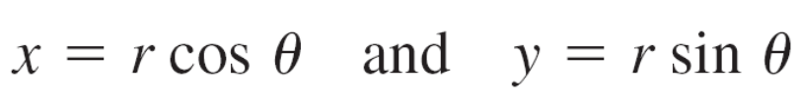
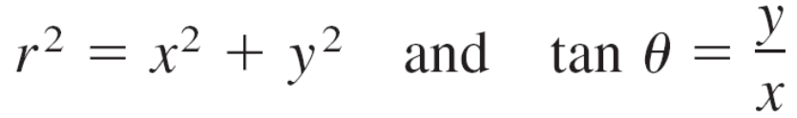
Double Integrals in Polar Coordinates
The polar coordinates (r, θ ) of a point are related to the rectangular coordinates (x, y) of the point as follows.

Slide 6
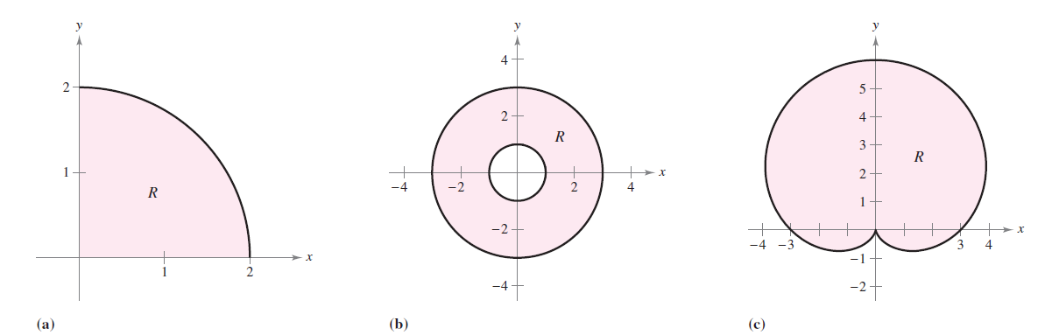
Example 1 – Using Polar Coordinates to Describe a Region
Use polar coordinates to describe each region shown in Figure 14.23.
Figure 14.23

Slide 7
Example 1 – Solution
a. The region R is a quarter circle of radius 2.
It can be described in polar coordinates as
b. The region R consists of all points between concentric circles of radii 1 and 3.
It can be described in polar coordinates as

Slide 8
Example 1 – Solution
cont’d
c. The region R is a cardioid with a = b = 3.
It can be described in polar coordinates as

Slide 9

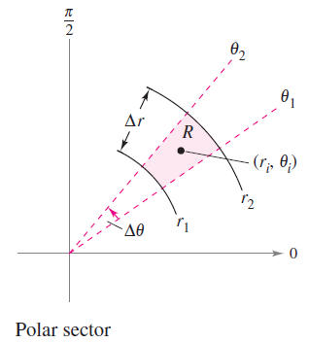
Double Integrals in Polar Coordinates
The regions in Example 1 are special cases of polar sectors
as shown in Figure 14.24.
Figure 14.24

Slide 10
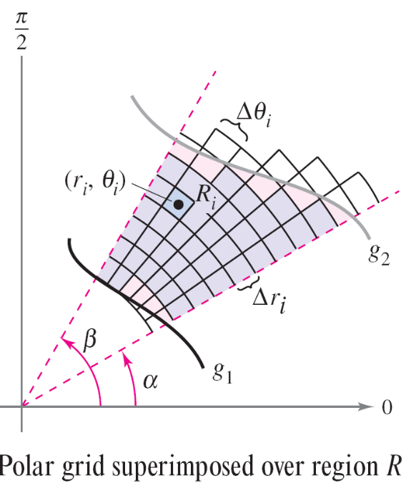
Double Integrals in Polar Coordinates
To define a double integral of a continuous function z = f(x, y) in polar coordinates, consider a region R bounded by the graphs of r = g₁(θ ) and r = g₂(θ ) and the lines θ = α and θ = β.
Instead of partitioning R into small
rectangles, use a partition of small
polar sectors.
On R, superimpose a polar grid
made of rays and circular arcs,
as shown in Figure 14.25.
Figure 14.25

Slide 11
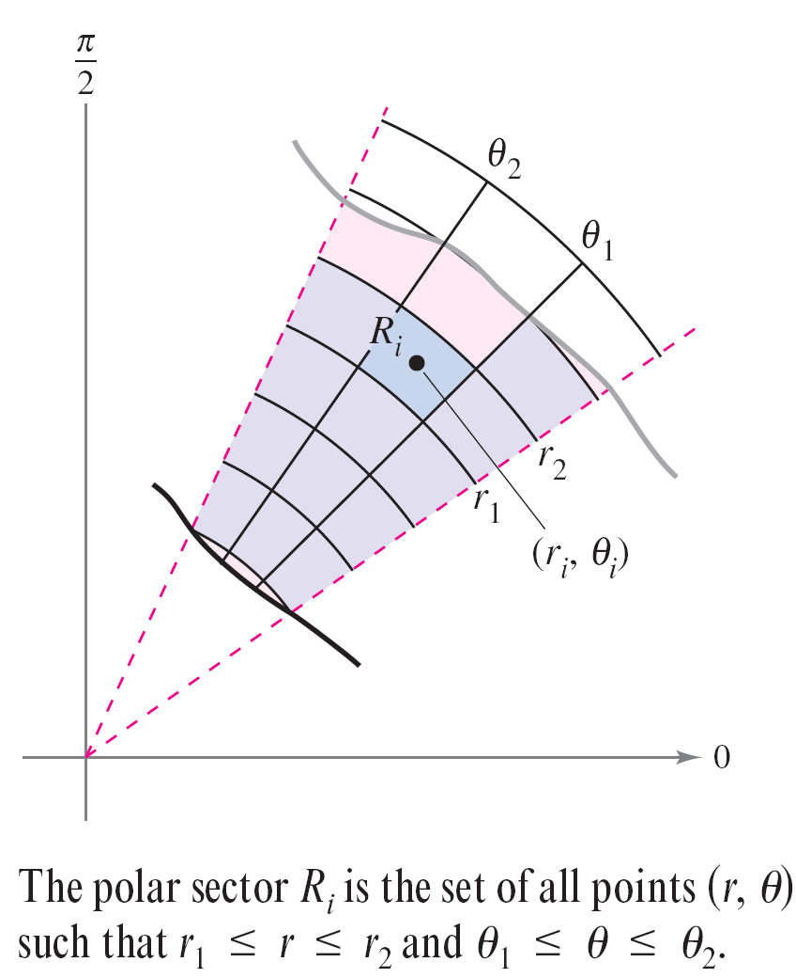
Double Integrals in Polar Coordinates
The polar sectors R_{i} lying entirely within R form an inner polar partition Δ, whose norm ||Δ|| is the length of the longest diagonal of the n polar sectors.
Consider a specific polar sector R_{i},
as shown in Figure 14.26.
Figure 14.26

Slide 12




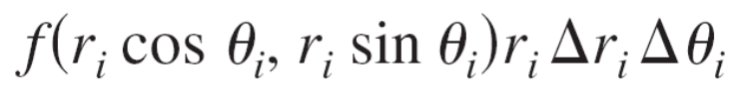
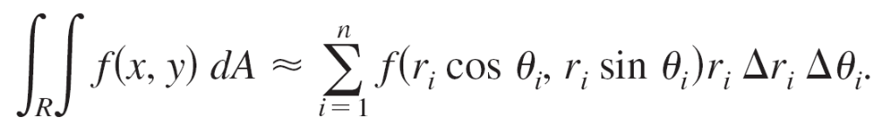

Double Integrals in Polar Coordinates
It can be shown that the area of R_{i} is
where and . This implies that the volume of the solid of height above R_{i} is approximately
and you have
The sum on the right can be interpreted as a Riemann sum for

Slide 13
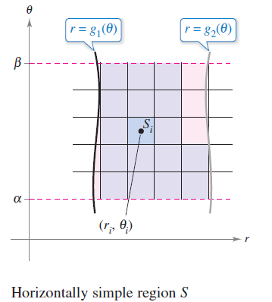
Double Integrals in Polar Coordinates
The region R corresponds to a horizontally simple region S in
the rθ -plane, as shown in Figure 14.27.
Figure 14.27

Slide 14


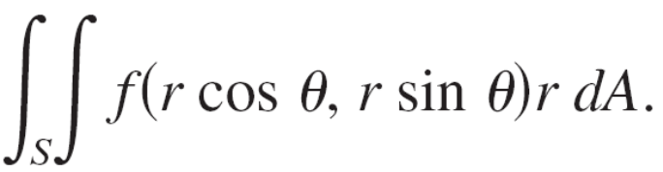
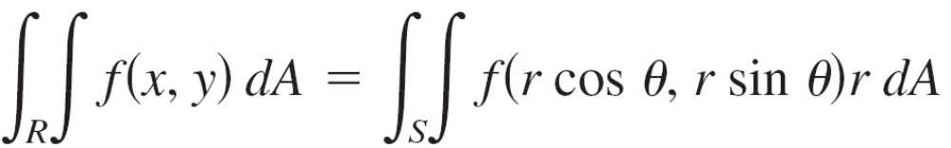
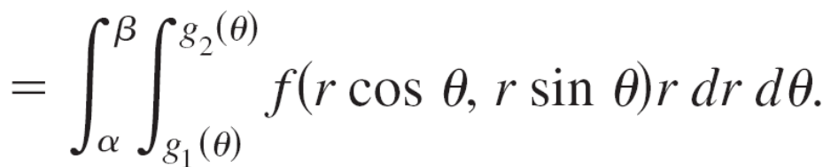
Double Integrals in Polar Coordinates
The polar sectors R_{i} correspond to rectangles S_{i}, and the area of S_{i} is
So, the right-hand side of the equation corresponds to the double integral
From this, you can write

Slide 15
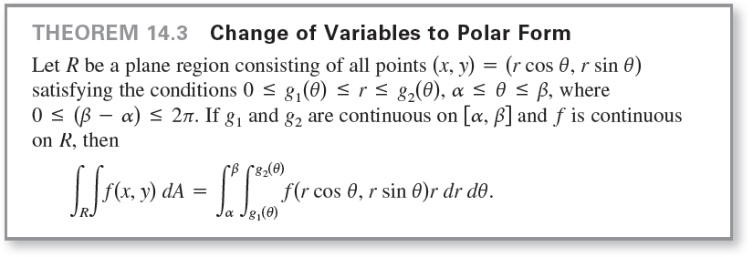
Double Integrals in Polar Coordinates
This suggests the following Theorem 14.3.

Slide 16
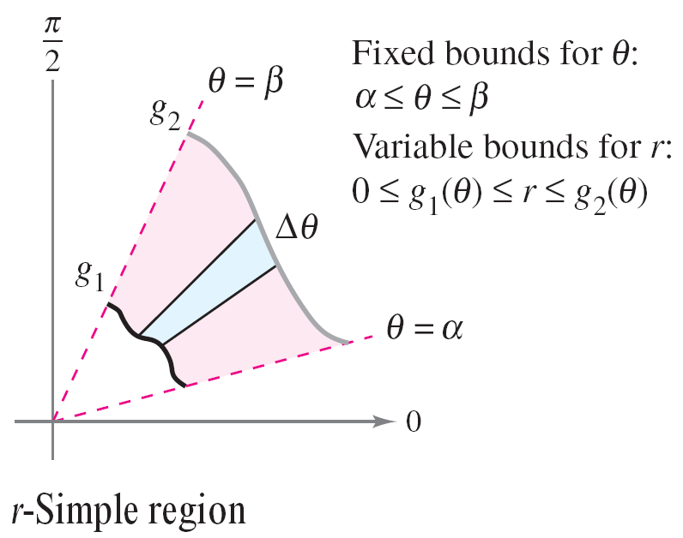
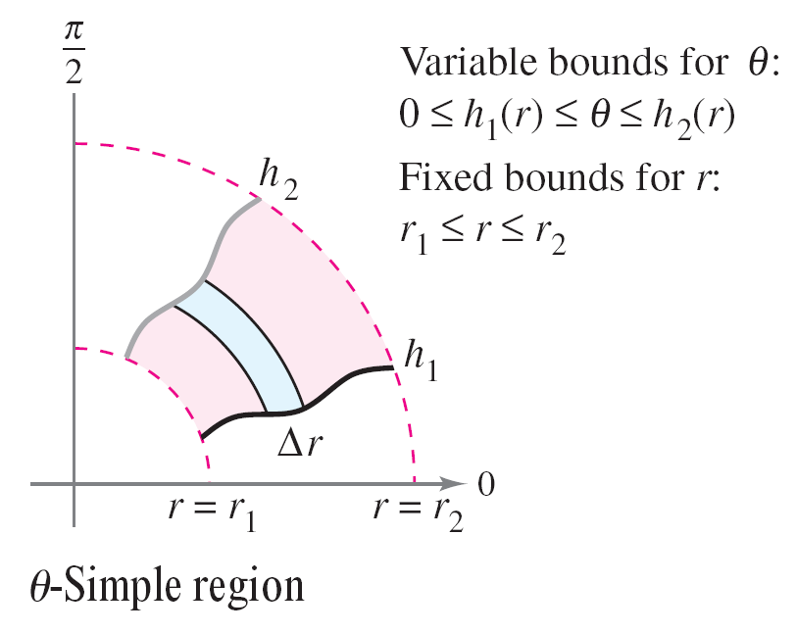
Double Integrals in Polar Coordinates
The region R is restricted to two basic types, r-simple regions and θ -simple regions, as shown in Figure 14.28.
Figure 14.28

Slide 17



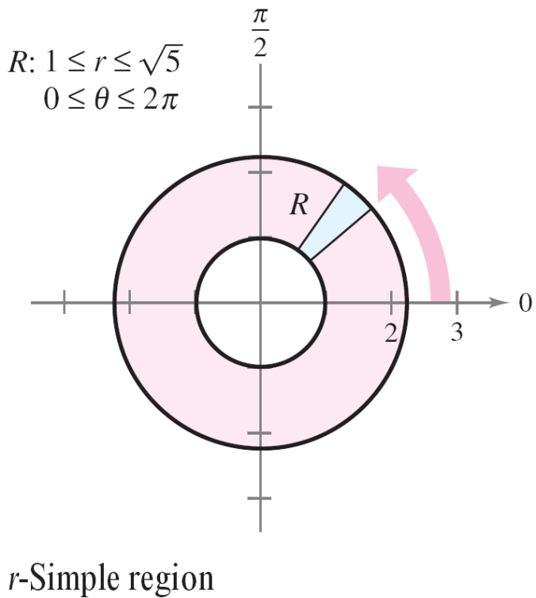


Example 2 – Evaluating a Double Polar Integral
Let R be the annular region lying between the two circles
and
Evaluate the integral
Solution:
The polar boundaries are
and as shown in
Figure 14.29.
Figure 14.29

Slide 18


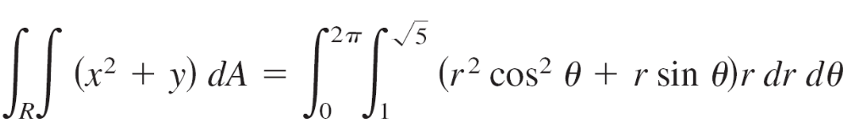
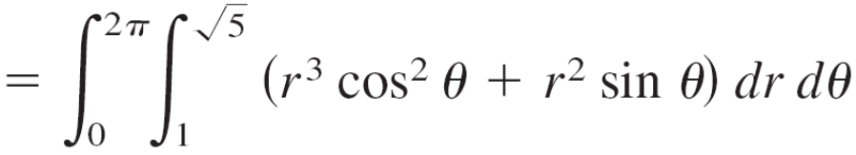
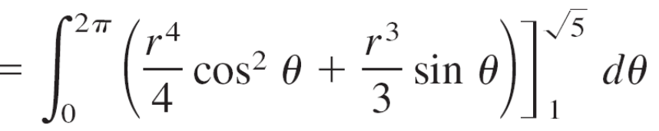
Example 2 – Solution
cont’d
Furthermore, and
So, you have

Slide 19
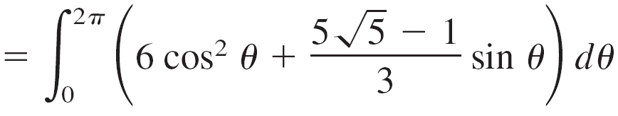
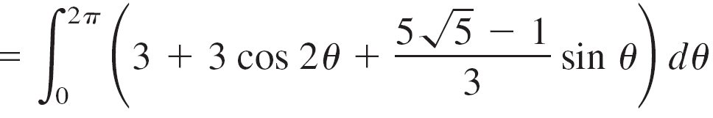
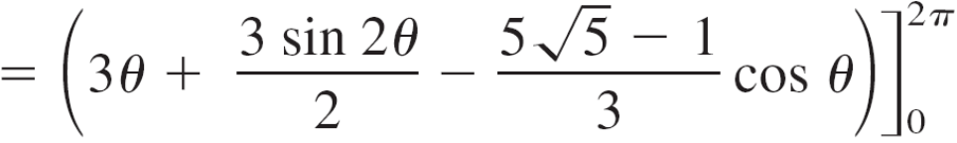

Example 2 – Solution
cont’d

