Slide 1


14
P
Multiple Integration
Copyright © Cengage Learning. All rights reserved.

Slide 2

Center of Mass and Moments of Inertia
14.4
Copyright © Cengage Learning. All rights reserved.

Slide 3
Objectives
Find the mass of a planar lamina using a double integral.
Find the center of mass of a planar lamina using double integrals.
Find moments of inertia using double integrals.

Slide 4
Mass

Slide 5
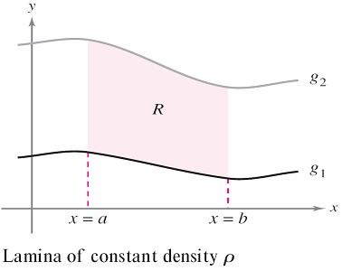
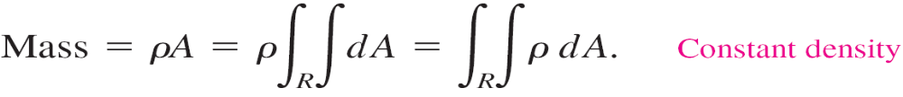
Mass
If the lamina corresponding to the region R, as shown
in Figure 14.33, has a constant density ρ,
then the mass of the lamina is given by
Figure 14.33

Slide 6
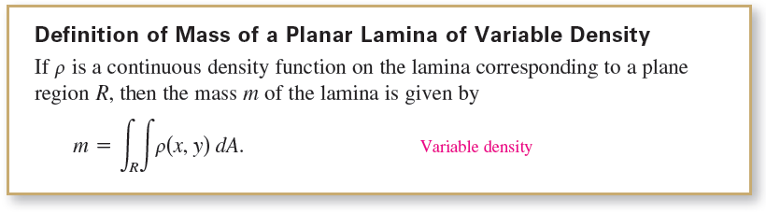
Mass
If not otherwise stated, a lamina is assumed to have a constant density. We will extend the definition of the term lamina to include thin plates of variable density.
Double integrals can be used to find the mass of a lamina of variable density, where the density at (x, y) is given by the density function ρ.

Slide 7
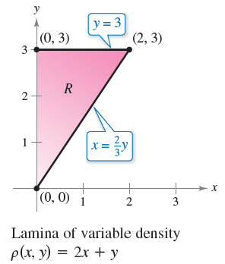
Example 1 – Finding the Mass of a Planar Lamina
Find the mass of the triangular lamina with vertices (0, 0), (0, 3), and (2, 3), given that the density at (x, y) is
ρ(x, y) = 2x + y.
Solution:
As shown in Figure 14.34,
region R has the boundaries
x = 0, y = 3, and
y = 3x/2 (or x = 2y/3).
Figure 14.34

Slide 8
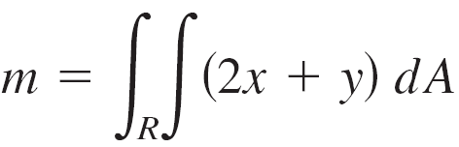
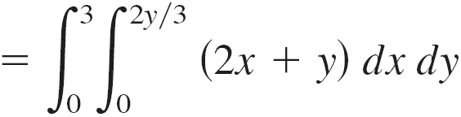
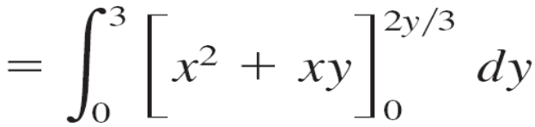
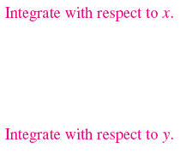
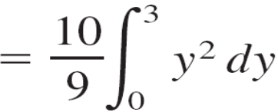
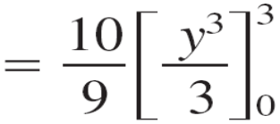

Example 1 – Solution
cont’d
Therefore, the mass of the lamina is

Slide 9
Example 1 – Solution
cont’d
In Figure 14.34, note that the planar lamina is shaded so that the darkest shading corresponds to the densest part.
Figure 14.34

Slide 10
Moments and Center of Mass

Slide 11
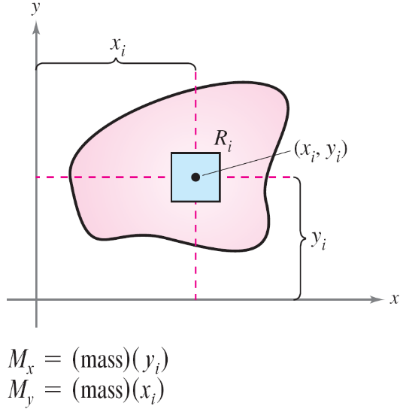
Moments and Center of Mass
For a lamina of variable density, moments of mass are defined in a manner similar to that used for the uniform density case.
For a partition Δ of a lamina corresponding to a plane region R, consider the i th rectangle R_{i} of one area ΔA_{i}, as shown in Figure 14.36.
Figure 14.36

Slide 12


Moments and Center of Mass
Assume that the mass of R_{i} is concentrated at one of its interior points (x_{i}, y_{i}). The moment of mass of R_{i} with respect to the x-axis can be approximated by
Similarly, the moment of mass with respect to the y-axis can be approximated by

Slide 13
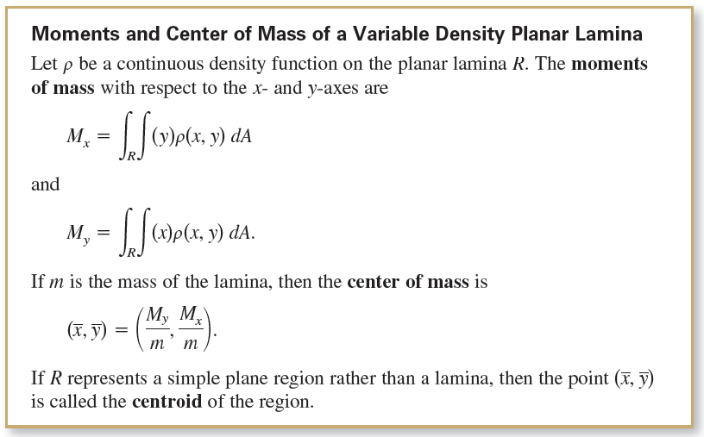
Moments and Center of Mass
By forming the Riemann sum of all such products and taking the limits as the norm of Δ approaches 0, you obtain the following definitions of moments of mass with respect to the x- and y-axes.

Slide 14
Moments and Center of Mass
For some planar laminas with a constant density ρ, you can determine the center of mass (or one of its coordinates) using symmetry rather than using integration.

Slide 15


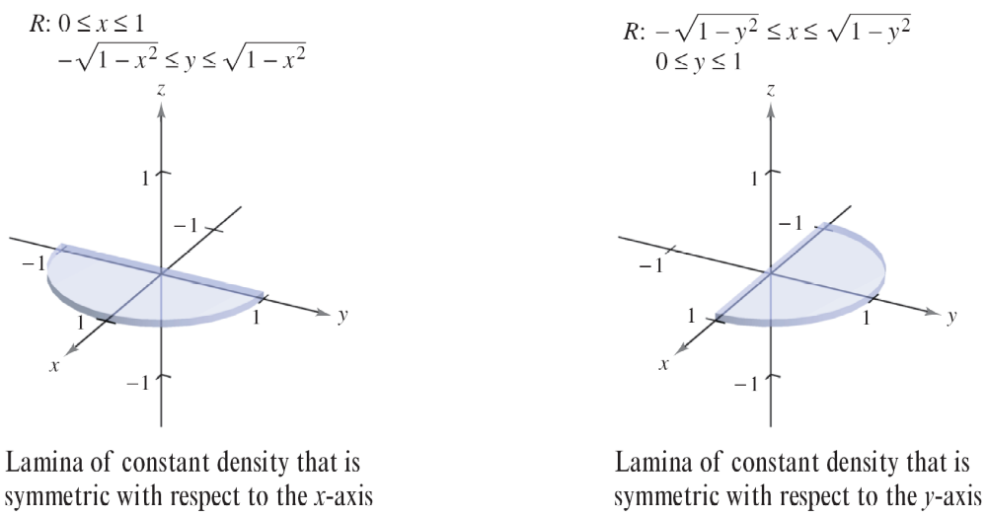
Moments and Center of Mass
For instance, consider the laminas of constant density shown in Figure 14.37.
Using symmetry, you can see that for the first lamina
and for the second lamina.
Figure 14.37

Slide 16
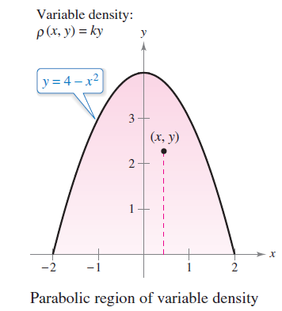
Example 3 – Finding the Center of Mass
Find the center of mass of the lamina corresponding to the parabolic region
0 ≤ y ≤ 4 – x² Parabolic region
where the density at the point (x, y) is proportional to the distance between (x, y) and the x-axis, as shown in Figure 14.38.
Figure 14.38

Slide 17

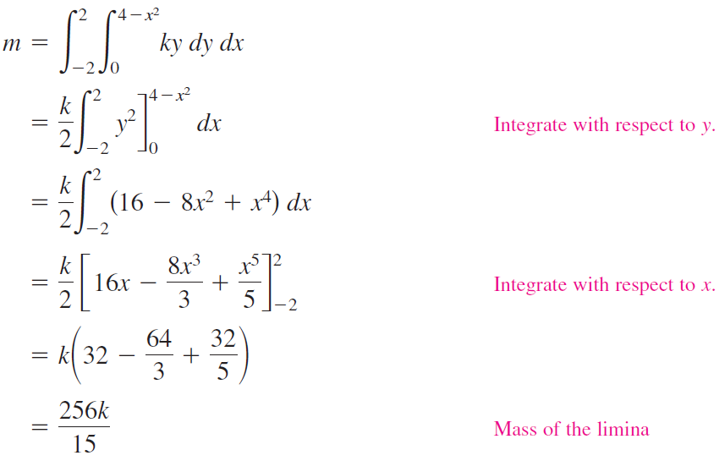
Example 3 – Solution
The lamina is symmetric with respect to the y-axis and
ρ(x, y) = ky, where k is the constant of proportionality. So, the center of mass lies on the y-axis and
To find , first find the mass of the lamina.

Slide 18
Example 3 – Solution
cont’d

Slide 19
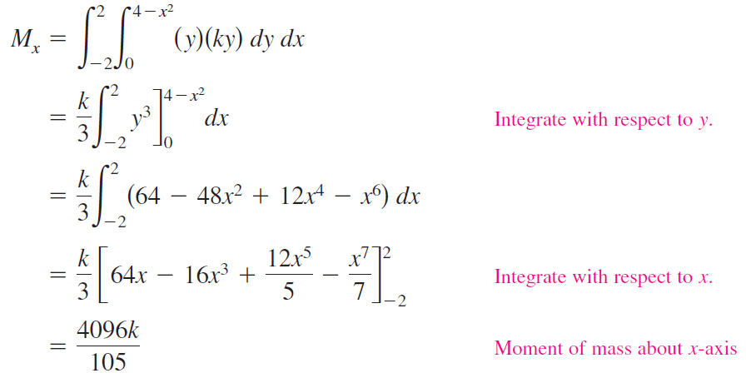
Example 3 – Solution
cont’d
Next, find the moment of mass about the x-axis.

Slide 20
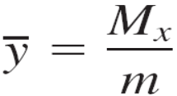
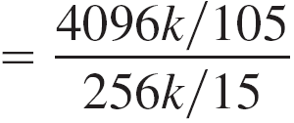
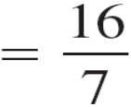

Example 3 – Solution
cont’d
So,
and the center of mass is

Slide 21
Moments of Inertia

Slide 22
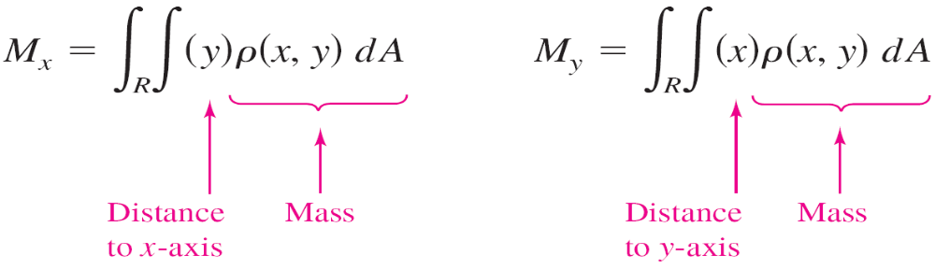
Moments of Inertia
The moments of M_{x} and M_{y} used in determining the center of mass of a lamina are sometimes called the first moments about the x- and y-axes.
In each case, the moment is the product of a mass times a distance.

Slide 23
Moments of Inertia
You will now look at another type of moment—the second moment, or the moment of inertia of a lamina about a line.
In the same way that mass is a measure of the tendency of matter to resist a change in straight-line motion, the moment of inertia about a line is a measure of the tendency of matter to resist a change in rotational motion.
For example, when a particle of mass m is a distance d from a fixed line, its moment of inertia about the line is defined as
I = md² = (mass)(distance)².

Slide 24
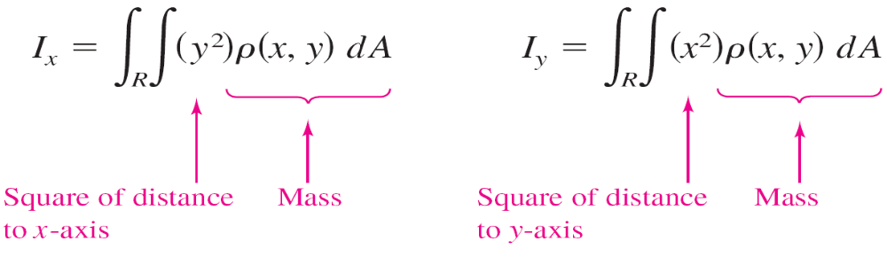
Moments of Inertia
As with moments of mass, you can generalize this concept to obtain the moments of inertia about the x- and y-axes of a lamina of variable density.
These second moments are denoted by I_{x} and I_{y}, and in each case the moment is the product of a mass times the square of a distance.
The sum of the moments I_{x} and I_{y} is called the polar moment of inertia and is denoted by I₀.

Slide 25

Moments of Inertia
For a lamina in the xy-plane, I₀ represents the moment of inertia of the lamina about the z-axis.
The term “polar moment of inertia” stems from the fact that the square of the polar distance r is used in the calculation.

Slide 26
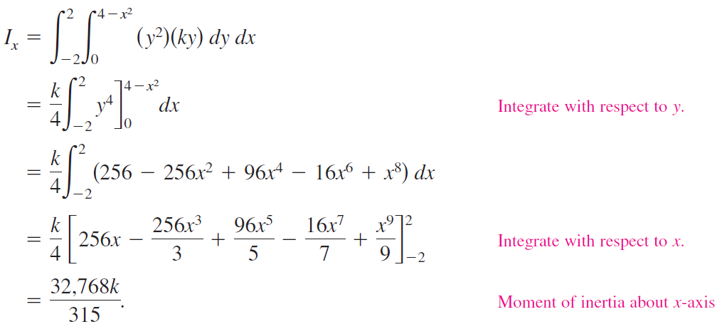
Example 4 – Finding the Moment of Inertia
Find the moment of inertia about the x-axis of the lamina in Example 3.
Solution:
From the definition of moment of inertia, you have

Slide 27
Example 4 – Solution
cont’d

Slide 28
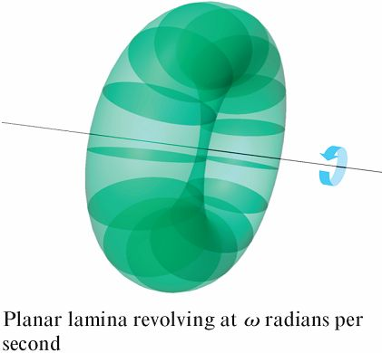
Moments of Inertia
The moment of inertia I of a revolving lamina can be used to measure its kinetic energy.
For example, suppose a planar lamina is revolving about a line with an angular speed of ω radians per second, as shown in Figure 14.40.
Figure 14.40

Slide 29
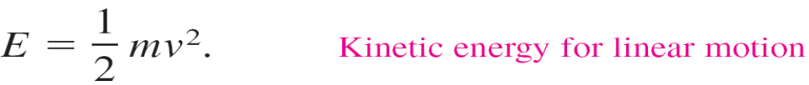
Moments of Inertia
The kinetic energy E of the revolving lamina is
On the other hand, the kinetic energy E of a mass m moving in a straight line at a velocity v is
So, the kinetic energy of a mass moving in a straight line is proportional to its mass, but the kinetic energy of a mass revolving about an axis is proportional to its moment of inertia.

Slide 30
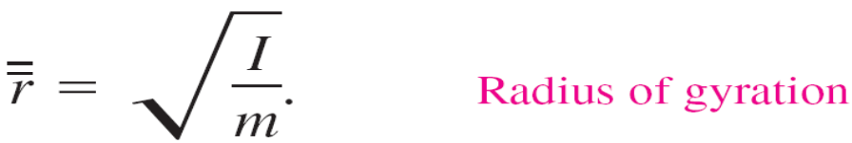
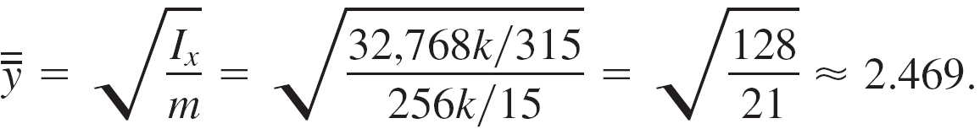
Moments of Inertia
The radius of gyration of a revolving mass m with moment of inertia I is defined as
If the entire mass were located at a distance from its axis of revolution, it would have the same moment of inertia and, consequently, the same kinetic energy. For instance, the radius of gyration of the lamina in Example 4 about the x-axis is

