Slide 1


14
P
Multiple Integration
Copyright © Cengage Learning. All rights reserved.

Slide 2

14.5
Surface Area
Copyright © Cengage Learning. All rights reserved.

Slide 3
Objective
Use a double integral to find the area of a surface.

Slide 4
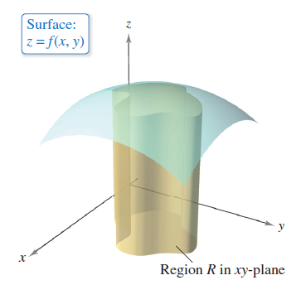
Surface Area
You know a great deal about the solid region lying between a surface and a closed and bounded region R in the xy-plane, as shown in Figure 14.42.
For example, you know
how to find the extrema
of f on R, the area of the
base R of the solid, the
volume of the solid, and
the centroid of the base R.
Figure 14.42

Slide 5

Surface Area
In this section, you will learn how to find the upper surface area of the solid.
To begin, consider a surface S given by
z = f(x, y)
defined over a region R. Assume that R is closed and bounded and that f has continuous first partial derivatives.

Slide 6
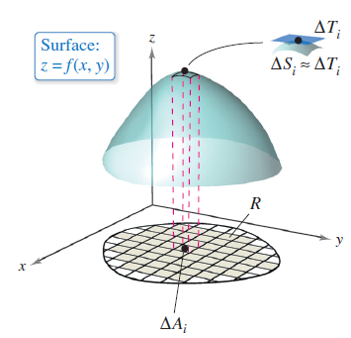
Surface Area
To find the surface area, construct an inner partition of R
consisting of n rectangles, where the area of the ith
rectangle R_{i} is ΔA_{i} = Δx_{i} Δy_{i}, as shown in Figure 14.43.
In each R_{i}, let (x_{i}, y_{i}) be the point
that is closest to the origin.
At the point
(x_{i}, y_{i}, z_{i} ) = (x_{i}, y_{i}, f(x_{i}, y_{i}))
on the surface S, construct a
tangent plane T_{i}.
Figure 14.43

Slide 7
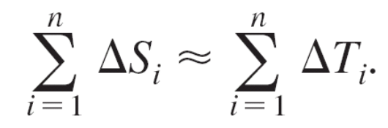
Surface Area
The area of the portion of the tangent plane that lies
directly above R_{i} is approximately equal to the area of the
surface lying directly above R_{i}. That is, ΔT_{i} ≈ ΔS_{i}.
So, the surface area of S is approximated by
To find the area of the parallelogram ΔT_{i}, note that its sides are given by the vectors
u = Δx_{i}i + f_{x}(x_{i}, y_{i}) Δx_{i}k
and
v = Δy_{i}j + f_{y}(x_{i}, y_{i}) Δy_{i}k.

Slide 8
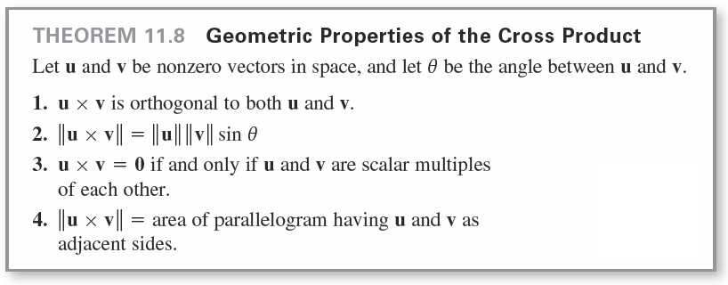

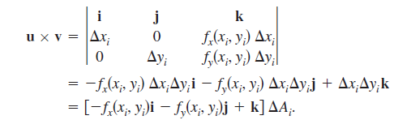
Surface Area
From Theorem 11.8, the area of ΔT_{i} is given by , where

Slide 9
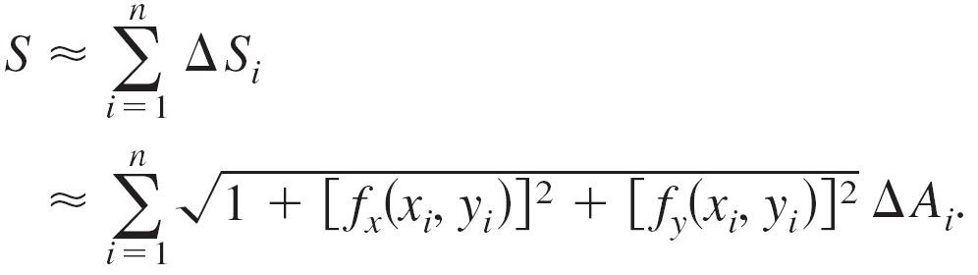
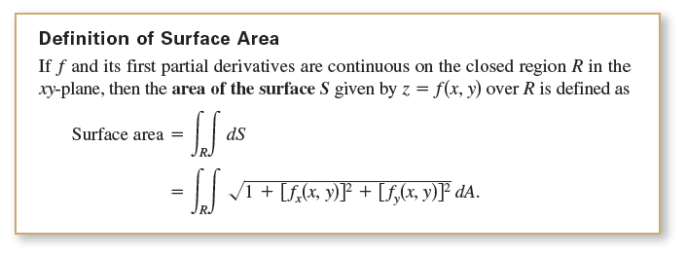
Surface Area
So, the area of ΔT_{i} is
and
Surface area of
This suggests the definition of surface area below.

Slide 10
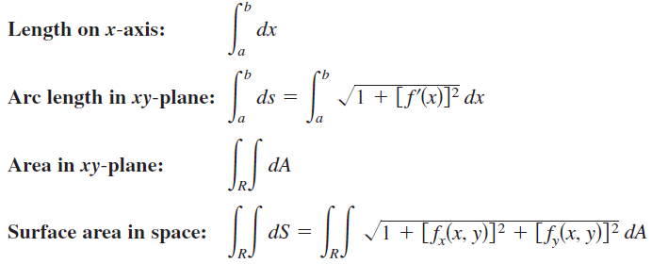
Surface Area
As an aid to remembering the double integral for surface area, it is helpful to note its similarity to the integral for arc length.

Slide 11
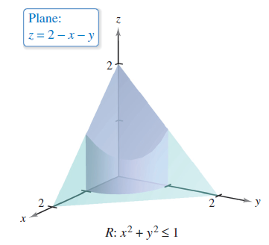
Example 1 – The Surface Area of a Plane Region
Find the surface area of the portion of the plane
z = 2 – x – y that lies above the circle x² + y² ≤ 1 in the first quadrant, as shown in Figure 14.44.
Figure 14.44

Slide 12
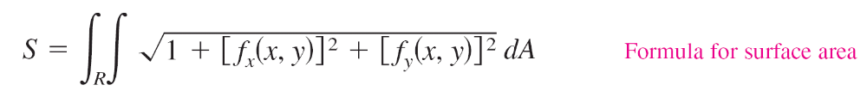
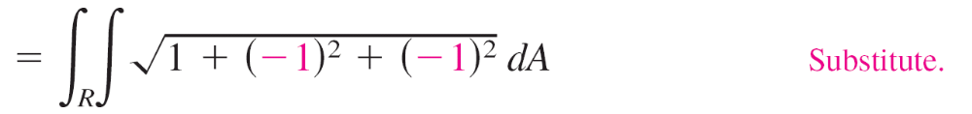
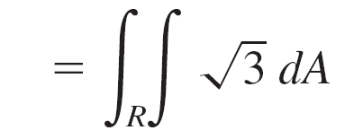
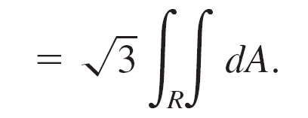
Example 1 – Solution
Note that f (x, y) = 2 – x – y, f_{x}(x, y) = –1, and f_{y}(x, y) = –1 are continuous on the region R.
So, the surface area is given by

Slide 13



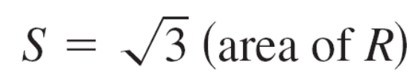
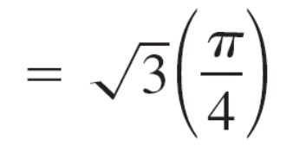
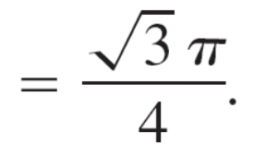
Example 1 – Solution
cont’d
Note that the last integral is times the area of the region R.
Because R is a quarter circle of radius 1, with area of R is
or .
So, the area of S is

