Slide 1


14
P
Multiple Integration
Copyright © Cengage Learning. All rights reserved.

Slide 2

Triple Integrals and Applications
14.6
Copyright © Cengage Learning. All rights reserved.

Slide 3
Objectives
Use a triple integral to find the volume of a solid region.
Find the center of mass and moments of inertia of a solid region.

Slide 4
Triple Integrals

Slide 5
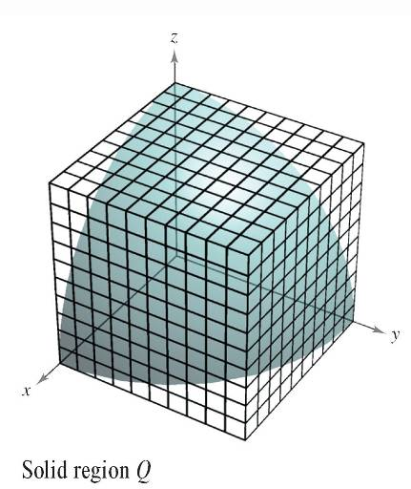
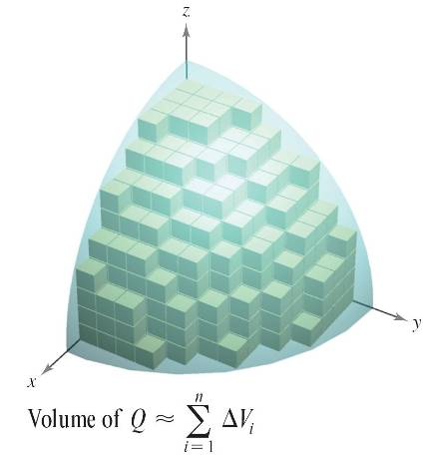
Triple Integrals
The procedure used to define a triple integral follows
that used for double integrals.
Consider a function f of three
variables that is continuous
over a bounded solid region Q.
Then encompass Q with a network
of boxes and form the inner partition
consisting of all boxes lying entirely
within Q, as shown in Figure 14.52.
Figure 14.52

Slide 6
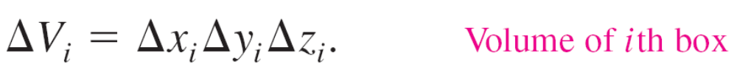

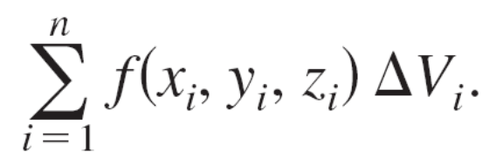
Triple Integrals
The volume of the ith box is
The norm of the partition is the length of the longest diagonal of the n boxes in the partition.
Choose a point (x_{i}, y_{i}, z_{i}) in each box and form the Riemann sum

Slide 7

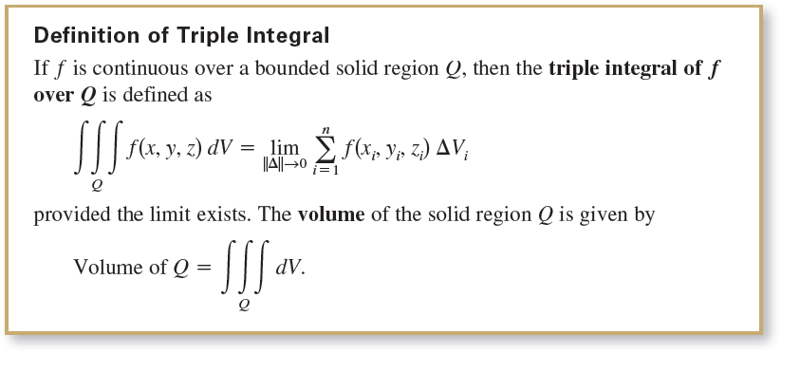
Triple Integrals
Taking the limit as leads to the following definition.

Slide 8
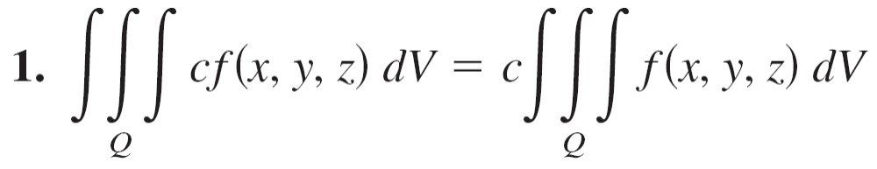
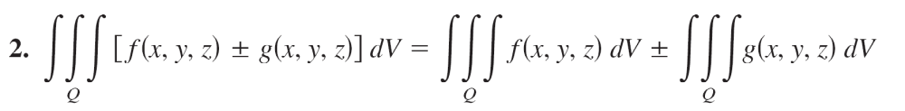
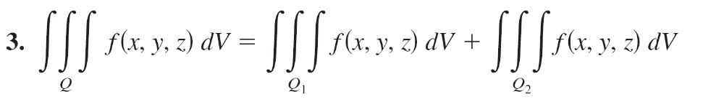
Triple Integrals
Some of the properties of double integrals can be restated in terms of triple integrals.

Slide 9

Triple Integrals
In these properties, Q is the union of two nonoverlapping solid subregions Q₁ and Q₂.
If the solid region Q is simple, then the triple integral
∫ ∫ ∫ f (x, y, z) dV can be evaluated with an iterated integral using one of the six possible orders of integration listed below.

Slide 10
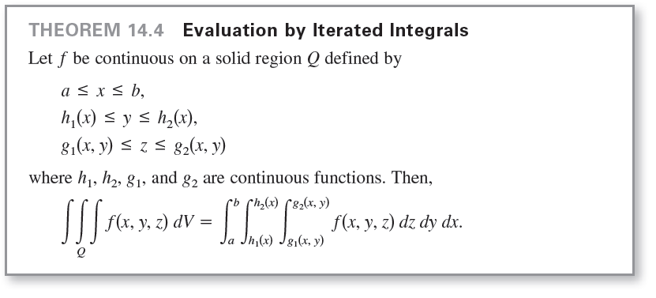
Triple Integrals

Slide 11
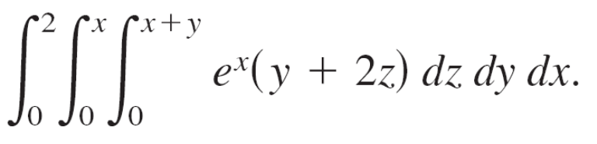
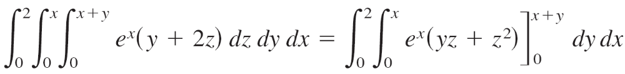
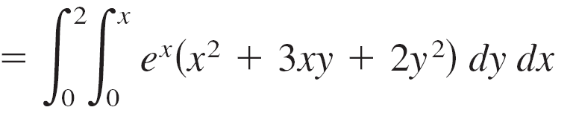
Example 1 – Evaluating a Triple Iterated Integral
Evaluate the triple iterated integral
Solution:
For the first integration, hold x and y constant and integrate with respect to z.

Slide 12
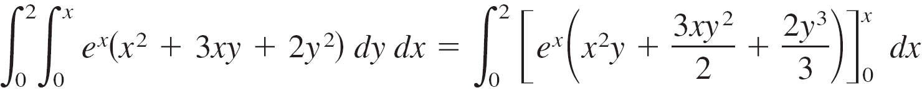
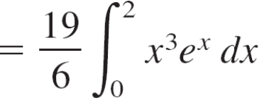
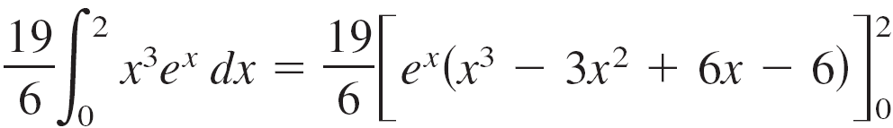
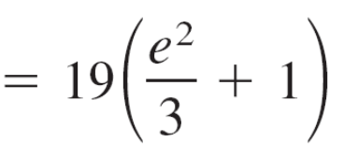

Example 1 – Solution
cont’d
For the second integration, hold x constant and integrate with respect to y.
Finally, integrate with respect to x.

Slide 13
Triple Integrals
To find the limits for a particular order of integration, it is generally advisable first to determine the innermost limits, which may be functions of the outer two variables.
Then, by projecting the solid Q onto the coordinate plane of the outer two variables, you can determine their limits of integration by the methods used for double integrals.

Slide 14
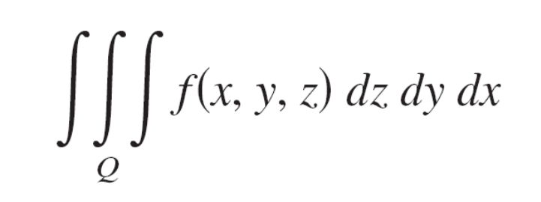
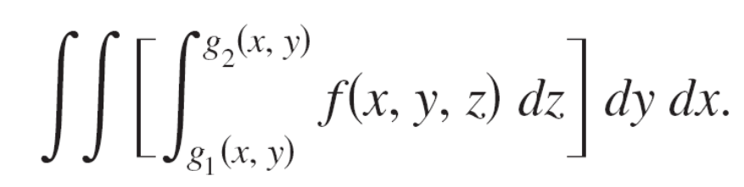
Triple Integrals
For instance, to evaluate
first determine the limits for z; the integral then has the form

Slide 15
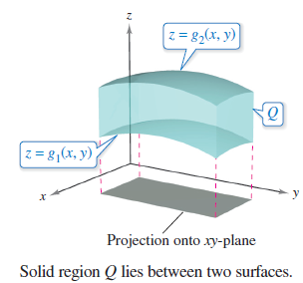
Triple Integrals
By projecting the solid Q onto the xy-plane, you can determine the limits for x and y as you did for double integrals, as shown in Figure 14.53.
Figure 14.53

Slide 16
Center of Mass and Moments of Inertia

Slide 17

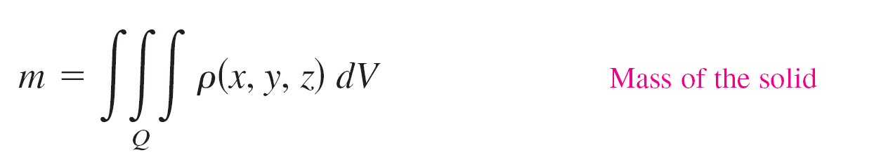
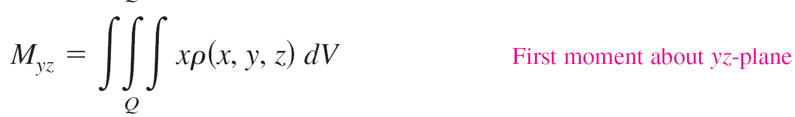
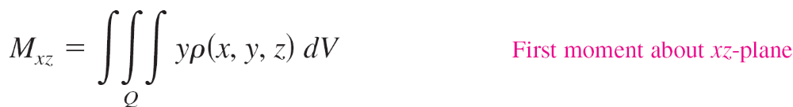
Center of Mass and Moments of Inertia
Consider a solid region Q whose density is given by the density function ρ.
The center of mass of a solid region Q of mass m is given by , where

Slide 18
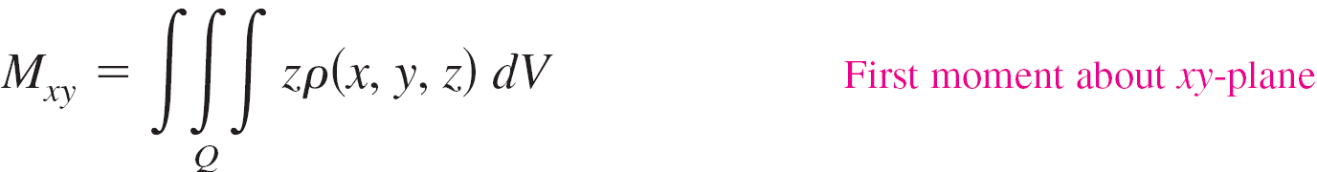
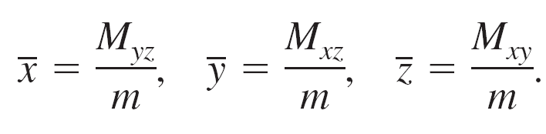
Center of Mass and Moments of Inertia
and
The quantities M_{yz}, M_{xz}, and M_{xy} are called the first moments of the region Q about the yz-, xz-, and xy-planes, respectively.
The first moments for solid regions are taken about a
plane, whereas the second moments for solids are taken about a line.

Slide 19
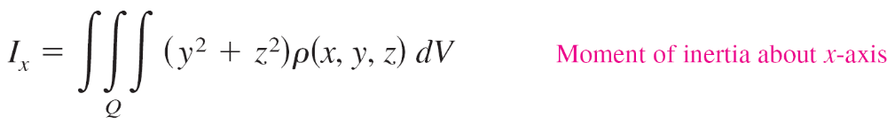
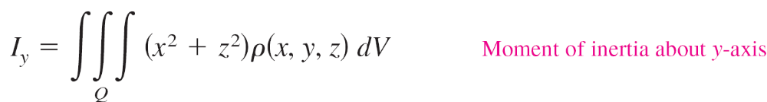
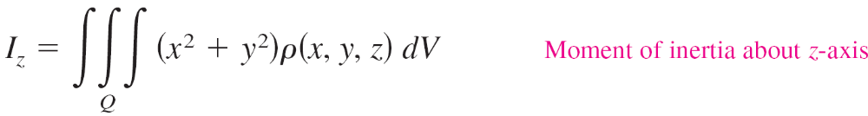
Center of Mass and Moments of Inertia
The second moments (or moments of inertia) about the and x-, y-, and z-axes are
and

Slide 20
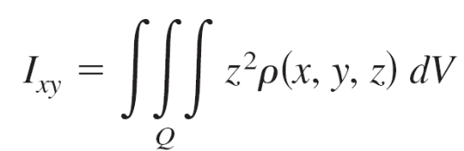
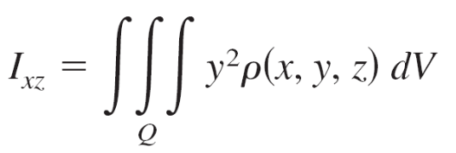
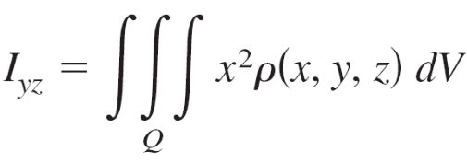
Center of Mass and Moments of Inertia
For problems requiring the calculation of all three moments, considerable effort can be saved by applying the additive property of triple integrals and writing
where I_{xy}, I_{xz}, and I_{yz} are
and

Slide 21
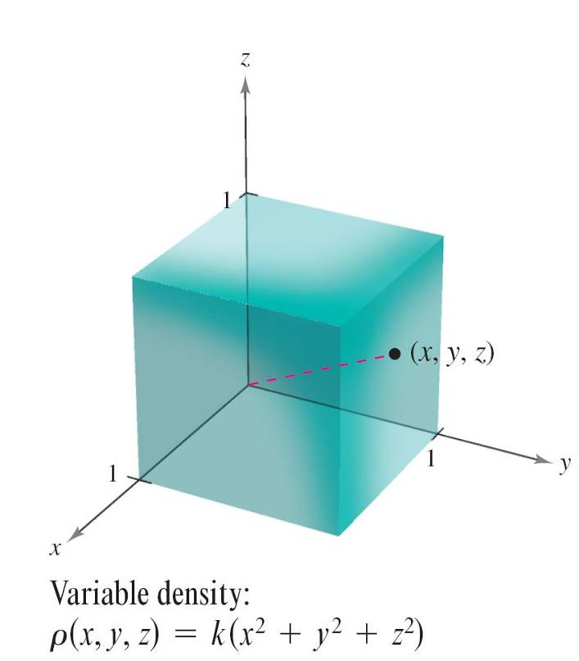
Example 5 – Finding the Center of Mass of a Solid Region
Find the center of mass of the unit cube shown in Figure 14.61, given that the density at the point (x, y, z) is proportional to the square of its distance from the origin.
Figure 14.61

Slide 22
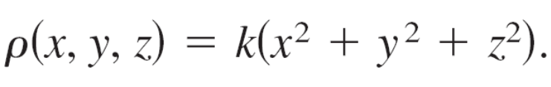
Example 5 – Solution
Because the density at (x, y, z) is proportional to the square of the distance between (0, 0, 0) and (x, y, z), you have
where k is the constant of proportionality.
You can use this density function to find the mass of the cube.
Because of the symmetry of the region, any order of integration will produce an integral of comparable difficulty.

Slide 23

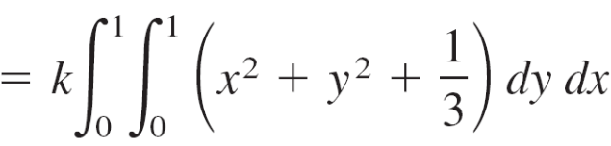
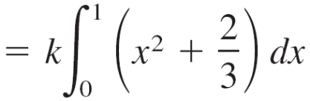
Example 5 – Solution
cont’d

Slide 24


Example 5 – Solution
cont’d
The first moment about the yz-plane is
Note that x can be factored out of the two inner integrals, because it is constant with respect to y and z.
After factoring, the two inner integrals are the same as for the mass m.

Slide 25
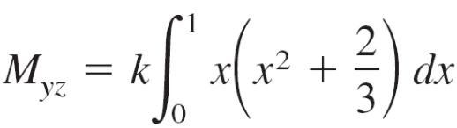

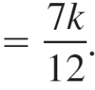


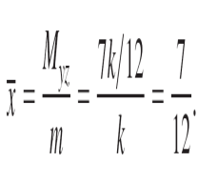

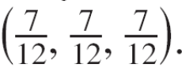
Example 5 – Solution
cont’d
Therefore, you have
So,
Finally, from the nature of ρ and the symmetry of x, y, and z in this solid region, you have , and the center of mass is .

