Slide 1


14
P
Multiple Integration
Copyright © Cengage Learning. All rights reserved.

Slide 2

Triple Integrals in Other Coordinates
14.7
Copyright © Cengage Learning. All rights reserved.

Slide 3
Objectives
Write and evaluate a triple integral in cylindrical coordinates.
Write and evaluate a triple integral in spherical coordinates.

Slide 4
Triple Integrals in Cylindrical Coordinates

Slide 5
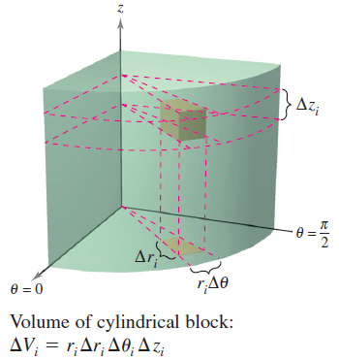
Triple Integrals in Cylindrical Coordinates
The rectangular conversion equations for cylindrical
coordinates are
x = r cos θ
y = r sin θ
z = z.
In this coordinate system, the simplest
solid region is a cylindrical block
determined by
r₁ ≤ r ≤ r₂
θ₁ ≤ θ ≤ θ₂ and z₁ ≤ z ≤ z₂
as shown in Figure 14.63.
Figure 14.63

Slide 6
Triple Integrals in Cylindrical Coordinates
To obtain the cylindrical coordinate form of a triple integral, consider a solid region Q whose projection R onto the
xy-plane can be described in polar coordinates.
That is,
Q = {(x, y, z): (x, y) is in R, h₁(x, y) ≤ z ≤ h₂(x, y)}
and
R = {(r, θ): θ₁ ≤ θ ≤ θ₂, g₁(θ) ≤ r ≤ g₂(θ)}.

Slide 7
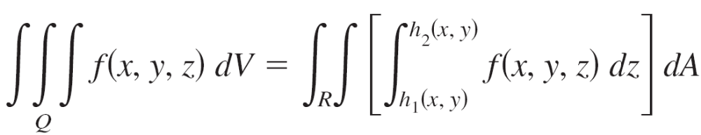

Triple Integrals in Cylindrical Coordinates
If f is a continuous function on the solid Q, then you can write the triple integral of f over Q as
where the double integral over R is evaluated in polar
coordinates. That is, R is a plane region that is either
r-simple or θ-simple. If R is r-simple, then the iterated form of the triple integral in cylindrical form is

Slide 8
Triple Integrals in Cylindrical Coordinates
To visualize a particular order of integration, it helps to view
the iterated integral in terms of three sweeping
Motions, each adding another dimension to the solid.
For instance, in the order dr dθ dz, the first integration
occurs in the r-direction as a point sweeps out a ray.
Then, as θ increases, the line sweeps out a sector.

Slide 9
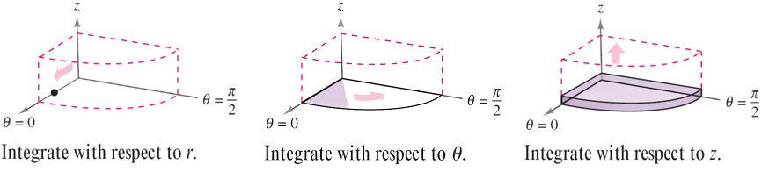
Triple Integrals in Cylindrical Coordinates
Finally, as z increases, the sector sweeps out a solid
wedge, as shown in Figure 14.64.
Figure 14.64

Slide 10
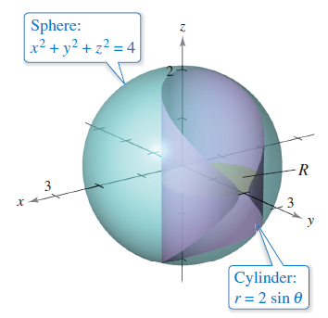
Example 1 – Finding Volume in Cylindrical Coordinates
Find the volume of the solid region Q cut from the sphere
x² + y² + z² = 4 by the cylinder r = 2 sin θ, as shown in
Figure 14.65.
Figure 14.65

Slide 11

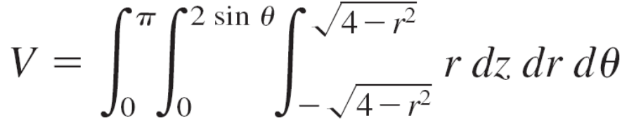
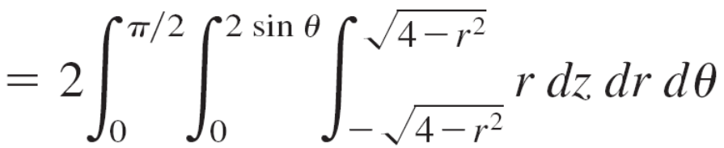
Example 1 – Solution
cont’d
Because x² + y² + z² = r² + z² = 4, the bounds on z are
Let R be the circular projection of the solid onto the
rθ-plane.
Then the bounds on R are 0 ≤ r ≤ 2 sin θ and 0 ≤ θ ≤ π.
So, the volume of Q is

Slide 12
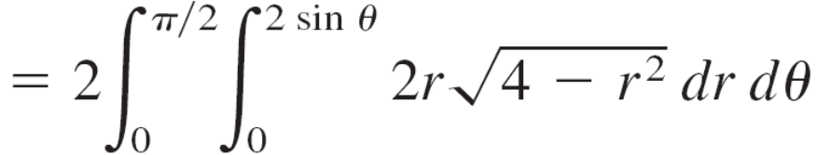

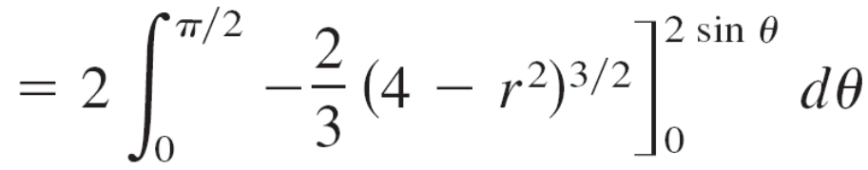
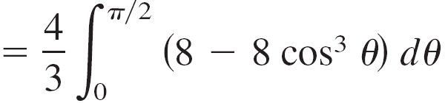
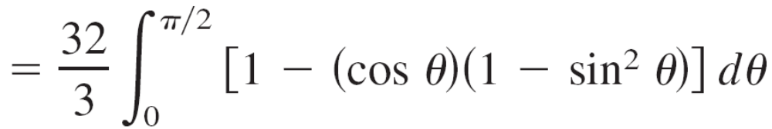

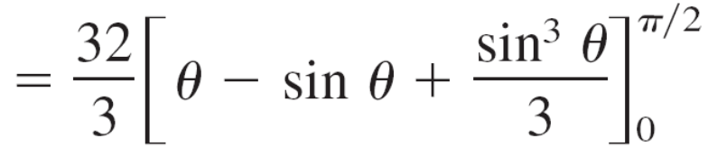
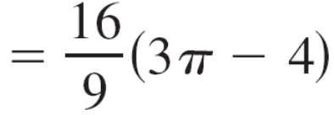

Example 1 – Solution
cont’d

Slide 13
Triple Integrals in Spherical Coordinates

Slide 14
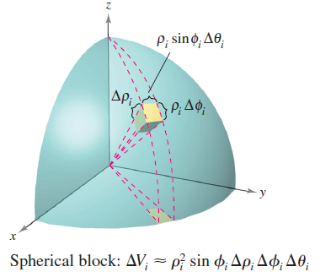
Triple Integrals in Spherical Coordinates
The rectangular conversion equations
for spherical coordinates are
x = ρ sin φ cos θ
y = ρ sin φ sin θ
z = ρ sin φ.
In this coordinate system, the simplest
region is a spherical block determined by
{(ρ, θ, φ): ρ₁ ≤ ρ ≤ ρ₂, θ₁ ≤ θ ≤ θ₂, φ₁ ≤ φ ≤ φ ₂}
where ρ₁ ≥ 0, θ₂ – θ₁ ≤ 2π, and 0 ≤ φ₁ ≤ φ₂ ≤ π,
as shown in Figure 14.68.
Figure 14.68

Slide 15

Triple Integrals in Spherical Coordinates
If (ρ, θ, φ) is a point in the interior of such a block, then the
volume of the block can be approximated by
ΔV ≈ ρ² sin φ Δρ Δφ Δθ.
Using the usual process involving an inner partition,
summation, and a limit, you can develop a triple integral in spherical coordinates for a continuous function f defined on the solid region Q.

Slide 16
Triple Integrals in Spherical Coordinates
Triple integrals in spherical coordinates are evaluated with
iterated integrals.
You can visualize a particular order of integration by
viewing the iterated integral in terms of three sweeping
Motions, each adding another dimension to the solid.

Slide 17
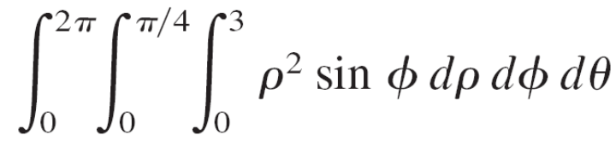
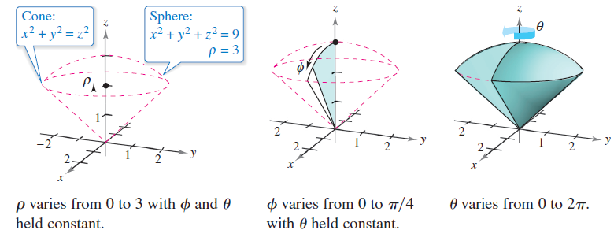
Triple Integrals in Spherical Coordinates
For instance, the iterated integral
is illustrated in Figure 14.69.
Figure 14.69

Slide 18
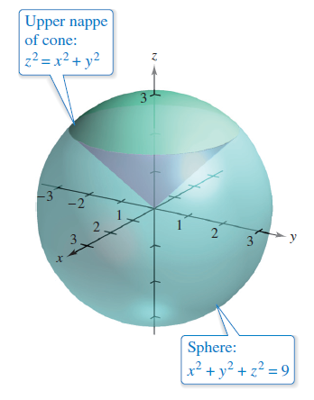
Example 4 – Finding Volume in Spherical Coordinates
Find the volume of the solid region Q bounded below by
the upper nappe of the cone z² = x² + y² and above
by the sphere x² + y² + z² = 9, as shown in Figure 14.70.
Figure 14.70

Slide 19

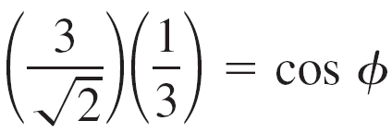

Example 4 – Solution
In spherical coordinates, the equation of the sphere is
ρ² = x² + y² + z² = 9
Furthermore, the sphere and cone intersect when
(x² + y²) + z² = (z²) + z² = 9
and, because z = ρ cos φ, it follows that

Slide 20



Example 4 – Solution
cont’d
Consequently, you can use the integration order dρ dφ dθ,
where 0 ≤ ρ ≤ 3, 0 ≤ φ ≤ π/4, and 0 ≤ θ ≤ 2π.
The volume is

Slide 21
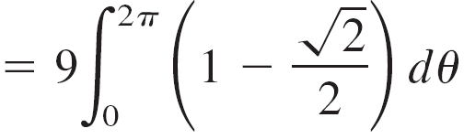

Example 4 – Solution
cont’d

