Slide 1


14
P
Multiple Integration
Copyright © Cengage Learning. All rights reserved.

Slide 2

Change of Variables: Jacobians
14.8
Copyright © Cengage Learning. All rights reserved.

Slide 3
Objectives
Understand the concept of a Jacobian.
Use a Jacobian to change variables in a double integral.

Slide 4
Jacobians

Slide 5
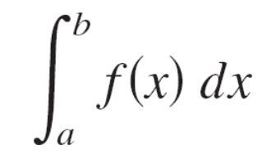
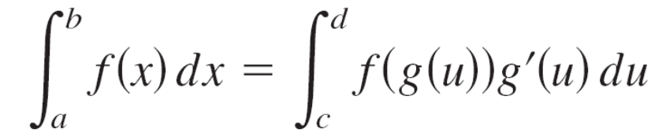
Jacobians
For the single integral
you can change variables by letting x = g(u), so that
dx = g′(u) du, and obtain
where a = g(c) and b = g(d).
The change of variables process introduces an additional factor g′(u) into the integrand.

Slide 6
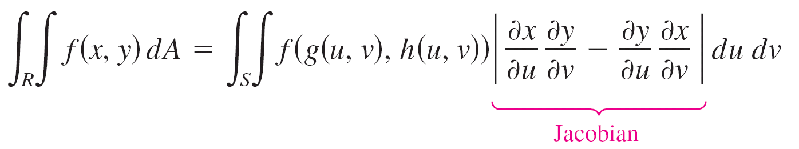
Jacobians
This also occurs in the case of double integrals
where the change of variables x = g(u, v) and y = h(u, v) introduces a factor called the Jacobian of x and y with respect to u and v.

Slide 7
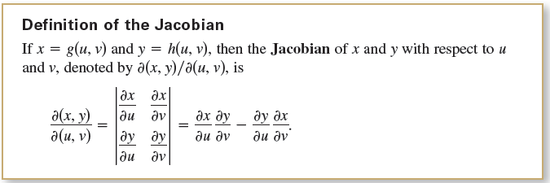
Jacobians
In defining the Jacobian, it is convenient to use the following determinant notation.

Slide 8
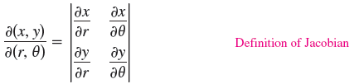

Example 1 – The Jacobian for Rectangular-to-Polar Conversion
Find the Jacobian for the change of variables defined by
x = r cos θ and y = r sin θ.
Solution:
From the definition of the Jacobian, you obtain

Slide 9
Example 1 – Solution
cont’d

Slide 10
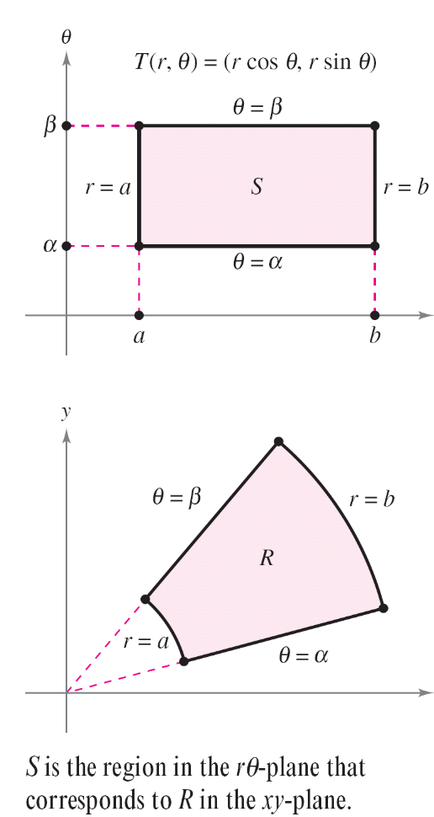
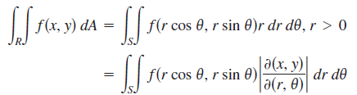
Jacobians
Example 1 points out that the change of variables from rectangular to polar coordinates for a
double integral can be written as
where S is the region in the
rθ-plane that corresponds
to the region R in the xy-plane,
as shown in Figure 14.71.
Figure 14.71

Slide 11
Jacobians
In general, a change of variables using a one-to-one transformation T from a region S in the uv-plane to a region R in the xy-plane is given by
T(u, v) = (x, y) = (g(u, v), h(u, v))
where g and h have continuous first partial derivatives in the region S.
Note that the point (u, v) lies in S and the point (x, y) lies in R.
In most cases, you are hunting for a transformation in which the region S is simpler than the region R.

Slide 12
Change of Variables for Double Integrals

Slide 13
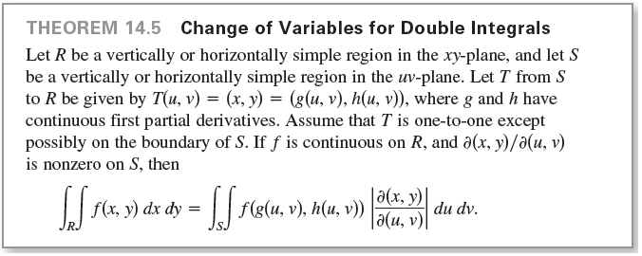
Change of Variables for Double Integrals

Slide 14
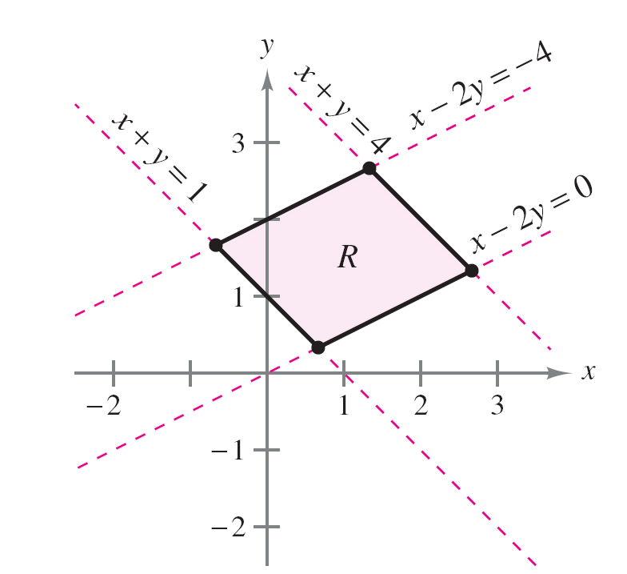
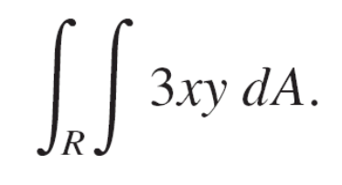
Example 3 – Using a Change of Variables to Simplify a Region
Let R be the region bounded by the lines
x – 2y = 0, x – 2y = –4, x + y = 4, and x + y = 1
as shown in Figure 14.76.
Evaluate the double integral
Figure 14.76

Slide 15
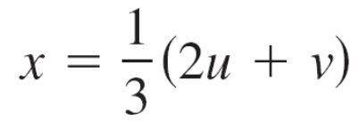
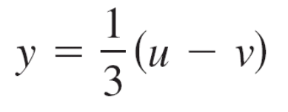
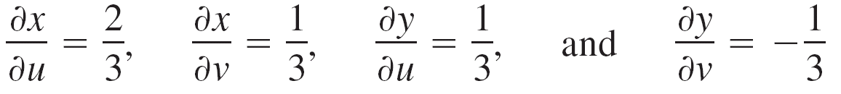
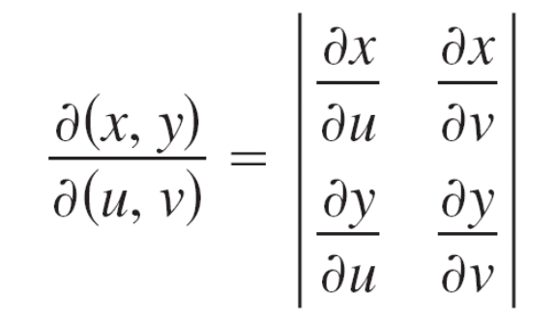
Example 3 – Solution
You can use the following change of variables
and .
The partial derivatives of x and y are
which implies that the Jacobian is

Slide 16
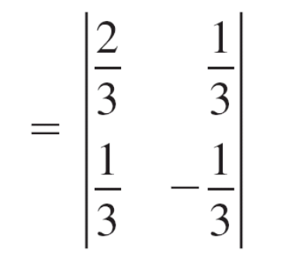
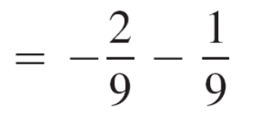
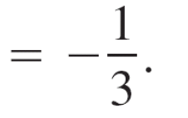
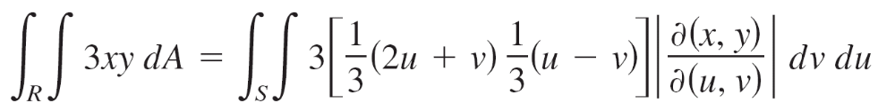
Example 3 – Solution
cont’d
So, by Theorem 14.5, you obtain

Slide 17
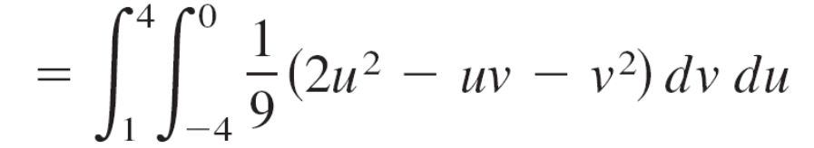
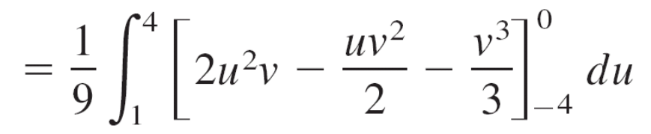
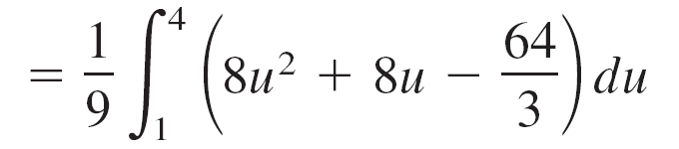
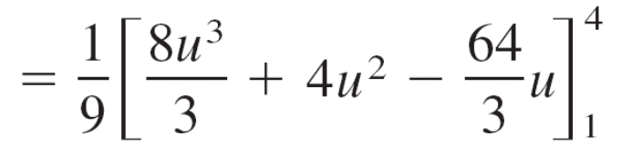
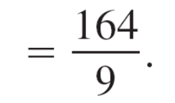
Example 3 – Solution
cont’d

