Slide 1

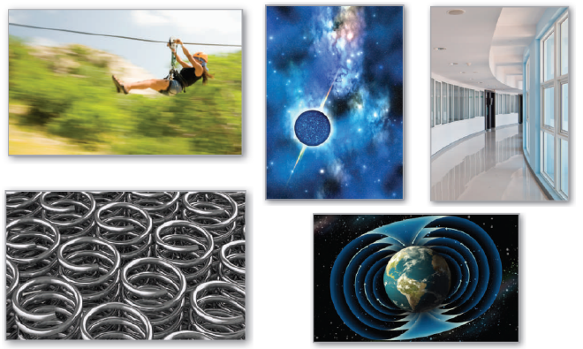
15
P
Vector Analysis
Copyright © Cengage Learning. All rights reserved.

Slide 2

15.1
Vector Fields
Copyright © Cengage Learning. All rights reserved.

Slide 3
Objectives
Understand the concept of a vector field.
Determine whether a vector field is conservative.
Find the curl of a vector field.
Find the divergence of a vector field.

Slide 4
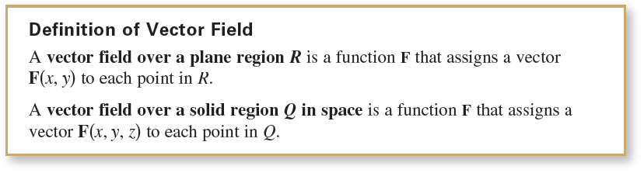
Vector Fields
We will study two types of vector-valued functions—functions that assign a vector to a point in the plane or a point in space. Such functions are called vector fields, and
they are useful in representing various types of force fields
and velocity fields.

Slide 5
Vector Fields
The gradient is one example of a vector field.
For example, if
f(x, y, z) = x² + y² + z²
then the gradient of f
∇f(x, y, z) = f_{x}(x, y, z)i + f_{y}(x, y, z)j + f_{z}(x, y, z)k
= 2xi + 2yj + 2zk Vector field in space
is a vector field in space.
Note that the component functions for this particular vector field are 2x, 2y, and 2z.

Slide 6
Vector Fields
A vector field
F(x, y, z) = M(x, y, z)i + N(x, y, z)j + P(x, y, z)k
is continuous at a point if and only if each of its component functions M, N, and P is continuous at that point.
Some common physical examples of vector fields are velocity fields, gravitational fields, and electric force fields.

Slide 7
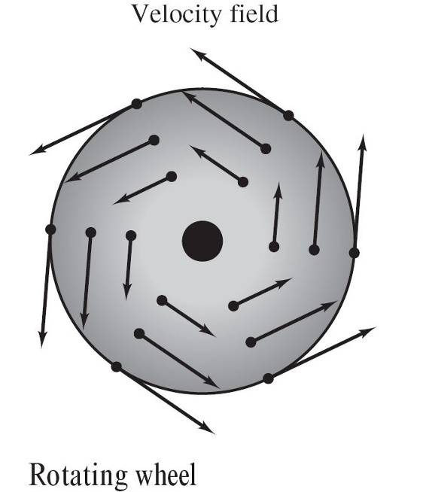
Vector Fields
1. Velocity fields describe the motions of systems of particles in the plane or in space. For instance, Figure 15.1 shows the vector field determined by a wheel rotating on an axle.
Notice that the velocity vectors
are determined by the locations
of their initial points—the farther
a point is from the axle, the greater
its velocity.
Figure 15.1

Slide 8
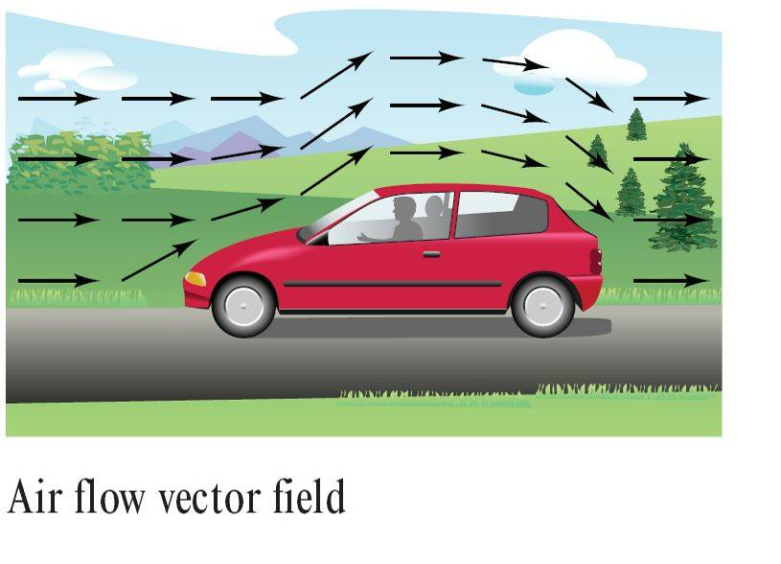
Vector Fields
Velocity fields are also determined by the flow of liquids through a container or by the flow of air currents around a moving object, as shown in Figure 15.2.
Figure 15.2

Slide 9
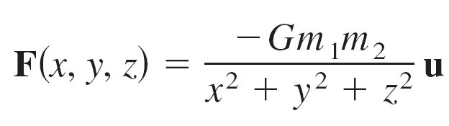
Vector Fields
2. Gravitational fields are defined by Newton’s Law of Gravitation, which states that the force of attraction exerted on a particle of mass m₁ located at (x, y, z)
by a particle of mass m₂ located at (0, 0, 0) is
where G is the gravitational constant and u is the unit vector in the direction from the origin to (x, y, z).

Slide 10
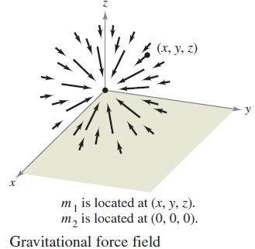
Vector Fields
In Figure 15.3, you can see that the gravitational field F has the properties that F(x, y, z) always points toward the origin, and that the magnitude of F(x, y, z) is the same at all points equidistant from the origin.
A vector field with these
two properties is called
a central force field.
Figure 15.3

Slide 11
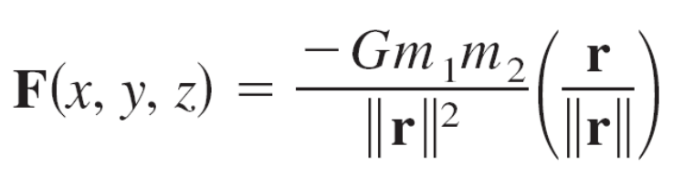
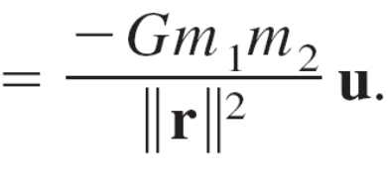
Vector Fields
Using the position vector
r = xi + yj + zk
for the point (x, y, z), you can write the gravitational field F as

Slide 12
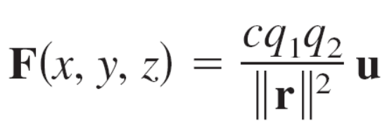
Vector Fields
3. Electric force fields are defined by Coulomb’s Law,
which states that the force exerted on a particle with
electric charge q₁ located at (x, y, z) by a particle with
electric charge q₂ located at (0, 0, 0) is
where r = xi + yj + zk, u = r/||r||, and c is a constant that
depends on the choice of units for ||r||, q₁, and q₂.

Slide 13
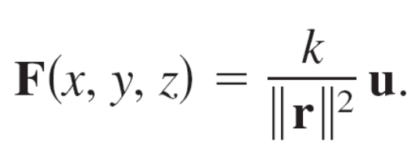
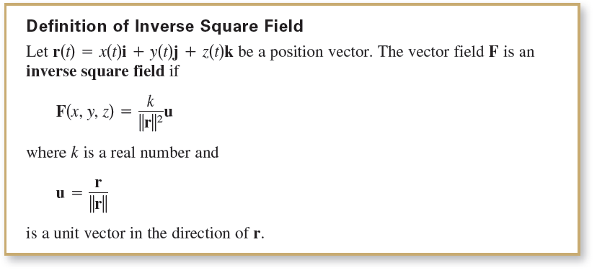
Vector Fields
Note that an electric force field has the same form as a gravitational field. That is,
Such a force field is called an inverse square field.

Slide 14



Example 1 – Sketching a Vector Field
Sketch some vectors in the vector field
F(x, y) = –yi + xj.
Solution:
You could plot vectors at several random points in the plane. It is more enlightening, however, to plot vectors of equal magnitude.
This corresponds to finding level curves in scalar fields. In this case, vectors of equal magnitude lie on circles.

Slide 15
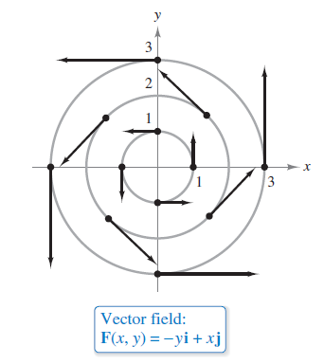
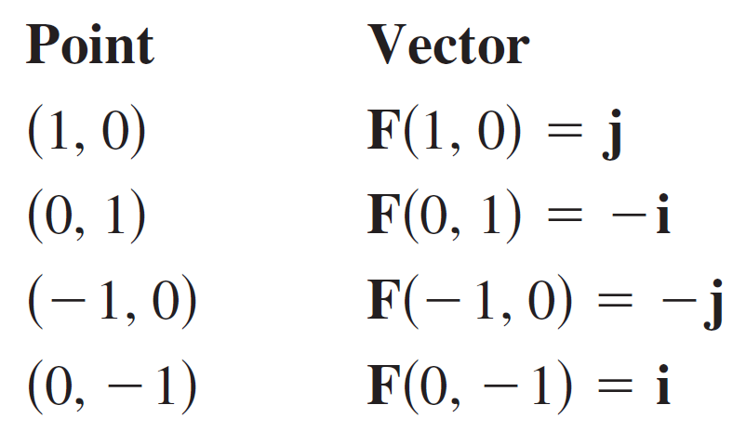
Example 1 – Solution
cont’d
To begin making the sketch, choose a value for c and plot several vectors on the resulting circle.
For instance, the following vectors occur on the unit circle.
These and several other vectors
in the vector field are shown in
Figure 15.4.
Figure 15.4

Slide 16
Conservative Vector Fields

Slide 17
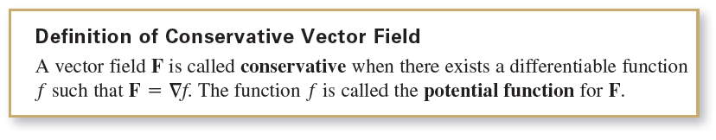
Conservative Vector Fields
Some vector fields can be represented as the gradients of differentiable functions and some cannot—those that can are called conservative vector fields.

Slide 18

Example 4(a) – Conservative Vector Fields
The vector field given by F(x, y) = 2xi + yj is conservative.
To see this, consider the potential function
Because
∇f = 2xi + yj = F
it follows that F is conservative.

Slide 19
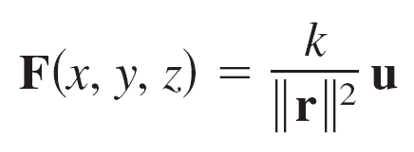
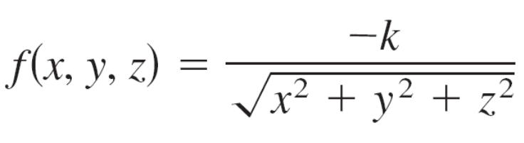
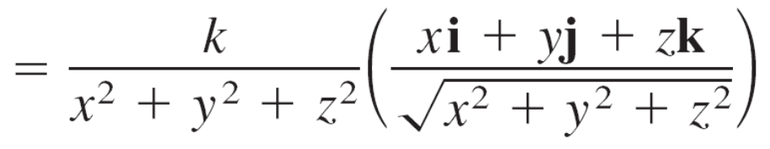
Example 4(b) – Conservative Vector Fields
cont’d
Every inverse square field is conservative. To see this,
let
and
where u = r/||r||.
Because

Slide 20
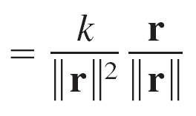
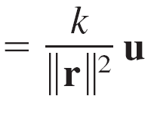
Example 4(b) – Conservative Vector Fields
cont’d
it follows that F is conservative.

Slide 21
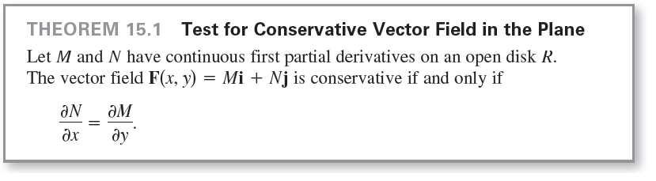
Conservative Vector Fields
The following important theorem gives a necessary and sufficient condition for a vector field in the plane to be conservative.

Slide 22
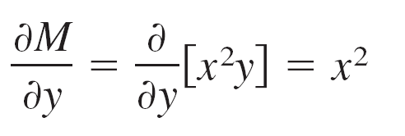
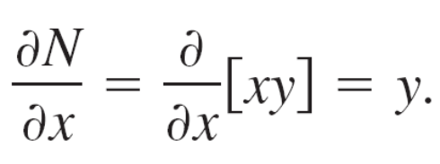
Example 5 – Testing for Conservative Vector Fields in the Plane
Determine whether the vector field given by F is conservative.
a. F(x, y) = x²yi + xyj b. F(x, y) = 2xi + yj
Solution:
a. The vector field F(x, y) = x²yi + xyj is not conservative because
and

Slide 23
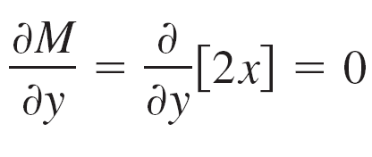
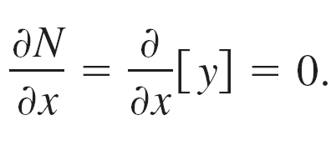
Example 5 – Solution
cont’d
b. The vector field F(x, y) = 2xi + yj is conservative
because
and

Slide 24
Curl of a Vector Field

Slide 25
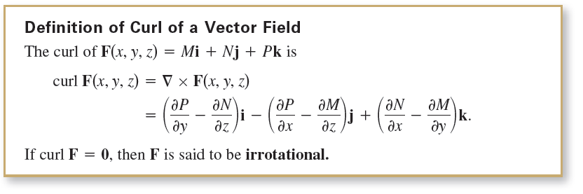
Curl of a Vector Field
The definition of the curl of a vector field in space is given below.

Slide 26
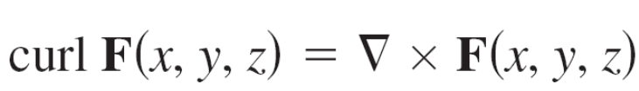
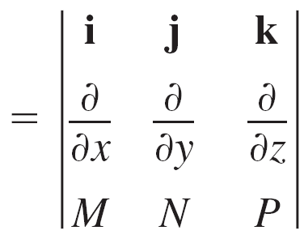
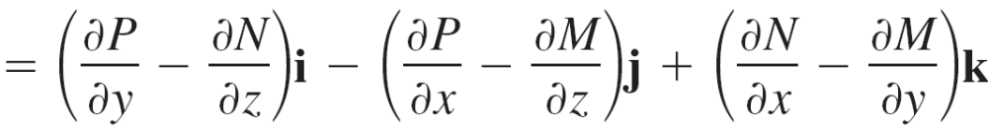
Curl of a Vector Field
The cross product notation used for curl comes from viewing the gradient ∇f as the result of the differential operator ∇ acting on the function f.
In this context, you can use the following determinant form as an aid in remembering the formula for curl.

Slide 27
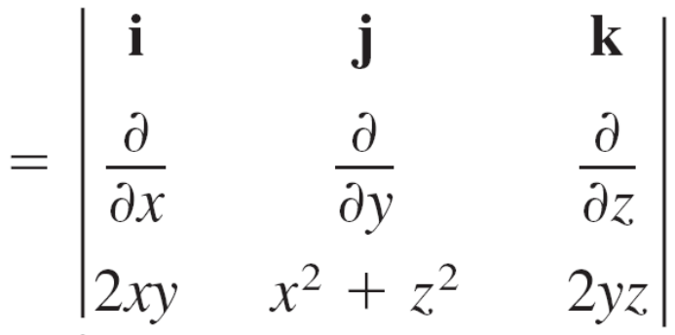
Example 7 – Finding the Curl of a Vector Field
Find curl F of the vector field
F(x, y, z) = 2xyi + (x² + z²)j + 2yzk.
Is F irrotational?
Solution:
The curl of F is
curl F(x, y, z) = ∇ × F(x, y, z)

Slide 28
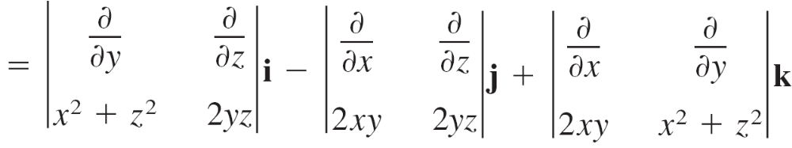


Example 7 – Solution
cont’d
Because curl F = 0, F is irrotational.

Slide 29
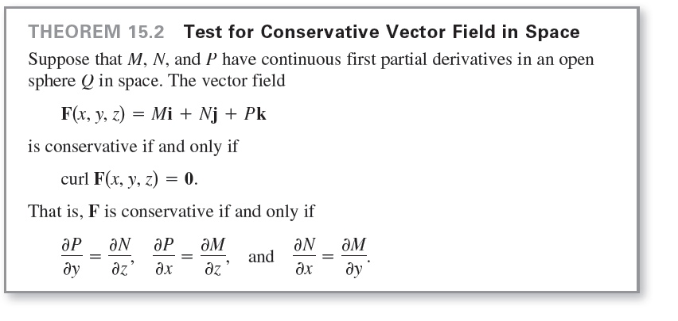
Curl of a Vector Field

Slide 30
Divergence of a Vector Field

Slide 31
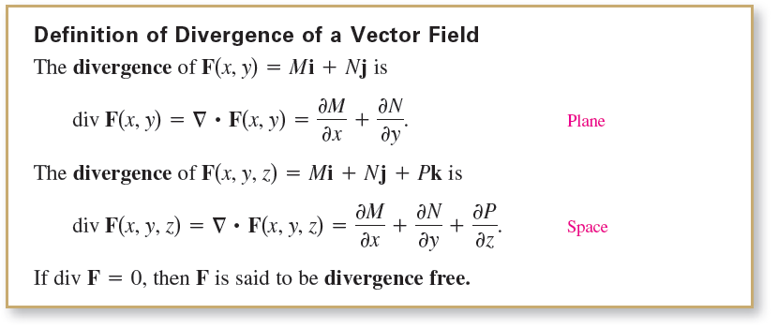
Divergence of a Vector Field
You have seen that the curl of a vector field F is itself a vector field. Another important function defined on a vector field is divergence, which is a scalar function.

Slide 32
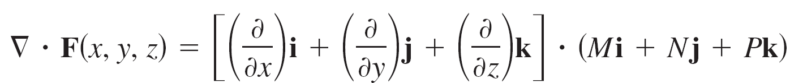
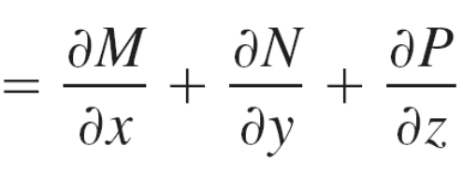
Divergence of a Vector Field
The dot product notation used for divergence comes from considering ∇ as a differential operator, as follows.

Slide 33
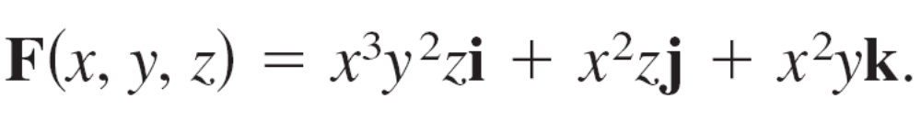
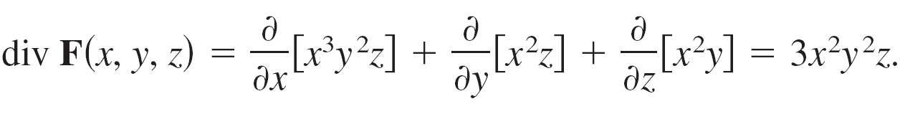
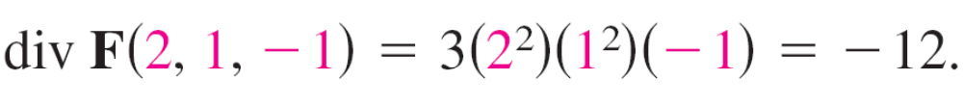
Example 9 – Finding the Divergence of a Vector Field
Find the divergence at (2, 1, –1) for the vector field
Solution:
The divergence of F is
At the point (2, 1, –1), the divergence is

Slide 34
Divergence of a Vector Field
Divergence can be viewed as a type of derivative of F in that, for vector fields representing velocities of moving particles, the divergence measures the rate of particle flow per unit volume at a point.
In hydrodynamics (the study of fluid motion), a velocity field that is divergence free is called incompressible.
In the study of electricity and magnetism, a vector field that is divergence free is called solenoidal.

Slide 35
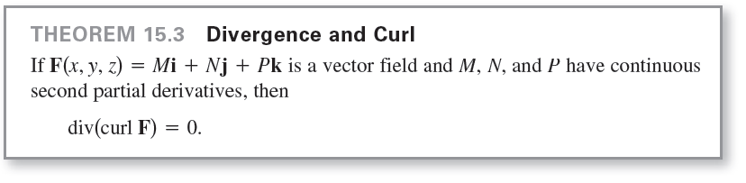
Divergence of a Vector Field
There are many important properties of the divergence and curl of a vector field F. One that is used often is described in the theorem below.

