Slide 1


15
P
Vector Analysis
Copyright © Cengage Learning. All rights reserved.

Slide 2

15.2
Line Integrals
Copyright © Cengage Learning. All rights reserved.

Slide 3
Objectives
Understand and use the concept of a piecewise smooth curve.
Write and evaluate a line integral.
Write and evaluate a line integral of a vector field.
Write and evaluate a line integral in differential form.

Slide 4
Piecewise Smooth Curves

Slide 5
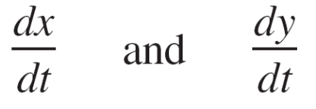
Piecewise Smooth Curves
A classic property of gravitational fields is that, subject to certain physical constraints, the work done by gravity on an object moving between two points in the field is independent of the path taken by the object.
One of the constraints is that the path must be a piecewise smooth curve. We know that a plane curve C given by
r(t) = x(t)i + y(t)j, a ≤ t ≤ b
is smooth when
are continuous on [a, b] and not simultaneously 0 on (a, b).

Slide 6
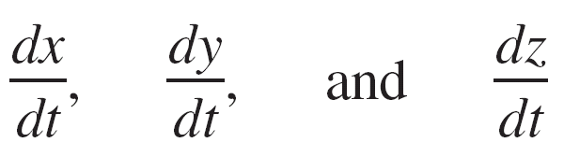
Piecewise Smooth Curves
Similarly, a space curve C given by
r(t) = x(t)i + y(t)j + z(t)k, a ≤ t ≤ b
is smooth when
are continuous on [a, b] and not simultaneously 0 on (a, b).
A curve C is piecewise smooth when the interval [a, b] can be partitioned into a finite number of subintervals, on each of which C is smooth.

Slide 7
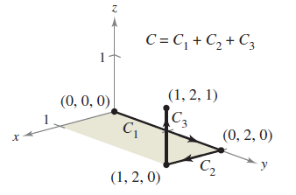
Example 1 – Finding a Piecewise Smooth Parametrization
Find a piecewise smooth parametrization of the graph of C shown in Figure 15.7.
Figure 15.7

Slide 8
Example 1 – Solution
Because C consists of three line segments C₁, C₂, and C₃, you can construct a smooth parametrization for each segment and piece them together by making the last t-value in C_{i} correspond to the first t-value in C_{i + 1}.

Slide 9
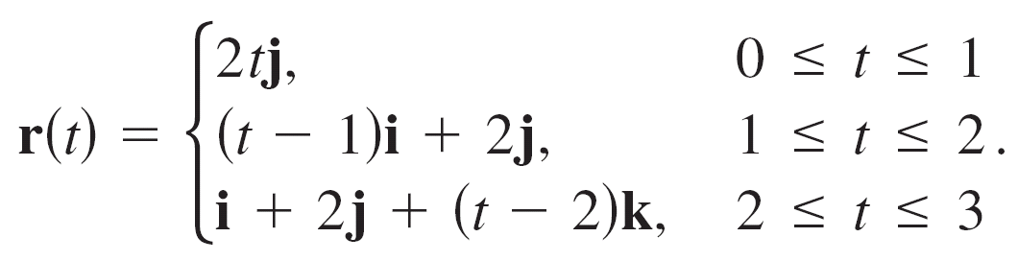
Example 1 – Solution
cont’d
So, C is given by
Because C₁, C₂, and C₃ are smooth, it follows that C is piecewise smooth.

Slide 10
Piecewise Smooth Curves
Parametrization of a curve induces an orientation to the curve.
For instance, in Example 1, the curve is oriented such that the positive direction is from (0, 0, 0), following the curve to (1, 2, 1).

Slide 11
Line Integrals

Slide 12
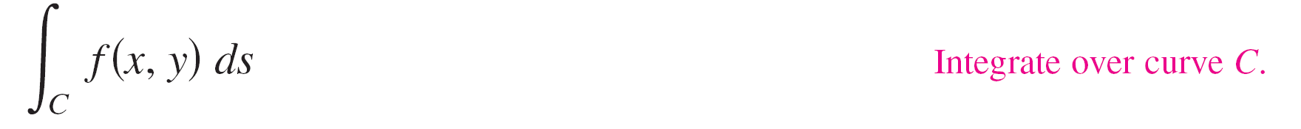
Line Integrals
In this section, you will study a new type of integral called a line integral
for which you integrate over a piecewise smooth curve C.
To introduce the concept of a line integral, consider the mass of a wire of finite length, given by a curve C in space.
The density (mass per unit length) of the wire at the point (x, y, z) is given by f(x, y, z).

Slide 13
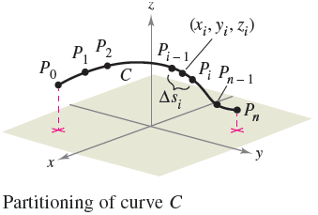
Line Integrals
Partition the curve C by the points
P₀, P₁, …, P_{n}
producing n subarcs, as shown in Figure 15.8.
Figure 15.8

Slide 14
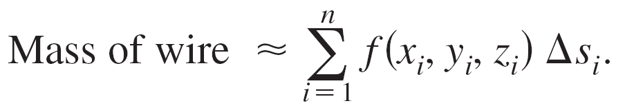
Line Integrals
The length of the i th subarc is given by ∆s_{i}.
Next, choose a point (x_{i}, y_{i}, z_{i}) in each subarc.
If the length of each subarc is small, then the total mass of the wire can be approximated by the sum
By letting ||∆|| denote the length of the longest subarc and letting ||∆|| approach 0, it seems reasonable that the limit of this sum approaches the mass of the wire.

Slide 15
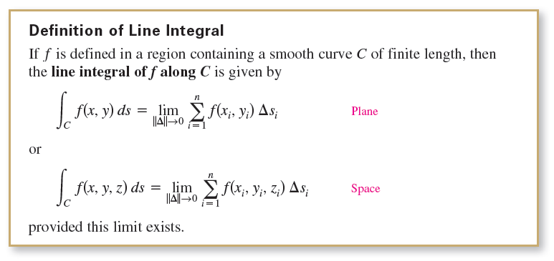
Line Integrals

Slide 16
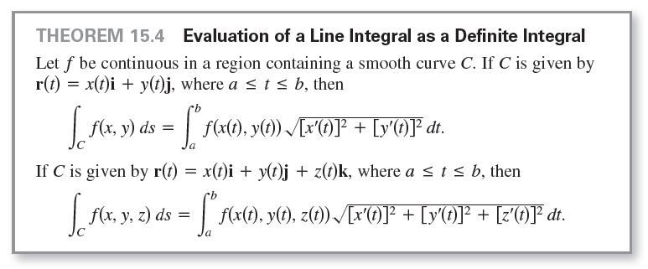
Line Integrals
To evaluate a line integral over a plane curve C given by r(t) = x(t)i + y(t)j, use the fact that
A similar formula holds for a space curve, as indicated in Theorem 15.4.

Slide 17

Line Integrals
Note that if f(x, y, z) = 1, then the line integral gives the arc length of the curve C. That is,

Slide 18
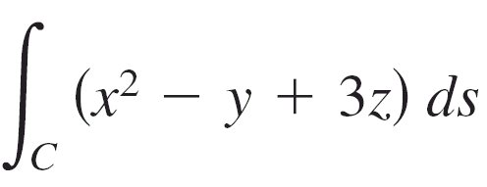
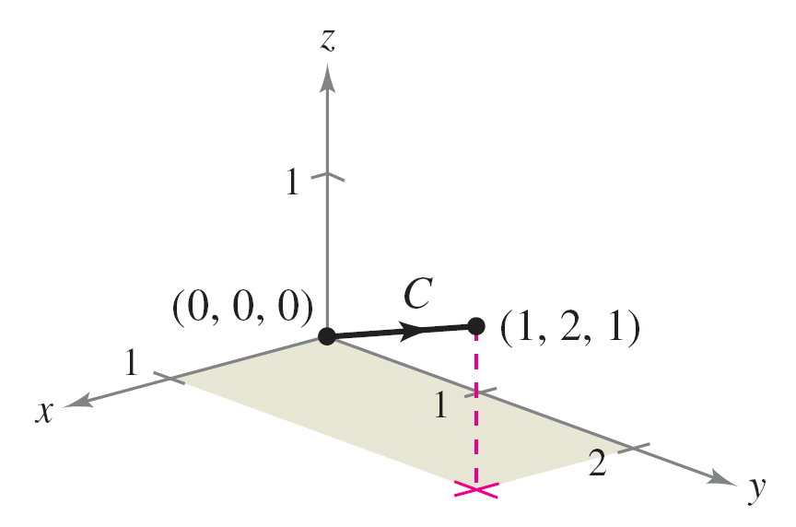
Example 2 – Evaluating a Line Integral
Evaluate
where C is the line segment shown in Figure 15.9.
Figure 15.9

Slide 19
Example 2 – Solution
Begin by writing a parametric form of the equation of the line segment:
x = t, y = 2t, and z = t, 0 ≤ t ≤ 1.
Therefore, x'(t) = 1, y'(t) = 2, and z'(t) = 1, which implies that

Slide 20
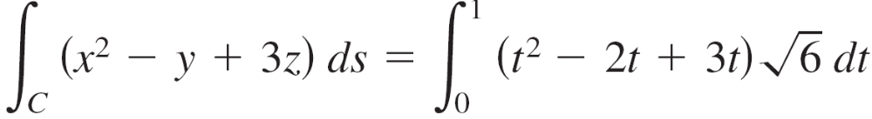
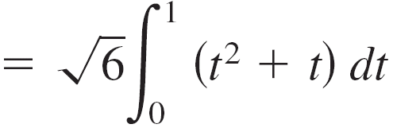
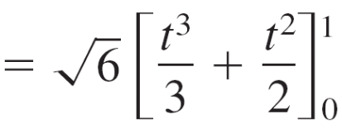
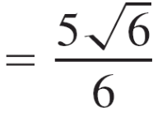
Example 2 – Solution
cont’d
So, the line integral takes the following form.

Slide 21

Line Integrals
For parametrizations given by r(t) = x(t)i + y(t)j + z(t)k, it is helpful to remember the form of ds as

Slide 22
Line Integrals of Vector Fields

Slide 23
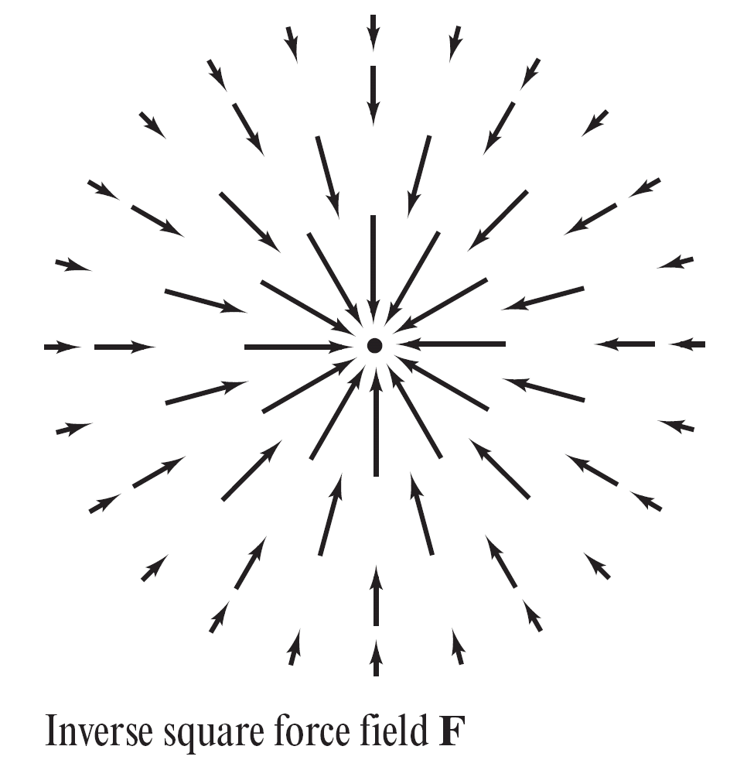
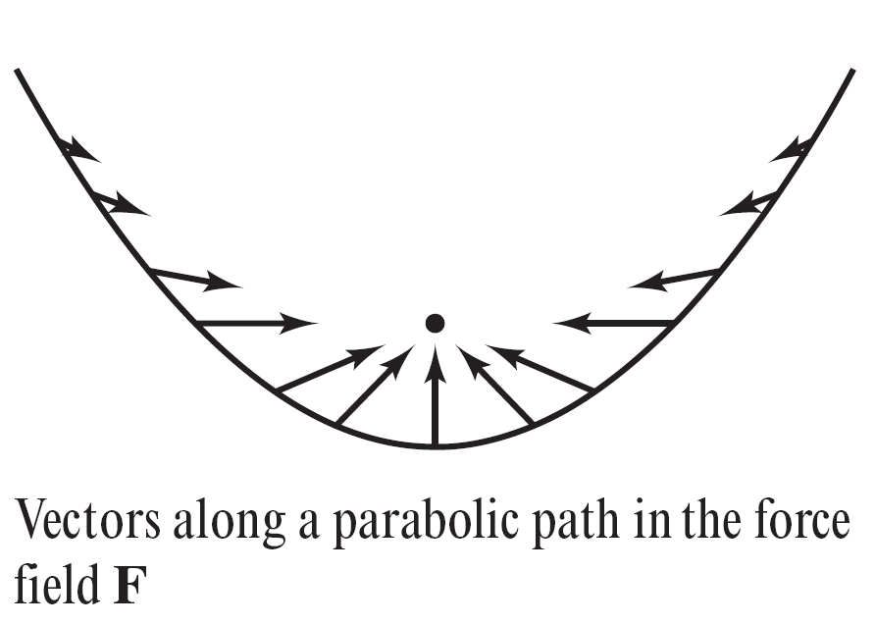
Line Integrals of Vector Fields
One of the most important physical applications of line integrals is that of finding the work done on an object moving in a force field.
For example, Figure 15.12 shows an inverse square force field similar to the gravitational field of the sun.
Figure 15.12

Slide 24
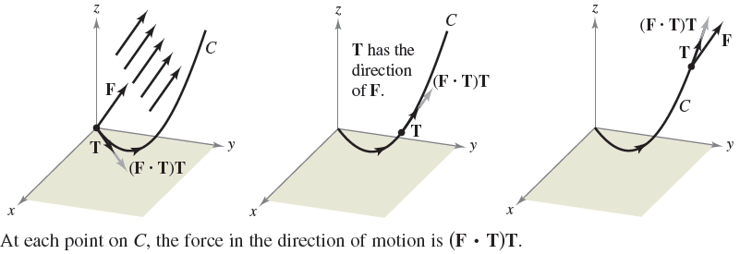
Line Integrals of Vector Fields
To see how a line integral can be used to find work done in a force field F, consider an object moving along a path C in the field, as shown in Figure 15.13.
Figure 15.13

Slide 25
Line Integrals of Vector Fields
To determine the work done by the force, you need consider only that part of the force that is acting in the same direction as that in which the object is moving.
This means that at each point on C, you can consider the projection F • T of the force vector F onto the unit tangent vector T.
On a small subarc of length ∆s_{i}, the increment of work is
∆W_{i} = (force)(distance)
≈ [F(x_{i}, y_{i}, z_{i}) • T(x_{i}, y_{i}, z_{i})] ∆s_{i}
where (x_{i}, y_{i}, z_{i}) is a point in the i th subarc.

Slide 26

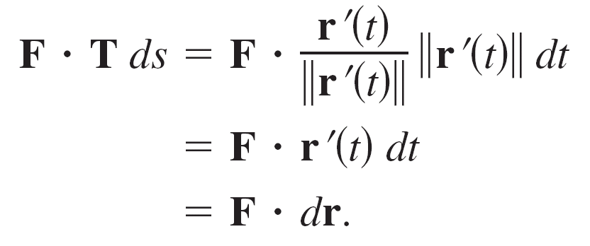
Line Integrals of Vector Fields
Consequently, the total work done is given by the integral
This line integral appears in other contexts and is the basis of the following definition of the line integral of a vector field.
Note in the definition that

Slide 27
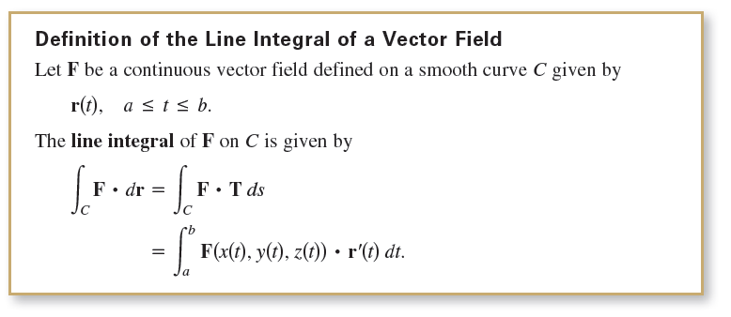
Line Integrals of Vector Fields

Slide 28
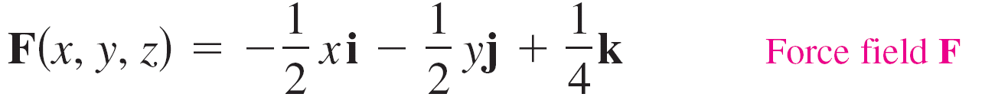
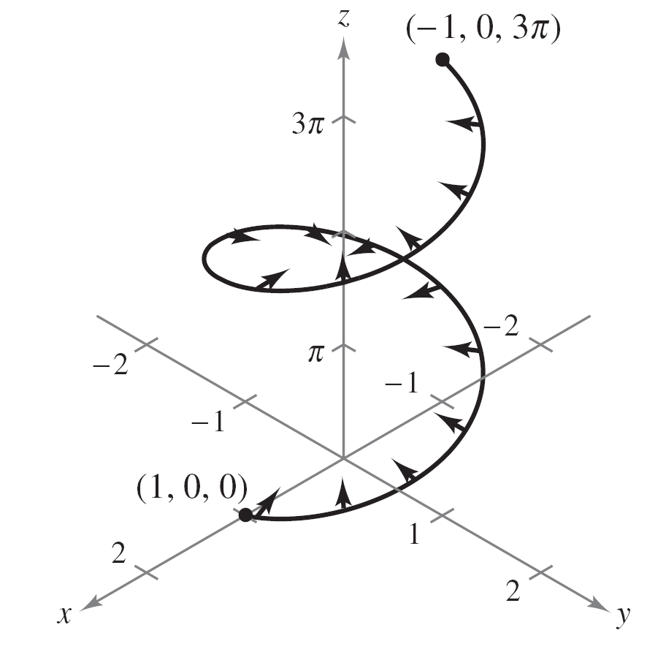
Example 6 – Work Done by a Force
Find the work done by the force field
on a particle as it moves along the helix given by
from the point (1, 0, 0) to the point
(–1, 0, 3π), as shown in Figure 15.14.
Figure 15.14

Slide 29
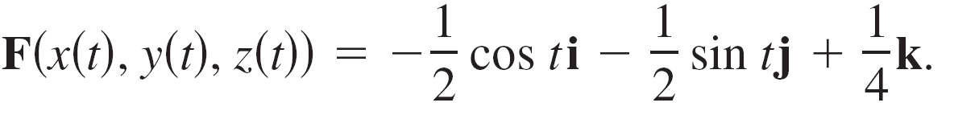
Example 6 – Solution
Because
r(t) = x(t)i + y(t)j + z(t)k
= cos t i + sin t j + t k
it follows that
x(t) = cos t, y(t) = sin t, and z(t) = t.
So, the force field can be written as

Slide 30
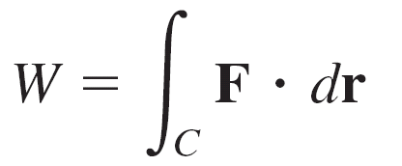
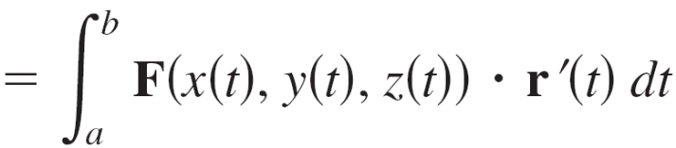
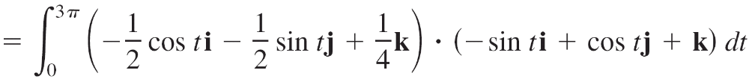

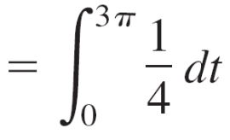
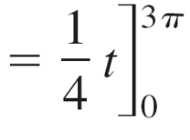
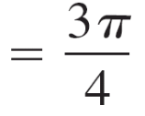
Example 6 – Solution
cont’d
To find the work done by the force field in moving a particle along the curve C, use the fact that
r'(t) = –sin t i + cos t j + k
and write the following.

Slide 31
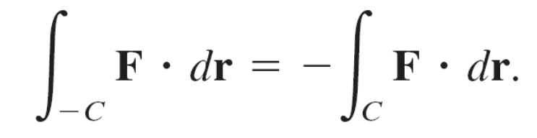
Line Integrals of Vector Fields
For line integrals of vector functions, the orientation of the curve C is important.
When the orientation of the curve is reversed, the unit tangent vector T(t) is changed to –T(t), and you obtain

Slide 32
Line Integrals in Differential Form

Slide 33
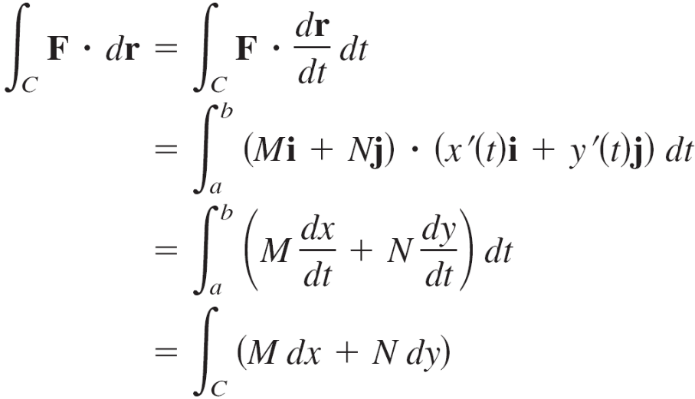
Line Integrals in Differential Form
A second commonly used form of line integrals is derived from the vector field notation used in the preceding section.
If F is a vector field of the form F(x, y) = Mi + Nj and C is given by r(t) = x(t)i + y(t)j, then F • dr is often written as M dx + N dy.
This differential form can be extended to three variables.

Slide 34
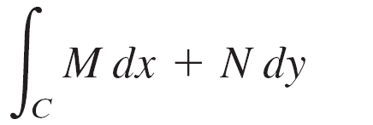

Line Integrals in Differential Form
The parentheses are often omitted from the differential form, as shown below.
In three variables, the differential from is

Slide 35
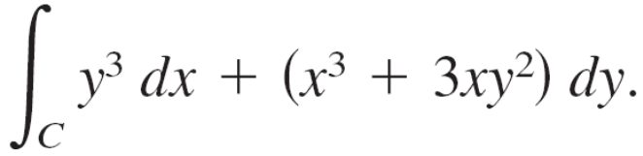
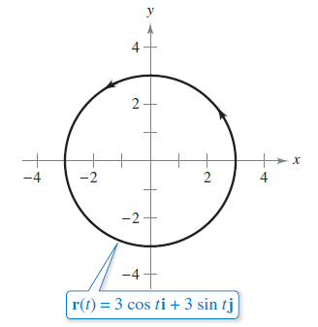
Example 8 – Evaluating a Line Integral in Differential Form
Let C be the circle of radius 3 given by
r(t) = 3 cos ti + 3 sin tj, 0 ≤ t ≤ 2π
as shown in Figure 15.17. Evaluate the line integral
Figure 15.17

Slide 36
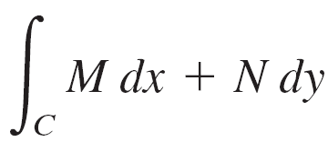
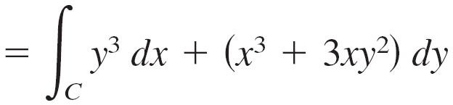
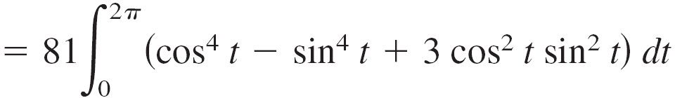
Example 8 – Solution
Because x = 3 cos t and y = 3 sin t, you have dx = –3 sin t dt and dy = 3 cos t dt. So, the line integral is

Slide 37

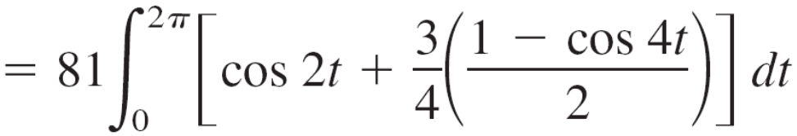
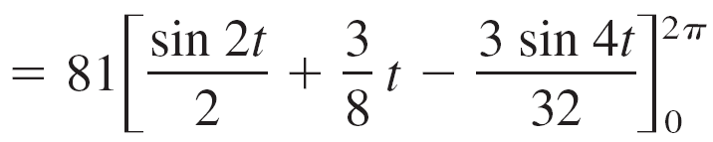
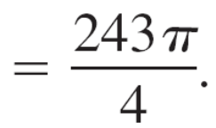
Example 8 – Solution
cont’d

