Slide 1


15
P
Vector Analysis
Copyright © Cengage Learning. All rights reserved.

Slide 2

Conservative Vector Fields and Independence of Path
15.3
Copyright © Cengage Learning. All rights reserved.

Slide 3
Objectives
Understand and use the Fundamental Theorem of Line Integrals.
Understand the concept of independence of path.
Understand the concept of conservation of energy.

Slide 4
Fundamental Theorem of Line Integrals

Slide 5
Fundamental Theorem of Line Integrals
In a gravitational field, the work done by gravity on an object moving between two points in the field is independent of the path taken by the object.
In this section, you will study an important generalization of this result—it is called the Fundamental Theorem of Line Integrals.

Slide 6
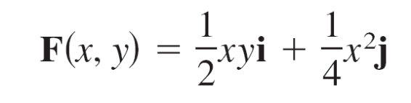
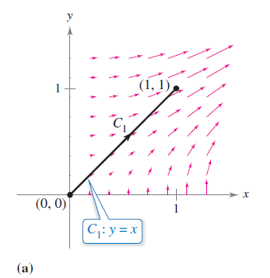
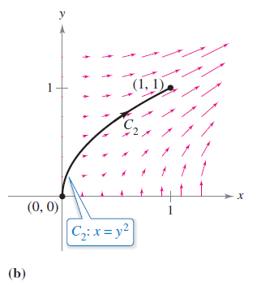
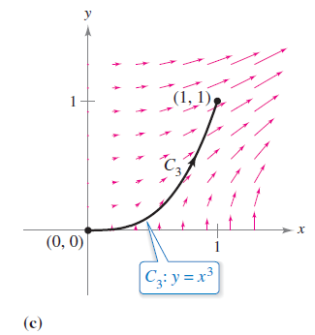
Example 1 – Line Integral of a Conservative Vector Field
Find the work done by the force field
on a particle that moves from (0, 0) to (1, 1) along each path, as shown in Figure 15.19.
a. C₁: y = x b. C₂: x = y² c. C₃: y = x³
Figure 15.19

Slide 7

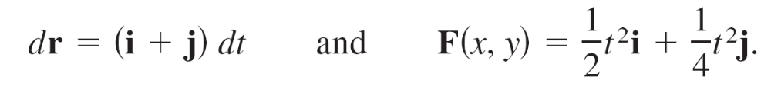




Example 1 – Solution
Note that F is conservative because the first partial derivatives are equal.
a. Let r(t) = t i + t j for 0 ≤ t ≤ 1, so that
Then the work done is

Slide 8

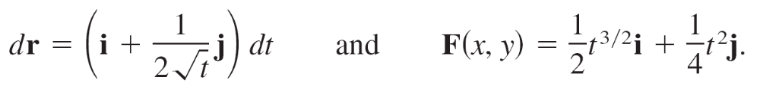
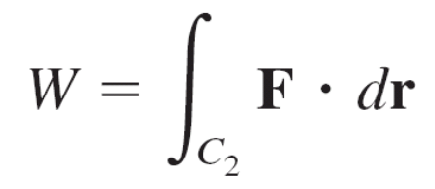
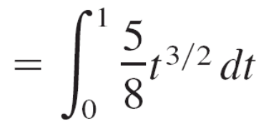
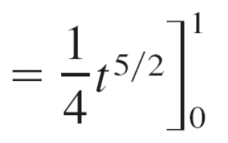
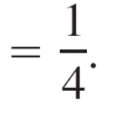
Example 1 – Solution
cont’d
b. Let r(t) = t i + for 0 ≤ t ≤ 1,
so that
Then the work done is

Slide 9
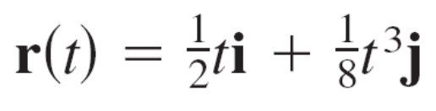
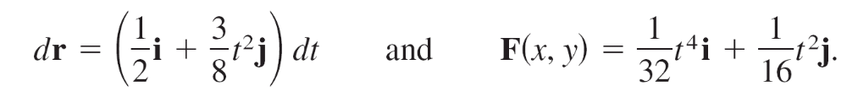
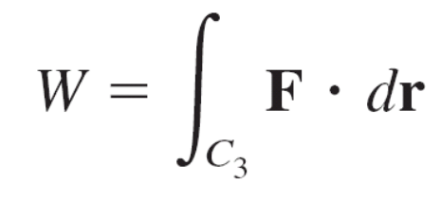
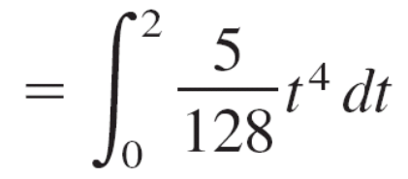
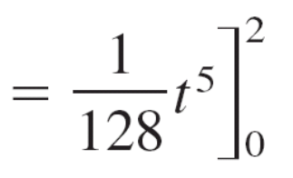
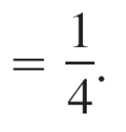
Example 1 – Solution
cont’d
c. Let r(t) for 0 ≤ t ≤ 2, so that
Then the work done is
So, the work done by the conservative vector field F is the same for each path.

Slide 10
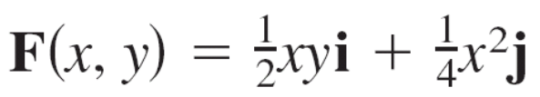



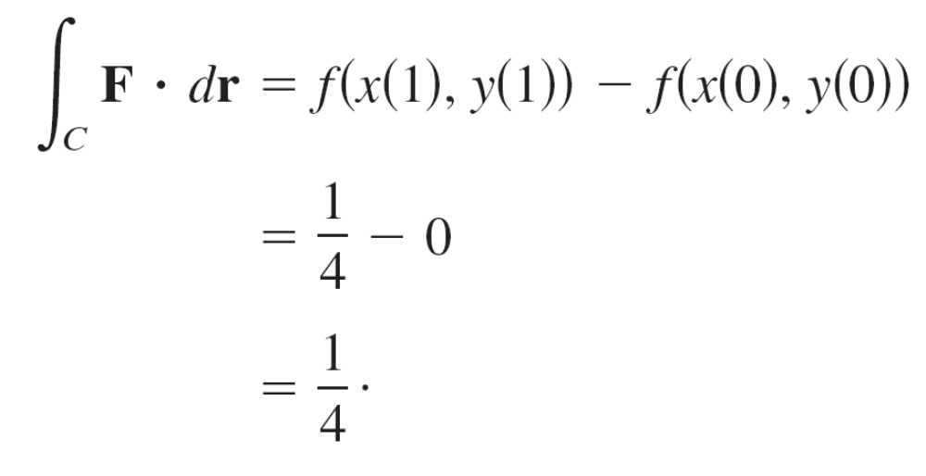
Fundamental Theorem of Line Integrals
In Example 1, note that the vector field
is conservative because , where
.
In such cases, the next theorem states that the value of
is given by

Slide 11
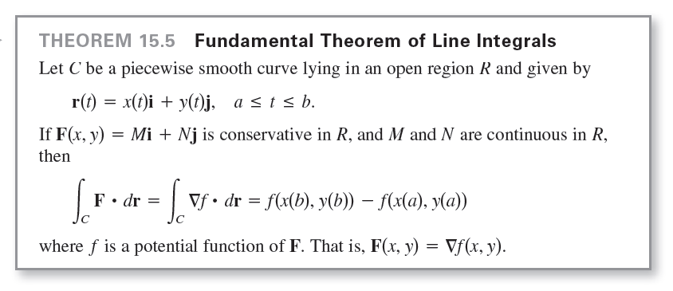
Fundamental Theorem of Line Integrals

Slide 12
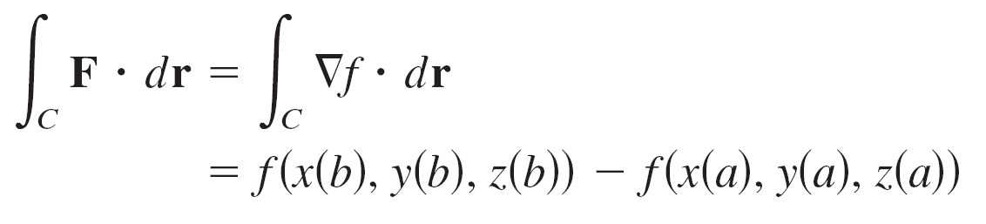

Fundamental Theorem of Line Integrals
In space, the Fundamental Theorem of Line Integrals takes the following form.
Let C be a piecewise smooth curve lying in an open region Q and given by
r(t) = x(t)i + y(t)j + z(t)k, a ≤ t ≤ b.
If F(x, y, z) = M i + N j + P k is conservative and M, N, and P are continuous, then
where

Slide 13
Fundamental Theorem of Line Integrals
The Fundamental Theorem of Line Integrals states that if
the vector field F is conservative, then the line integral between any two points is simply the difference in the values of the potential function f at these points.

Slide 14
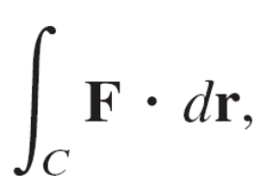
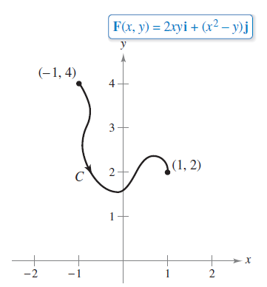
Example 2 – Using the Fundamental Theorem of Line Integrals
Evaluate where C is a piecewise smooth curve
from (−1, 4) to (1, 2) and F(x, y) = 2xyi + (x² − y)j as shown in Figure 15.20.
Figure 15.20

Slide 15
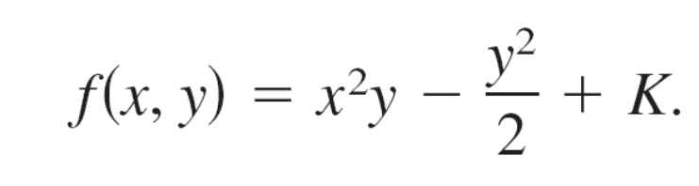
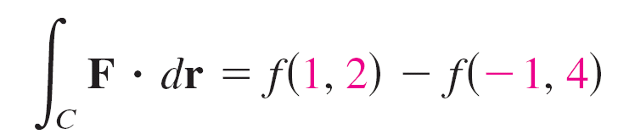
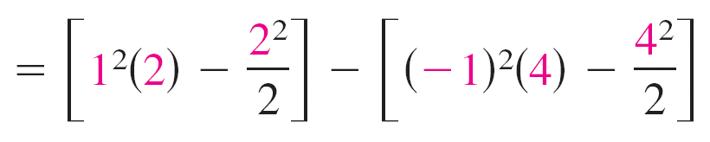

Example 2 – Solution
We know that F is the gradient of f,
where
Consequently, F is conservative, and by the Fundamental
Theorem of Line Integrals, it follows that

Slide 16
Independence of Path

Slide 17

Independence of Path
From the Fundamental Theorem of Line Integrals it is clear that if F is continuous and conservative in an open region R, then the value of is the same for every piecewise smooth curve C from one fixed point in R to another fixed point in R.
This result is described by saying that the line
is independent of path in the region R.

Slide 18
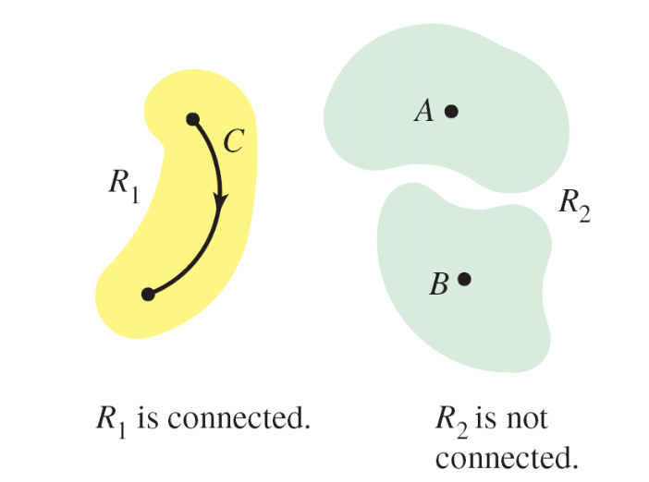
Independence of Path
A region in the plane (or in space) is connected when any two points in the region can be joined by a piecewise smooth curve lying entirely within the region, as shown in Figure 15.22.
In open regions that are connected,
the path independence of
is equivalent to the condition that
F is conservative.
Figure 15.22

Slide 19
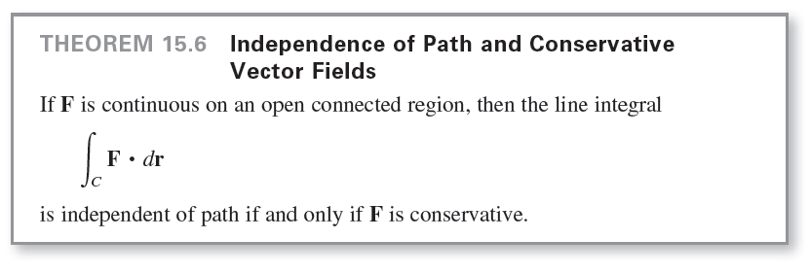
Independence of Path

Slide 20
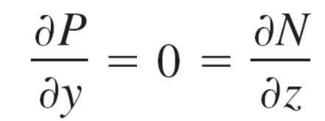
Example 4 – Finding Work in a Conservative Force Field
For the force field given by
F(x, y, z) = e^{x} cos y i − e^{x} sin y j + 2k
show that is independent of path, and calculate the work done by F on an object moving along a curve C from (0, π/2, 1) to (1, π, 3).
Solution:
Writing the force field in the form F(x, y, z) = M i + N j + P k,
you have M = e^{x} cos y, N = –e^{x} sin y, and P = 2, and it follows that

Slide 21
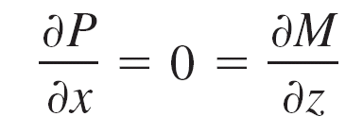
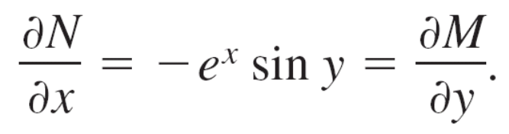



Example 4 – Solution
cont’d
and
So, F is conservative. If f is a potential function of F, then
and

Slide 22
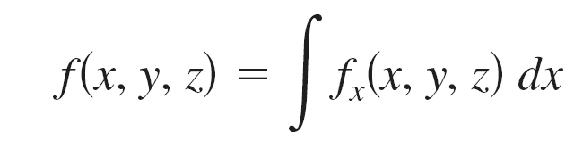
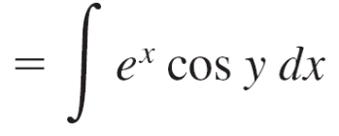
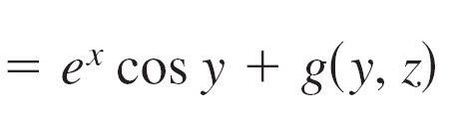
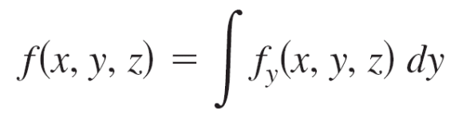
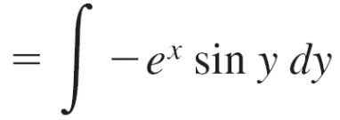
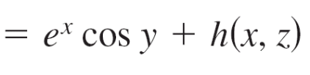
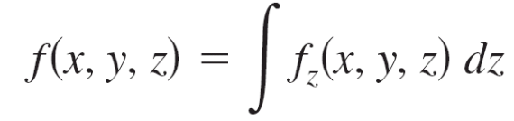
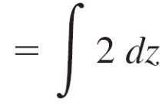

Example 4 – Solution
cont’d
By integrating with respect to x, y, and z separately, you obtain
and
By comparing these three versions of f(x, y, z), you can conclude that
f(x, y, z) = e^{x} cos y + 2z + K.

Slide 23
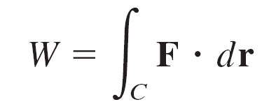



Example 4 – Solution
cont’d
Therefore, the work done by F along any curve C from
(0, π /2, 1) to (1, π, 3) is

Slide 24
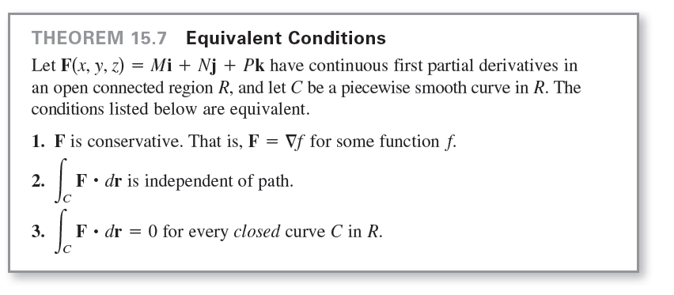
Independence of Path
A curve C given by r(t) for a ≤ t ≤ b is closed if r(a) = r(b).
By the Fundamental Theorem of Line Integrals, you can
conclude that if F is continuous and conservative on
an open region R, then the line integral over every closed
curve C is 0.

Slide 25
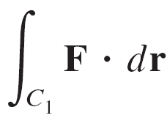
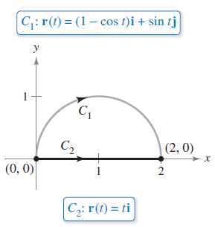
Example 5 – Evaluating a Line Integral
Evaluate , where
F(x, y) = (y³ + 1)i + (3xy² + 1)j
and C₁ is the semicircular path from (0, 0) to (2, 0), as shown in Figure 15.24.
Figure 15.24

Slide 26
Example 5 – Solution
You have the following three options.
a. You can use the method presented in the preceding
section to evaluate the line integral along the given curve.
To do this, you can use the parametrization
r(t) = (1 − cos t)i + sin t j, where 0 ≤ t ≤ π.
For this parametrization, it follows that
dr = r′(t) dt = (sin t i + cos t j) dt,
and
This integral should dampen your enthusiasm for this
option.

Slide 27
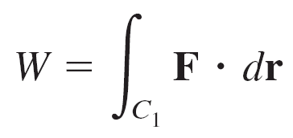
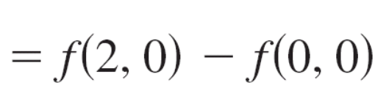

Example 5 – Solution
cont’d
b. You can try to find a potential function and evaluate the line integral by the Fundamental Theorem of Line Integrals.
Using the technique demonstrated in Example 4, you can find the potential function to be
f(x, y) = xy³ + x + y + K,
and, by the Fundamental Theorem,

Slide 28

Example 5 – Solution
cont’d
c. Knowing that F is conservative, you have a third option. Because the value of the line integral is independent of path, you can replace the semicircular path with a simpler path.
Choose the straight-line path C₂ from (0, 0) to (2, 0).
Let, r(t) = t i, for 0 ≤ t ≤ 2, so that

Slide 29
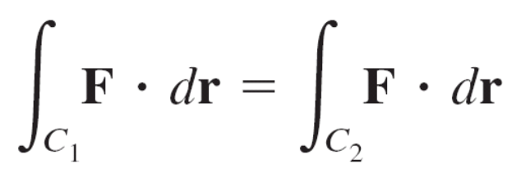
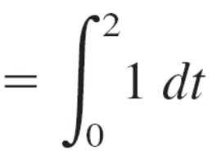
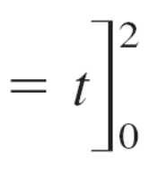
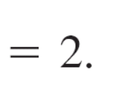
Example 5 – Solution
cont’d
Then the integral is
Of the three options, the third one is obviously the easiest.

Slide 30
Conservation of Energy

Slide 31
Conservation of Energy
The English physicist Michael Faraday wrote, “Nowhere is there a pure creation or production of power without a corresponding exhaustion of something to supply it.”
This statement represents the first formulation of one of the most important laws of physics—the Law of Conservation of Energy.
In modern terminology, the law is stated as follows: In a conservative force field, the sum of the potential and kinetic energies of an object remains constant from point to point.

Slide 32

Conservation of Energy
From physics, the kinetic energy of a particle of mass m and speed v is
The potential energy p of a particle at point (x, y, z) in a conservative vector field F is defined as
p(x, y, z) = −f(x, y, z),
where f is the potential function for F.

Slide 33
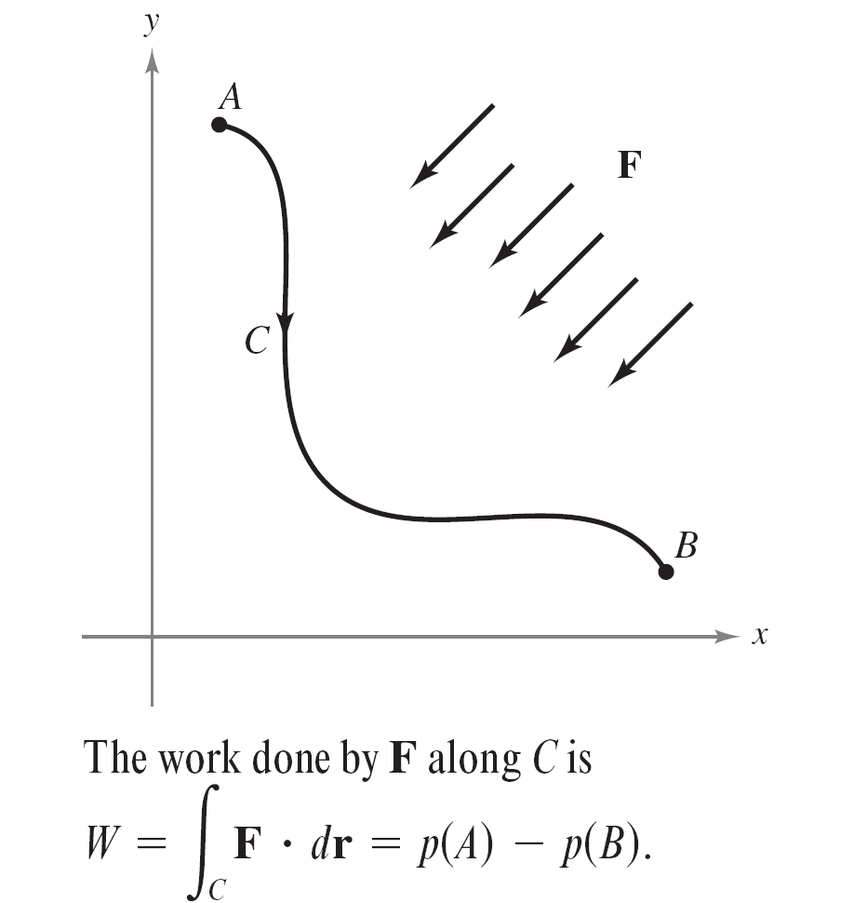
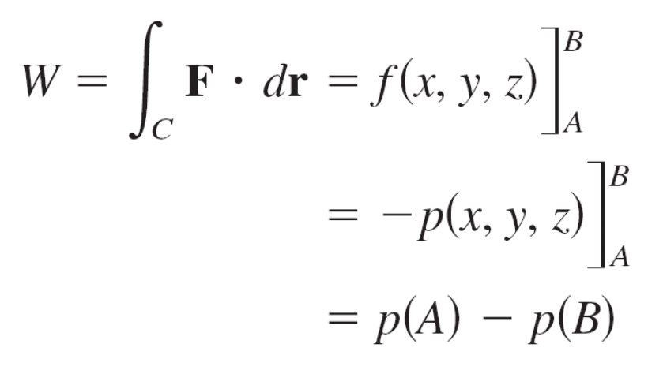
Conservation of Energy
Consequently, the work done by F along a smooth curve C from A to B is
as shown in Figure 15.25.
Figure 15.25

Slide 34
Conservation of Energy
Now, suppose that r(t) is the position vector for a particle moving along C from A = r(a) to B = r(b).
At any time t, the particle’s velocity, acceleration, and
speed are v(t) = r′(t), a(t) = r′′(t), and v(t) = ||v(t)||,
respectively.

Slide 35

Conservation of Energy
So, by Newton’s Second Law of Motion,
F = ma(t) = m(v′(t)),
and the work done by F is

Slide 36

Conservation of Energy

Slide 37
Conservation of Energy
Equating these two results for W produces
p(A) − p(B) = k(B) − k(A)
p(A) + k(A) = p(B) + k(B)
which implies that the sum of the potential and kinetic energies remains constant from point to point.

