Slide 1

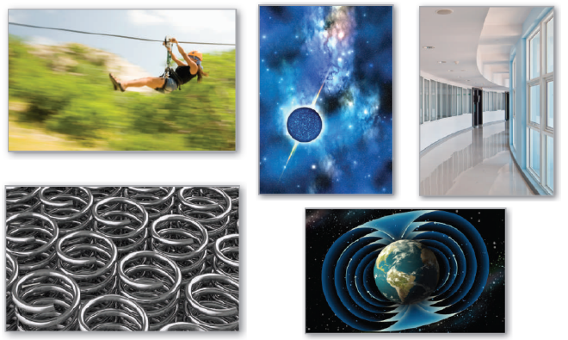
15
P
Vector Analysis
Copyright © Cengage Learning. All rights reserved.

Slide 2

15.4
Green’s Theorem
Copyright © Cengage Learning. All rights reserved.

Slide 3
Objectives
Use Green’s Theorem to evaluate a line integral.
Use alternative forms of Green’s Theorem.

Slide 4
Green’s Theorem
In this section, you will study Green’s Theorem, named after the English mathematician George Green (1793–1841).
This theorem states that the value of a double integral over a simply connected plane region R is determined by the value of a line integral around the boundary of R.
A curve C given by r(t) = x(t)i + y(t)j, where a ≤ t ≤ b, is simple when it does not cross itself—that is, r(c) ≠ r(d) for all c and d in the open interval (a, b).

Slide 5
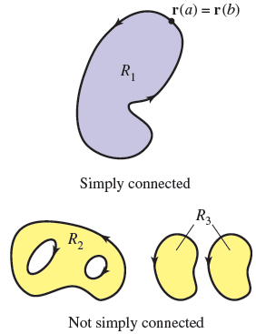
Green’s Theorem
A connected plane region R is simply connected when every simple closed curve in R encloses only points that are in R (see Figure 15.26).
Informally, a simply connected
region cannot consist of separate
parts or holes.
Figure 15.26

Slide 6
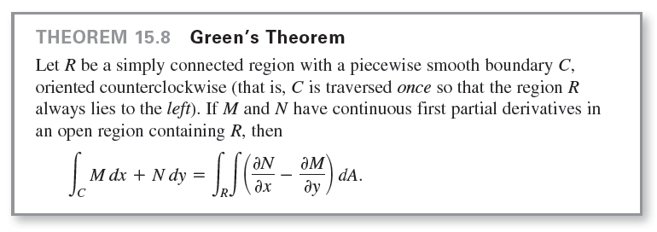
Green’s Theorem

Slide 7
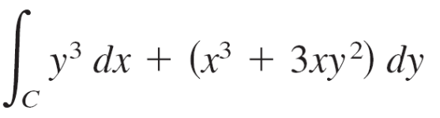
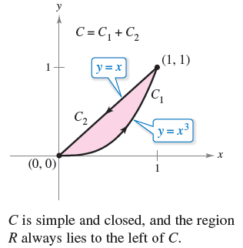
Example 1 – Using Green’s Theorem
Use Green’s Theorem to evaluate the line integral
where C is the path from (0, 0)
to (1, 1) along the graph of
y = x³ and from (1, 1) to (0, 0)
along the graph of y = x,
as shown in Figure 15.28.
Figure 15.28

Slide 8
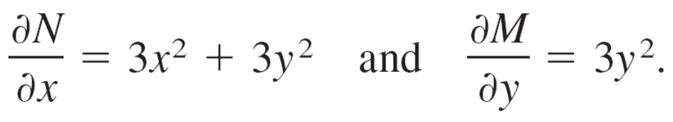
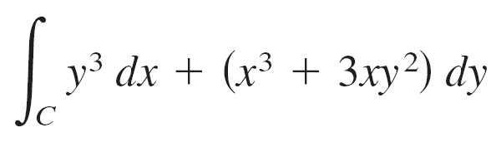
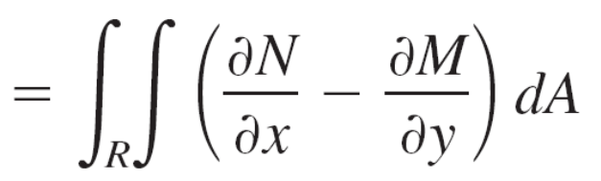
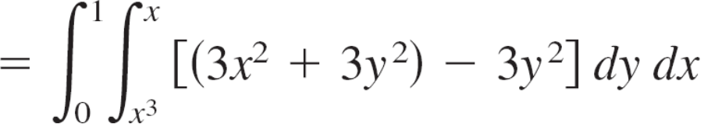
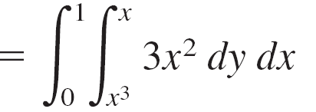
Example 1 – Solution
Because M = y³ and N = x³ + 3xy², it follows that
Applying Green’s Theorem, you then have

Slide 9
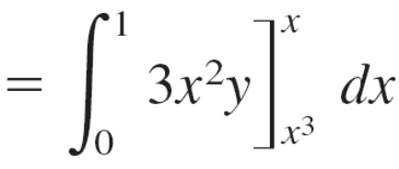
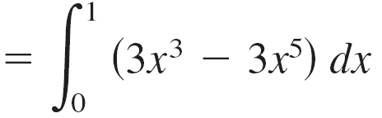
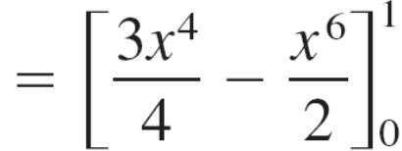
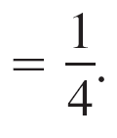
Example 1 – Solution
cont’d

Slide 10
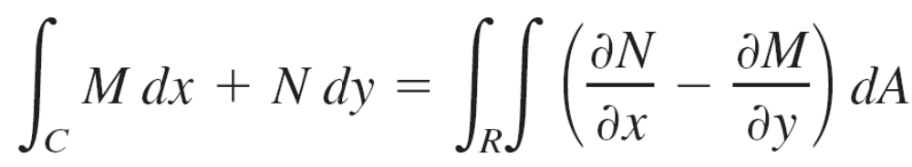
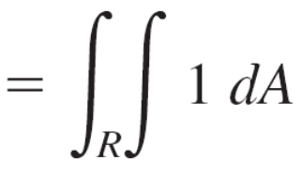
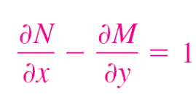
Green’s Theorem
In Example 1, Green’s Theorem was used to evaluate line integrals as double integrals.
You can also use the theorem to evaluate double integrals as line integrals.
One useful application occurs when ∂N/∂x – ∂M/∂y = 1.
= area of region R

Slide 11
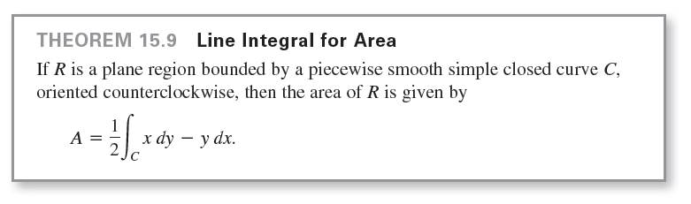
Green’s Theorem
Among the many choices for M and N satisfying the stated condition, the choice of M = –y/2 and N = x/2 produces the following line integral for the area of region R.

Slide 12
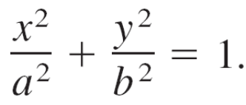
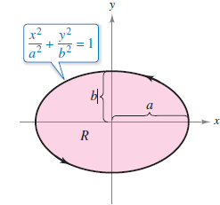
Example 5 – Finding Area by a Line Integral
Use a line integral to find the area of the ellipse
Solution:
Using Figure 15.32, you can induce a counterclockwise orientation to the elliptical path by letting
x = a cos t and y = b sin t, 0 ≤ t ≤ 2π.
Figure 15.32

Slide 13
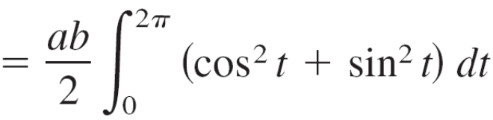
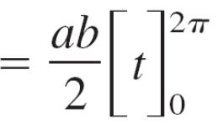

Example 5 – Solution
cont’d
So, the area is

Slide 14
Alternative Forms of Green’s Theorem

Slide 15
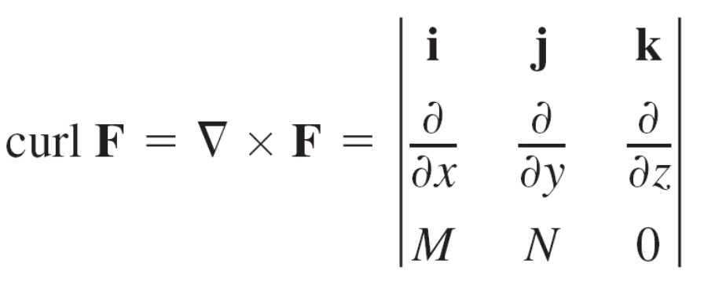
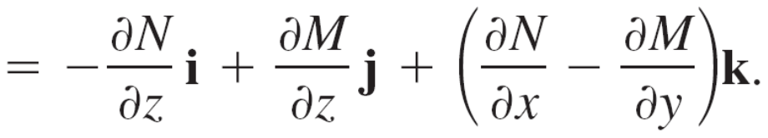
Alternative Forms of Green’s Theorem
This section concludes with the derivation of two vector forms of Green’s Theorem for regions in the plane.
For a vector field F in the plane, you can write
F(x, y, z) = Mi + Nj + 0k
so that the curl of F, as described in Section 15.1, is given by

Slide 16
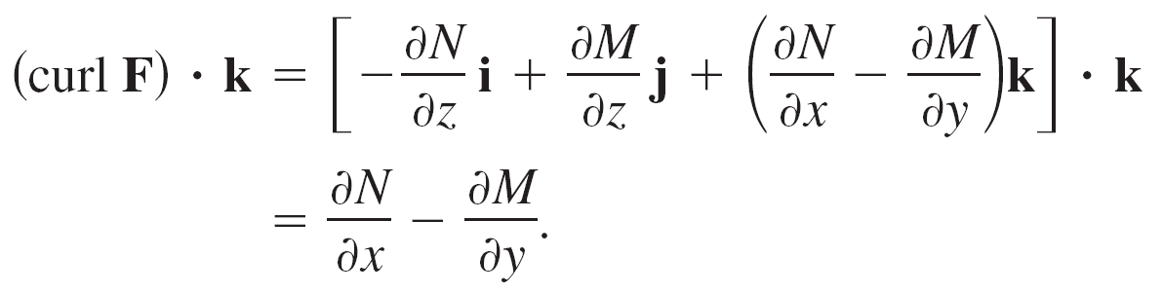
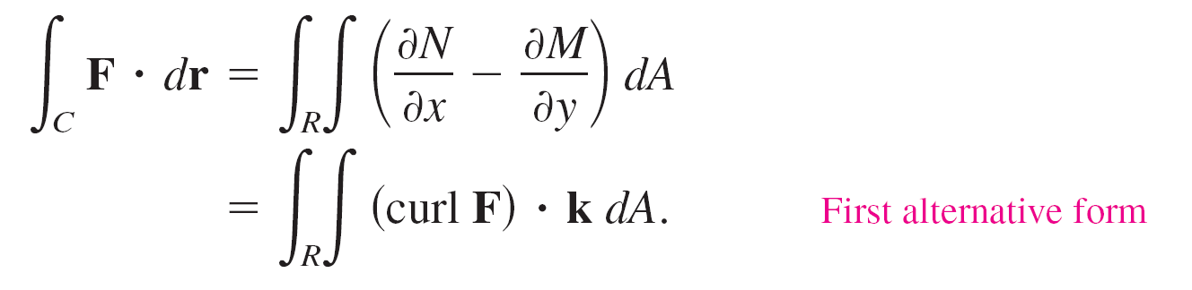
Alternative Forms of Green’s Theorem
Consequently,
With appropriate conditions on F, C, and R, you can write Green’s Theorem in the vector form
The extension of this vector form of Green’s Theorem to surfaces in space produces Stokes’s Theorem.

Slide 17
Alternative Forms of Green’s Theorem
For the second vector form of Green’s Theorem, assume the same conditions for F, C, and R.
Using the arc length parameter s for C, you have r(s) = x(s)i + y(s)j.
So, a unit tangent vector T to curve C is given by r′(s) = T = x′(s)i + y′(s)j.

Slide 18
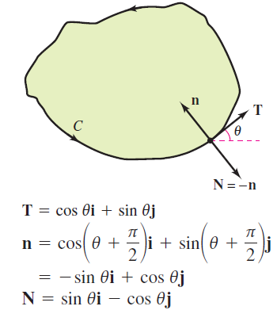
Alternative Forms of Green’s Theorem
From Figure 15.34, you can see that the outward unit normal vector N can then be written as N = y′(s)i – x′(s)j.
Figure 15.34

Slide 19
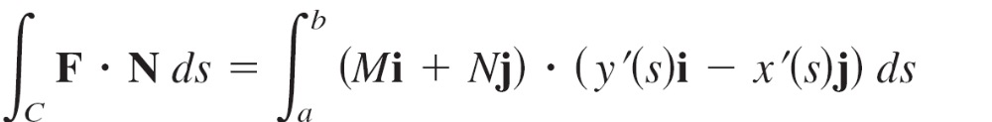
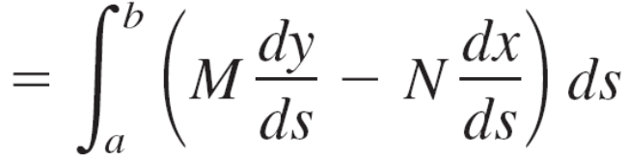
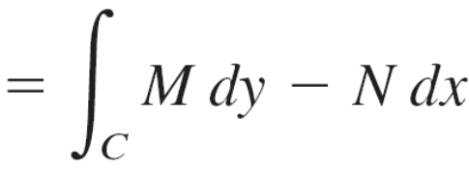
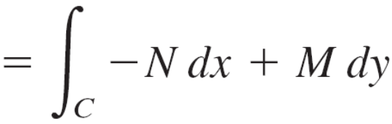
Alternative Forms of Green’s Theorem
Consequently, for F(x, y) = Mi + Nj, you can apply Green’s Theorem to obtain

Slide 20
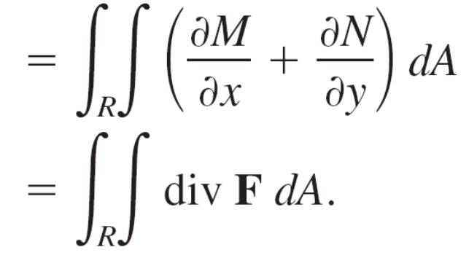

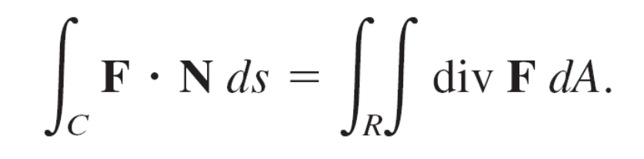

Alternative Forms of Green’s Theorem
Therefore,
The extension of this form to three dimensions is called the Divergence Theorem.

