Slide 1

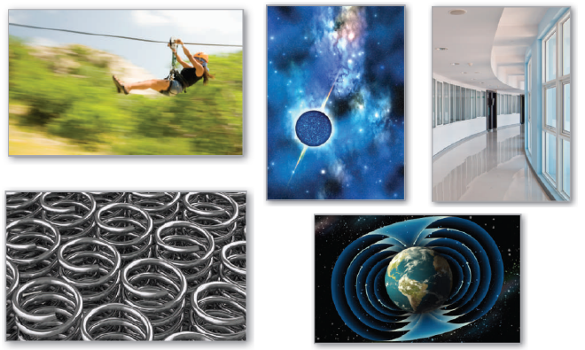
15
P
Vector Analysis
Copyright © Cengage Learning. All rights reserved.

Slide 2

15.5
Parametric Surfaces
Copyright © Cengage Learning. All rights reserved.

Slide 3
Objectives
Understand the definition of a parametric surface, and sketch the surface.
Find a set of parametric equations to represent a surface.
Find a normal vector and a tangent plane to a parametric surface.
Find the area of a parametric surface.

Slide 4
Parametric Surfaces
You already know how to represent a curve in the plane or in space by a set of parametric equations—or, equivalently, by a vector-valued function.
r(t) = x(t)i + y(t)j Plane curve
r(t) = x(t)i + y(t)j + z(t)k Space curve
In this section, you will learn how to represent a surface in space by a set of parametric equations—or by a vector-valued function.
For curves, note that the vector-valued function r is a function of a single parameter t. For surfaces, the vector-valued function is a function of two parameters u and v.

Slide 5
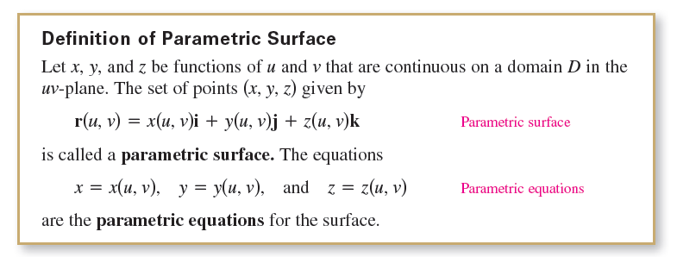
Parametric Surfaces

Slide 6
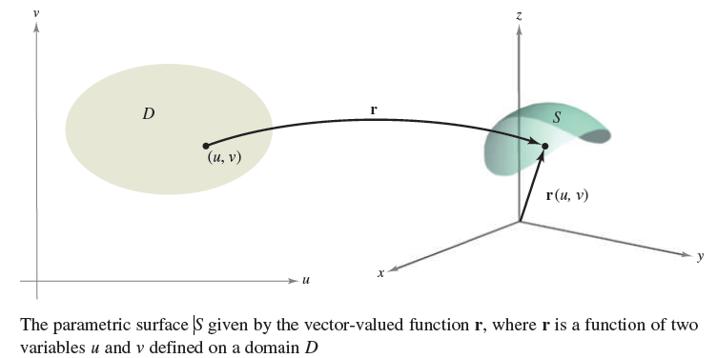
Parametric Surfaces
If S is a parametric surface given by the vector-valued function r, then S is traced out by the position vector r(u, v) as the point (u, v) moves throughout the domain D, as shown in Figure 15.35.
Figure 15.35

Slide 7
Example 1 – Sketching a Parametric Surface
Identify and sketch the parametric surface S given by
r(u, v) = 3 cos ui + 3 sin uj + vk
where 0 ≤ u ≤ 2π and 0 ≤ v ≤ 4.
Solution:
Because x = 3 cos u and y = 3 sin u, you know that for each point (x, y, z) on the surface, x and y are related by the equation
x² + y² = 3².

Slide 8
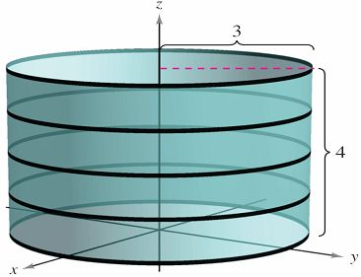
Example 1 – Solution
cont’d
In other words, each cross section of S taken parallel to the xy-plane is a circle of radius 3, centered on the z-axis.
Because z = v, where 0 ≤ v ≤ 4 you can see that the surface is a right circular cylinder of height 4.
The radius of the cylinder is 3,
and the z-axis forms the
axis of the cylinder, as shown
in Figure 15.36.
Figure 15.36

Slide 9
Finding Parametric Equations for Surfaces

Slide 10
Finding Parametric Equations for Surfaces
In Example 1, you were asked to identify the surface described by a given set of parametric equations.
The reverse problem—that of writing a set of parametric equations for a given surface—is generally more difficult.
One type of surface for which this problem is straightforward, however, is a surface that is given by
z = f(x, y).
You can parametrize such a surface as
r(x, y) = xi + yj + f (x, y)k.

Slide 11

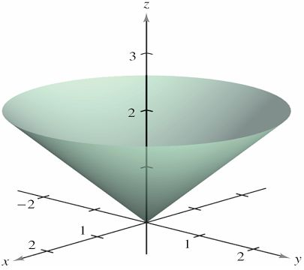
Example 3 – Representing a Surface Parametrically
Write a set of parametric equations for the cone given by
as shown in Figure 15.38.
Figure 15.38

Slide 12
Example 3 – Solution
Because this surface is given in the form z = f (x, y), you can let x and y be the parameters.
Then the cone is represented by the vector-valued function
where (x, y) varies over the entire xy-plane.

Slide 13
Finding Parametric Equations for Surfaces
A second type of surface that is easily represented parametrically is a surface of revolution.
For instance, to represent the surface formed by revolving the graph of
y = f (x), a ≤ x ≤ b
about the x-axis, use
x = u, y = f (u) cos v, and z = f (u) sin v
where a ≤ u ≤ b and 0 ≤ v ≤ 2π.

Slide 14
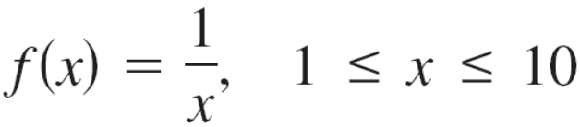

Example 4 – Representing a Surface of Revolution Parametrically
Write a set of parametric equations for the surface of revolution obtained by revolving
about the x-axis.
Solution:
Use the parameters u and v as described above to write
x = u, y = f(u) cos v = cos v, and z = f(u) sin v = sin v
where
1 ≤ u ≤ 10 and 0 ≤ v ≤ 2π.

Slide 15
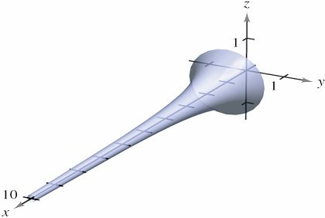
Example 4 – Solution
cont’d
The resulting surface is a portion of Gabriel’s Horn, as shown in Figure 15.39.
Figure 15.39

Slide 16
Normal Vectors and Tangent Planes

Slide 17
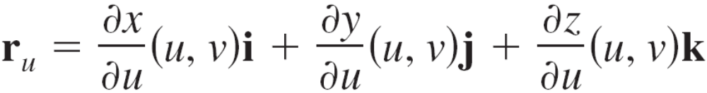
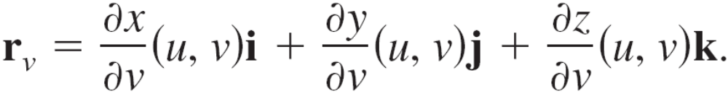
Normal Vectors and Tangent Planes
Let S be a parametric surface given by
r(u, v) = x(u, v)i + y(u, v)j + z(u, v)k
over an open region D such that x, y, and z have continuous partial derivatives on D.
The partial derivatives of r with respect to u and v are defined as
and
Each of these partial derivatives is a vector-valued function that can be interpreted geometrically in terms of tangent vectors.

Slide 18
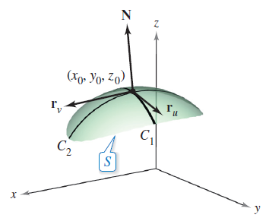
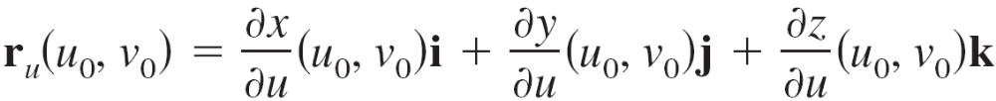
Normal Vectors and Tangent Planes
For instance, if v = v₀ is held constant,
then r(u, v₀) is a vector-valued function
of a single parameter and defines
a curve C₁ that lies on the surface S.
The tangent vector to C₁ at the point
(x(u₀, v₀), y(u₀, v₀), z(u₀, v₀)) is given by
as shown in Figure 15.40.
Figure 15.40

Slide 19
Normal Vectors and Tangent Planes
In a similar way, if u = u₀ is held constant, then r(u₀, v) is a vector-valued function of a single parameter and defines a curve C₂ that lies on the surface S.
The tangent vector to C₂ at the point (x(u₀, v₀), y(u₀, v₀), z(u₀, v₀)) is given by
If the normal vector r_{u} × r_{v} is not 0 for any (u, v) in D, then the surface S is called smooth and will have a tangent plane.

Slide 20
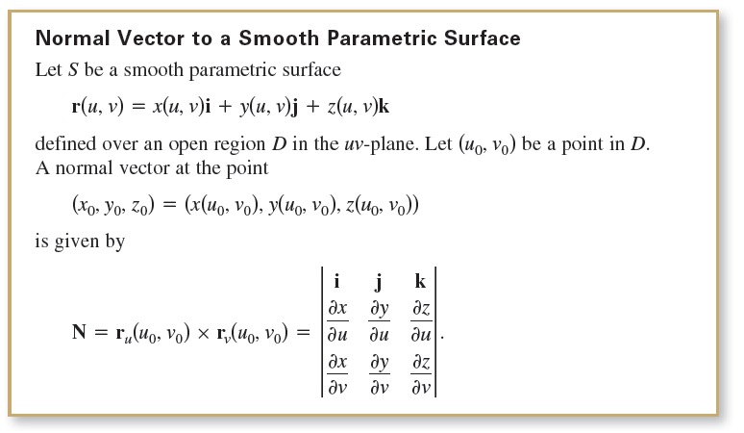
Normal Vectors and Tangent Planes

Slide 21
Example 5 – Finding a Tangent Plane to a Parametric Surface
Find an equation of the tangent plane to the paraboloid r(u, v) = ui + vj + (u² + v²)k
at the point (1, 2, 5).
Solution:
The point in the uv-plane that is mapped to the point
(x, y, z) = (1, 2, 5) is (u, v) = (1, 2).
The partial derivatives of r are
r_{u} = i + 2uk and r_{v} = j + 2vk.

Slide 22
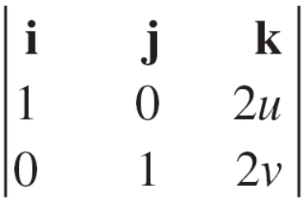
Example 5 – Solution
cont’d
The normal vector is given by
r_{u} × r_{v} = = –2ui – 2vj + k
which implies that the normal vector at (1, 2, 5) is
r_{u} × r_{v} = –2i – 4j + k.
So, an equation of the tangent plane at (1, 2, 5) is
–2(x – 1) – 4(y – 2) + (z – 5) = 0
–2x – 4y + z = –5.

Slide 23
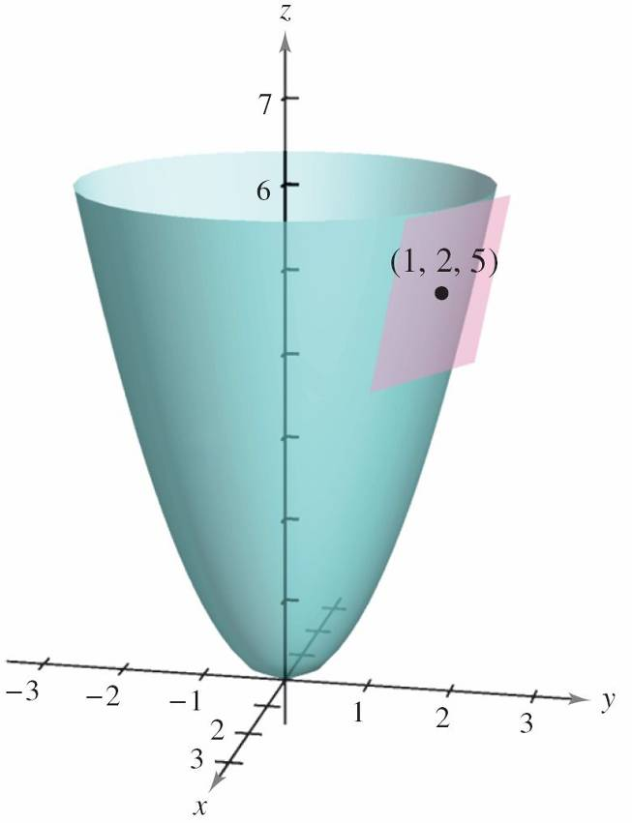
Example 5 – Solution
cont’d
The tangent plane is shown in Figure 15.41.
Figure 15.41

Slide 24
Area of a Parametric Surface

Slide 25
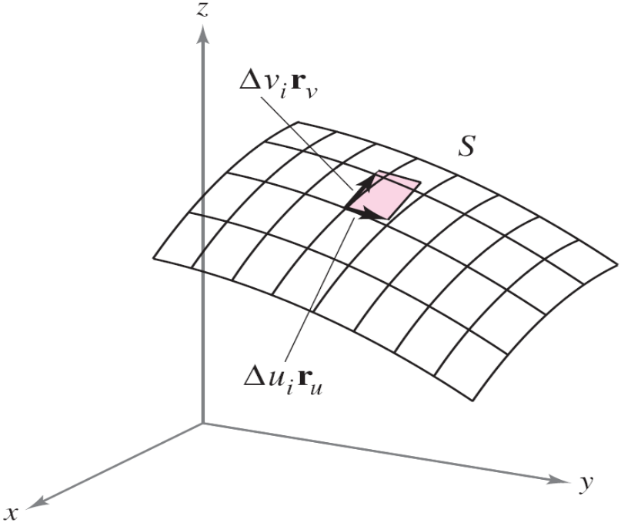
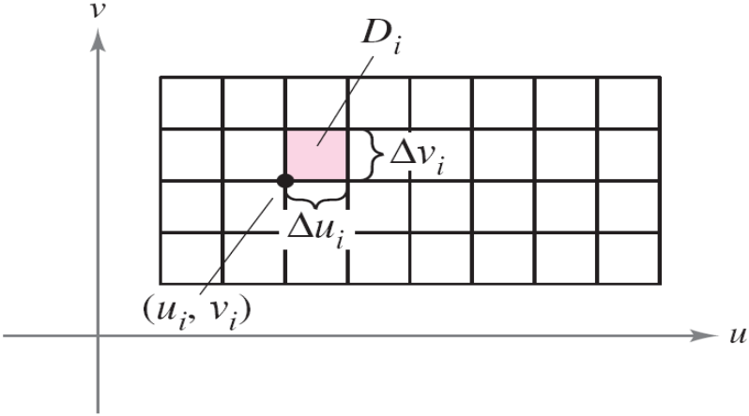
Area of a Parametric Surface
To define the area of a parametric surface, begin by constructing an inner partition of D consisting of n rectangles, where the area of the i th rectangle D_{i} is
∆A_{i} = ∆u_{i} ∆v_{i}, as shown in Figure 15.42.
Figure 15.42

Slide 26
Area of a Parametric Surface
In each D_{i} let (u_{i}, v_{i}) be the point that is closest to the origin.
At the point (x_{i}, y_{i}, z_{i}) = (x(u_{i}, v_{i}), y(u_{i}, v_{i}), z(u_{i}, v_{i})) on the surface S, construct a tangent plane T_{i} .
The area of the portion of S that corresponds to D_{i}, ∆S_{i}, can be approximated by a parallelogram ∆T_{i} in the tangent plane. That is, ∆T_{i} ≈ ∆S_{i}.
So, the surface area of S is given by Σ ∆S_{i} ≈ Σ ∆T_{i}.

Slide 27
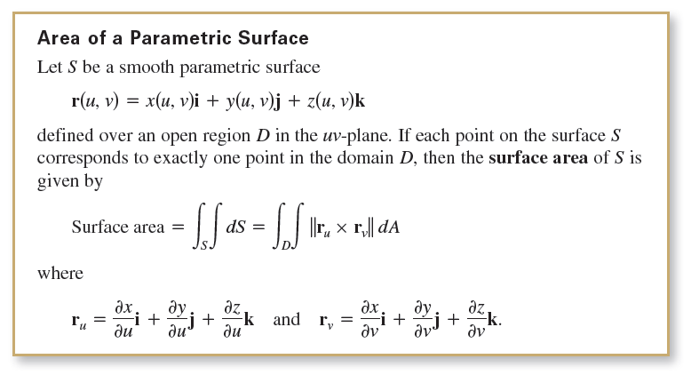
Area of a Parametric Surface
The area of the parallelogram in the tangent plane is
which leads to the following definition.

Slide 28
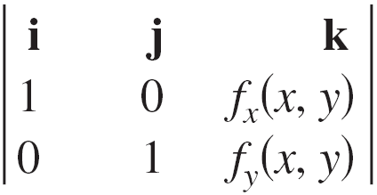

Area of a Parametric Surface
For a surface S given by z = f (x, y), you can parametrize the surface using the vector-valued function
r(x, y) = xi + yj + f (x, y)k
defined over the region R in the xy-plane. Using
r_{x} = i + f_{x}(x, y)k and r_{y} = j + f_{y}(x, y)k,
you have
r_{x} × r_{y} = = –f_{x}(x, y)i – f_{y}(x, y)j + k
and
||r_{x} × r_{y}|| =

Slide 29
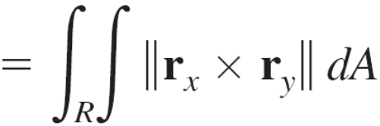
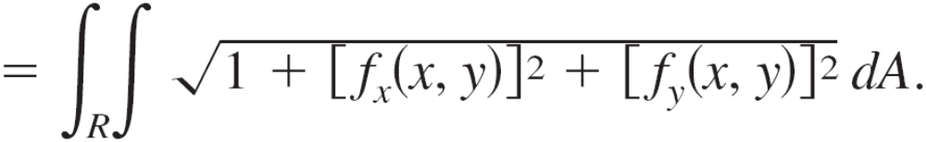
Area of a Parametric Surface
This implies that the surface area of S is
Surface area

Slide 30
Example 6 – Finding Surface Area
Find the surface area of the unit sphere
r(u, v) = sin u cos vi + sin u sin vj + cos uk
where the domain D is given by 0 ≤ u ≤ π and 0 ≤ v ≤ 2π.
Solution:
Begin by calculating r_{u} and r_{v}.
r_{u} = cos u cos vi + cos u sin vj – sin uk
r_{v} = –sin u sin vi + sin u cos vj

Slide 31
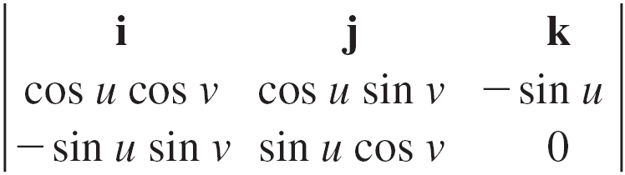


Example 6 – Solution
cont’d
The cross product of these two vectors is
r_{u} × r_{v} =
= sin² u cos vi + sin² u sin vj + sin u cos uk
which implies that
||r_{u} × r_{v}||

Slide 32
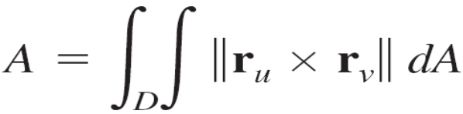
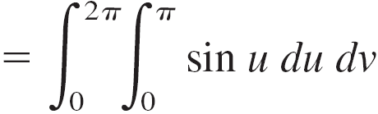
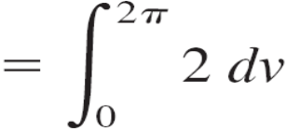

Example 6 – Solution
cont’d
Finally, the surface area of the sphere is

