Slide 1

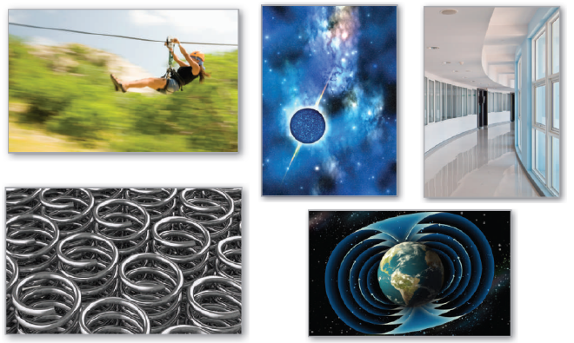
15
P
Vector Analysis
Copyright © Cengage Learning. All rights reserved.

Slide 2

15.6
Surface Integrals
Copyright © Cengage Learning. All rights reserved.

Slide 3
Objectives
Evaluate a surface integral as a double integral.
Evaluate a surface integral for a parametric surface.
Determine the orientation of a surface.
Understand the concept of a flux integral.

Slide 4
Surface Integrals

Slide 5
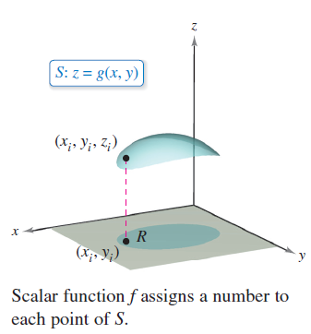
Surface Integrals
You will first consider surfaces given by z = g(x, y). Later in this section, you will consider more general surfaces given in parametric form.
Let S be a surface given by
z = g(x, y) and let R be its
projection onto the xy-plane,
as shown in Figure 15.44.
Let g, g_{x}, and g_{y} be continuous
at all points in R and let f
be a scalar function defined on S.
Figure 15.44

Slide 6
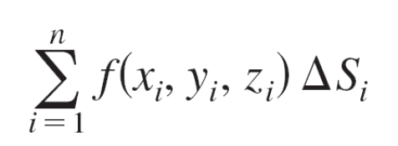
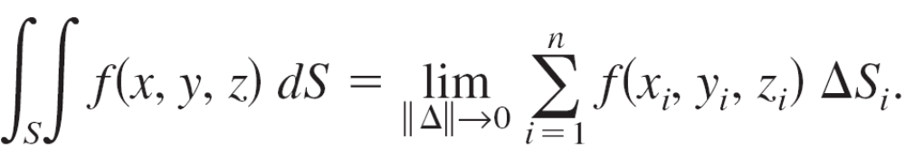
Surface Integrals
Employing the procedure used to find surface area, evaluate f at (x_{i}, y_{i}, z_{i}) and form the sum
where
Provided the limit of this sum as ||∆|| approaches 0 exists, the surface integral of f over S is defined as
This integral can be evaluated by a double integral.

Slide 7
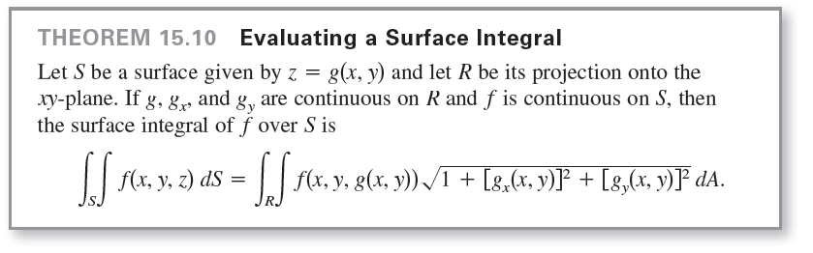
Surface Integrals

Slide 8
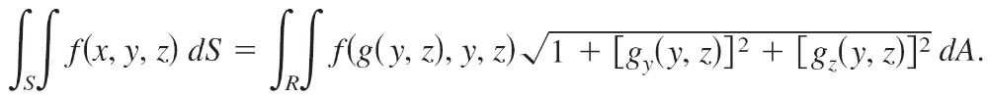
Surface Integrals
For surfaces described by functions of x and z (or y and z), you can make the following adjustments to Theorem 15.10. If S is the graph of y = g(x, z) and R is its projection onto the xz-plane, then
If S is the graph of x = g(y, z) and R is its projection onto the yz-plane, then
If f(x, y, z) = 1, the surface integral over S yields the surface area of S.

Slide 9
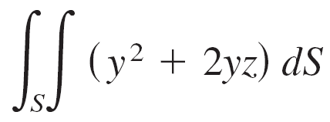

Example 1 – Evaluating a Surface Integral
Evaluate the surface integral
where S is the first-octant portion of the plane
2x + y + 2z = 6.
Solution:
Begin by writing S as

Slide 10

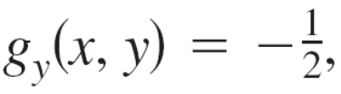
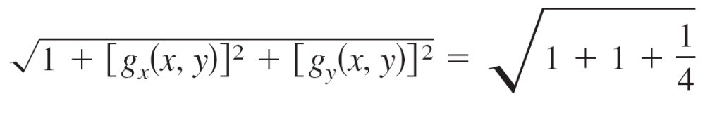
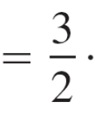
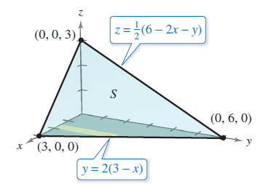
Example 1 – Solution
cont’d
Using the partial derivatives and
you can write
Figure 15.45

Slide 11
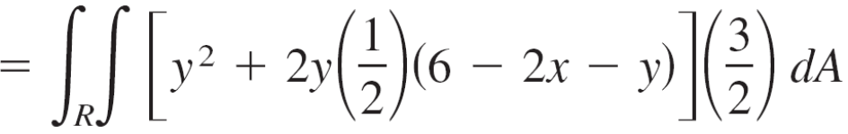
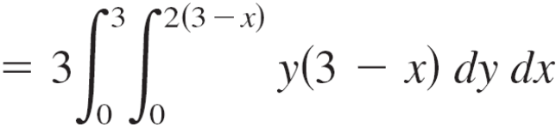
Example 1 – Solution
cont’d
Using Figure 15.45 and Theorem 15.10, you obtain

Slide 12


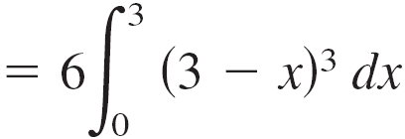
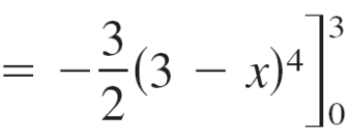
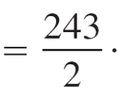
Example 1 – Solution
cont’d

Slide 13
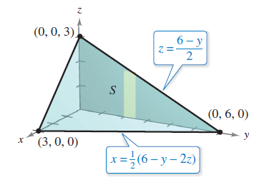

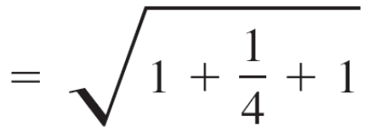
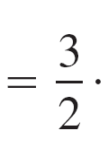
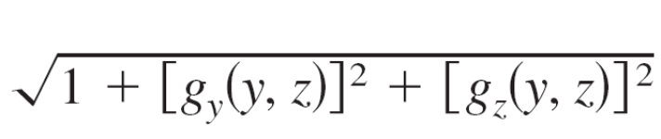
Example 1 – Solution
cont’d
An alternative solution to Example 1 would be to project S onto the yz-plane, as shown in Figure 15.46.
Then,
and
Figure 15.46

Slide 14
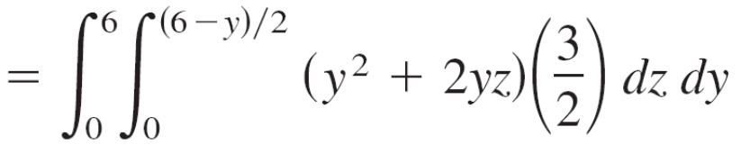
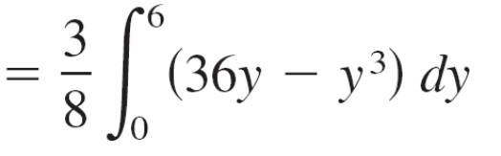
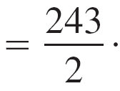
Example 1 – Solution
cont’d
So, the surface integral is

Slide 15
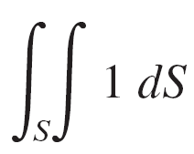
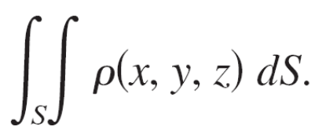
Surface Integrals
You have already seen that when the function f defined on the surface S is simply f(x, y, z) = 1, the surface integral yields the surface area of S.
Area of surface =
On the other hand, when S is a lamina of variable density and ρ(x, y, z) is the density at the point (x, y, z), then the mass of the lamina is given by
Mass of lamina =

Slide 16

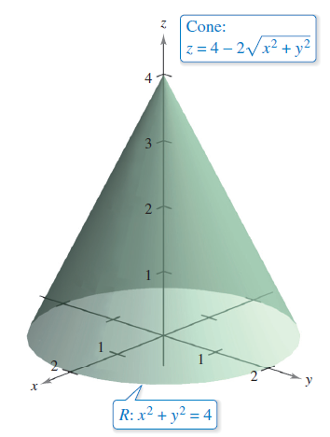
Example 3 – Finding the Mass of a Surface Lamina
A cone-shaped surface lamina S is given by
as shown in Figure 15.48.
At each point on S, the
density is proportional to
the distance between the
point and the z-axis.
Find the mass m of the lamina.
Figure 15.48

Slide 17


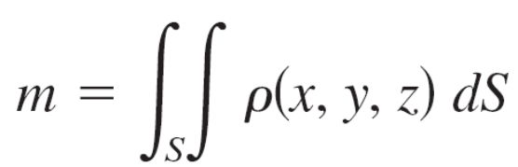
Example 3 – Solution
Projecting S onto the xy-plane produces
with a density of , where k is the constant of proportionality.
Using a surface integral, you can find the mass to be

Slide 18
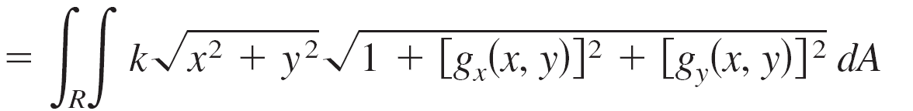

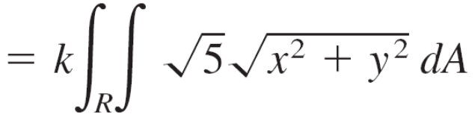
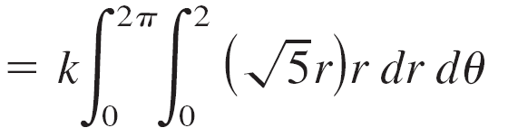

Example 3 – Solution
cont’d

Slide 19
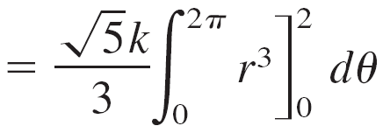
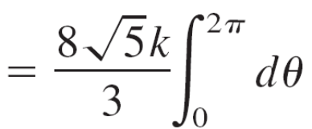
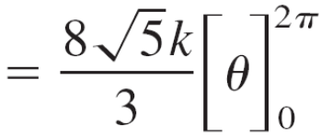
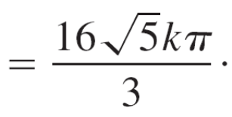
Example 3 – Solution
cont’d

Slide 20
Parametric Surfaces and Surface Integrals

Slide 21
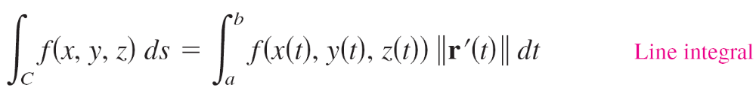
Parametric Surfaces and Surface Integrals
For a surface S given by the vector-valued function
r(u, v) = x(u, v)i + y(u, v)j + z(u, v)k Parametric surface
defined over a region D in the uv-plane, you can show that the surface integral of f(x, y, z) over S is given by
Note the similarity to a line integral over a space curve C.
Line integral

Slide 22
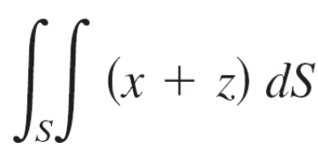
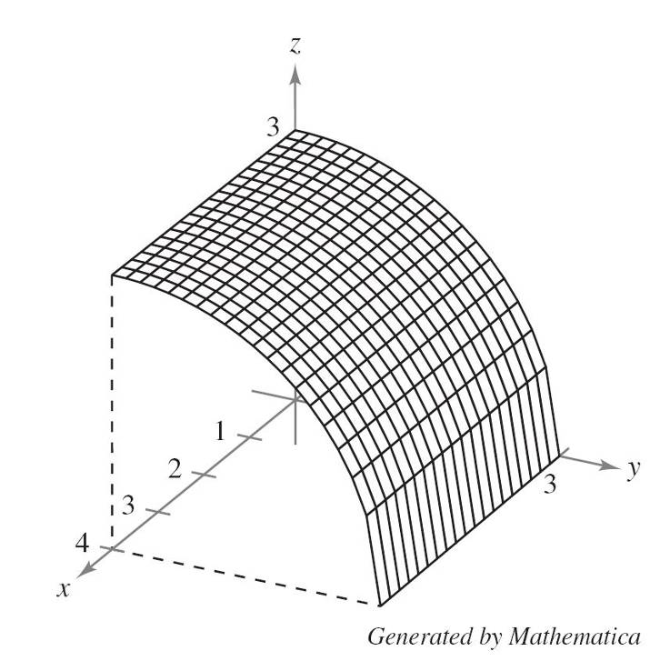
Example 4 – Evaluating a Surface Integral
Evaluate the surface integral
where S is the first-octant portion of the cylinder y² + z² = 9 between x = 0 and x = 4, as shown in Figure 15.49. Reevaluate this integral in parametric form.
Figure 15.49

Slide 23
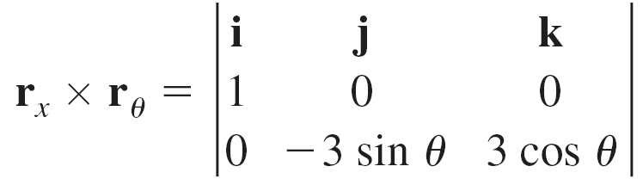
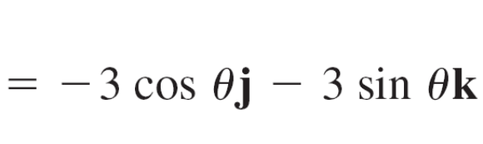
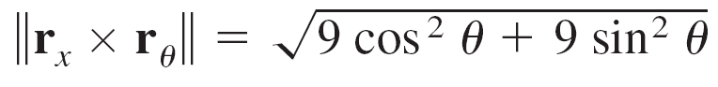

Example 4 – Solution
In parametric form, the surface is given by
r(x, θ) = xi + 3 cos θj + 3 sin θk
where 0 ≤ x ≤ 4 and 0 ≤ θ ≤ π/2.
To evaluate the surface integral in parametric form, begin by calculating the following.
r_{x} = i
r_{θ} = – 3 sin θj + 3 cos θk

Slide 24
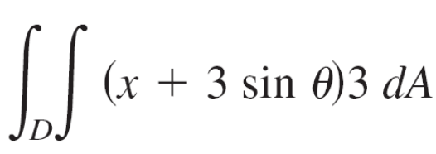
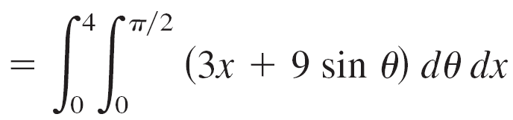
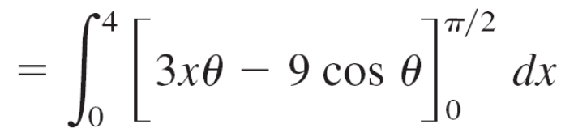
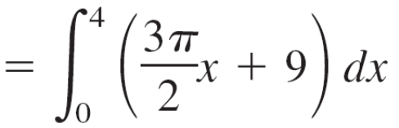
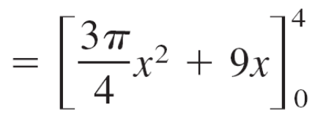
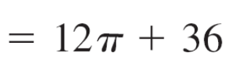
Example 4 – Solution
cont’d
So, the surface integral can be evaluated as follows.

Slide 25
Orientation of a Surface

Slide 26
Orientation of a Surface
Unit normal vectors are used to induce an orientation to a surface S in space.
A surface is orientable when a unit normal vector N can be defined at every nonboundary point of S in such a way that the normal vectors vary continuously over the surface S. The surface S is called an oriented surface.
An orientable surface S has two distinct sides. So, when you orient a surface, you are selecting one of the two possible unit normal vectors.

Slide 27
Orientation of a Surface
For a closed surface such as a sphere, it is customary to choose the unit normal vector N to be the one that points outward from the sphere.
Most common surfaces, such as spheres, paraboloids, ellipses, and planes, are orientable.
Moreover, for an orientable surface, the gradient provides a convenient way to find a unit normal vector.

Slide 28
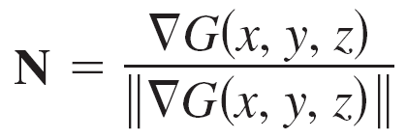
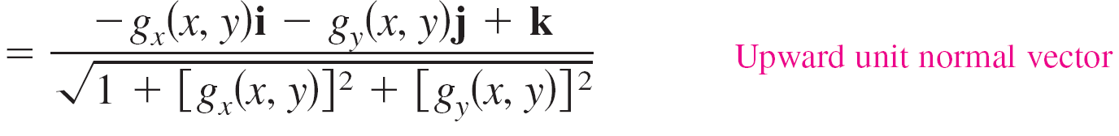
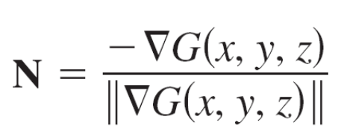
Orientation of a Surface
That is, for an orientable surface S given by
z = g(x, y) Orientable surface
let
G(x, y, z) = z – g(x, y).
Then, S can be oriented by either the unit normal vector
or the unit normal vector

Slide 29
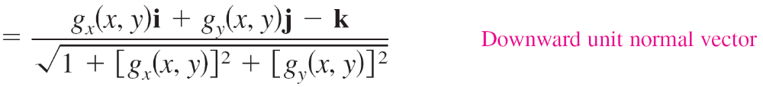


Orientation of a Surface
as shown in Figure 15.50.
Figure 15.50

Slide 30


Orientation of a Surface
If the smooth orientable surface S is given in parametric form by
r(u, v) = x(u, v)i + y(u, v)j + z(u, v)k Parametric surface
then the unit normal vectors are given by
and

Slide 31
Orientation of a Surface
For an orientable surface given by
y = g(x, y) or x = g(y, z)
you can use the gradient
or
to orient the surface.

Slide 32
Flux Integrals

Slide 33
Flux Integrals
One of the principal applications involving the vector form of a surface integral relates to the flow of a fluid through a surface.
Consider an oriented surface S submerged in a fluid having a continuous velocity field F.
Let ∆S be the area of a small patch of the surface S over which F is nearly constant.

Slide 34

Flux Integrals
Then the amount of fluid crossing this region per unit of time is approximated by the volume of the column of height F  N, as shown in Figure 15.51.
Figure 15.51

Slide 35

Flux Integrals
That is,
∆V = (height)(area of base) = (F  N) ∆S.
Consequently, the volume of fluid crossing the surface S per unit of time (called the flux of F across S) is given by the surface integral in the following definition.

Slide 36

Flux Integrals
Geometrically, a flux integral is the surface integral over S of the normal component of F.
If ρ(x, y, z) is the density of the fluid at (x, y, z), then the flux integral
represents the mass of the fluid flowing across S per unit of time.

Slide 37



Flux Integrals
To evaluate a flux integral for a surface given by
z = g(x, y), let
G(x, y, z) = z – g(x, y).
Then N dS can be written as follows.

Slide 38

Flux Integrals

Slide 39

Example 5 – Using a Flux Integral to Find the Rate of Mass Flow
Let S be the portion of the paraboloid z = g(x, y) = 4 – x² – y²
lying above the xy-plane, oriented by an upward unit normal vector, as shown in Figure 15.52.
A fluid of constant density ρ is flowing
through the surface S according to
the vector field
F(x, y, z) = xi + yj + zk.
Find the rate of mass flow through S.
Figure 15.52

Slide 40



Example 5 – Solution
Note that S is oriented upward and the partial derivatives of g are
g_{x}(x, y) = –2x
and
g_{y}(x, y) = –2y.
So, the rate of mass flow through the surface S is

Slide 41





Example 5 – Solution
cont’d

Slide 42


Example 6 – Finding the Flux of an Inverse Square Field
Find the flux over the sphere S
given by x² + y² + z² = a² Sphere S
where F is an inverse square
field given by
and r = xi + yj + zk.
Assume S is oriented outward,
as shown in Figure 15.53.
Figure 15.53

Slide 43

Example 6 – Solution
The sphere is given by
r(u, v) = x(u, v)i + y(u, v)j + z(u, v)k
= a sin u cos vi + a sin u sin vj + a cos uk
where 0 ≤ u ≤ π and 0 ≤ v ≤ 2π.
The partial derivatives of r are
r_{u}(u, v) = a cos u cos vi + a cos u sin vj – a sin uk and
r_{v}(u, v) = –a sin u sin vi + a sin u cos vj
which implies that the normal vector r_{u} × r_{v} is

Slide 44




Example 6 – Solution
cont’d
Now, using
it follows that

Slide 45





Example 6 – Solution
cont’d
Finally, the flux over the sphere S is given by

Slide 46

Flux Integrals
The result in Example 6 shows that the flux across a sphere S in an inverse square field is independent of the radius of S.
In particular, if E is an electric field, then the result in Example 6, along with Coulomb’s Law, yields one of the basic laws of electrostatics, known as Gauss’s Law:
where q is a point charge located at the center of the sphere and k is the Coulomb constant.
Gauss’s Law is valid for more general closed surfaces that enclose the origin, and relates the flux out of the surface to the total charge inside the surface.

Slide 47
Flux Integrals
Surface integrals are also used in the study of heat flow. Heat flows from areas of higher temperature to areas of lower temperature in the direction of greatest change.
As a result, measuring heat flux involves the gradient of the temperature. The flux depends on the area of the surface.
It is the normal direction to the surface that is important, because heat that flows in directions tangential to the surface will produce no heat loss.

Slide 48


Flux Integrals
So, assume that the heat flux across a portion of the surface of area ∆S is given by where T is the temperature, N is the unit normal vector to the surface in the direction of the heat flow, k is the thermal diffusivity of the material.
The heat flux across the surface is given by

Slide 49

Flux Integrals

Slide 50

Flux Integrals
cont’d

