Slide 1


15
P
Vector Analysis
Copyright © Cengage Learning. All rights reserved.

Slide 2

15.7
Divergence Theorem
Copyright © Cengage Learning. All rights reserved.

Slide 3
Objectives
Understand and use the Divergence Theorem.
Use the Divergence Theorem to calculate flux.

Slide 4
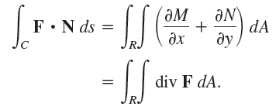
Divergence Theorem
An alternative form of Green’s Theorem is
In an analogous way, the Divergence Theorem gives the relationship between a triple integral over a solid region Q and a surface integral over the surface of Q.
In the statement of the theorem, the surface S is closed in the sense that it forms the complete boundary of the
solid Q.

Slide 5
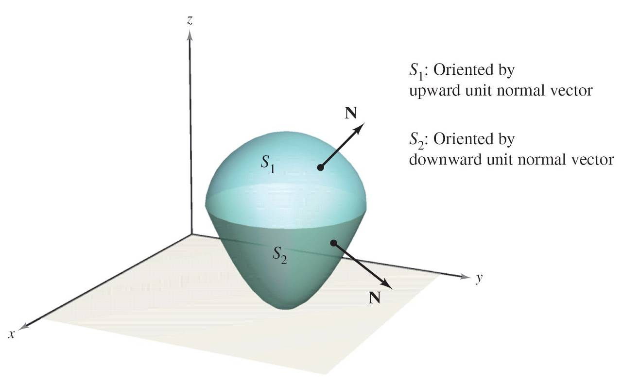
Divergence Theorem
Let Q be a solid region on which a triple integral can be evaluated, and let S be a closed surface that is oriented by outward unit normal vectors, as shown in Figure 15.54.
Figure 15.54

Slide 6
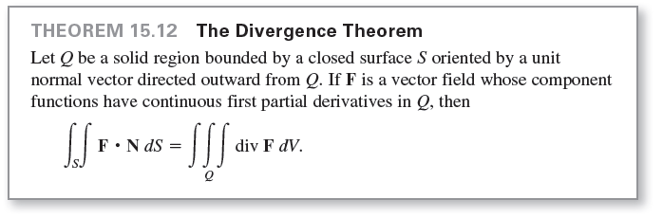
Divergence Theorem
With these restrictions on S and Q, the Divergence Theorem can be stated as shown below.

Slide 7
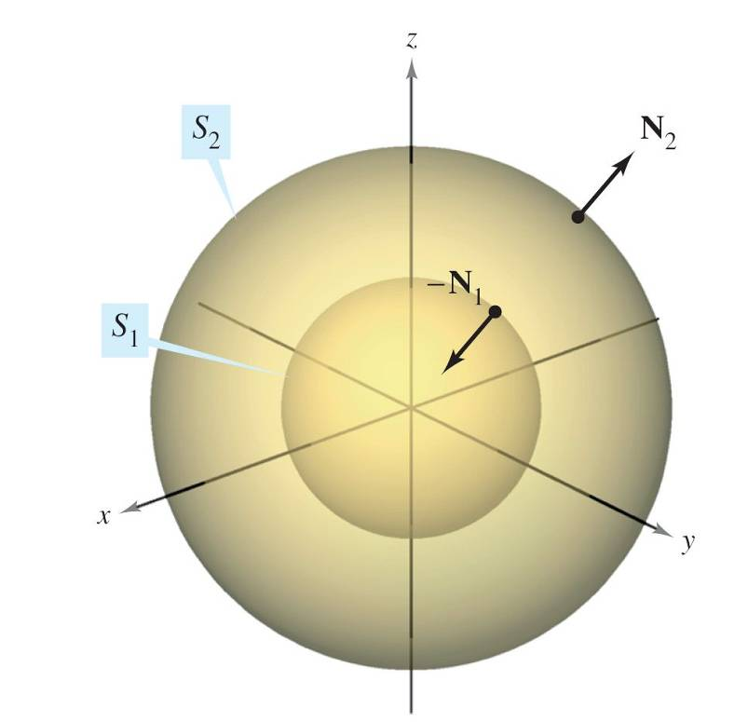
Divergence Theorem
Even though the Divergence Theorem was stated for a simple solid region Q bounded by a closed surface, the theorem is also valid for regions that are the finite unions of simple solid regions.
For example, let Q be the
solid bounded by the closed
surfaces S₁ and S₂, as shown
in Figure 15.56.
To apply the Divergence
Theorem to this solid,
let S = S₁ U S₂.
Figure 15.56

Slide 8
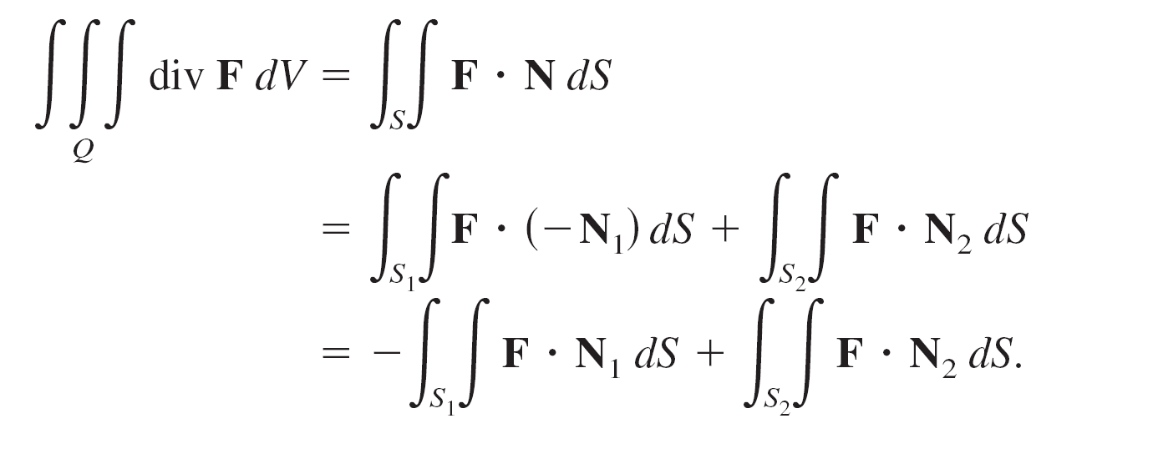
Divergence Theorem
The normal vector N to S is given by −N₁ on S₁ and by N₂ on S₂.
So, you can write

Slide 9
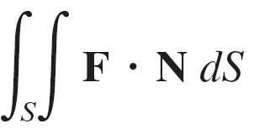
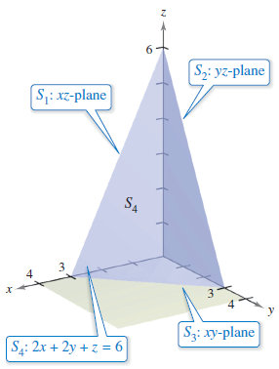
Example 1 – Using the Divergence Theorem
Let Q be the solid region bounded by the coordinate planes and the plane 2x + 2y + z = 6 and let F = xi + y²j + zk.
Find ,
where S is the surface of Q.
Solution:
From Figure 15.57,
you can see that Q is bounded
by four subsurfaces.
Figure 15.57

Slide 10





Example 1 – Solution
cont’d
So, you would need four surface integrals to evaluate
However, by the Divergence Theorem, you need only one triple integral. Because
you have

Slide 11

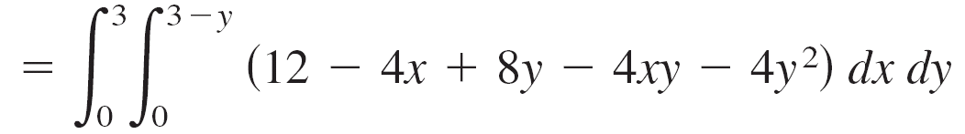
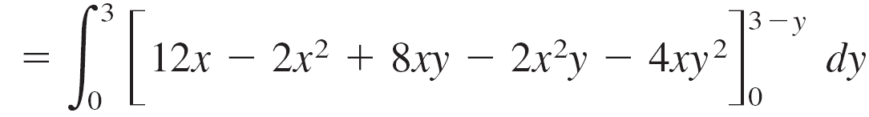
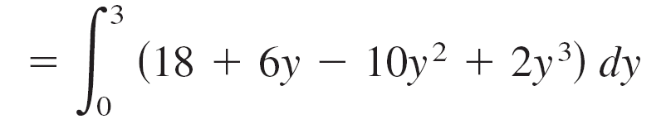
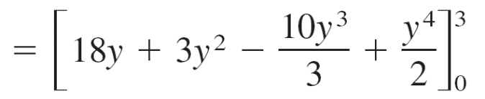
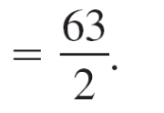
Example 1 – Solution
cont’d

Slide 12
Flux and the Divergence Theorem

Slide 13

Flux and the Divergence Theorem
To help understand the Divergence Theorem, consider the two sides of the equation
You know that the flux integral on the left determines the total fluid flow across the surface S per unit of time. This can be approximated by summing the fluid flow across small patches of the surface.
The triple integral on the right measures this same fluid flow across S but from a very different perspective—namely, by calculating the flow of fluid into (or out of) small cubes of volume ∆V_{i} .

Slide 14
Flux and the Divergence Theorem
The flux of the ith cube is approximately div F(x_{i}, y_{i}, z_{i}) ∆V_{i} for some point (x_{i}, y_{i}, z_{i}) in the ith cube.
Note that for a cube in the interior of Q, the gain (or loss) of fluid through any one of its six sides is offset by a corresponding loss (or gain) through one of the sides of an adjacent cube.
After summing over all the cubes in Q, the only fluid flow that is not canceled by adjoining cubes is that on the outside edges of the cubes on the boundary.

Slide 15

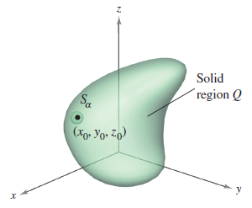
Flux and the Divergence Theorem
So, the sum
approximates the total flux into (or out of) Q and therefore through the surface S.
To see what is meant by the
divergence of F at a point,
consider ∆V_{α} to be the volume
of a small sphere S_{α} of
radius α and center (x₀, y₀, z₀)
contained in region Q,
as shown in Figure 15.60.
Figure 15.60

Slide 16




Flux and the Divergence Theorem
Applying the Divergence Theorem to S_{α} produces
where Q_{α} is the interior of S_{α}. Consequently, you have
By taking the limit as α → 0, you obtain the divergence
of F at the point (x₀, y₀, z₀).

Slide 17
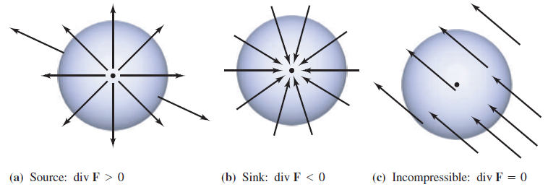
Flux and the Divergence Theorem
The point (x₀, y₀, z₀) in a vector field is classified as a source, a sink, or incompressible, as shown in the list below.
Source, for div F > 0
Sink, for div F < 0
Incompressible, for div F = 0
See Figure 15.61(a).
See Figure 15.61(b).
See Figure 15.61(c).
Figure 15.61

Slide 18

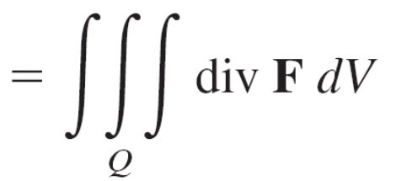

Example 4 – Calculating Flux by the Divergence Theorem
Let Q be the region bounded by the sphere x² + y² + z² = 4.
Find the outward flux of the vector field
F(x, y, z) = 2x³i + 2y³j + 2z³k
through the sphere.
Solution:
By the Divergence Theorem, you have

Slide 19

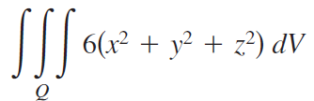





Example 4 – Solution
cont’d
Next, use spherical coordinates with ρ² = x² + y² + z² and
x

