Slide 1


15
P
Vector Analysis
Copyright © Cengage Learning. All rights reserved.

Slide 2

15.8
Stokes’s Theorem
Copyright © Cengage Learning. All rights reserved.

Slide 3
Objectives
Understand and use Stokes’s Theorem.
Use curl to analyze the motion of a rotating liquid.

Slide 4
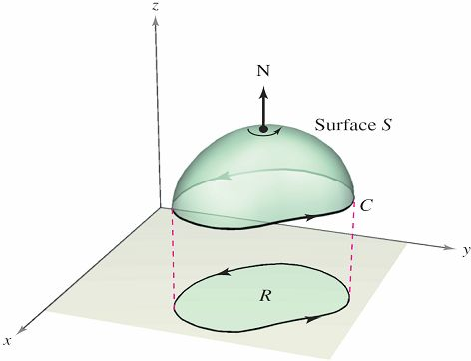
Stokes’s Theorem
A second higher-dimension analog of Green’s Theorem is called Stokes’s Theorem, after the English mathematical physicist George Gabriel Stokes.
Stokes’s Theorem gives
the relationship between
a surface integral over an
oriented surface S and
a line integral along a
closed space curve C
forming the boundary of S,
as shown in Figure 15.62.
An oriented surface S bounded by
a closed space curve C
Figure 15.62

Slide 5
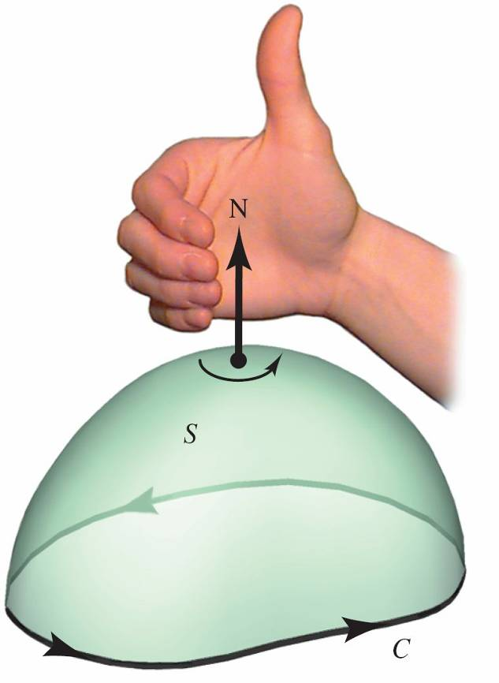
Stokes’s Theorem
The positive direction along C is counterclockwise relative to the normal vector N.
That is, if you imagine grasping
the normal vector N with your
right hand, with your thumb
pointing in the direction of N,
then your fingers will point in the
positive direction C,
as shown in Figure 15.63.
The positive direction along C is
counterclockwise relative to N.
Figure 15.63

Slide 6
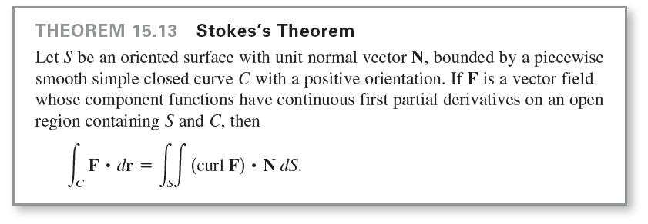
Stokes’s Theorem

Slide 7
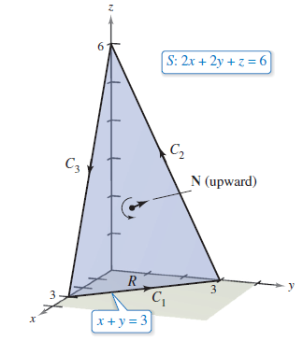
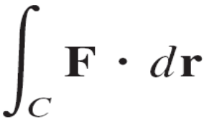
Example 1 – Using Stokes’s Theorem
Let C be the oriented triangle lying in the plane
2x + 2y + z = 6 as shown in Figure 15.64.
Evaluate
where F(x, y, z) = –y²i + zj + xk.
Figure 15.64

Slide 8
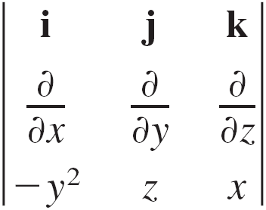

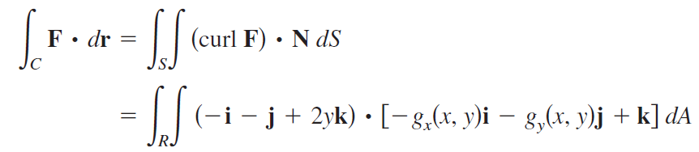
Example 1 – Solution
Using Stokes’s Theorem, begin by finding the curl of F.
curl F =
= –i – j + 2yk
Considering
you can use Theorem 15.11 for an upward normal vector to obtain

Slide 9
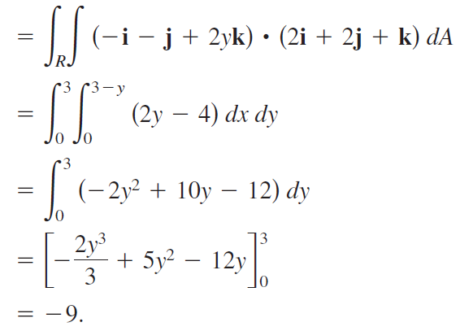
Example 1 – Solution
cont’d

Slide 10
Physical Interpretation of Curl

Slide 11
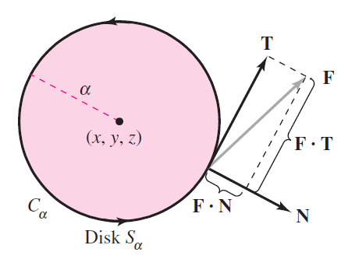
Physical Interpretation of Curl
Stokes’s Theorem provides insight into a physical interpretation of curl. In a vector field F, let S_{α} be a small circular disk of radius α, centered at (x, y, z) and with boundary C_{α}, as shown in Figure 15.66.
Figure 15.66

Slide 12

Physical Interpretation of Curl
At each point on the circle C_{α}, F has a normal component
F  N and a tangential component F  T.
The more closely F and T are aligned, the greater the value
of F  T. So, a fluid tends to move along the circle rather
than across it.
Consequently, you say that the line integral around C_{α}
measures the circulation of F around C_{α}. That is,

Slide 13
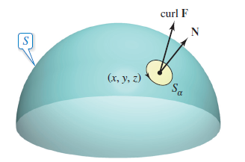
Physical Interpretation of Curl
Now consider a small disk S_{α} to be centered at some point (x, y, z) on the surface S, as shown in Figure 15.67.
On such a small disk, curl F is nearly constant, because it varies little from its value at (x, y, z). Moreover, (curl F)  N is also nearly constant on S_{α} because all unit normal to S_{α} are about the same.
Figure 15.67

Slide 14
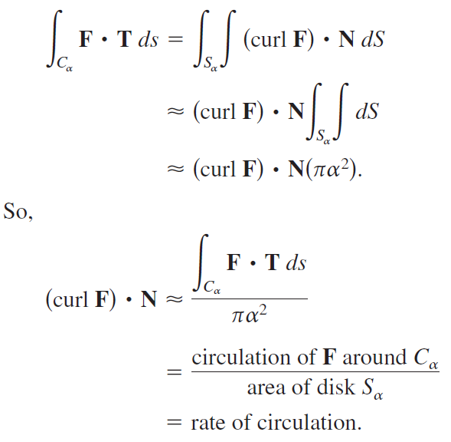
Physical Interpretation of Curl
Consequently, Stokes’s Theorem yields

Slide 15

Physical Interpretation of Curl
Assuming conditions are such that the approximation improves for smaller and smaller disks (α → 0), it follows that
which is referred to as the rotation of F about N.
That is,
curl F(x, y, z)  N = rotation of F about N at (x, y, z).
In this case, the rotation of F is maximum when curl F and N have the same direction.

Slide 16
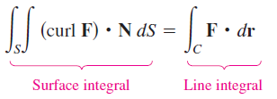
Physical Interpretation of Curl
Normally, this tendency to rotate will vary from point to point on the surface S, and Stokes’s Theorem
says that the collective measure of this rotational tendency taken over the entire surface S (surface integral) is equal to the tendency of a fluid to circulate around the boundary C (line integral).

Slide 17
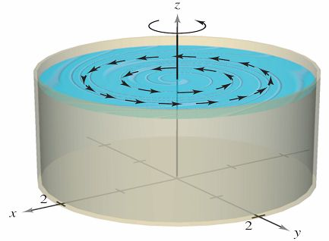
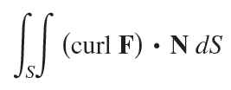
Example 3 – An Application of Curl
A liquid is swirling around in a cylindrical container of radius 2, so that its motion is described by the velocity field
as shown in figure at right.
Find
where S is the upper surface
of the cylindrical container.

Slide 18
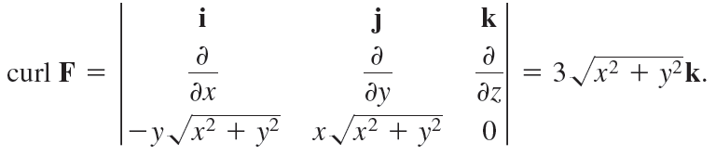
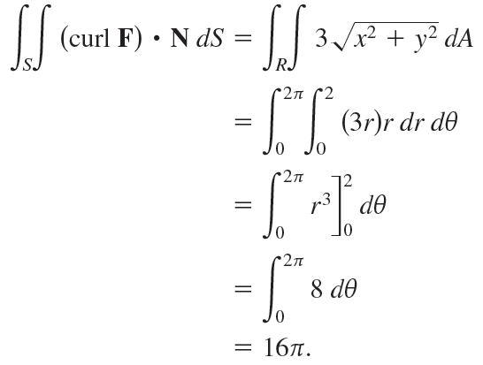
Example 3 – Solution
The curl of F is given by
Letting N = k, you have

Slide 19
Example 3 – Solution
cont’d

Slide 20
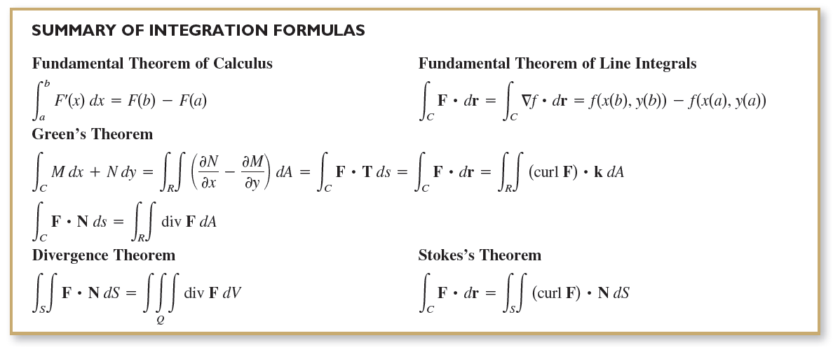
Physical Interpretation of a Curl

